Slide 1
arXiv:1912.12530
One Hundred Years After Heisenberg:
Discovering the World of Simultaneous Measurements of Noncommuting Observables
Carlton M. Caves
Center for Quantum Information and Control
University of New Mexico
http://info.phys.unm.edu/~caves
arXiv:1912.12530
“Well, why not say that all the things which should be handled in theory are just those things which we also can hope to observe somehow.” … I remember that when I first saw Einstein I had a talk with him about this. … [H]e said, ``That may be so, but still it's the wrong principle in philosophy.'' And he explained that it is the theory finally which decides what can be observed and what can not and, therefore, one cannot before the theory, know what is observable and what not.
Werner Heisenberg, recalling a conversation with Einstein in 1926,
interviewed by Thomas S. Kuhn, February 15, 1963
This work was carried out with Christopher S. Jackson, whose genius and vision inform every aspect.

Slide 2
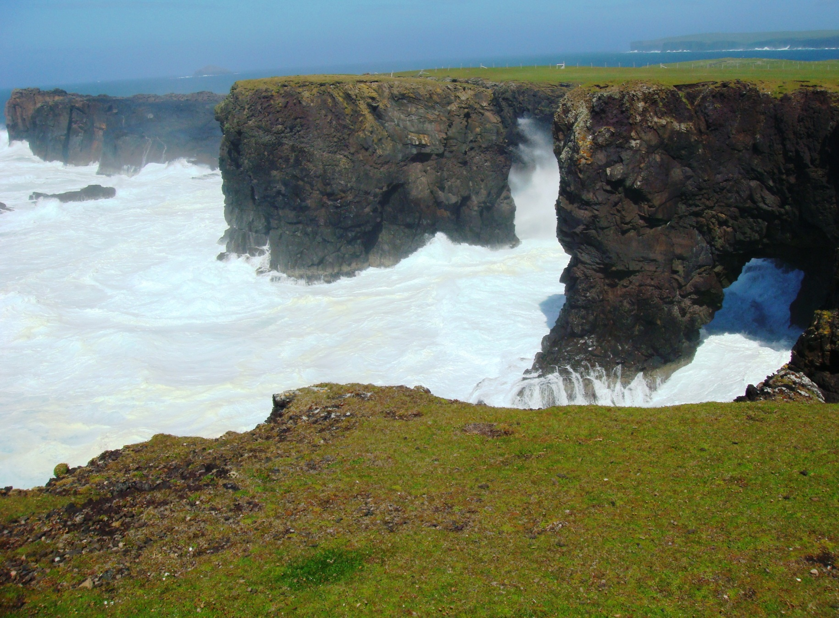
A brief glimpse into
a whole new world
Moo Stack and the Villians of Ure
Eshaness, Shetland

Slide 3
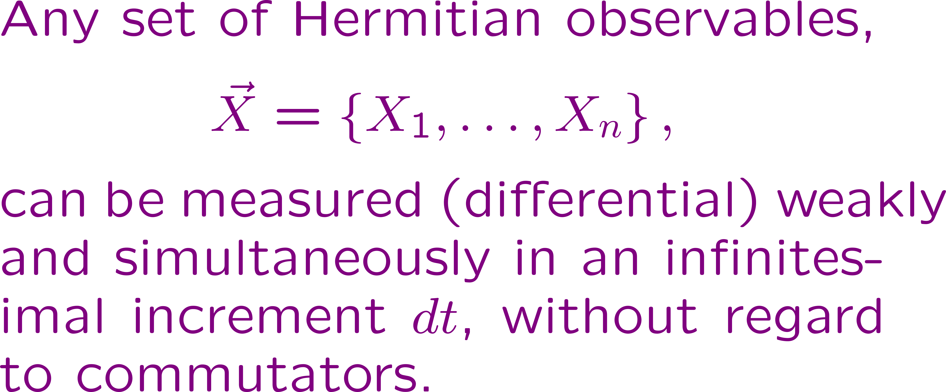
A brief glimpse into a whole new world
A magic carpet ride
Into a whole new world.
A new, fantastic point of view,
A thrilling chase,
A wondrous space,
And now we bring this whole new world to you.
Big-time apologies to Aladdin

Slide 4
A brief glimpse into a whole new world
A magic carpet ride
Into a whole new world.
A new, fantastic point of view,
A thrilling chase,
A wondrous space,
And now we bring this whole new world to you.
Big-time apologies to Aladdin
The details in three papers
C. S. Jackson and C. M. Caves
“Simultaneous measurements of noncommuting observables: Positive transformations and instrumental Lie groups,” Entropy 25, 1254 (2023). (a.k.a. 1-2-3), https://doi.org/10.3390/e25091254
“Simultaneous momentum and position measurement and the instrumental Weyl-Heisenberg group,” Entropy 25, 1221 (2023). (a.k.a. SPQM), https://doi.org/10.3390/e25081221
“How to perform the coherent measurement of a curved phase space by continuous isotropic measurement. I. Spin and the Kraus-operator geometry of SL(2,C),” Quantum 7, 1085 (2023), arXiv:2107.12396v3. (a.k.a ISM), https://doi.org/10.22331/q-2023-08-16-1085
plus
C. S. Jackson, “The photodetector, the heterodyne instrument, and the principle of instrument autonomy,” arXiv:2210.11100.

Slide 5
A brief glimpse into a whole new world
Any set of observables can be measured simultaneously if measured differential weakly. Commutators can be disregarded for differential weak measurements.
Differential weak measurements define a fundamental incremental Kraus operator, a differential positive transformation, which is the positive-operator analogue of an infinitesimal unitary transformation and equally fundamental.
Instrument (Kraus-operator) evolution is autonomous, temporal, and stochastic.
Instrument Manifold Program. The instrument evolution occurs on the manifold of an instrumental Lie group, which is generated by the measured observables.
Motion of the Kraus operators on the instrumental Lie group is described using the three faces of the stochastic trinity: Wiener path integrals, stochastic differential equations, and a diffusion equation for a Kraus-operator distribution function.
Universal instruments. The instrumental Lie group is generated universally, detached from and independent of Hilbert space.
Principal instruments (e.g., measure position and momentum or three components of spin) have a low-dimensional universal instrumental group: they limit to coherent-state POVMs—collapse within irrep—and thus define a phase space, which is connected to the identity across a symmetric space. These instruments are special and universal (pre-quantum) and structure any Hilbert space in which they are represented; principal instruments are what Heisenberg and Einstein meant when they talked about identifying what is observable.
Chaotic instruments (e.g., measure two components of spin or two squeezing symplectic generators) have an infinite-dimensional universal instrumental group: these are generic, evolve chaotically, and have no limiting strong measurement.
This talk is about thinking of instruments (measurements) in a new way,
which places them at the foundation of quantum mechanics.

Slide 6
100 years of quantum measurements
Pinnacles National Park
Central California

Slide 7
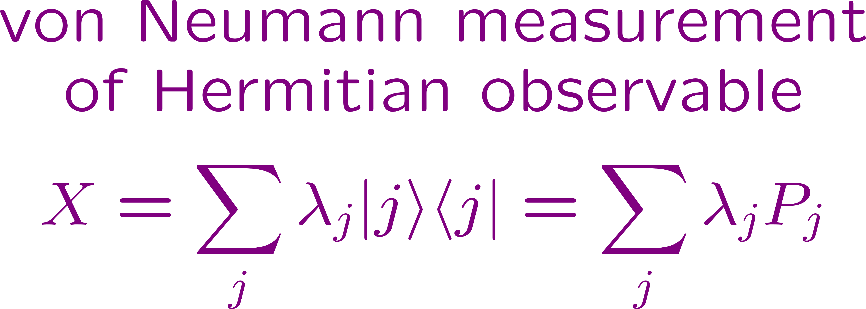
100 years of quantum measurements.
The founding (1925–32)
Matrix mechanics, commutators, and uncertainty principle
Wave mechanics (the Schrödinger equation)
Linear algebra of square-integrable functions
Dirac-Jordan transformation theory
Born probability rule
von Neumann’s synthesis: inner products and Hilbert space, unitary transformations (Hamiltonian dynamics), and measurements of Hermitian observables.
Temporal:
(continuous) process
Autonomous: independent of state
Physics by fiat:
no simultaneous measurements of noncommuting observables
Temporal Autonomous Transformation Group
No Yes Yes No

Slide 8
100 years of quantum measurements.
The desert (1932–60)
Quantum measurement theory withered under the desert sun, whereas the unitary side of quantum mechanics thrived with constant and well-deserved nurturing.
Everybody used the Born rule, though how to interpret its probabilities and the quantum state itself remains a source of discussion and debate today. Nobody used and next to nobody bought von Neumann’s collapse, because there were no repeated measurements on the same system.
All measurements were actually von Neumann’s indirect measurements and analyzed using the Born rule without using von Neumann measurements of Hermitian observables.
Mathematical developments
Unitary Lie groups: symmetry groups and representation theory
Functional and harmonic analysis
Functional (path) integration
Transformation groups
Differential geometry of complex Lie groups
Measures and probability theory, stochastic processes, and stochastic calculus
First three and a bit of the fourth fell on fertile soil in the unitary sector of quantum mechanics and quantum field theory.
None of this got into (or was needed in) the desiccated quantum measurement theory.
We use all these developments.

Slide 9
100 years of quantum measurements.
Generalized measurement theory (1960–85)
Overcomplete-basis measurements (measurements of noncommuting observables, coherent states, heterodyne)
Hint of repeated measurements
Wigner
Davies
Ludwig
Kraus
Generalized measurement theory. Taking advantage of von Neumann’s indirect measurements
Positive

Slide 10
100 years of quantum measurements.
Generalized measurement theory (1960–85)
Concatenating measurements
Temporal Autonomous Transformation Group
Gettin’ there ? Yes No
To normalize or not to normalize?

Slide 11
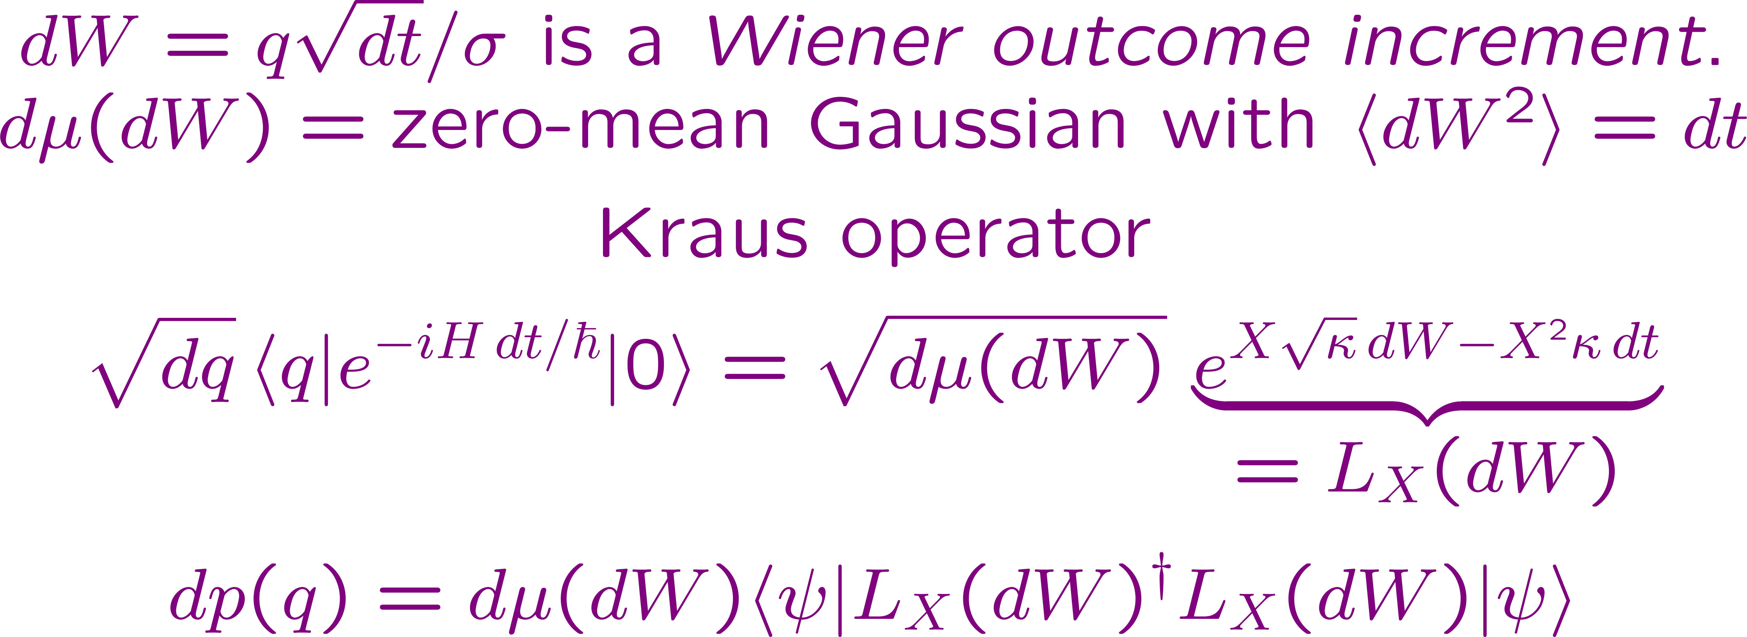
100 years of quantum measurements.
Continuous weak measurements (1980–2010)
We are interested in differential weak measurements:
Kraus operators close to the identity.
Davies
Barchielli
Carmichael
Milburn
Wiseman
Goetsch/Graham
Doherty
Mabuchi
Jacobs
Brun
Steck
Differential weak measurement of X in increment dt

Slide 12
100 years of quantum measurements.
Continuous weak measurements (1980–2010)
Concatenating: Continuous, differential weak measurement of X over finite time T.
Temporal Autonomous Transformation Group
Yes ? Yes ?
Normalizing at each increment gives a stochastic master equation for an evolving state. Not normalizing (sometimes called a linear quantum trajectory) gives autonomous instrument evolution and a group.

Slide 13
100 years of quantum measurements.
Continuous weak measurements (1980–2010)
Continuous, differential weak measurement of X over finite time T.
Instrument evolution
Temporal Autonomous Transformation Group
Yes Yes Yes Yes
Continuous measurements of a single observable are trivial because everything commutes (time ordering is irrelevant; irreps are 1D). They limit to a strong measurement that is a von Neumann measurement (standard collapse between irreps).

Slide 14
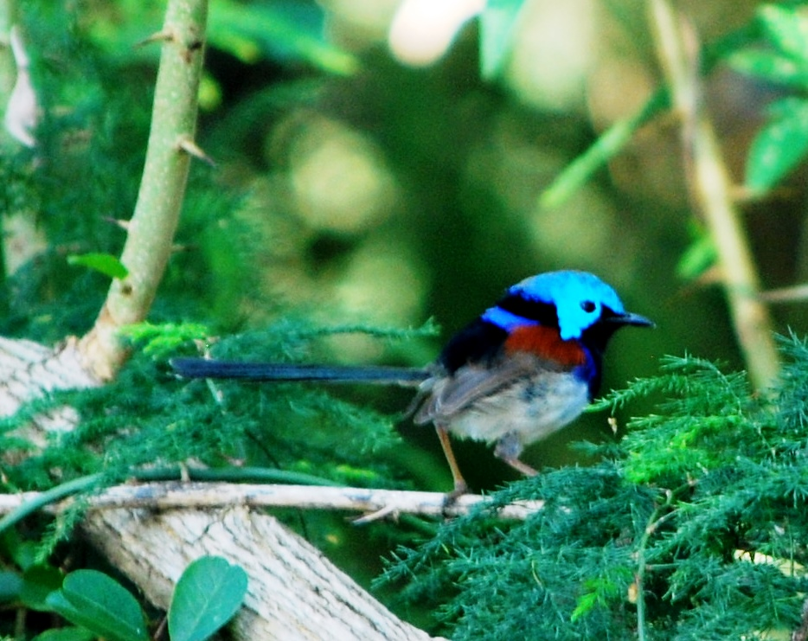
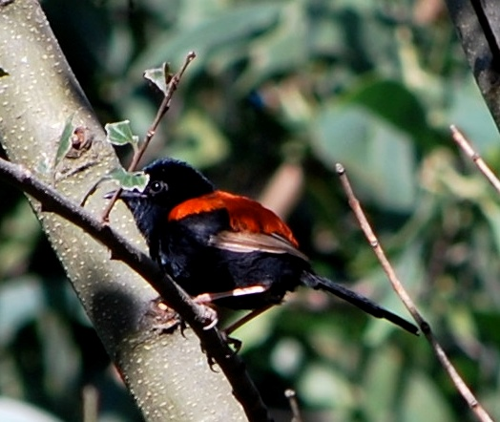
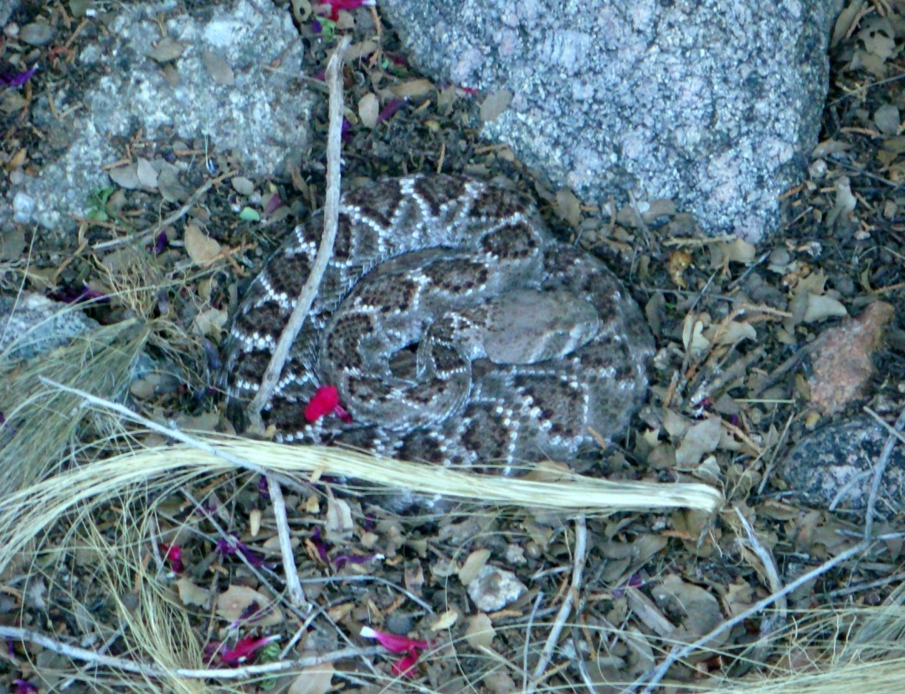
Variegated fairy wren
Oxley Common, Brisbane
Red-backed fairy wren
Oxley Common, Brisbane
Instrument manifold program
Western diamondback rattlesnake
My front yard, Sandia Heights

Slide 15
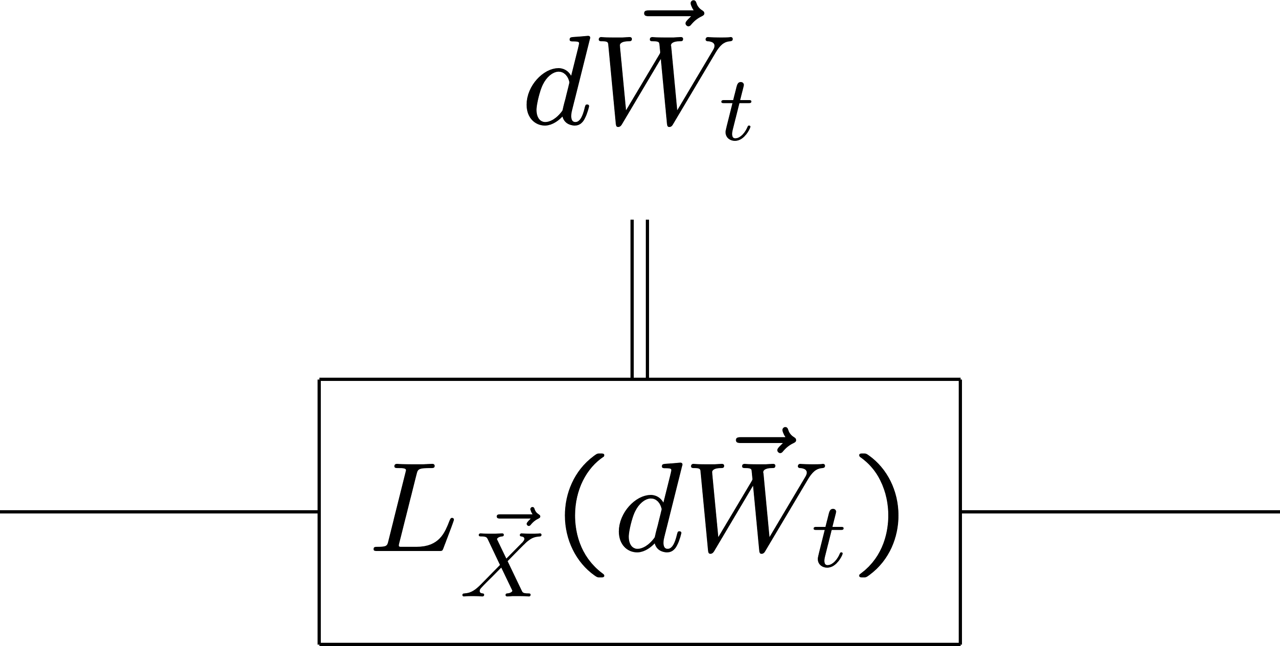
Instrument manifold program
Exponentials for different observables can be combined into a single exponential at order dt—commutators ignored—because the Wiener outcome increments are uncorrelated.
Commutators can be disregarded for differential weak measurements.
Differential weak measurements define a fundamental incremental Kraus operator, a differential positive transformation, which is fundamental in the same way as infinitesimal unitary transformations.

Slide 16
Instrument manifold program
Instrument evolution: “piling up” Kraus operators
Instrument evolution is an autonomous, temporal, stochastic process.

Slide 17
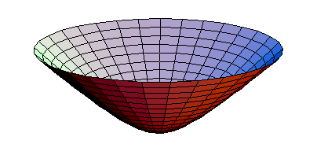
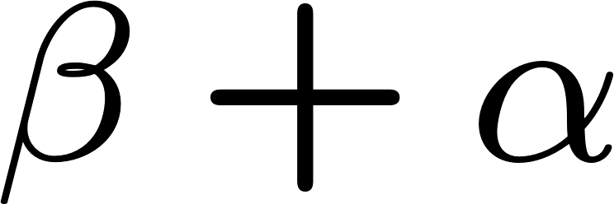
Instrument manifold program
Instrument evolution
The quantum circuit becomes a stochastic path on the instrumental Lie group manifold.
SPQM
ISM
Heart of the Instrument Manifold Program: Instrumental Lie groups.

Slide 18
Instrument manifold program. How we do it.
Stochastic differential equation
Wiener path integral
Diffusion equation
Stochastic trinity

Slide 19
Instrument manifold program
Universal instruments detached from Hilbert space.
Principal universal instruments. Very special. Pre-quantum.
Coherent-state POVMs and phase space; collapse within irrep; phase space connected to the identity across a symmetric space.
Chaotic universal instruments. Generic.
Chaotic evolution and no limiting universal strong measurement.

Slide 20
SPQM, ISM, and chaos
Truchas from East Pecos Baldy
Sangre de Cristo Range, northern New Mexico

Slide 21
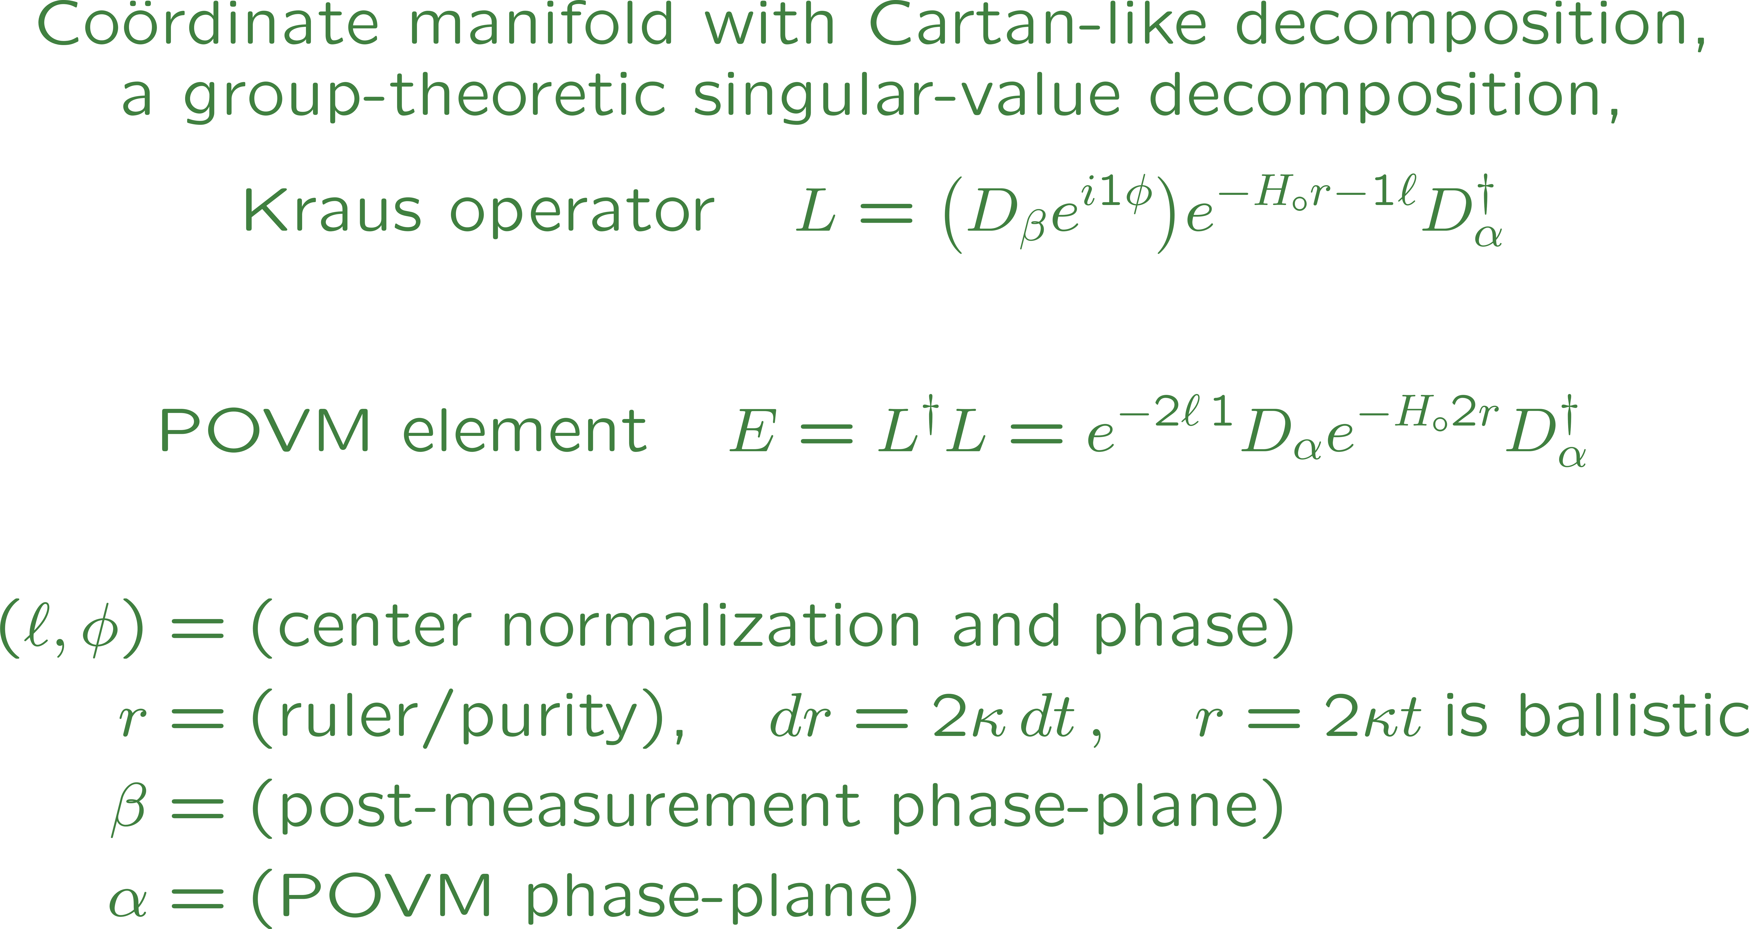
Simultaneous momentum and position
measurement (SPQM): A principal instrument
Write the SDEs and FPKE
in these coördinates.

Slide 22
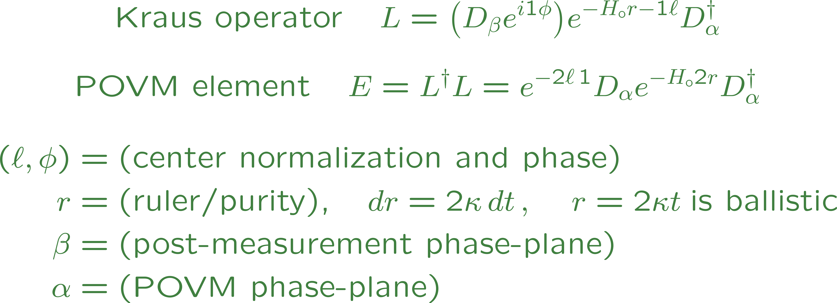
SPQM: A principal instrument

Slide 23
SPQM: A principal instrument

Slide 24
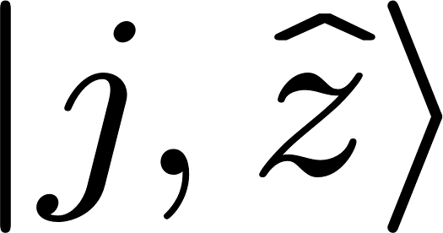
Isotropic spin measurement (ISM):
A principal instrument
Write the SDE and FPKE
in these coördinates.

Slide 25
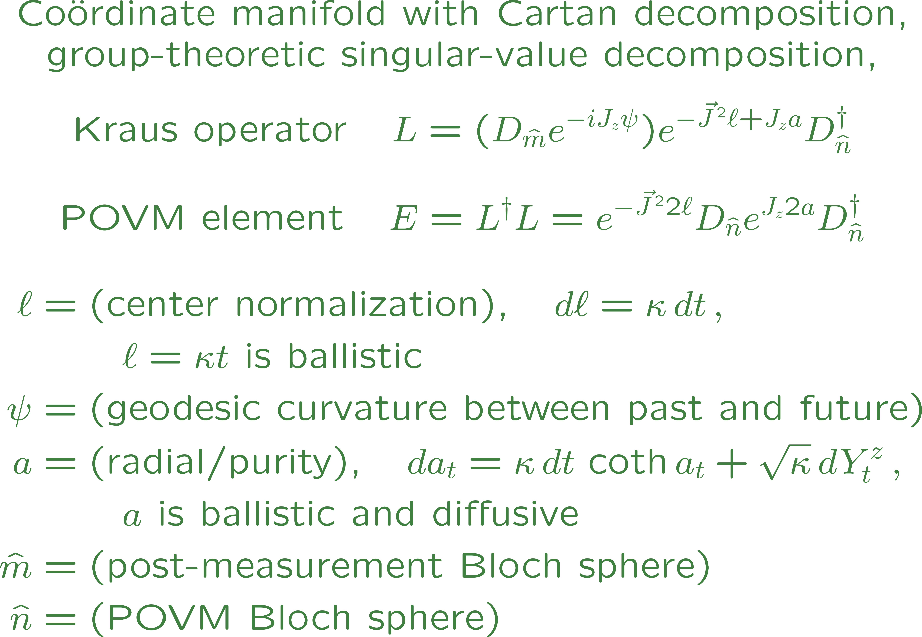
ISM: A principal instrument
To get the induced geometry right, one regards the hyperboloid as embedded in Minkowski space, not Euclidean space.

Slide 26
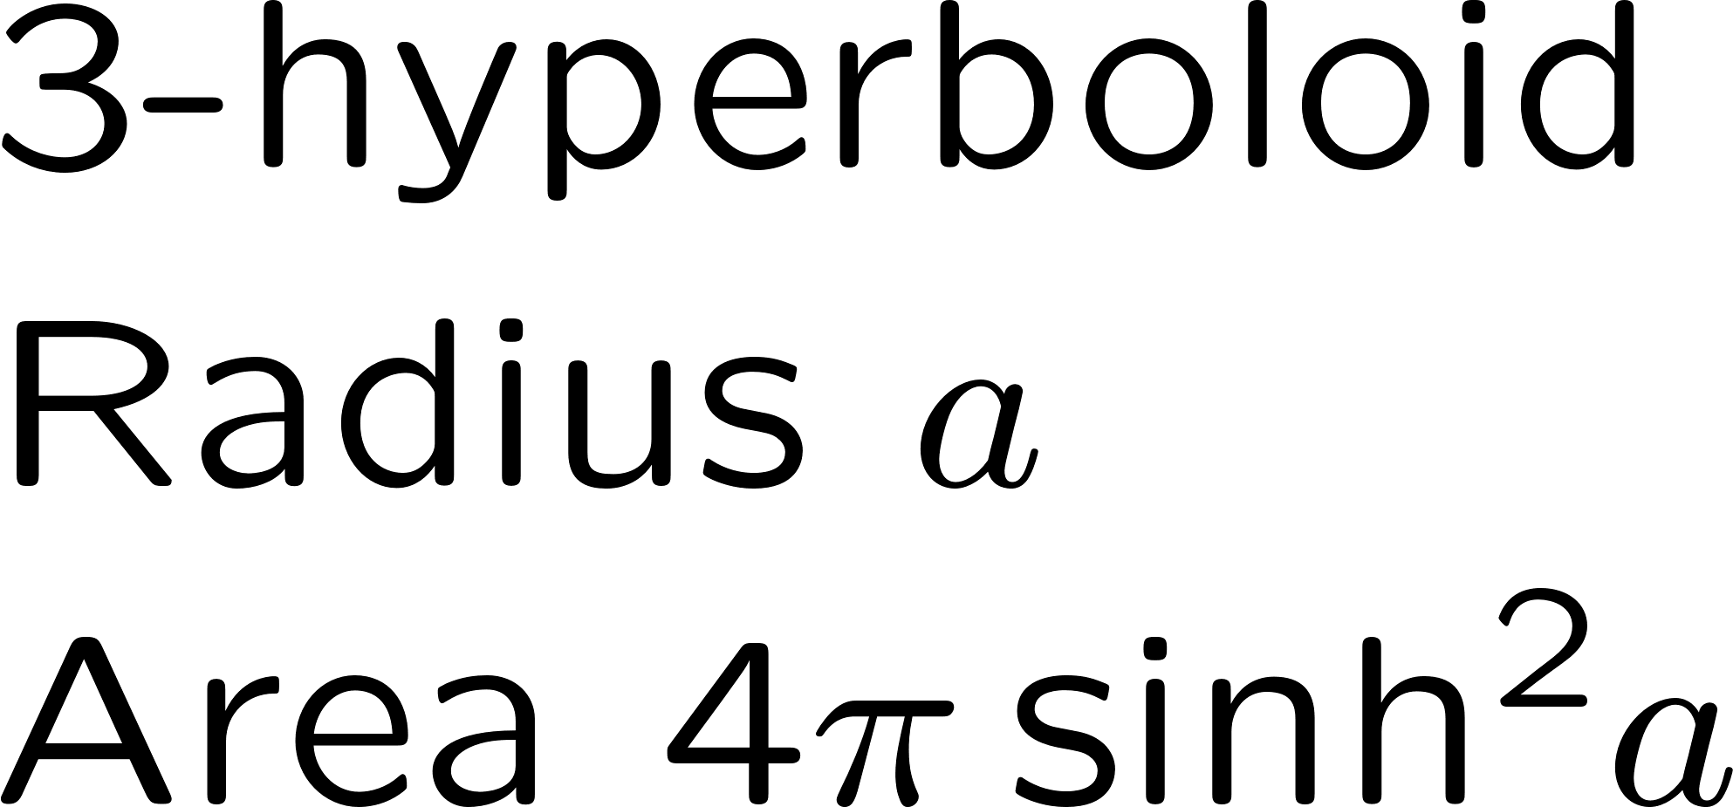
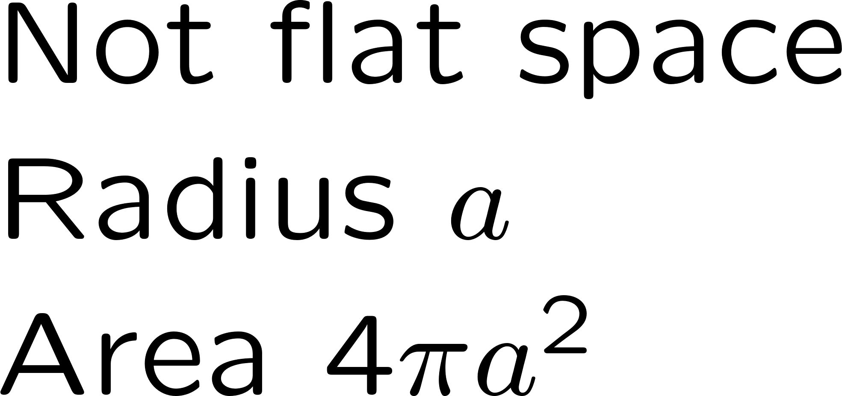
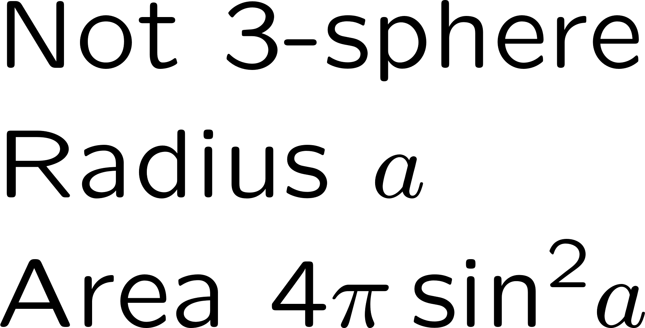
ISM: A principal instrument
The angular diffusion of the POVM displacement is overwhelmed by the area exponentiation.
Nearly ballistic “collapse” to the coherent-state boundary at a = infinity.

Slide 27
Principal vs. chaotic instruments
SPQM and ISM are principal universal instruments, for which the universal instrumental group is finite-dimensional, because the nonlinear quadratic term has special properties. Principal instruments are very special: they approach a strong measurement of coherent states asymptotically; these instruments are thus universal (pre-quantum) and structure any Hilbert space in which they are represented. They are what Heisenberg and Einstein meant by identifying what is observable.
Generic measurements—two components of spin, two squeezing symplectic generators—have an infinite-dimensional universal instrumental group because of the nonlinear quadratic term. They do not have a representation-independent strong measurement, and the evolution of the instrument devolves into
o
h
s
C
a

Slide 28
Chaotic instruments
o
h
s
C
a
A universal chaotic instrument evolves stochastically into an increasing number of Lie-group dimensions. These Lie-group dimensions correspond to higher and higher powers of the measured observables and thus to finer and finer scales on a classical phase phase (sensitivity to initial conditions). Quantum chaos is what happens when the Lie-group dimensions, the higher powers, and the finer scales are cut off in a finite-dimensional Hilbert-space representation. All this is to be quantified by the entropies of the Kraus-operator distribution functions.
Discovery of universal chaotic instruments—and their quantum counterparts in finite-dimensional representations—promises a new group-theoretic method for analyzing quantum chaos and dynamical complexity.

Slide 29
Concluding paragraph of SPQM: Suffice it to say that we think we have found something: the home of quantum dynamics, the Lie-group manifold that supports all three faces of the trinity. The exhausted reader who has survived to read this concluding sentence of a very long paper might be pleased—or so we hope—to learn that our ambition is larger than was evident at the beginning.
Welcome to a
whole new world
Cable Beach
Western Australia

