Slide 1
Should we think of quantum probabilities as Bayesian probabilities?
Carlton M. Caves
C. M. Caves, C. A. Fuchs, R. Schack, “Subjective probability and quantum certainty,”
Studies in History and Philosophy of Modern Physics 38, 255--274 (2007)..
Department of Physics and Astronomy
University of New Mexico
and
Department of Physics
University of Queensland
caves@info.phys.unm.edu
http://info.phys.unm.edu/~caves
Sydney Foundations Seminar
U Sydney, 2008 May 7
Yes, because facts never determine probabilities or quantum states.

Slide 2
Solipsism? Waving the red flag
Is there something in nature even when there are no observers or agents about? At the practical level, it would seem hard to deny this, and neither of the authors wish to be viewed as doing so. The world persists without the observer---there is no doubt in either of our minds about that. But then, does that require that two of the most celebrated elements (namely, quantum states and operations) in quantum theory---our best, most all-encompassing scientific theory to date---must be viewed as objective, agent-independent constructs? There is no reason to do so, we say. In fact, we think there is everything to be gained from carefully delineating which part of the structure of quantum theory is about the world and which part is about the agent’s interface with the world.
C. A. Fuchs and R. Schack, “Unknown quantum states and operations, a Bayesian view,” in Quantum State Estimation, edited by M. Paris and J. Řeháček (Springer, Berlin, 2004), pp. 147–187.
Some mathematical objects in a scientific theory are our tools; others correspond to reality. Which is which?

Slide 3
Oljeto Wash
Southern Utah

Slide 4
Subjective Bayesian probabilities
Category distinction
Facts
Outcomes of events
Truth values of propositions
Objective
Probabilities
Agent’s degree of belief
in outcome of an event or
truth of a proposition
Subjective
Facts never imply probabilities.
Two agents in possession of the same facts can assign different probabilities.

Slide 5
Subjective Bayesian probabilities
Probabilities
Agent’s degree of belief in outcome of an event or truth of a proposition.
Consequence of ignorance
Agent’s betting odds
Subjective
Rules for manipulating probabilities are objective consequences of consistent betting behavior (Dutch book).

Slide 6
Subjective Bayesian probabilities
Facts in the form of observed data d are used to update probabilities via Bayes’s rule:
conditional (model, likelihood)
prior
posterior
The posterior always depends on the prior, except when d logically implies h₀:
Facts never determine (nontrivial) probabilities.
This is irrelevant to the quantum-mechanical discussion.
The posterior depends on the model even in this case.

Slide 7
Objective probabilities
● Logical probabilities (objective Bayesian): symmetry implies probability
■ Symmetries are applied to judgments, not to facts.
● Probabilities as frequencies: probability as verifiable fact
■ Frequencies are facts, not probabilities.
■ Bigger sample space: exchangeability.
QM: Derivation of quantum probability rule from infinite frequencies?
C. M. Caves, R. Schack, ``Properties of the frequency operator do not imply the quantum probability postulate,'' Annals of Physics 315, 123-146 (2005) [Corrigendum: 321, 504--505 (2006)].
● Objective chance (propensity): probability as specified fact
■ Some probabilities are ignorance probabilities, but others are
specified by the facts of a “chance situation.”
■ Specification of “chance situation”: same, but different.
objective
chance
QM: Probabilities from physical law. Salvation of objective chance?

Slide 8
Bungle Bungle Range
Western Australia

Slide 9
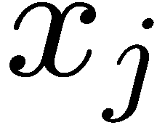
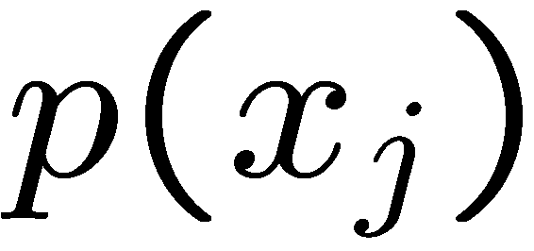
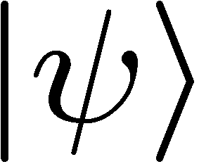
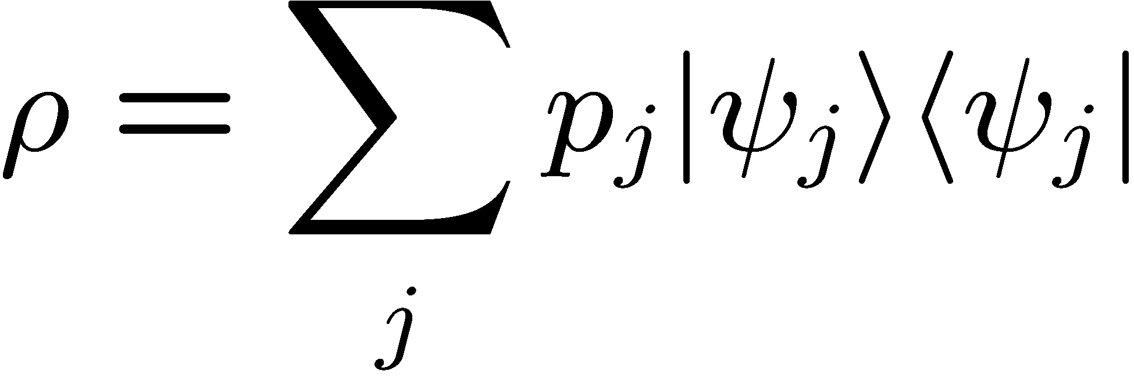
 | Classical (realistic, deterministic) world |  | Quantum world
State space | Simplex of probabilities for microstates |  | Convex set of density operators
State | Extreme point Microstate | Ensemble | Extreme point Pure state State vector | Ensemble Mixed state Density operator
Scorecard:
1. Predictions for fine-grained measurements
Verification (state determination)
State change on measurement
Uniqueness of ensembles
Nonlocal state change (steering)
Specification (state preparation)
 | Objective | Subjective | Objective | Subjective

Slide 10
 | Classical (realistic, deterministic) world |  | Quantum world
State space | Simplex of probabilities for microstates |  | Convex set of density operators
State | Extreme point Microstate | Ensemble | Extreme point Pure state State vector | Ensemble Mixed state Density operator
Fine-grained measurement | Certainty | Probabilities | Certainty or Probabilities | Probabilities
Certainty:
 | Objective | Subjective | Objective | Subjective

Slide 11
 | Classical (realistic, deterministic) world |  | Quantum world
State space | Simplex of probabilities for microstates |  | Convex set of density operators
State | Extreme point Microstate | Ensemble | Extreme point Pure state State vector | Ensemble Mixed state Density operator
Verification: state determination | Yes | No | No | No
Whom do you ask for the system state? The system or an agent?

Slide 12
 | Classical (realistic, deterministic) world |  | Quantum world
State space | Simplex of probabilities for microstates |  | Convex set of density operators
State | Extreme point Microstate | Ensemble | Extreme point Pure state State vector | Ensemble Mixed state Density operator
Can you reliably distinguish two nonidentical states?
 | iff orthogonal Always | iff orthogonal | iff orthogonal | iff orthogonal

Slide 13
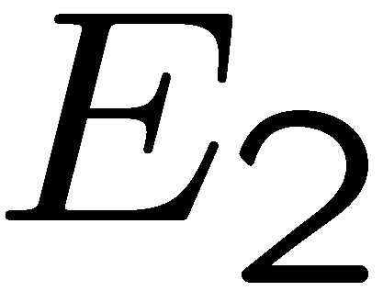
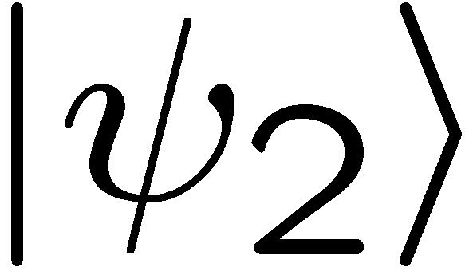
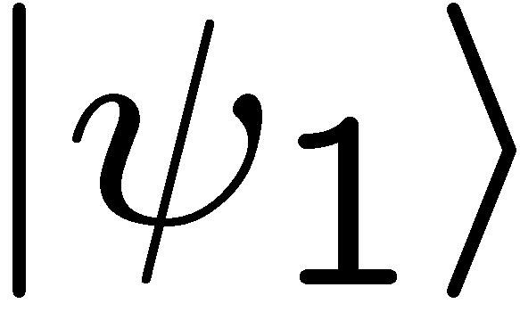
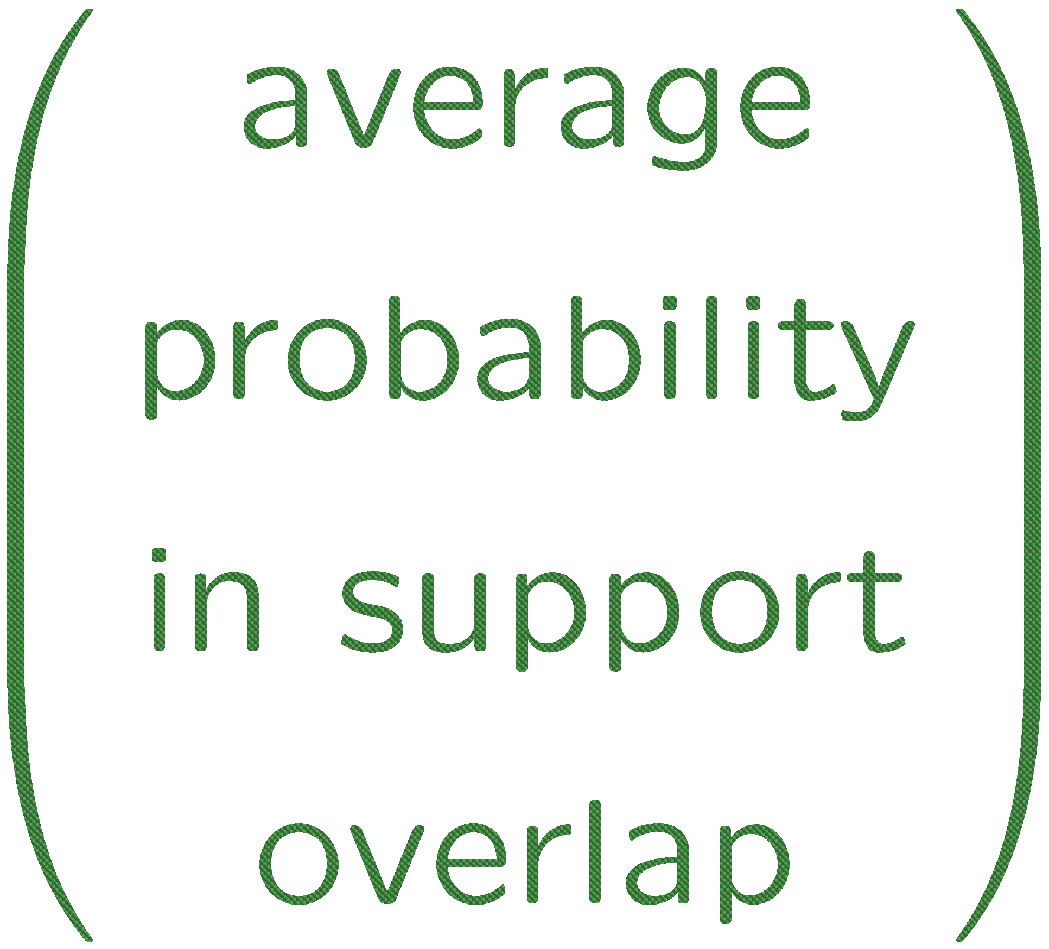
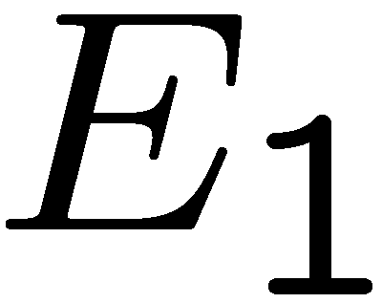
 | Classical (realistic, deterministic) world |  | Quantum world
State space | Simplex of probabilities for microstates |  | Convex set of density operators
State | Extreme point Microstate | Ensemble | Extreme point Pure state State vector | Ensemble Mixed state Density operator
Can you unambiguously distinguish two nonidentical states?
 | Always | Sometimes (iff supports not identical) | Always (supports are not identical) | Sometimes (iff supports not identical)

Slide 14
 | Classical (realistic, deterministic) world |  | Quantum world
State space | Simplex of probabilities for microstates |  | Convex set of density operators
State | Extreme point Microstate | Ensemble | Extreme point Pure state State vector | Ensemble Mixed state Density operator
Verification: state determination | Yes | No | No | No
Whom do you ask for the system state? The system or an agent?
 | Objective | Subjective | Ubjective | Subjective

Slide 15
 | Classical (realistic, deterministic) world |  | Quantum world
State space | Simplex of probabilities for microstates |  | Convex set of density operators
State | Extreme point Microstate | Ensemble | Extreme point Pure state State vector | Ensemble Mixed state Density operator
State change on measurement | No | Yes | Yes | Yes
State-vector reduction
or wave-function collapse
Real physical disturbance?
 | Objective | Subjective | Ubjective | Subjective

Slide 16
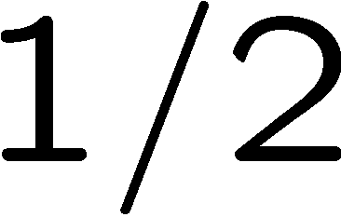
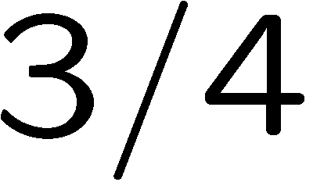
 | Classical (realistic, deterministic) world |  | Quantum world
State space | Simplex of probabilities for microstates |  | Convex set of density operators
State | Extreme point Microstate | Ensemble | Extreme point Pure state State vector | Ensemble Mixed state Density operator
Uniqueness of ensembles | Yes | No | No | No
 | Objective | Subjective | Ubjective | Subjective

Slide 17
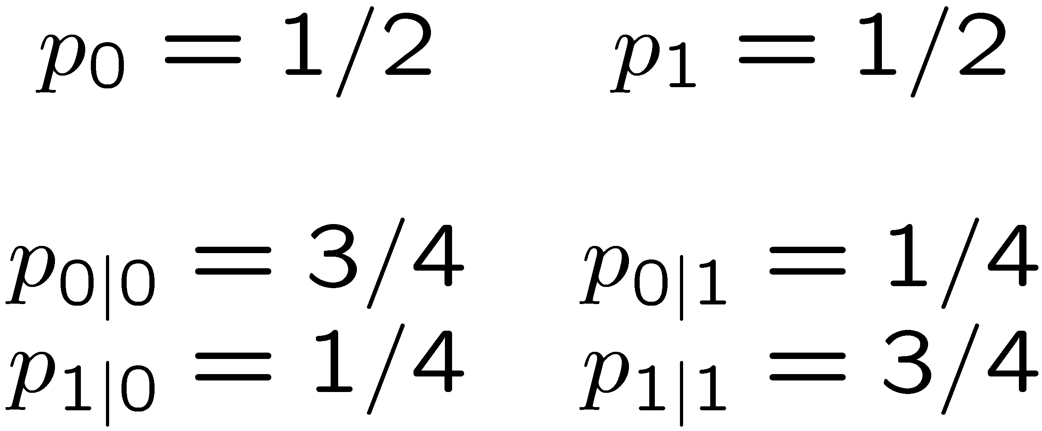
 | Classical (realistic, deterministic) world |  | Quantum world
State space | Simplex of probabilities for microstates |  | Convex set of density operators
State | Extreme point Microstate | Ensemble | Extreme point Pure state State vector | Ensemble Mixed state Density operator
Nonlocal state change (steering) | No | Yes | Yes | Yes
Real nonlocal physical disturbance?
 | Objective | Subjective | Subjective | Subjective

Slide 18
Truchas from East Pecos Baldy
Sangre de Cristo Range
Northern New Mexico

Slide 19
 | Classical (realistic, deterministic) world |  | Quantum world
State space | Simplex of probabilities for microstates |  | Convex set of density operators
State | Extreme point Microstate | Ensemble | Extreme point Pure state State vector | Ensemble Mixed state Density operator
Specification: state preparation | Yes | No | Copenhagen: Yes | Copenhagen: Yes
Copenhagen interpretation:
Classical facts specifying the properties of the preparation device determine a pure state.
Copenhagen (objective preparations view) becomes the home of objective chance, with nonlocal physical disturbances.
 | Objective | Subjective | Objective | Objective

Slide 20
Copenhagen | Classical (realistic, deterministic) world |  | Quantum world
State space | Simplex of probabilities for microstates |  | Convex set of density operators
State | Extreme point Microstate | Ensemble | Extreme point Pure state State vector | Ensemble Mixed state Density operator
Fine-grained measurement | Certainty | Probabilities | Certainty or Probabilities | Probabilities
Verification: state determination | Yes | No | No | No
State change on measurement | No | Yes | Yes | Yes
Uniqueness of ensembles | Yes | No | No | No
Nonlocal state change (steering) | No | Yes | Yes | Yes
Specification: state preparation | Yes | No | Yes | Yes
 | Objective | Subjective | Objective | Objective

Slide 21
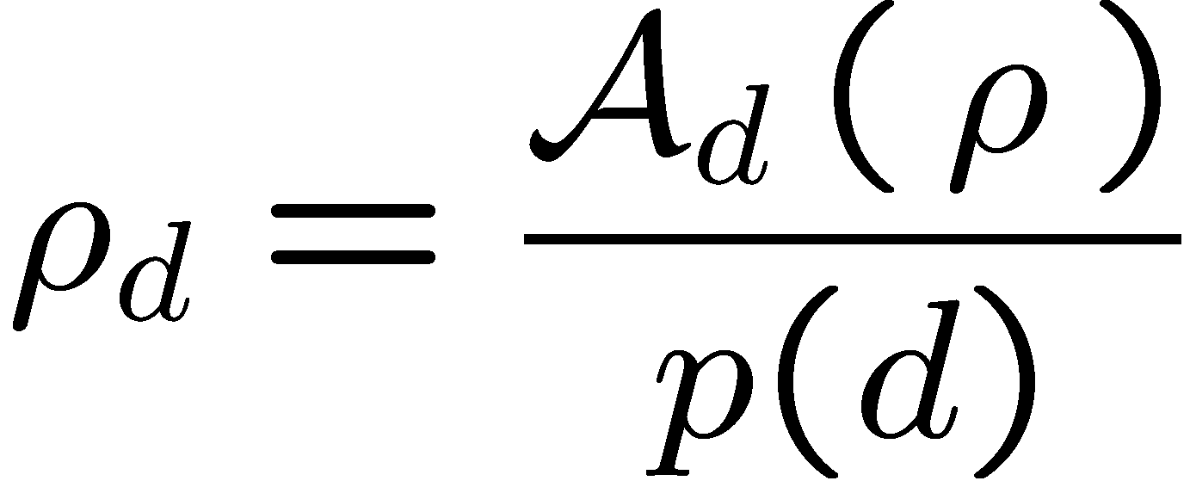
Classical and quantum updating
Facts in the form of observed data d are used to update probabilities via Bayes’s rule:
Facts in the form of observed data d are used to update quantum states:
conditional (model, likelihood)
quantum operation (model)
prior
prior
posterior
posterior
The posterior always depends on the prior, except when d logically implies h₀:
Quantum state preparation:
The posterior state always depends on prior beliefs, even for quantum state preparation, because there is a judgment involved in choosing the quantum operation.
Facts never determine probabilities or quantum states.

Slide 22
Where does Copenhagen go wrong?
The Copenhagen interpretation forgets that the preparation device is quantum mechanical. A detailed description of the operation of a preparation device (provably) involves prior judgments in the form of quantum state assignments.
It is possible to show that neither deterministic nor stochastic preparation devices can prepare the same system state independent of system and device initial states.

Slide 23
Subjective Bayesian | Classical (realistic, deterministic) world |  | Quantum world
State space | Simplex of probabilities for microstates |  | Convex set of density operators
State | Extreme point Microstate | Ensemble | Extreme point Pure state State vector | Ensemble Mixed state Density operator
Fine-grained measurement | Certainty | Probabilities | Certainty or Probabilities | Probabilities
Verification: state determination | Yes | No | No | No
State change on measurement | No | Yes | Yes | Yes
Uniqueness of ensembles | Yes | No | No | No
Nonlocal state change (steering) | No | Yes | Yes | Yes
Specification: state preparation | Yes | No | No | No
 | Objective | Subjective | Subjective | Subjective

Slide 24
Echidna Gorge
Bungle Bungle Range
Western Australia

Slide 25
Quantum states vs. probabilities
Are quantum states the same as probabilities? No, though both are subjective, there are differences, but these differences can be stated in Bayesian terms.
A quantum state is a catalogue of probabilities, but the rules for manipulating quantum states are different than for manipulating probabilities.
The rules for manipulating quantum states are objective consequences of restrictions on how agents interface with the real world.

Slide 26
Is a quantum coin toss more random than a classical one?
Why trust a quantum random generator over a classical one?
Measure spin along z axis:
Measure spin along x axis:
C. M. Caves, R. Schack, “Quantum randomness,” in preparation.
quantum coin toss
 | Classical (realistic, deterministic) world |  | Quantum world
State space | Simplex of probabilities for microstates |  | Convex set of density operators
State | Extreme point Microstate | Ensemble | Extreme point Pure state State vector | Ensemble Mixed state Density operator
Fine-grained measurement | Certainty | Probabilities | Certainty or Probabilities | Probabilities

Slide 27
Is a quantum coin toss more random than a classical one?
Why trust a quantum random generator over a classical one?
Measure spin along z axis:
Measure spin along x axis:
quantum coin toss
Standard answer: The quantum coin toss is objective, with probabilities guaranteed by physical law.
Subjective Bayesian answer? No inside information.

Slide 28
Pure states and inside information
Party B has inside information about event E, relative to party A, if A is willing to agree to a bet on E that B believes to be a sure win. B has one-way inside information if B has inside information relative to A, but A does not have any inside information relative to A.
The unique situation in which no other party can have one-way inside information relative to a party Z is when Z assigns a pure state. Z is said to have a maximal belief structure.
Subjective Bayesian answer
We trust quantum over classical coin tossing because an agent who believes the coin is fair cannot rule out an insider attack, whereas the beliefs that lead to a pure-state assignment are inconsistent with any other party’s being able to launch an insider attack.

Slide 29
Cape Hauy
Tasman Peninsula

Slide 30
Taking a stab at ontology
CMC only
Quantum systems are defined by attributes, such as position, momentum, angular momentum, and energy or Hamiltonian. These attributes—and thus the numerical particulars of their eigenvalues and eigenfunctions and their inner products—are objective properties of the system.
The value assumed by an attribute is not an objective property, and the quantum state that we use to describe the system is purely subjective.

Slide 31
Taking a stab at ontology
The attributes orient and give structure to a system’s Hilbert space. Without them we are clueless as to how to manipulate and interact with a system.
The attributes are unchanging properties of a system, which can be determined from facts. The attributes determine the structure of the world.
The system Hamiltonian is one of the attributes, playing the special role of orienting a system’s Hilbert space now with the same space later.
Convex combinations of Hamiltonian evolutions are essentially unique (up to degeneracies).
Why should you care?
If you do care, how can this be made convincing?
Status of quantum operations?
Effective attributes and effective Hamiltonians? “Effective reality”?

