Slide 1
What are the laws of physics?
Resisting reification
Carlton M. Caves
C. M. Caves, C. A. Fuchs, and R. Schack, “Subjective probability and quantum certainty,”
Studies in History and Philosophy of Modern Physics 38, 255-274 (2007).
C. G. Timpson, “Quantum Bayesianism: A Study,” Studies in History and Philosophy of
Modern Physics 39, 579-609 (2008).
Department of Physics and Astronomy
University of New Mexico
caves@info.phys.unm.edu
http://info.phys.unm.edu/~caves
The laws are out there. Probabilities aren’t.

Slide 2
Laws of physics?
Some mathematical objects in a scientific theory are our tools; others correspond to reality. Which is which?

Slide 3
Subjective Bayesian probabilities
Oljeto Wash
Southern Utah

Slide 4
Objective probabilities
● Probabilities as frequencies: probability as verifiable fact
■ Probabilities are used routinely for individual systems.
■ Frequencies are observed facts, not probabilities.
■ Bigger sample space: exchangeability.
QM: Derivation of quantum probability rule from infinite frequencies?
C. M. Caves, R. Schack, ``Properties of the frequency operator do not imply the quantum probability postulate,'' Annals of Physics 315, 123-146 (2005) [Corrigendum: 321, 504--505 (2006)].
● Objective chance (propensity): probability as specified fact
■ Some probabilities are ignorance probabilities, but others are
specified by the facts of a “chance situation.”
■ Specification of “chance situation”: same, but different.
objective
chance
QM: Probabilities from physical law. Salvation of objective chance?
● Logical probabilities (objective Bayesian): physical symmetry implies probability
■ Symmetries are applied to judgments, not to facts.

Slide 5
Subjective Bayesian probabilities
Category distinction
Facts
Outcomes of events
Truth values of propositions
Objective
Probabilities
Agent’s degree of belief
in outcome of an event or
truth of a proposition
Subjective
Facts never imply (nontrivial) probabilities.
Two agents in possession of the same facts can assign different probabilities.

Slide 6
Subjective Bayesian probabilities
Probabilities
Agent’s degree of belief in outcome of an event or truth of a proposition.
Consequence of ignorance
Agent’s betting odds
Subjective
Agent A regards $q as fair price for the ticket.
A assigns p(E)=q.

Slide 7
Dutch-book consistency
A’s probability assignments, i.e., ticket prices, are inconsistent if they can lead to a sure loss.
The standard rules for manipulating probabilities are objective consequences of requiring consistent betting behavior.
The usual argument: If A does not obey the probability rules, she will lose in the long run.
Dutch-book argument: If A does not obey the probability rules, she will lose in one shot.

Slide 8
Dutch-book argument: Rules (i) and (ii)
A is willing to sell ticket for a negative amount.
Sure loss.
A is willing to sell ticket, which is definitely worth $1 to her, for less than $1.
Sure loss.

Slide 9
Dutch-book argument: Rule (iii)
A would buy the purple ticket for $q and sell the green tickets for $r + $s.
If q > r + s, sure loss.

Slide 10
Dutch-book argument: Rule (iv)

Slide 11
Subjective Bayesian probabilities
The standard rules of probability theory are objective consequences of requiring consistent betting behavior.

Slide 12
Subjective Bayesian probabilities
Facts in the form of observed data d are used to update probabilities via Bayes’s rule:
conditional (model, likelihood)
prior
posterior
The posterior always depends on the prior, except when d logically implies h₀:
Facts never determine (nontrivial) probabilities.

Slide 13
Are quantum probabilities subjective?
Bungle Bungle Range
Western Australia

Slide 14
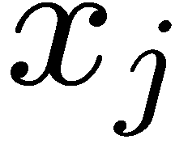
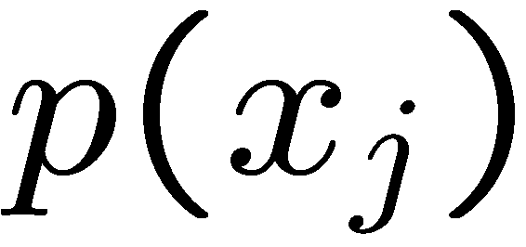
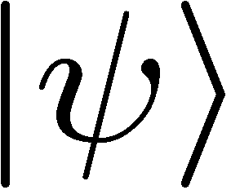
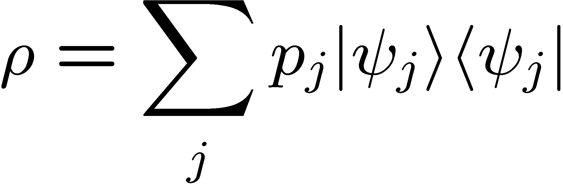
 | Classical (realistic, deterministic) world |  | Quantum world
State space | Simplex of probabilities for microstates |  | Convex set of density operators
State | Extreme point Microstate | Ensemble | Extreme point Pure state State vector | Ensemble Mixed state Density operator
Scorecard:
1. Predictions for fine-grained measurements
Verification (state determination)
State change on measurement
Uniqueness of ensembles
Nonlocal state change (steering)
Specification (state preparation)
 | Objective | Subjective | Objective | Subjective

Slide 15
 | Classical (realistic, deterministic) world |  | Quantum world
State space | Simplex of probabilities for microstates |  | Convex set of density operators
State | Extreme point Microstate | Ensemble | Extreme point Pure state State vector | Ensemble Mixed state Density operator
Fine-grained measurement | Certainty | Probabilities | Certainty or Probabilities | Probabilities
Certainty:
 | Objective | Subjective | Objective | Subjective

Slide 16
 | Classical (realistic, deterministic) world |  | Quantum world
State space | Simplex of probabilities for microstates |  | Convex set of density operators
State | Extreme point Microstate | Ensemble | Extreme point Pure state State vector | Ensemble Mixed state Density operator
Verification: state determination | Yes | No | No | No
Whom do you ask for the system state? The system or an agent?

Slide 17
 | Classical (realistic, deterministic) world |  | Quantum world
State space | Simplex of probabilities for microstates |  | Convex set of density operators
State | Extreme point Microstate | Ensemble | Extreme point Pure state State vector | Ensemble Mixed state Density operator
Can you reliably distinguish two nonidentical states?
 | iff orthogonal Always | iff orthogonal | iff orthogonal | iff orthogonal

Slide 18
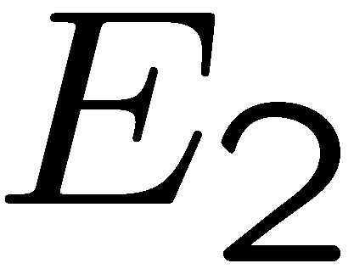
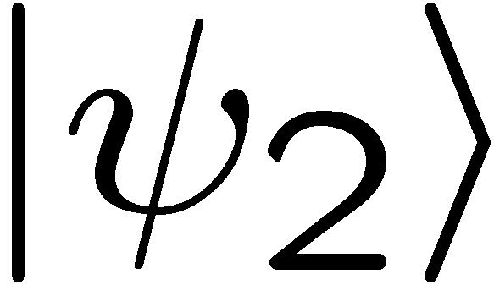
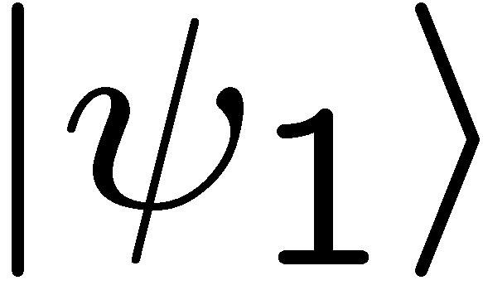
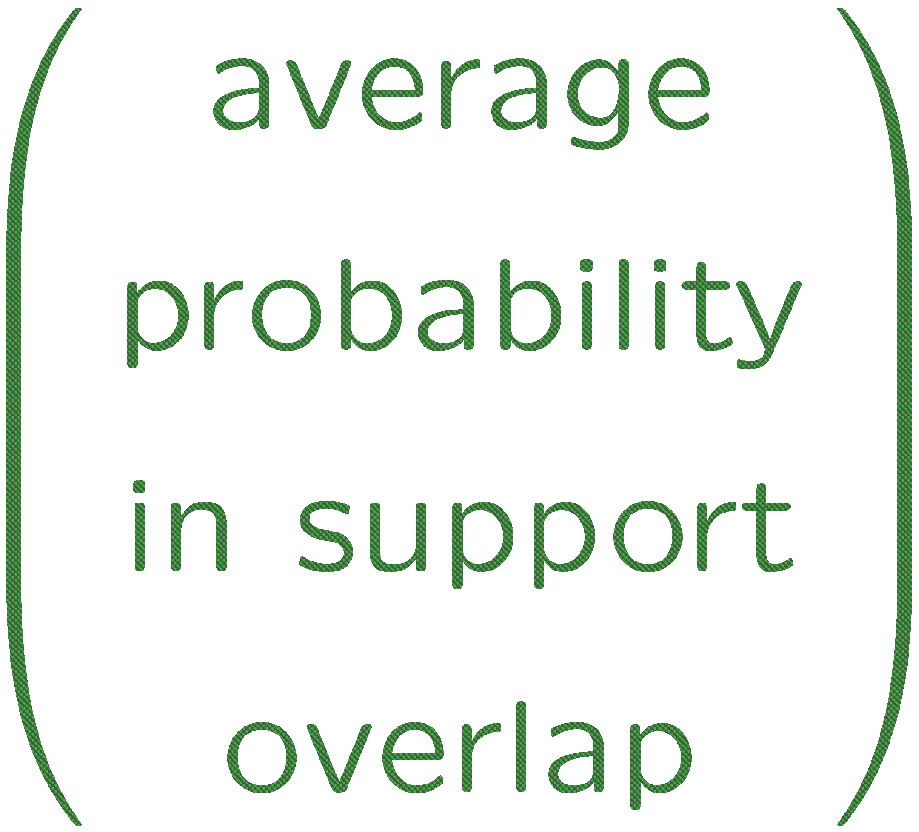
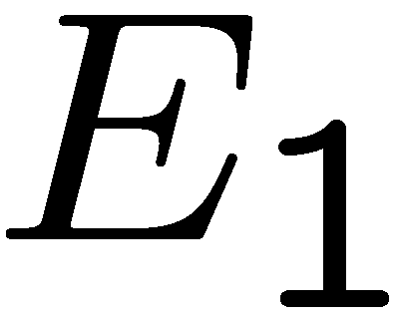
 | Classical (realistic, deterministic) world |  | Quantum world
State space | Simplex of probabilities for microstates |  | Convex set of density operators
State | Extreme point Microstate | Ensemble | Extreme point Pure state State vector | Ensemble Mixed state Density operator
Can you unambiguously distinguish two nonidentical states?
 | Always | Sometimes (iff supports not identical) | Always (supports are not identical) | Sometimes (iff supports not identical)

Slide 19
 | Classical (realistic, deterministic) world |  | Quantum world
State space | Simplex of probabilities for microstates |  | Convex set of density operators
State | Extreme point Microstate | Ensemble | Extreme point Pure state State vector | Ensemble Mixed state Density operator
Verification: state determination | Yes | No | No | No
Whom do you ask for the system state? The system or an agent?
 | Objective | Subjective | Objective | Subjective

Slide 20
 | Classical (realistic, deterministic) world |  | Quantum world
State space | Simplex of probabilities for microstates |  | Convex set of density operators
State | Extreme point Microstate | Ensemble | Extreme point Pure state State vector | Ensemble Mixed state Density operator
State change on measurement | No | Yes | Yes | Yes
State-vector reduction
or wave-function collapse
Real physical disturbance?
 | Objective | Subjective | Subjective | Subjective

Slide 21
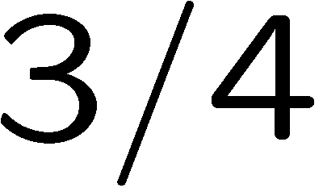
 | Classical (realistic, deterministic) world |  | Quantum world
State space | Simplex of probabilities for microstates |  | Convex set of density operators
State | Extreme point Microstate | Ensemble | Extreme point Pure state State vector | Ensemble Mixed state Density operator
Uniqueness of ensembles | Yes | No | No | No
 | Objective | Subjective | Subjective | Subjective

Slide 22
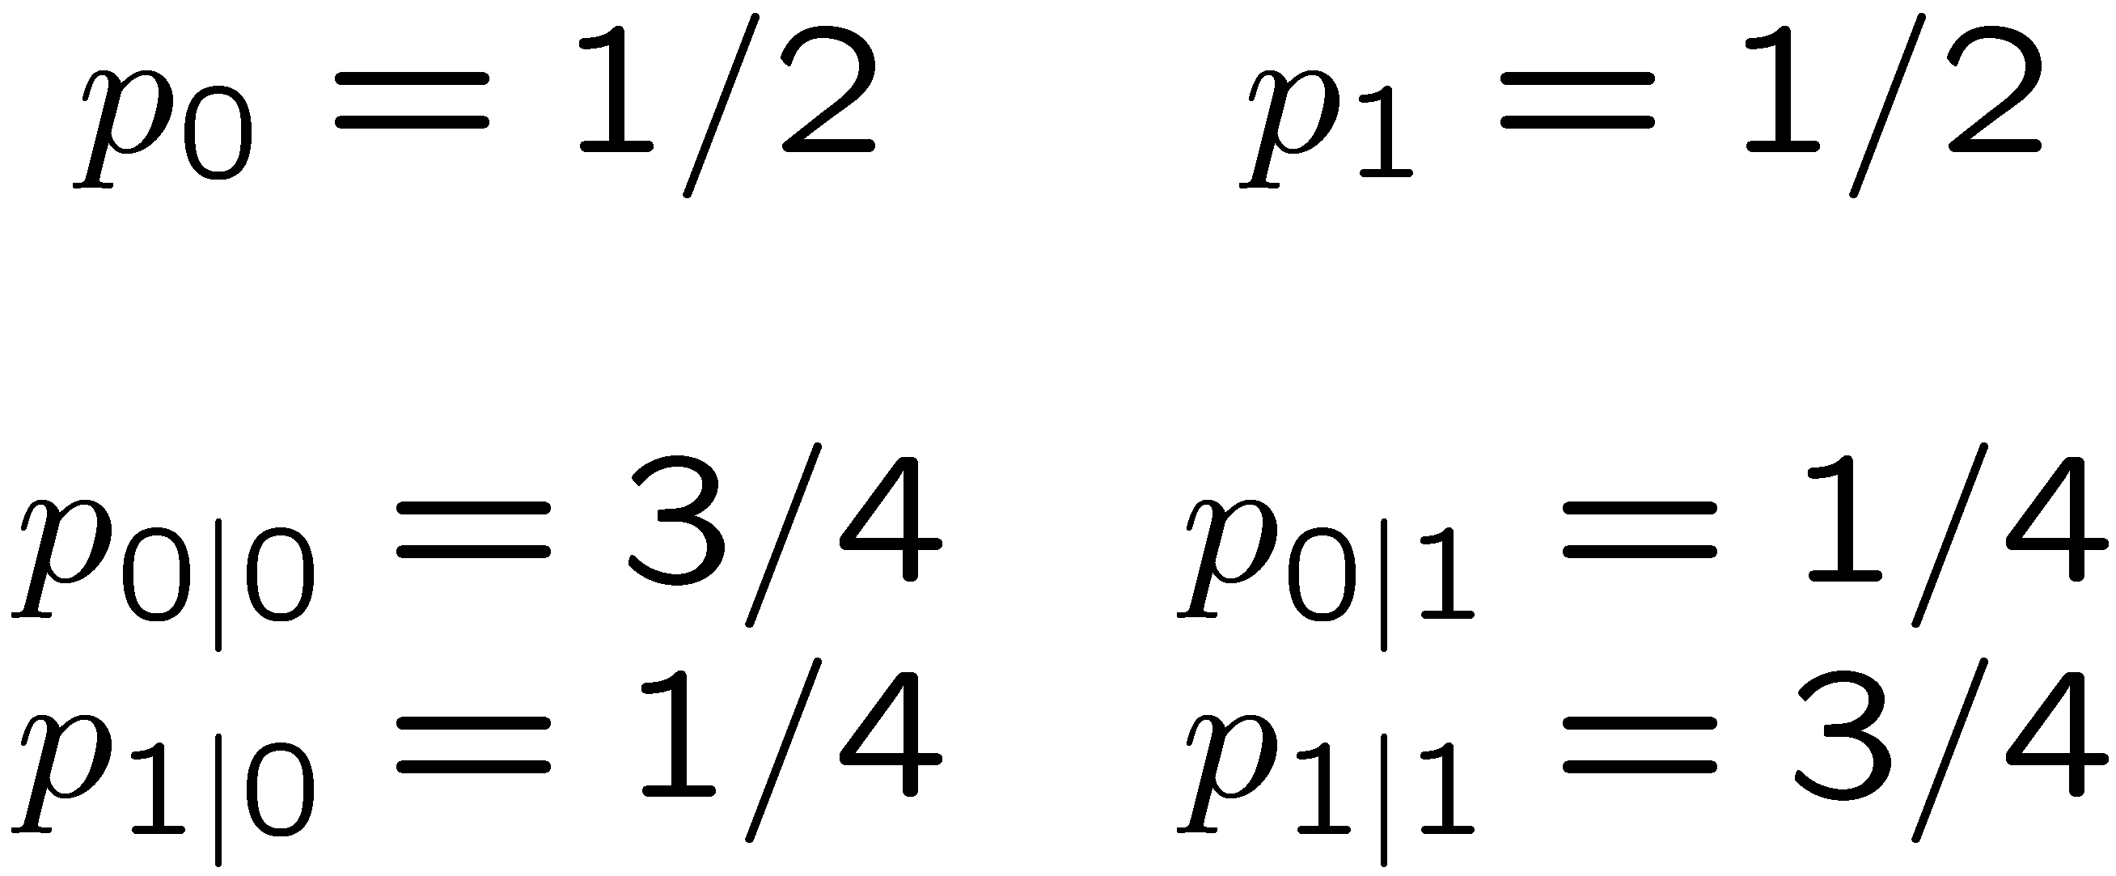
 | Classical (realistic, deterministic) world |  | Quantum world
State space | Simplex of probabilities for microstates |  | Convex set of density operators
State | Extreme point Microstate | Ensemble | Extreme point Pure state State vector | Ensemble Mixed state Density operator
Nonlocal state change (steering) | No | Yes | Yes | Yes
Real nonlocal physical disturbance?
 | Objective | Subjective | Subjective | Subjective

Slide 23
 | Classical (realistic, deterministic) world |  | Quantum world
State space | Simplex of probabilities for microstates |  | Convex set of density operators
State | Extreme point Microstate | Ensemble | Extreme point Pure state State vector | Ensemble Mixed state Density operator
Fine-grained measurement | Certainty | Probabilities | Certainty or Probabilities | Probabilities
Verification: state determination | Yes | No | No | No
State change on measurement | No | Yes | Yes | Yes
Uniqueness of ensembles | Yes | No | No | No
Nonlocal state change (steering) | No | Yes | Yes | Yes
Specification: state preparation | Yes | No | ? | ?
 | Objective | Subjective | Subjective | Subjective

Slide 24
Copenhagen vs. Bayes
Truchas from East Pecos Baldy
Sangre de Cristo Range
Northern New Mexico

Slide 25
 | Classical (realistic, deterministic) world |  | Quantum world
State space | Simplex of probabilities for microstates |  | Convex set of density operators
State | Extreme point Microstate | Ensemble | Extreme point Pure state State vector | Ensemble Mixed state Density operator
Specification: state preparation | Yes | No | Copenhagen: Yes | Copenhagen: Yes
Copenhagen interpretation:
Classical facts specifying the properties of the preparation device determine a pure state.
Copenhagen (objective preparations view) becomes the home of objective chance, with nonlocal physical disturbances.
 | Objective | Subjective | Objective | Objective

Slide 26
Copenhagen | Classical (realistic, deterministic) world |  | Quantum world
State space | Simplex of probabilities for microstates |  | Convex set of density operators
State | Extreme point Microstate | Ensemble | Extreme point Pure state State vector | Ensemble Mixed state Density operator
Fine-grained measurement | Certainty | Probabilities | Certainty or Probabilities | Probabilities
Verification: state determination | Yes | No | No | No
State change on measurement | No | Yes | Yes | Yes
Uniqueness of ensembles | Yes | No | No | No
Nonlocal state change (steering) | No | Yes | Yes | Yes
Specification: state preparation | Yes | No | Yes | Yes
 | Objective | Subjective | Objective | Objective

Slide 27
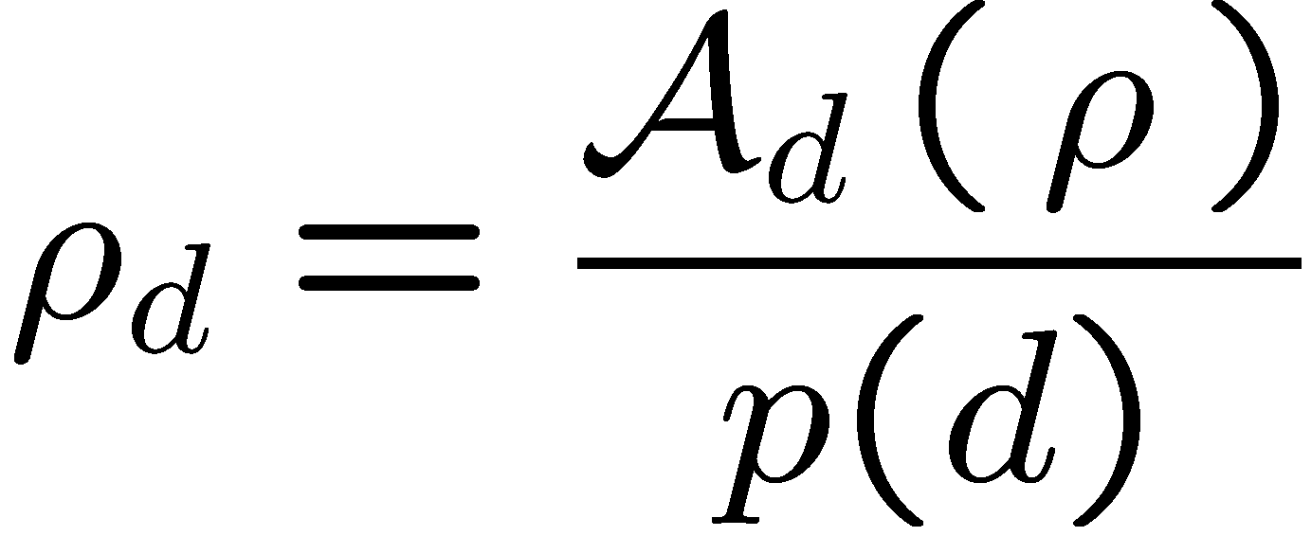
Classical and quantum updating
Facts in the form of observed data d are used to update probabilities via Bayes’s rule:
Facts in the form of observed data d are used to update quantum states:
conditional (model, likelihood)
quantum operation (model)
prior
prior
posterior
posterior
The posterior always depends on the prior, except when d logically implies h₀:
Quantum state preparation:
The posterior state always depends on prior beliefs, even for quantum state preparation, because there is a judgment involved in choosing the quantum operation.
Facts never determine probabilities or quantum states.

Slide 28
Where does Copenhagen go wrong?
The Copenhagen interpretation forgets that the preparation device is quantum mechanical. A detailed description of the operation of a preparation device (provably) involves prior judgments in the form of quantum state assignments.
It is possible to show that neither deterministic nor stochastic preparation devices can prepare the same system state independent of system and device initial states.

Slide 29
Subjective Bayesian | Classical (realistic, deterministic) world |  | Quantum world
State space | Simplex of probabilities for microstates |  | Convex set of density operators
State | Extreme point Microstate | Ensemble | Extreme point Pure state State vector | Ensemble Mixed state Density operator
Fine-grained measurement | Certainty | Probabilities | Certainty or Probabilities | Probabilities
Verification: state determination | Yes | No | No | No
State change on measurement | No | Yes | Yes | Yes
Uniqueness of ensembles | Yes | No | No | No
Nonlocal state change (steering) | No | Yes | Yes | Yes
Specification: state preparation | Yes | No | No | No
 | Objective | Subjective | Subjective | Subjective

Slide 30
Bayesian quantum probabilities
Echidna Gorge
Bungle Bungle Range
Western Australia

Slide 31
Quantum states vs. probabilities
Are quantum states the same as probabilities? No, though both are subjective, there are differences, but these differences should be stated in Bayesian terms.
A quantum state is a catalogue of probabilities, but the rules for manipulating quantum states are different than for manipulating probabilities.
The rules for manipulating quantum states are objective consequences of restrictions on how agents interface with the real world.

Slide 32
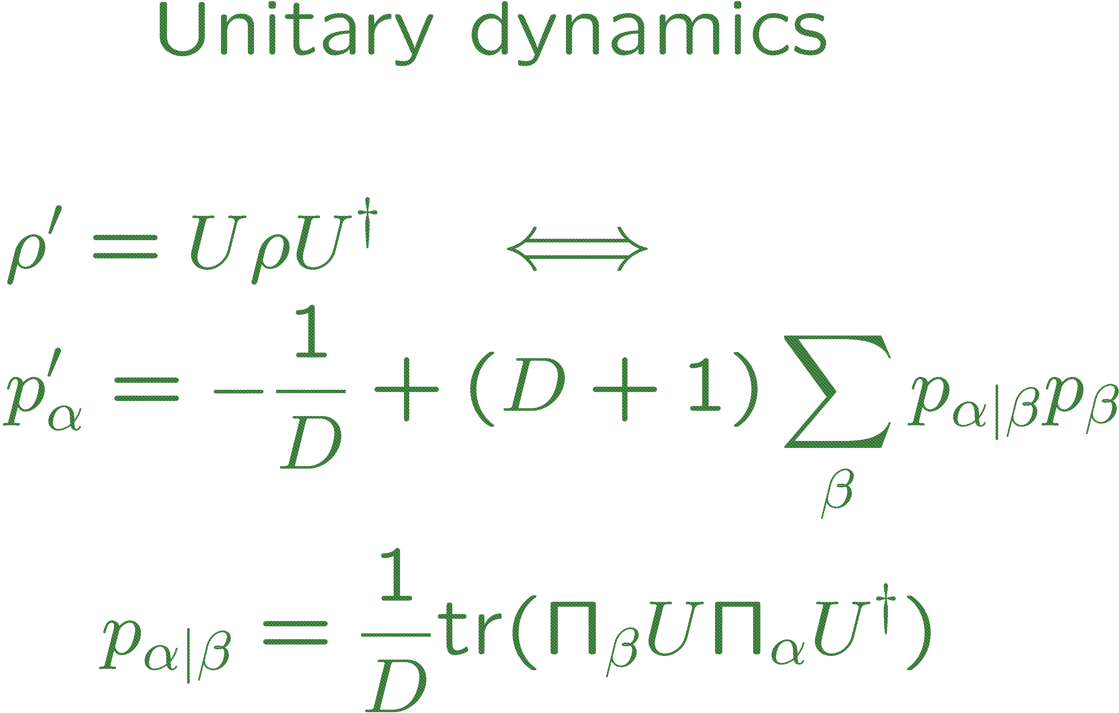
Catalogue of probabilities: Fuchs’s gold standard
Symmetric Informationally Complete (SIC)-POVM

Slide 33
Quantum coin tossing
Cable Beach
Western Australia

Slide 34
Is a quantum coin toss more random than a classical one?
Why trust a quantum random generator over a classical one?
Measure spin along z axis:
Measure spin along x axis:
C. M. Caves, R. Schack, “Quantum randomness,” in preparation.
quantum coin toss
 | Classical (realistic, deterministic) world |  | Quantum world
State space | Simplex of probabilities for microstates |  | Convex set of density operators
State | Extreme point Microstate | Ensemble | Extreme point Pure state State vector | Ensemble Mixed state Density operator
Fine-grained measurement | Certainty | Probabilities | Certainty or Probabilities | Probabilities

Slide 35
Is a quantum coin toss more random than a classical one?
Why trust a quantum random generator over a classical one?
Measure spin along z axis:
Measure spin along x axis:
quantum coin toss
Standard answer: The quantum coin toss is objective, with probabilities guaranteed by physical law.
Subjective Bayesian answer? No inside information.

Slide 36
Pure states and inside information
Party B has inside information about event E, relative to party A, if A is willing to agree to a bet on E that B believes to be a sure win. B has one-way inside information if B has inside information relative to A, but A does not have any inside information relative to A.
The unique situation in which no other party can have one-way inside information relative to a party Z is when Z assigns a pure state. Z is said to have a maximal belief structure.
Subjective Bayesian answer
We trust quantum over classical coin tossing because an agent who believes the coin is fair cannot rule out an insider attack, whereas the beliefs that lead to a pure-state assignment are inconsistent with any other party’s being able to launch an insider attack.

Slide 37
A stab at ontology
Cape Hauy
Tasman Peninsula

Slide 38
A stab at ontology
Quantum systems are defined by attributes, such as position, momentum, angular momentum, and energy or Hamiltonian. These attributes—and thus the numerical particulars of their eigenvalues and eigenfunctions—are objective properties of the system.
The value assumed by an attribute is not an objective property, and the quantum state that we use to describe the system is purely subjective.

Slide 39
A stab at ontology
The attributes orient and give structure to a system’s Hilbert space. Without them we are clueless as to how to manipulate and interact with a system.
The attributes are unchanging properties of a system, which can be determined from observable facts. The attributes determine the structure of the world.
The system Hamiltonian is one of the attributes, playing the special role of orienting a system’s Hilbert space now with the same space later.
Convex combinations of Hamiltonian evolutions are essentially unique (up to degeneracies).
Why should you (I) care?
If you do care, how can this be made convincing?
Status of quantum operations?
Effective attributes and effective Hamiltonians? “Effective reality”?

Slide 40
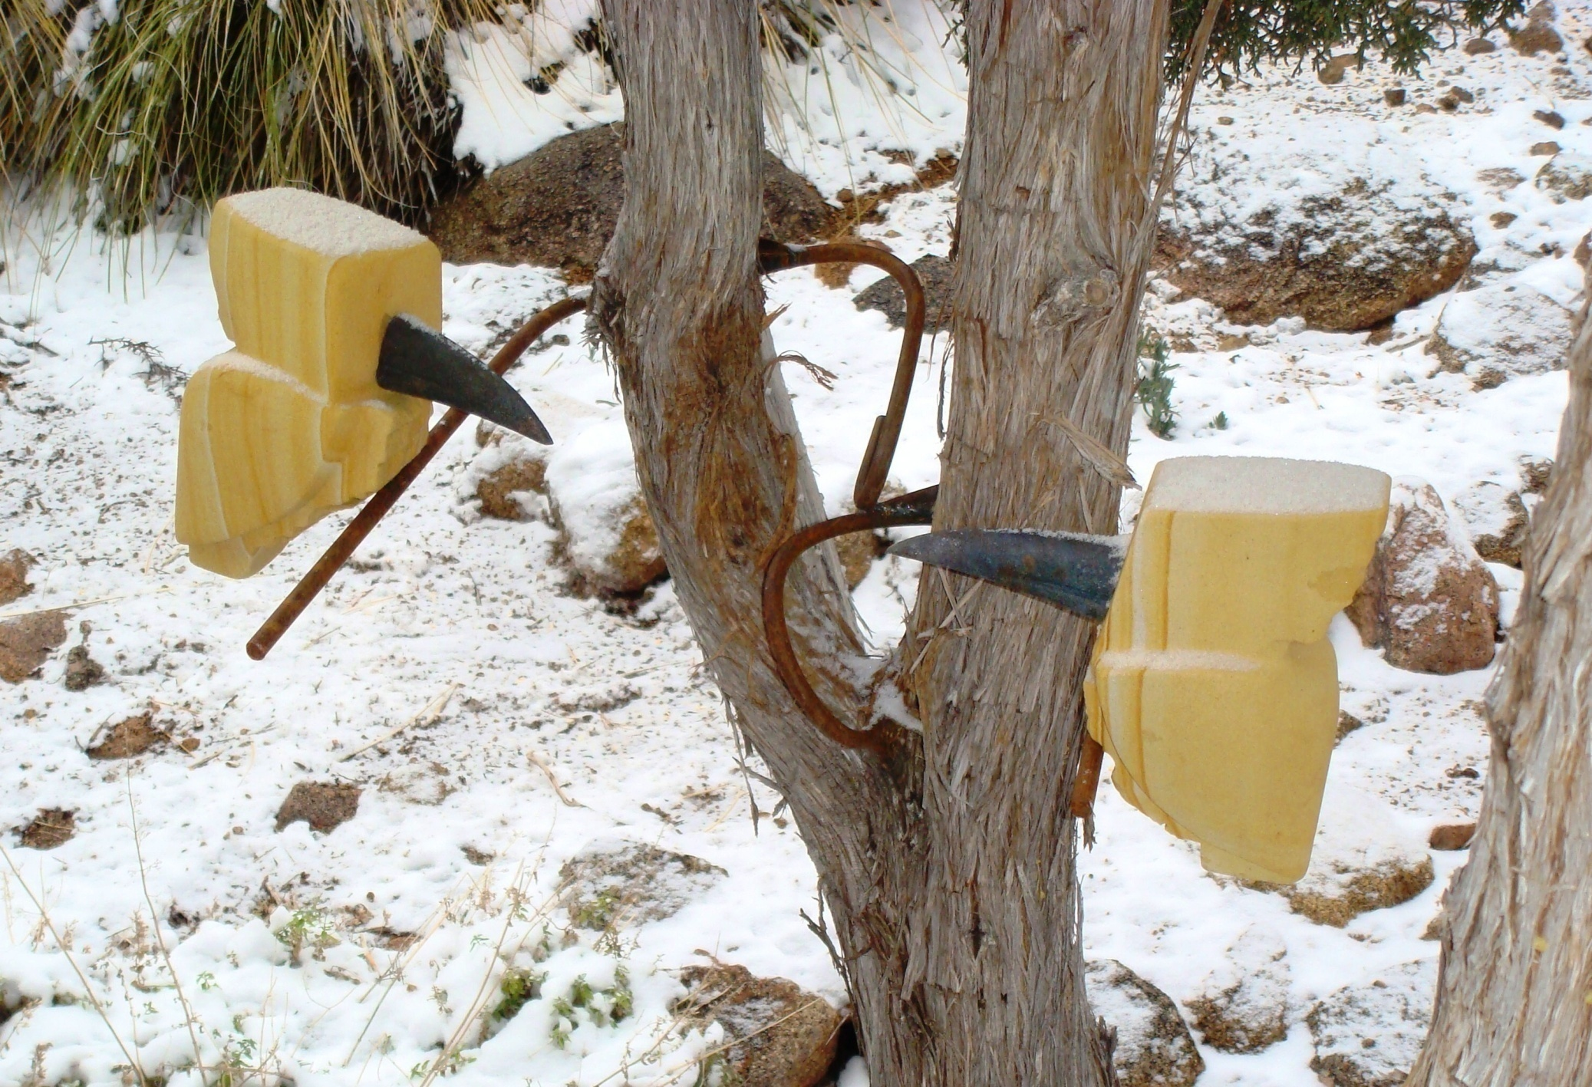
Kookaburras in New Mexico

