Slide 1
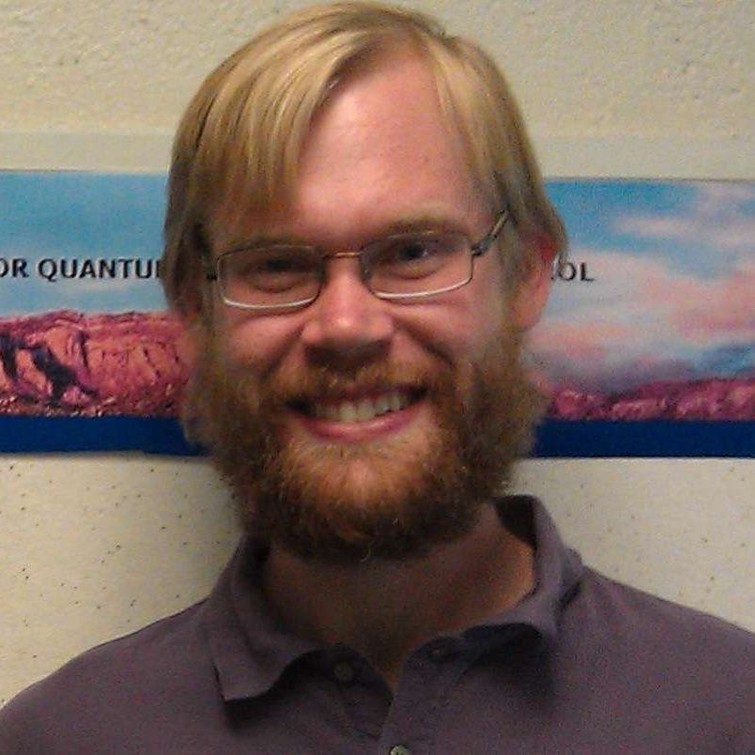
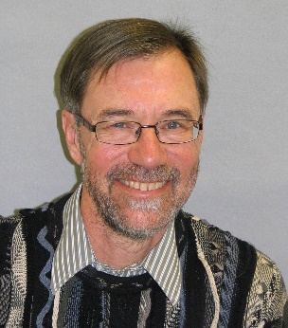
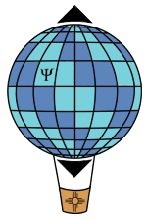
Quantum Gerrymandering: Positivity, Bias,
and Anisotropy Among Quantum States
Introduction: Geometry, Tomography, and Metrology
How gerrymandered is quantum state space?
Tomography and the spherical cow
Anisotropy in qutrit tomography
Jonathan A. Gross and Carlton M. Caves
Center for Quantum Information and Control, University of New Mexico
https://cquic.unm.edu/
Center for Quantum Information and Control

Slide 2
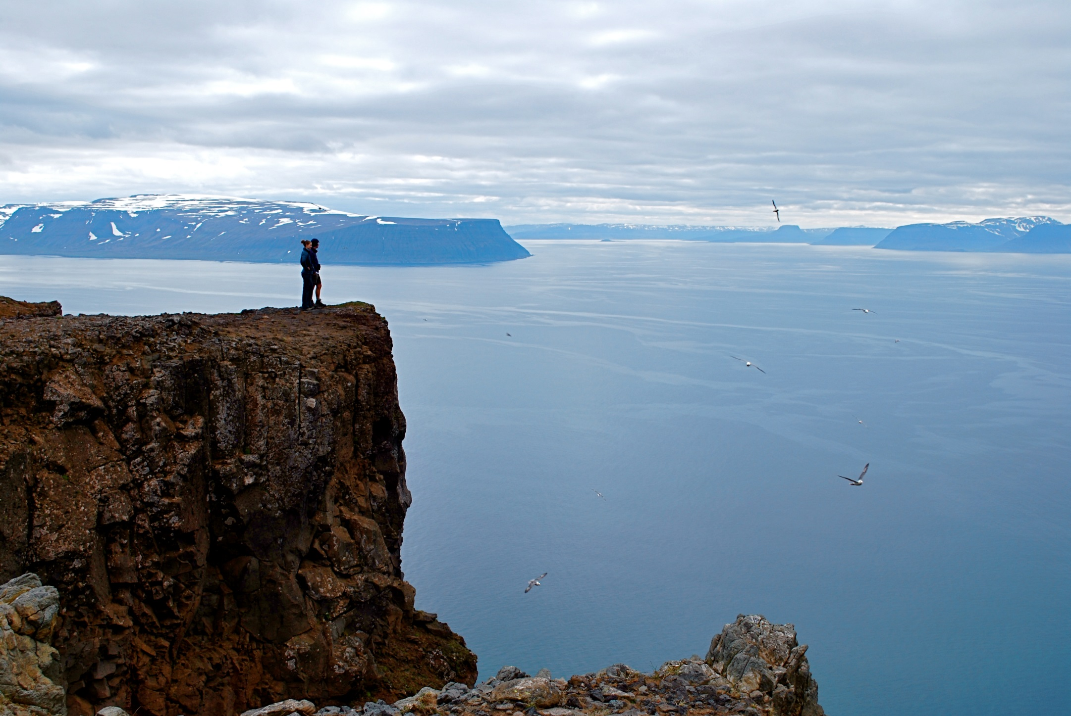
I. Introduction
Holstrandir Peninsula overlooking Ísafjarðardjúp
Westfjords, Iceland

Slide 3
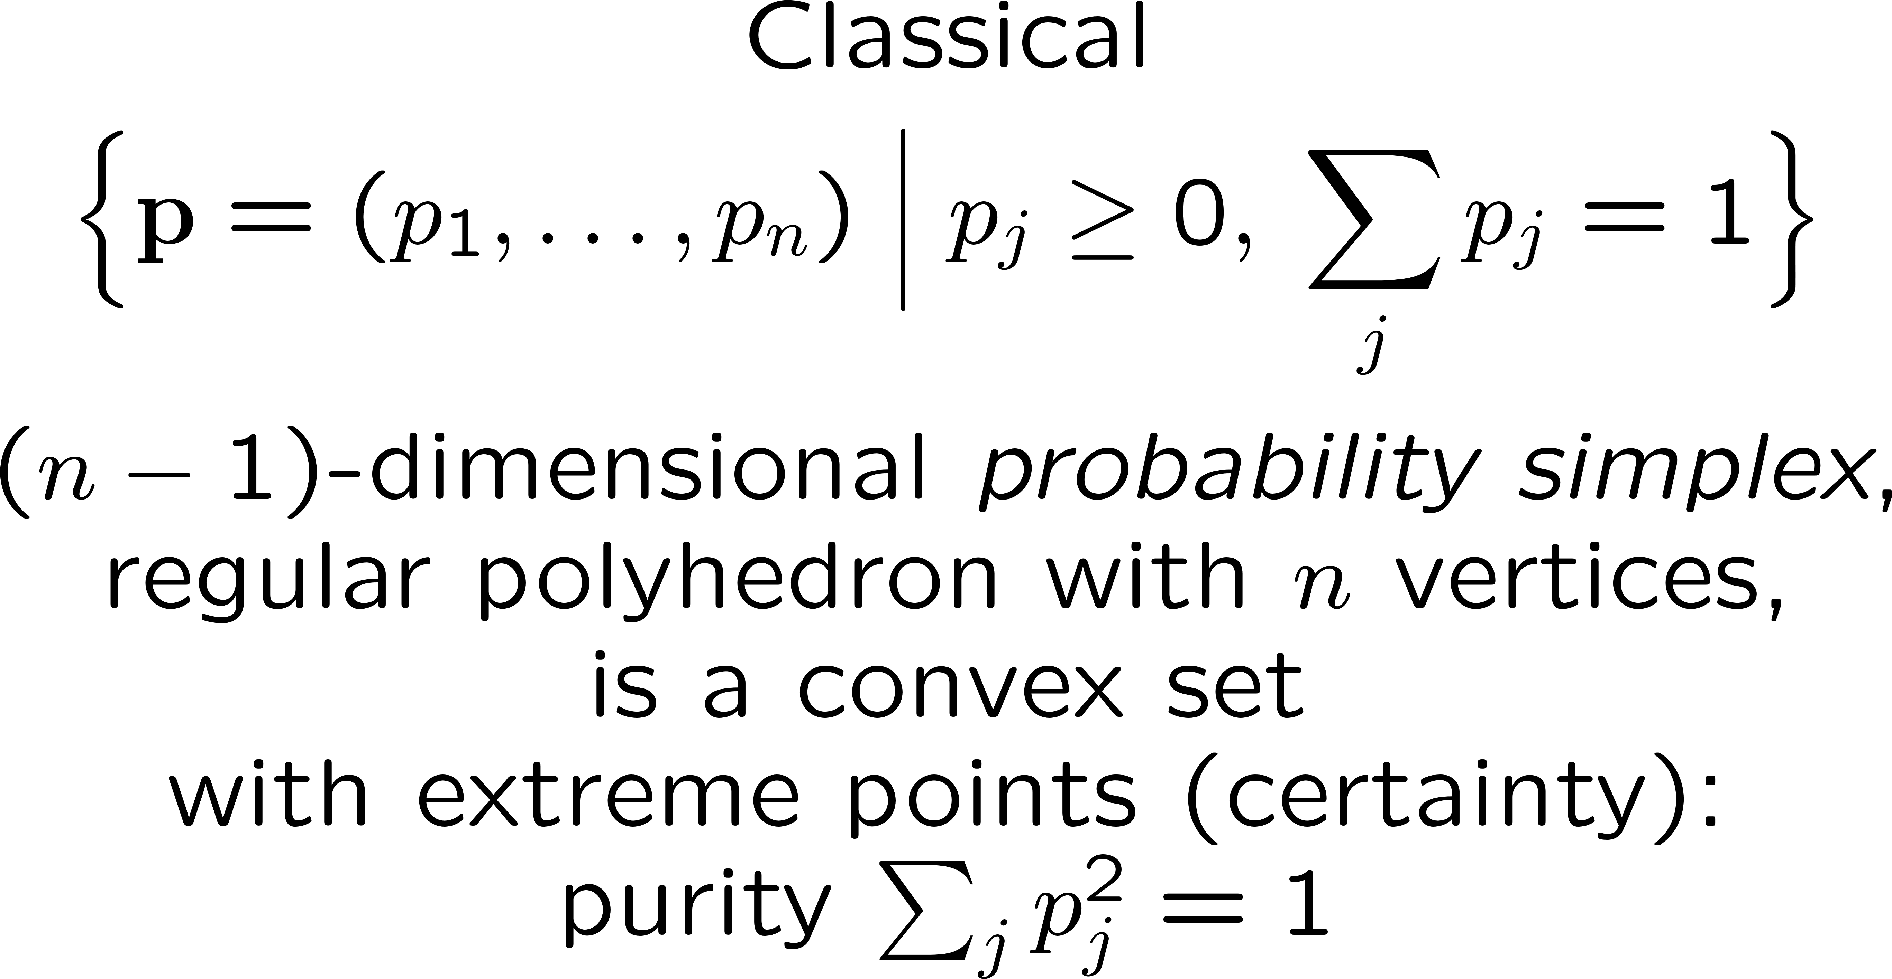
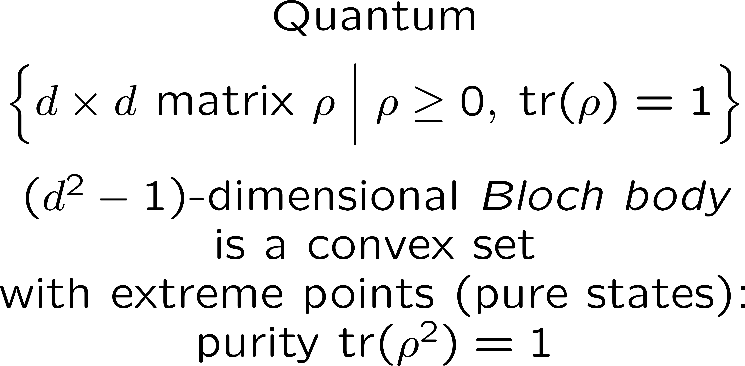
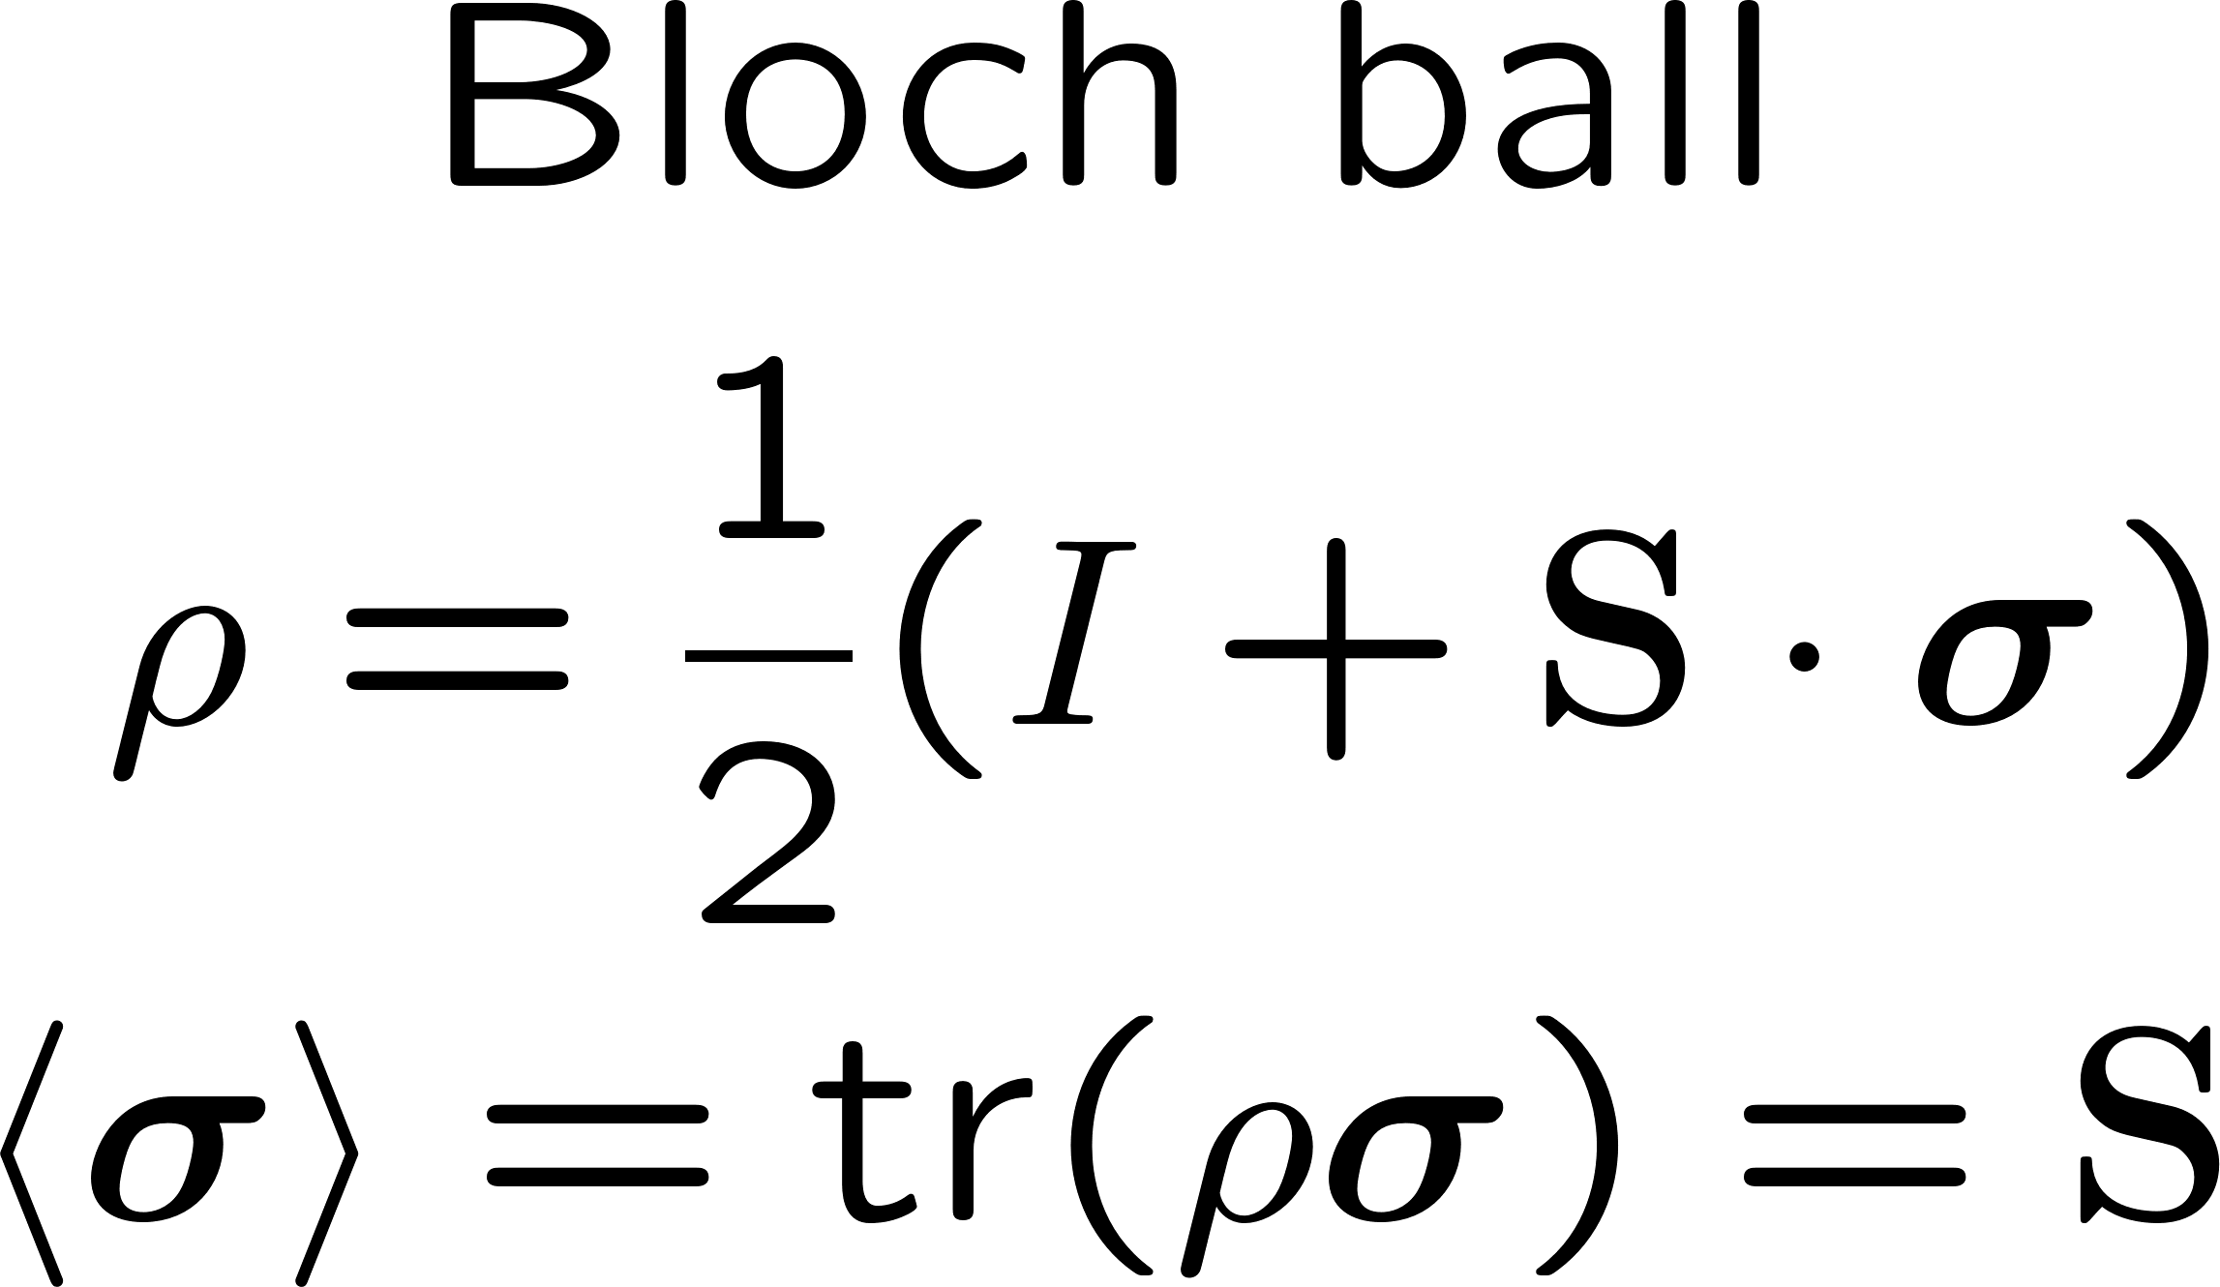
State space

Slide 4
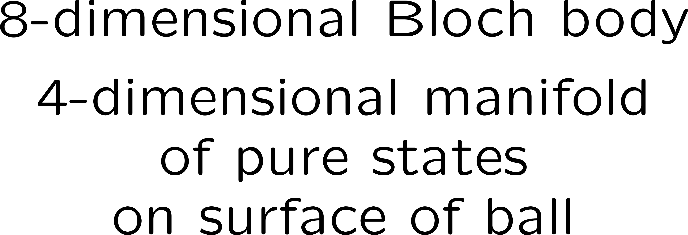
State space

Slide 5
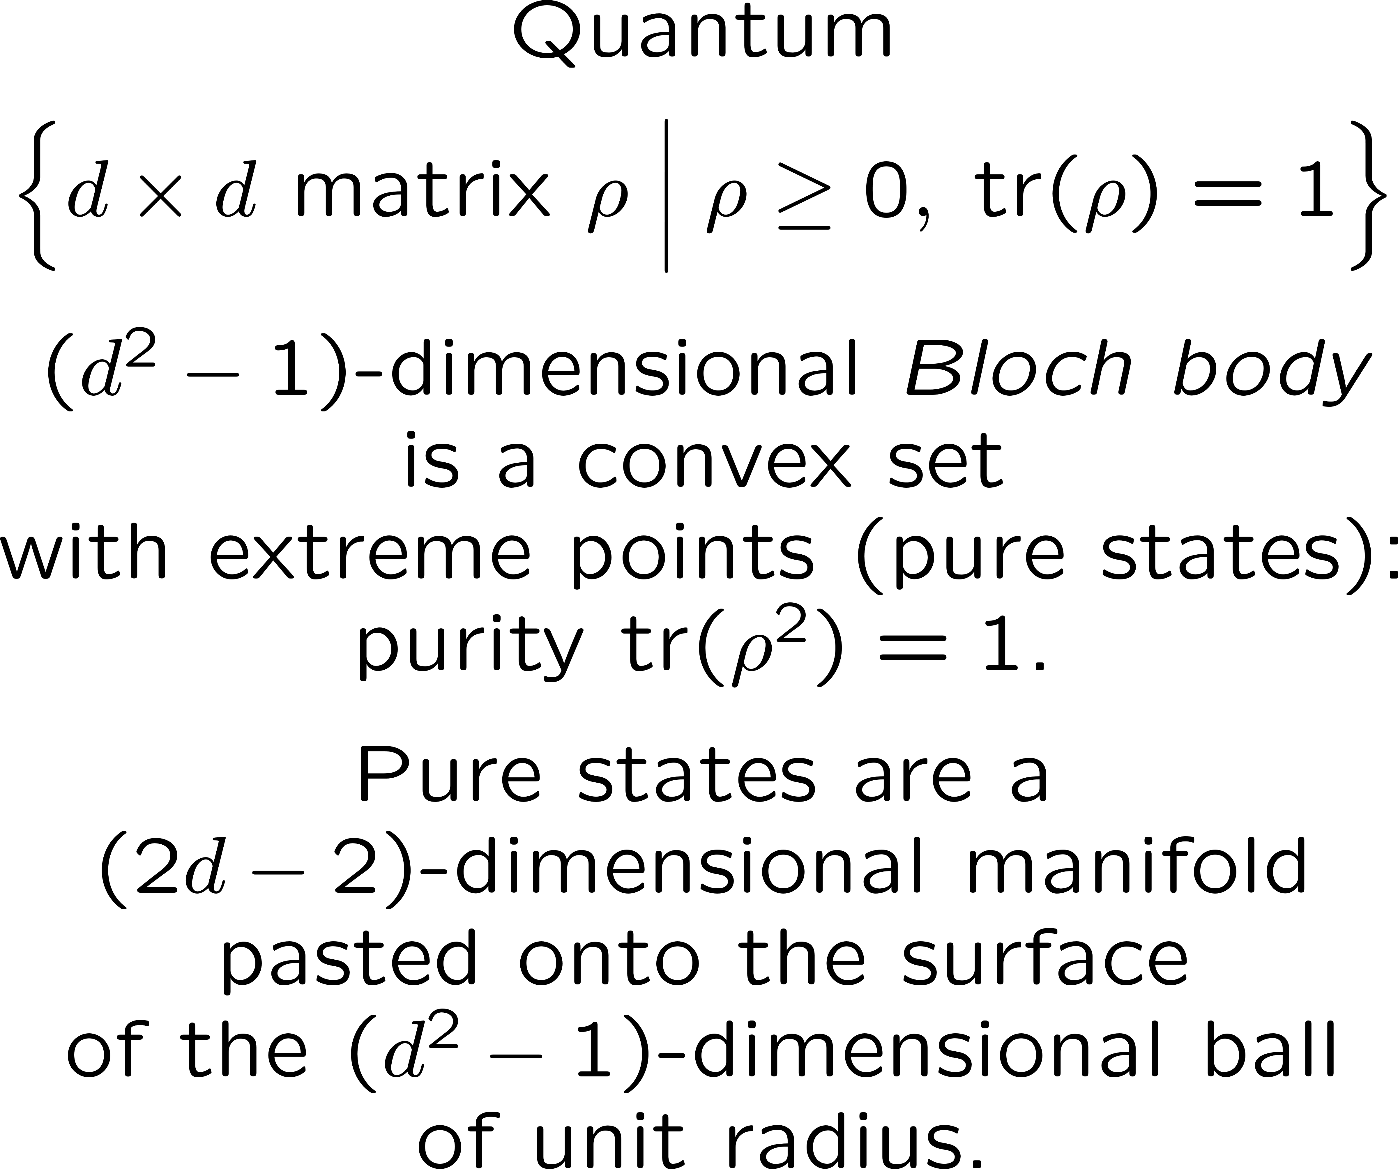
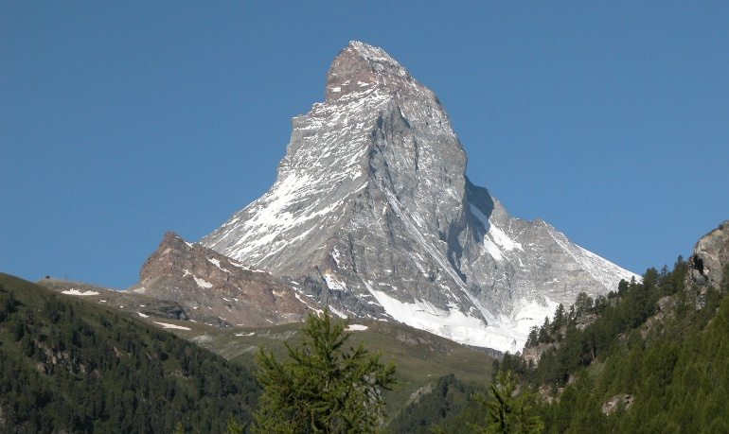
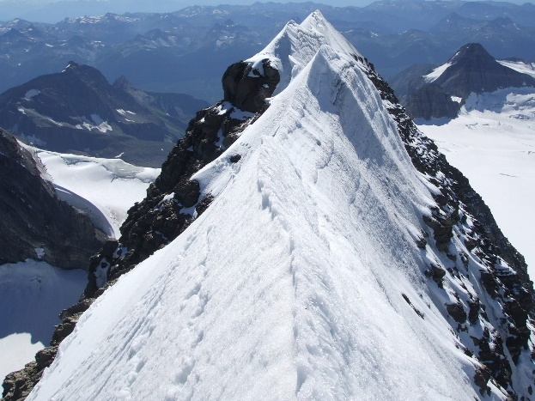
State space
Near an extreme point
Matterhorn
Swiss Alps
Mt. Sir Alexander
Canadian Rockies

Slide 6
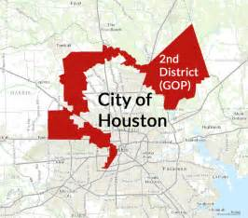
State space
Near an extreme point
Gerrymandering

Slide 7
Exploring the corners of state space
Know the nooks and crannies of your neighborhood.
Geometry
Tomography
Metrology
Low-rank tomography is all about working the corners of state space.
Tomography is the ultimate metrology. Fisher information is the tool.

Slide 8
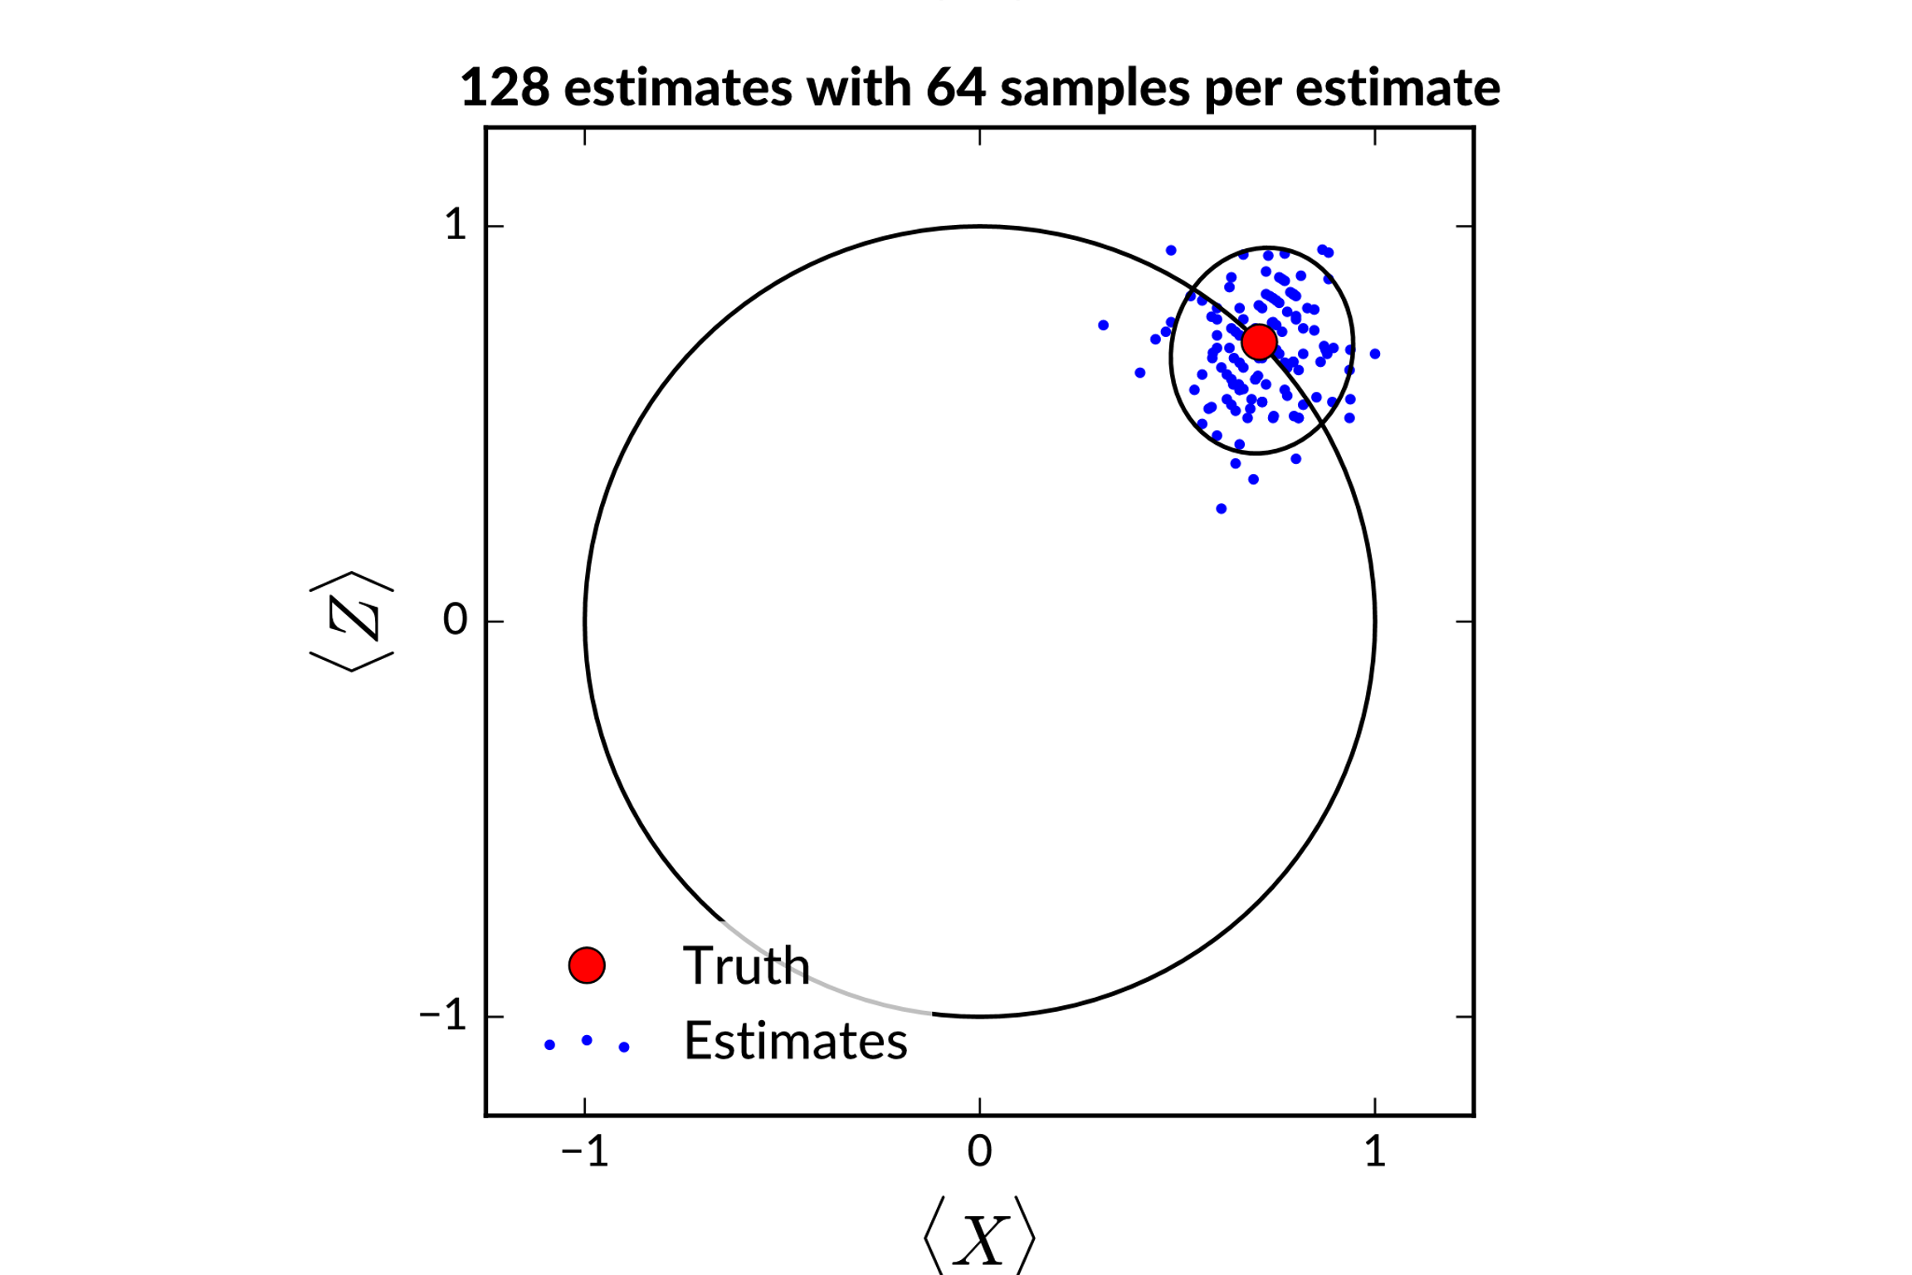
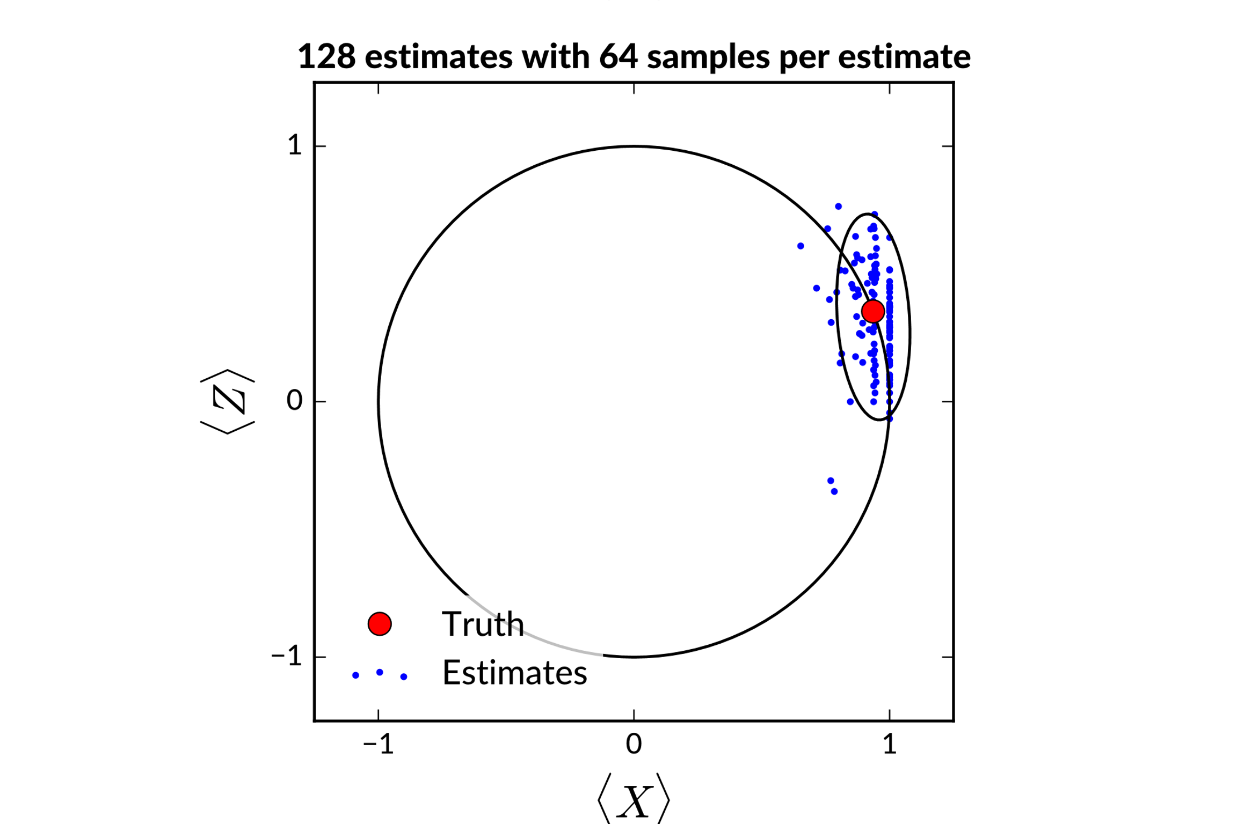
Geometry, tomography, and metrology
Qubit
Measure X and Z
Maximum-likelihood estimation
Classical Fisher information

Slide 9
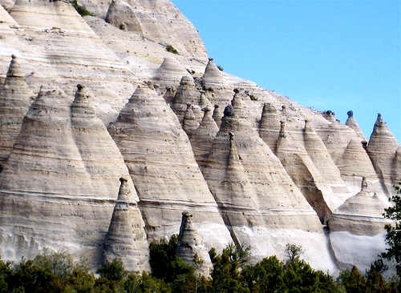
How gerrymandered is quantum state space?
Tent Rocks
Kasha-Katuwe National Monument
Northern New Mexico

Slide 10
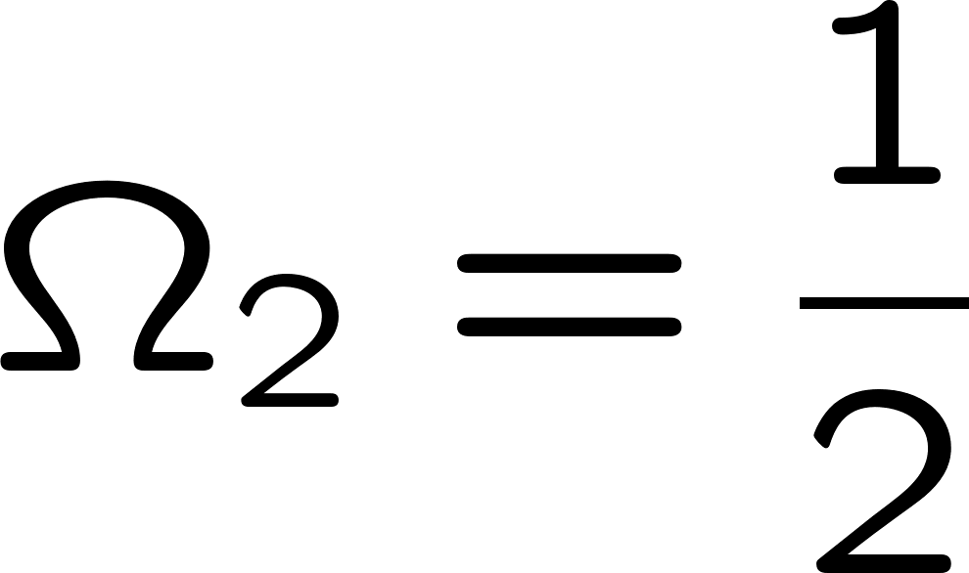
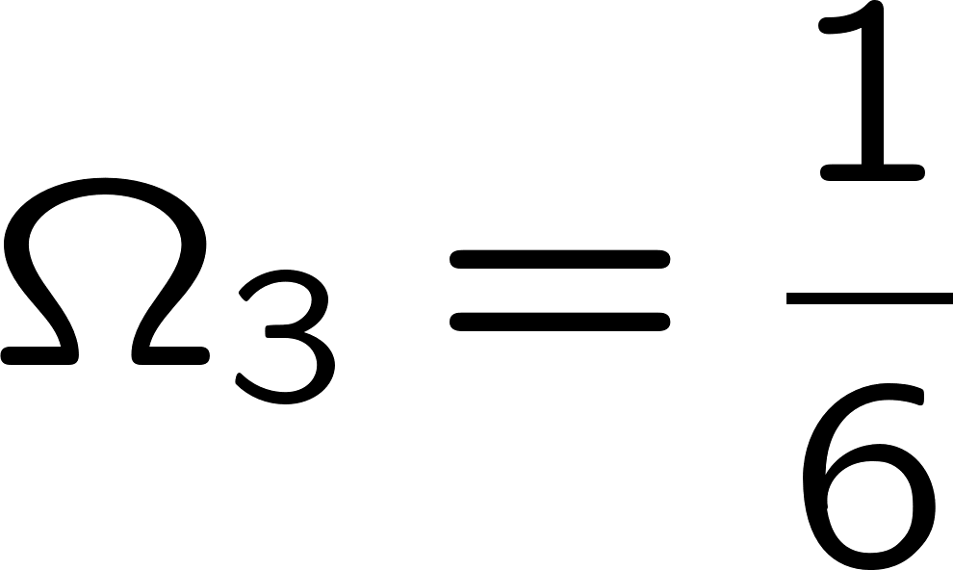
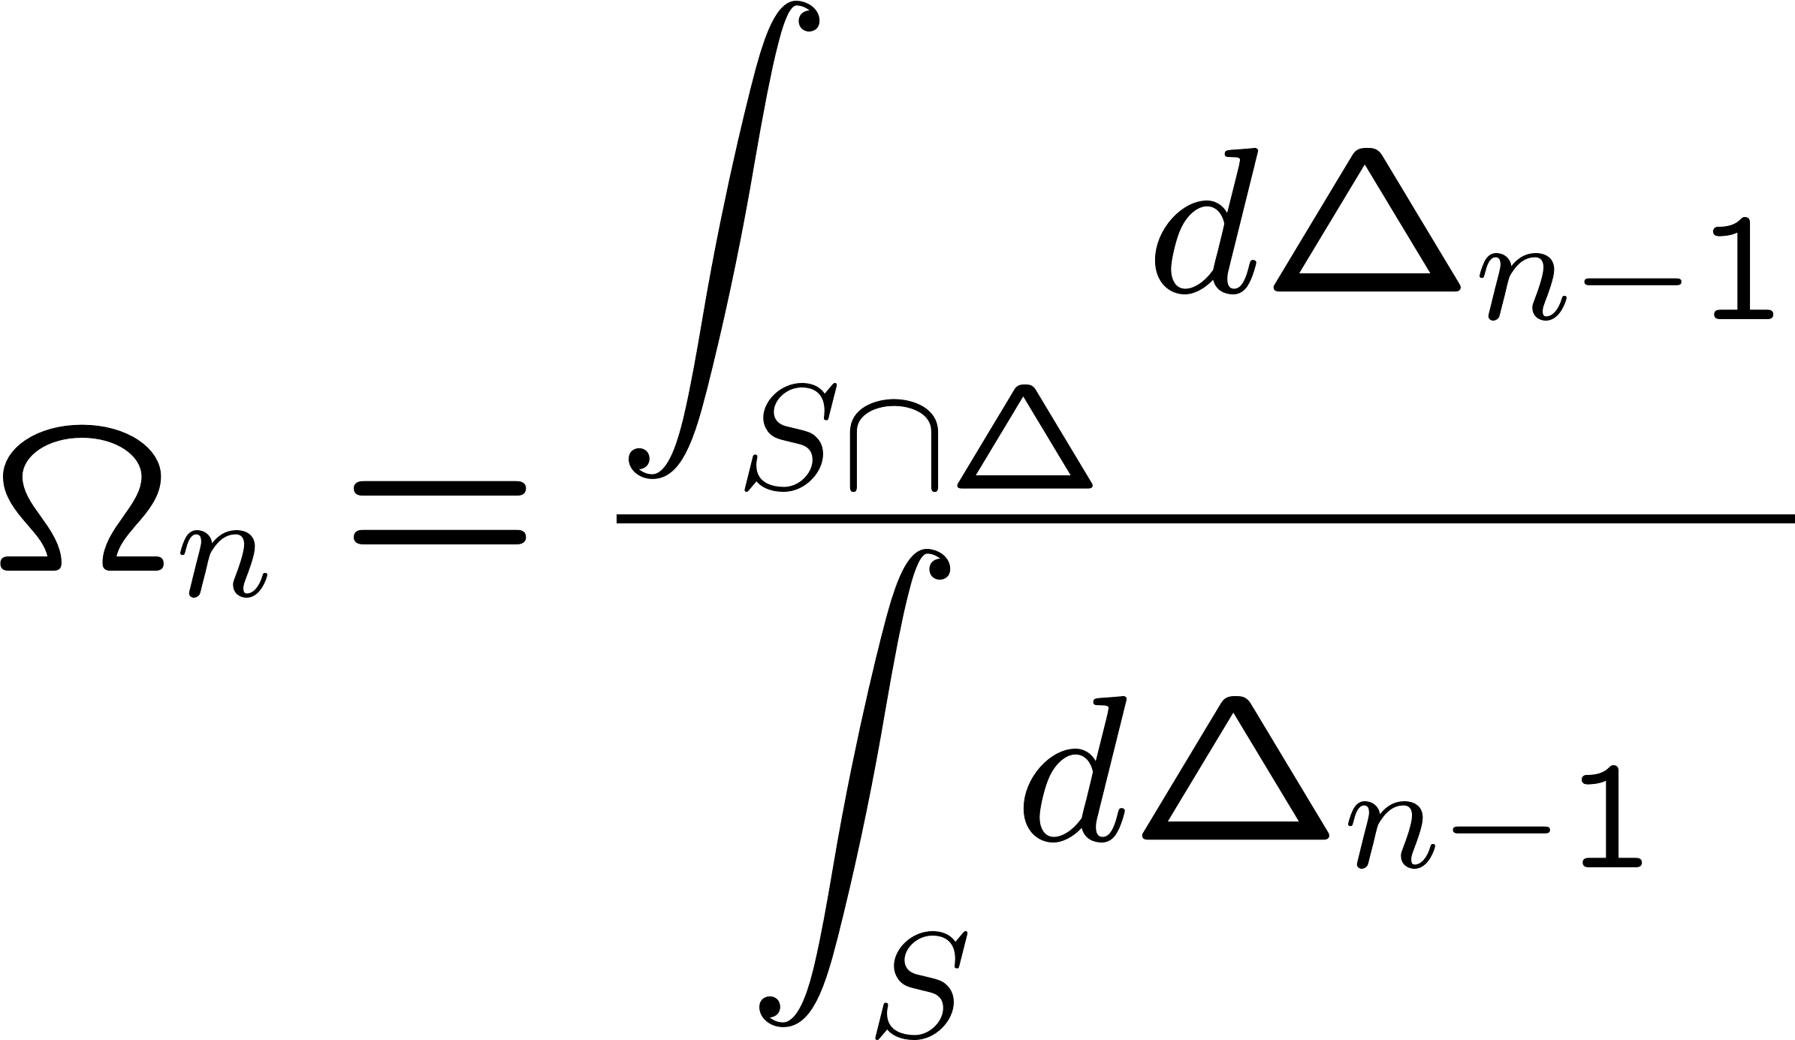
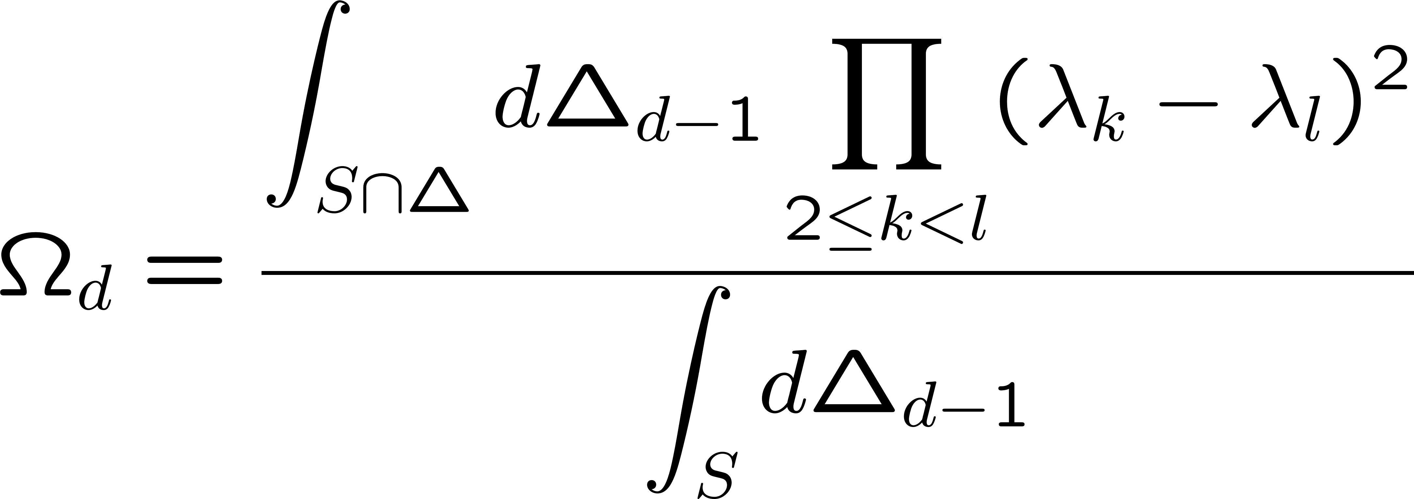
Fractional solid angle of physicality
Classical
Quantum

Slide 11
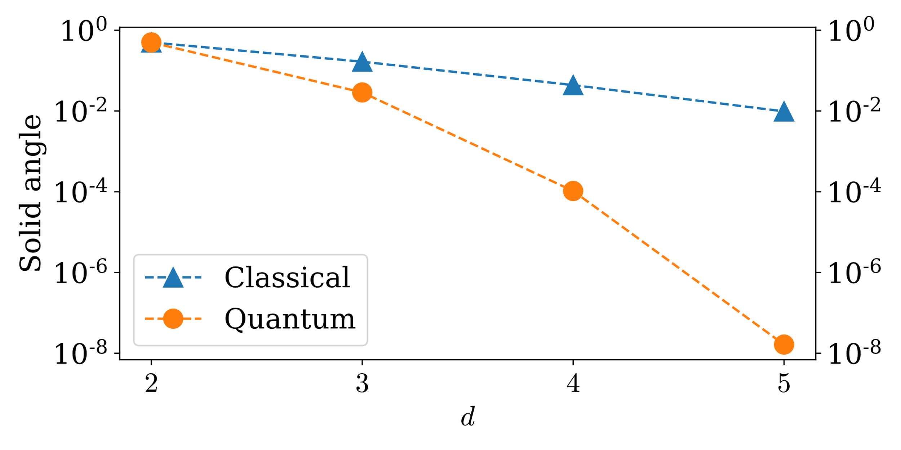
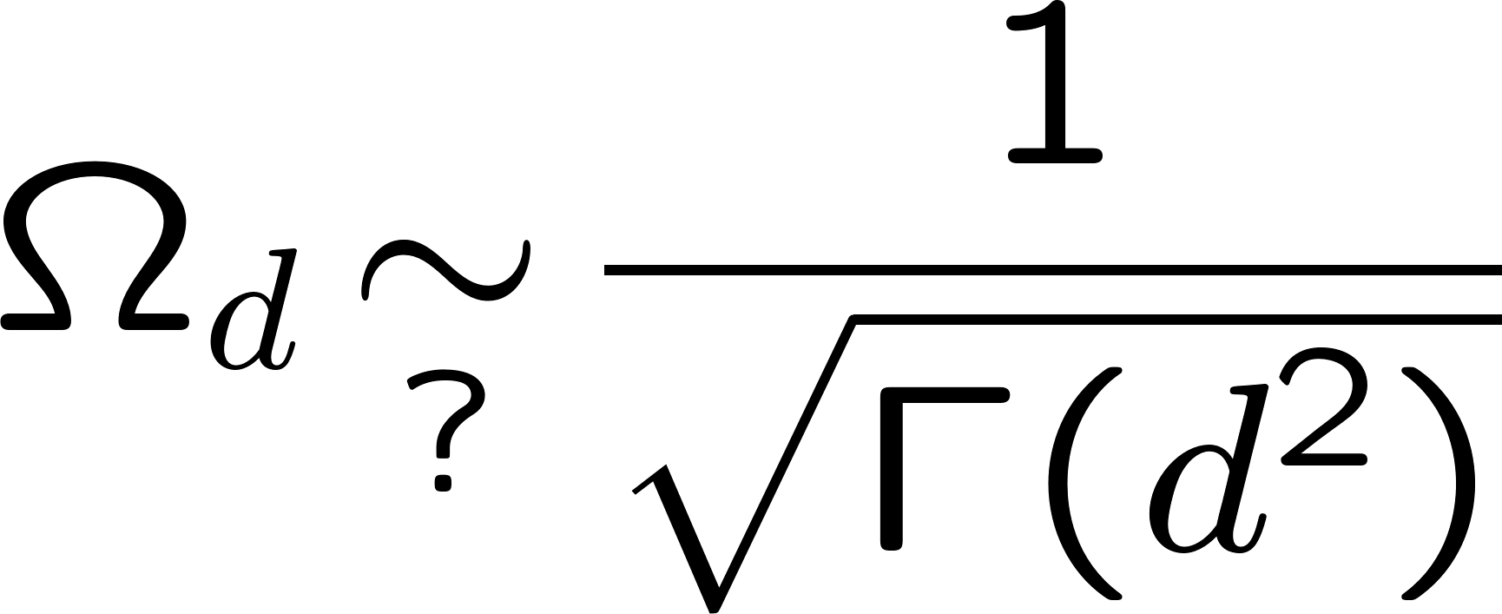
Fractional solid angle of physicality
Classical
Quantum

Slide 12
III. Tomography and the spherical cow
View from Cape Hauy
Tasman Peninsula, Tasmania

Slide 13
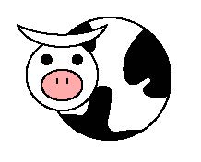
Tomography:
Flat metric vs. Fisher metric
Qubit: Measure X and Z
Maximum-likelihood estimation
Classical Fisher information
Hilbert-Schmidt (HS) flat metric: isotropic
Fisher metric: can it be
isotropic?

Slide 14
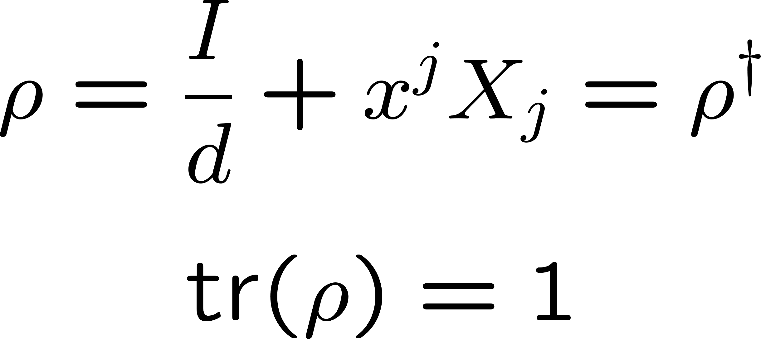
Classical Fisher matrix
Classical Fisher-information matrix

Slide 15
Classical Fisher metric
Classical Fisher-information matrix
Classical Fisher-information metric

Slide 16
Classical Fisher metric
Classical Fisher-information metric
Extension (completeness) properties

Slide 17
Classical Fisher metric
Special property

Slide 18
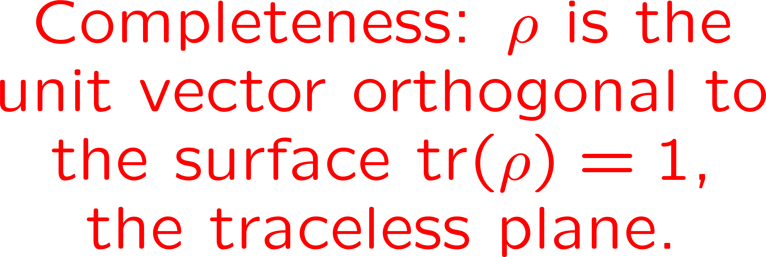
Are there spherical cows?
Can the Hilbert-Schmidt metric be the Fisher metric
for a rank-one POVM?

Slide 19
Are there spherical cows?
Can the Hilbert-Schmidt metric be the Fisher metric
for a rank-one POVM?
Except for qubits and the maximally mixed state

Slide 20
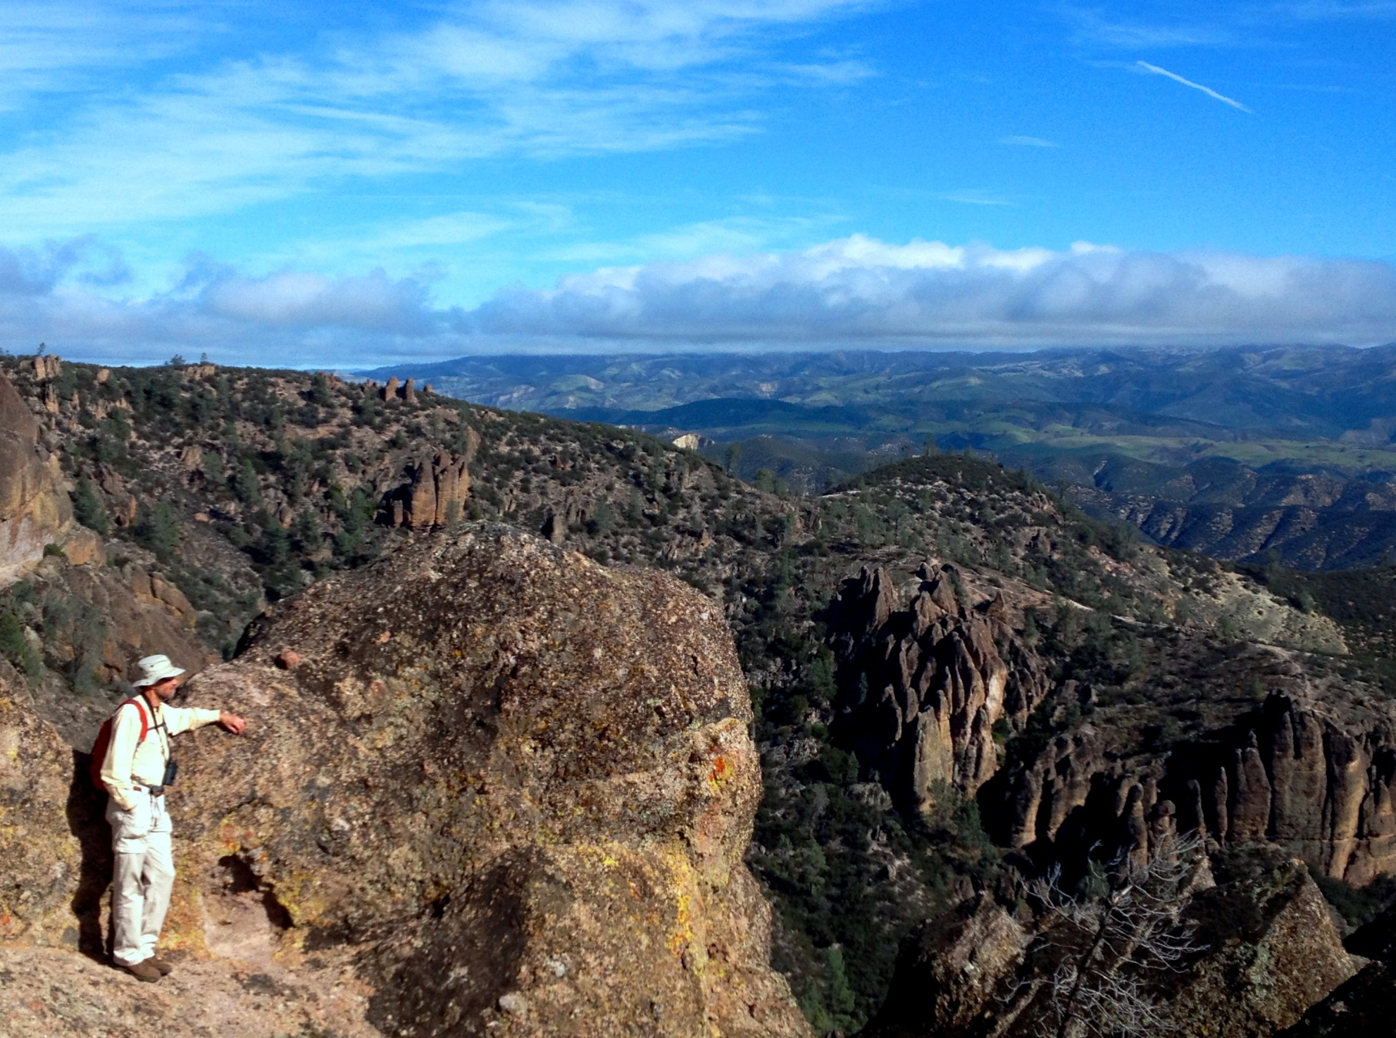
IV. Anistropy in qutrit tomography
Pinnacles National Park
Central California

Slide 21
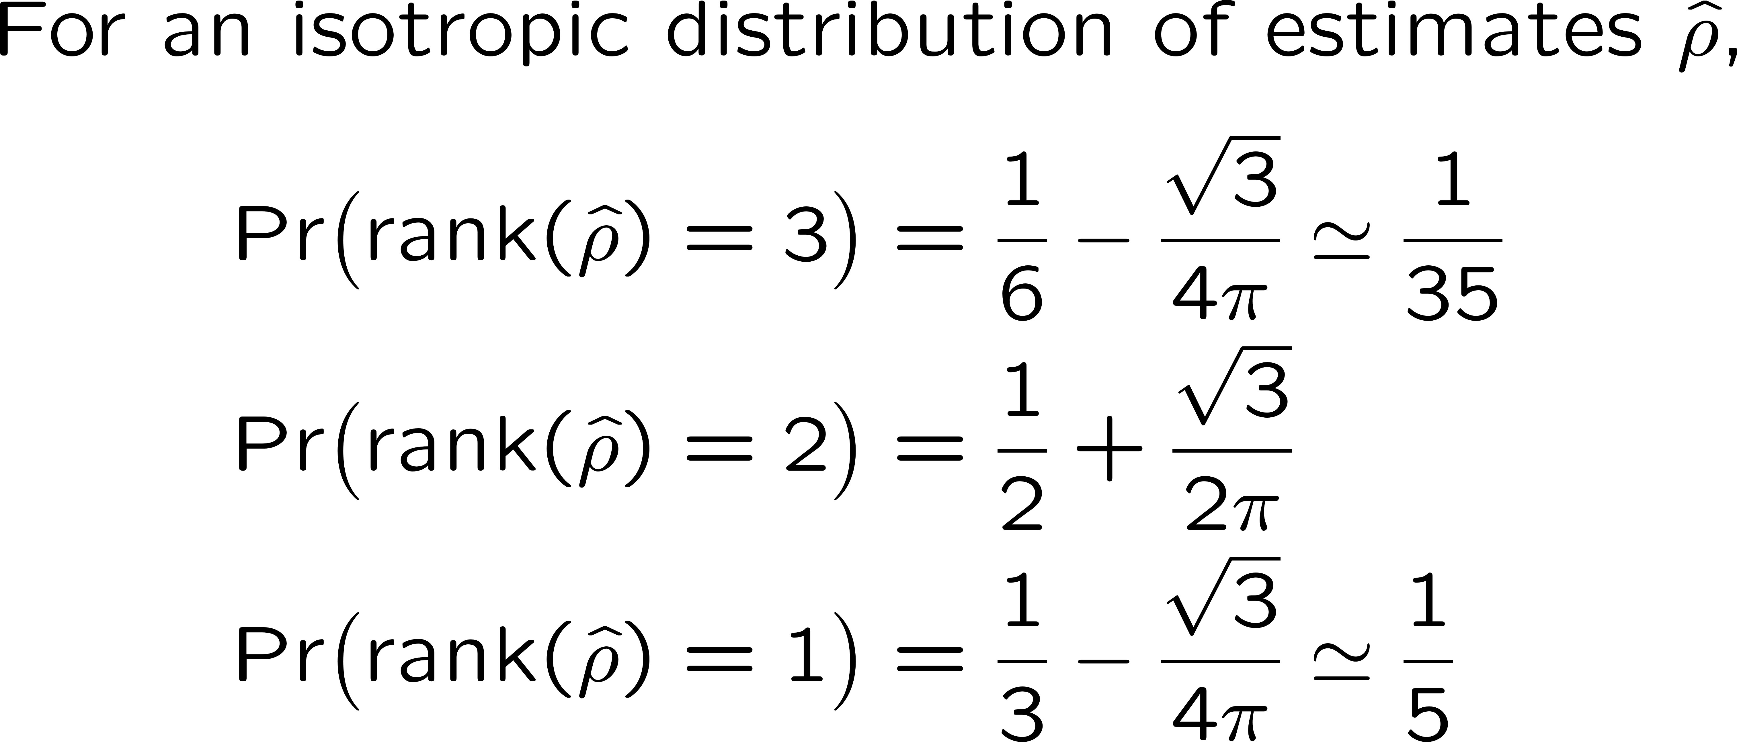
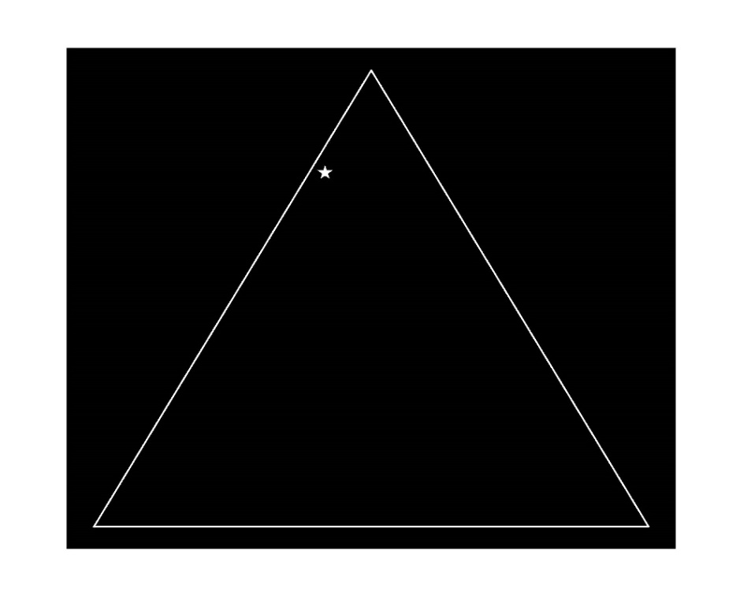
Anistropy in qutrit tomography
Rank distributions
Classical simplex
Quantum gerrymandering

Slide 22
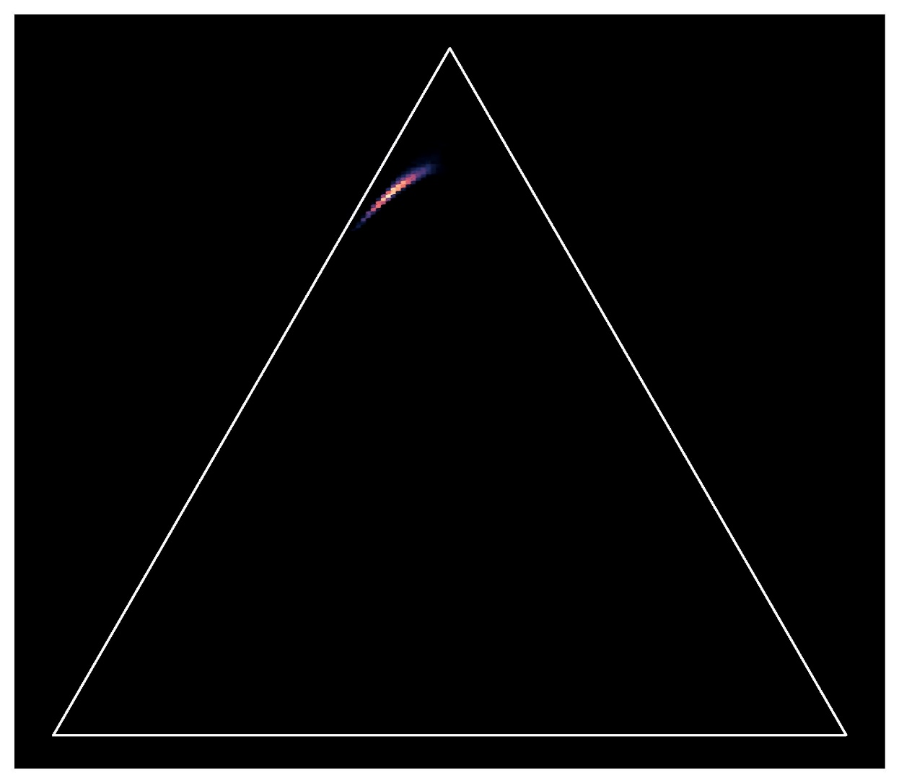
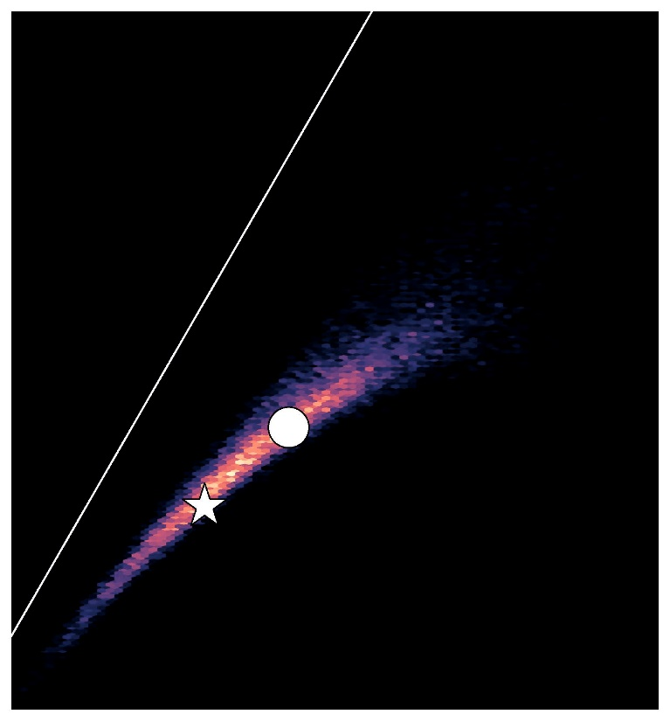
Anistropy in qutrit tomography
Rank distributions
SIC-POVM
Rank 2
For the supercilious: the supercilium
Rank 1
Rank 3

Slide 23
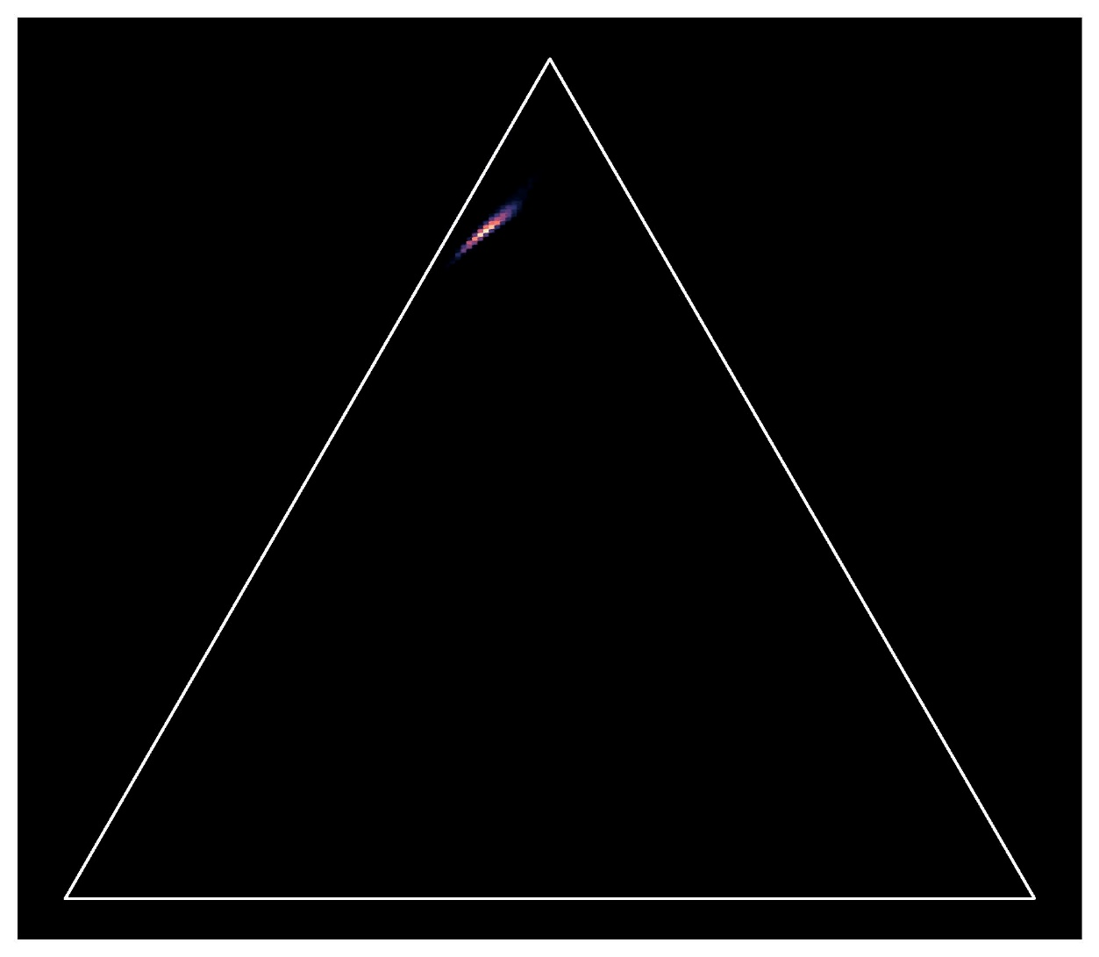
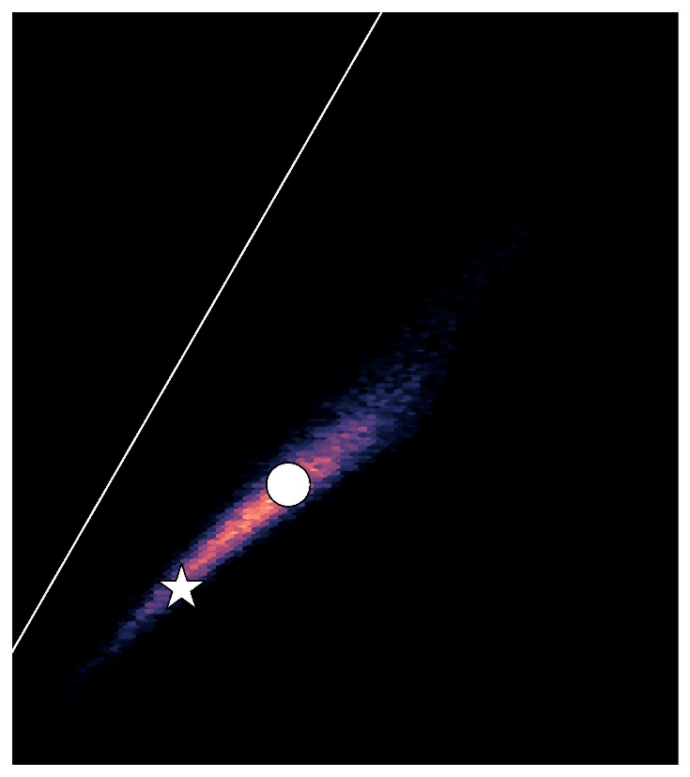
Anistropy in qutrit tomography
Rank distributions
MUB
Rank 2
Rank 1
Rank 3

Slide 24
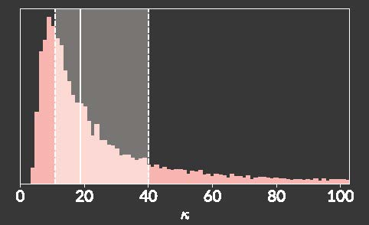
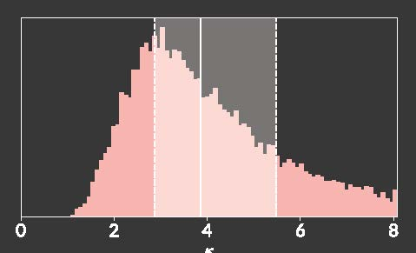
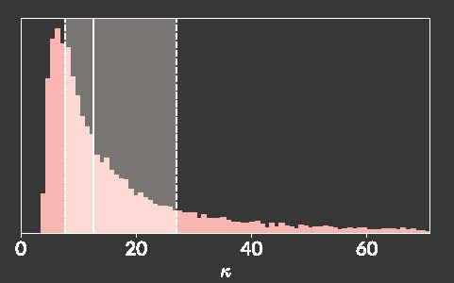
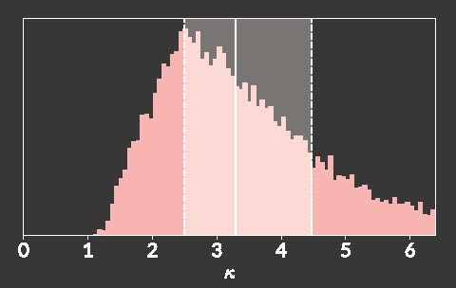
Anistropy in qutrit tomography
Condition numbers
Condition number: ratio of largest to smallest eigenvalue
SIC-POVM
relevant directions
MUB

Slide 25
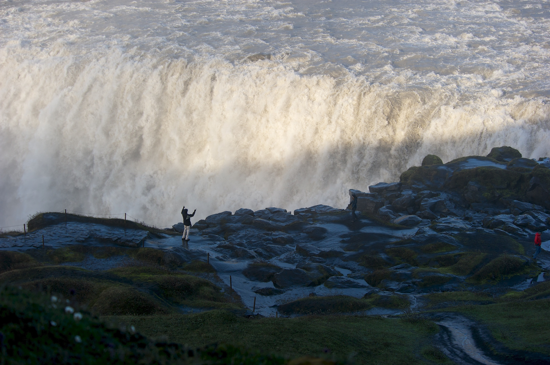
Thanks for your attention.
Dettifoss
Iceland

