Slide 1
Complexity and Disorder at Ultra-Low Temperatures
30th Annual Conference of LANL Center for Nonlinear Studies SantaFe, 2010 June 25
Quantum metrology: Dynamics vs. entanglement
Quantum noise limit and Heisenberg limit
Quantum metrology and resources
Beyond the Heisenberg limit
Two-component BECs for quantum metrology
Carlton M. Caves
Center for Quantum Information and Control
University of New Mexico
http://info.phys.unm.edu/~caves
Collaborators: E. Bagan, S. Boixo, A. Datta, S. Flammia, M. J. Davis,
JM Geremia, G. J. Milburn, A Shaji, A. Tacla, M. J. Woolley

Slide 2

I. Quantum noise limit and Heisenberg limit
View from Cape Hauy
Tasman Peninsula
Tasmania

Slide 3
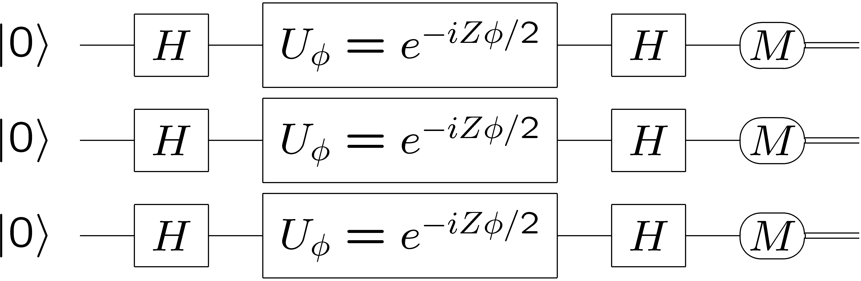
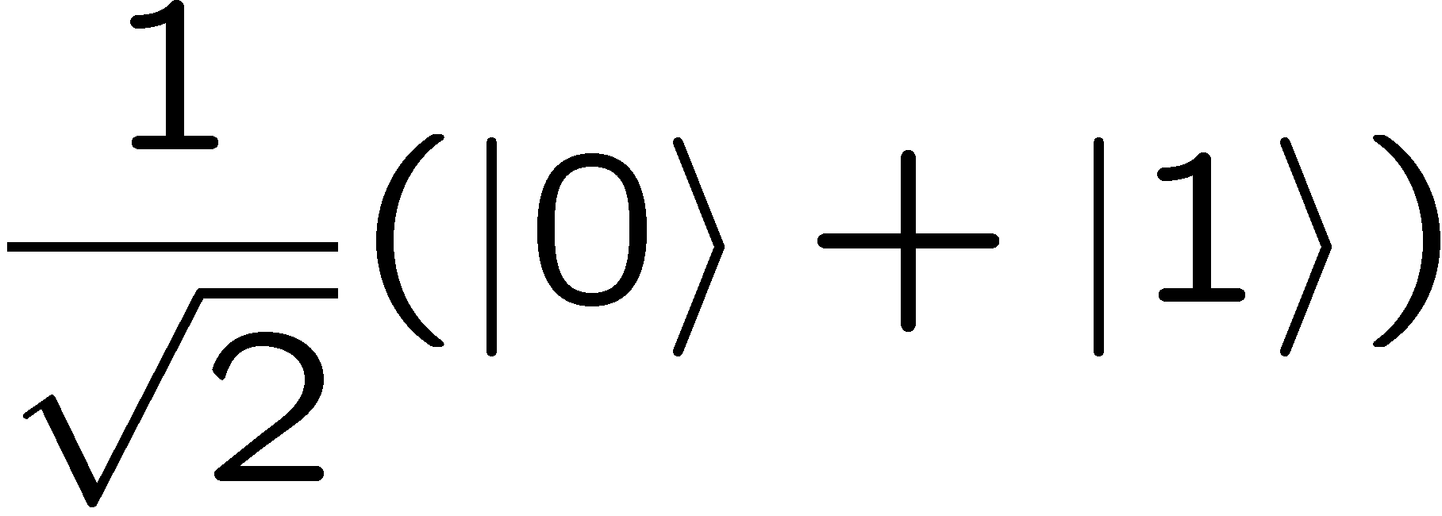
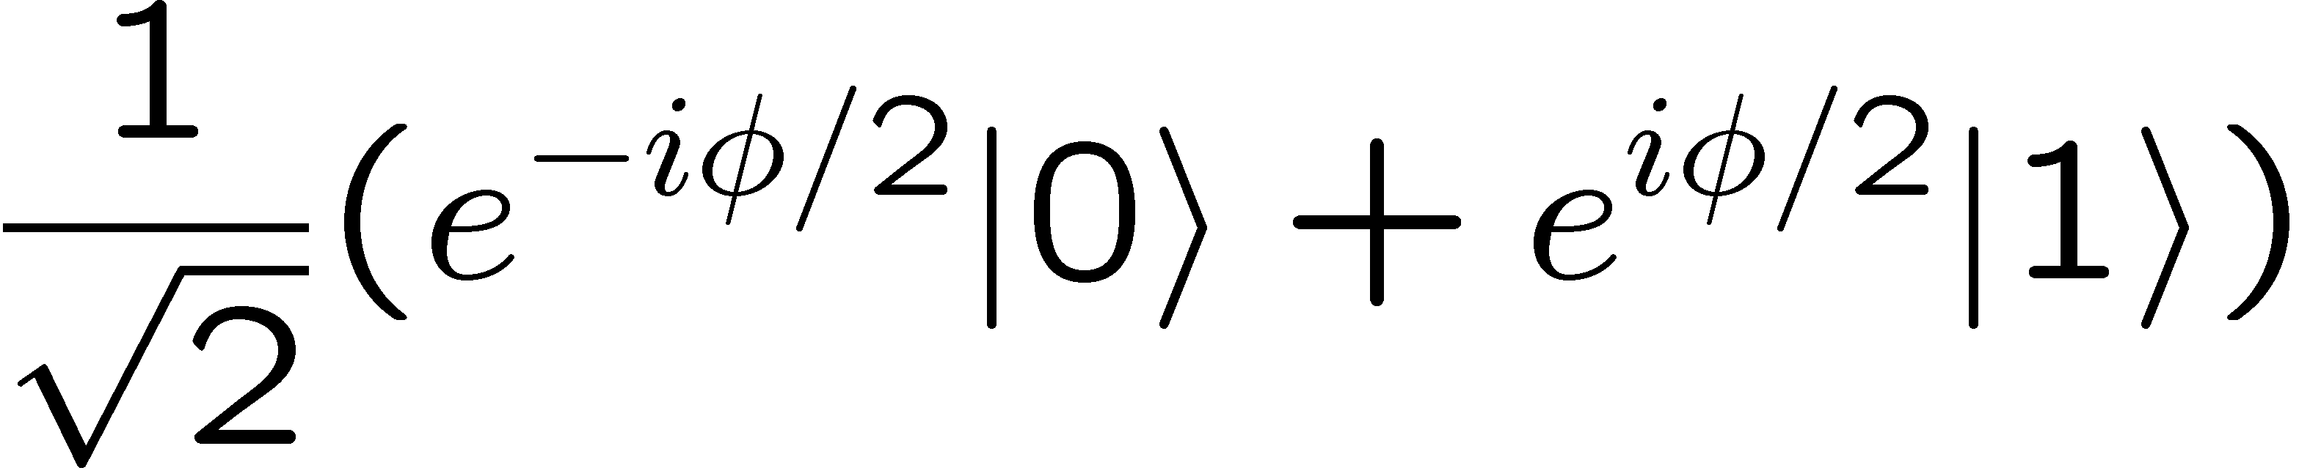
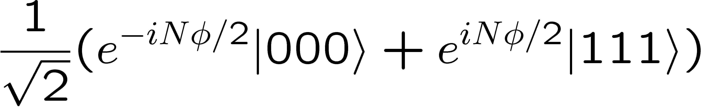
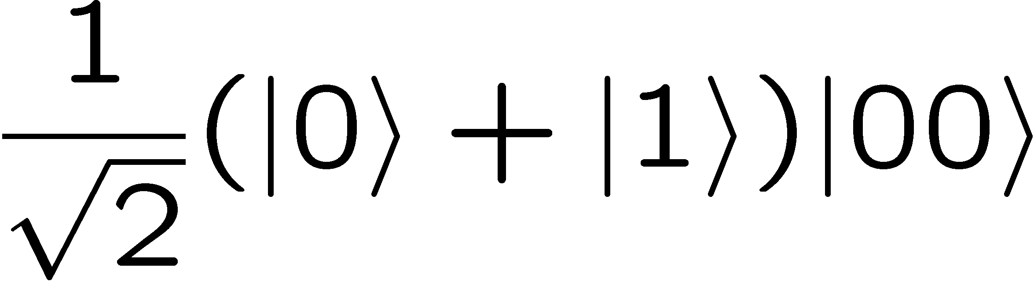
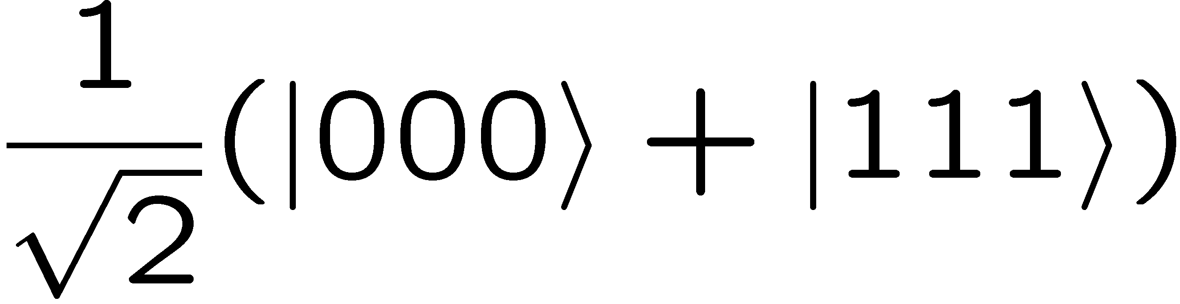
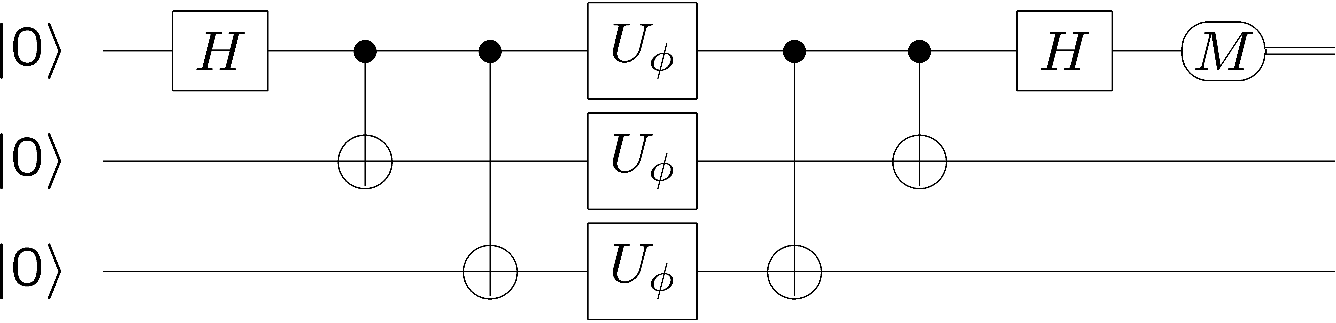
Quantum information version of interferometry
Quantum noise limit
cat state
N = 3
Heisenberg limit
Fringe pattern with period 2π/N

Slide 4
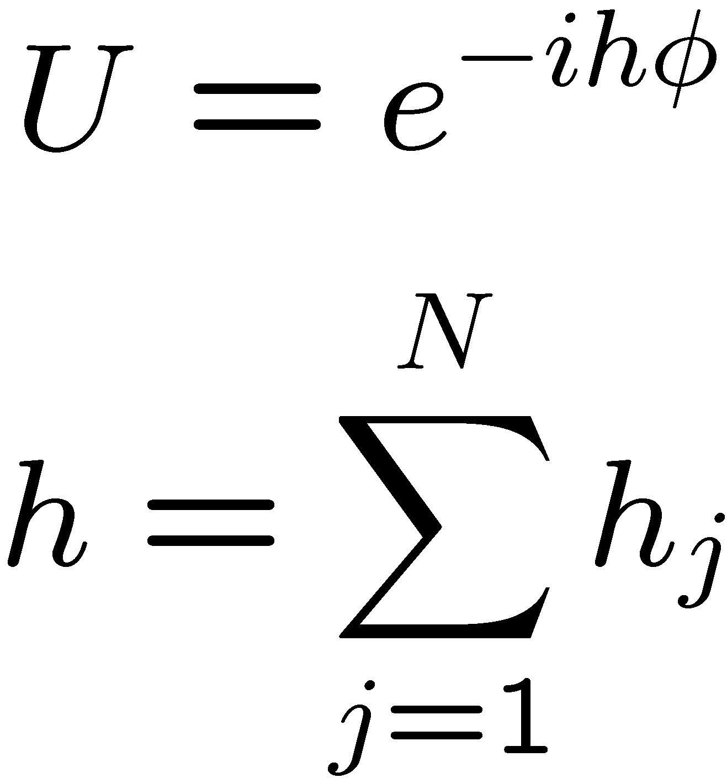
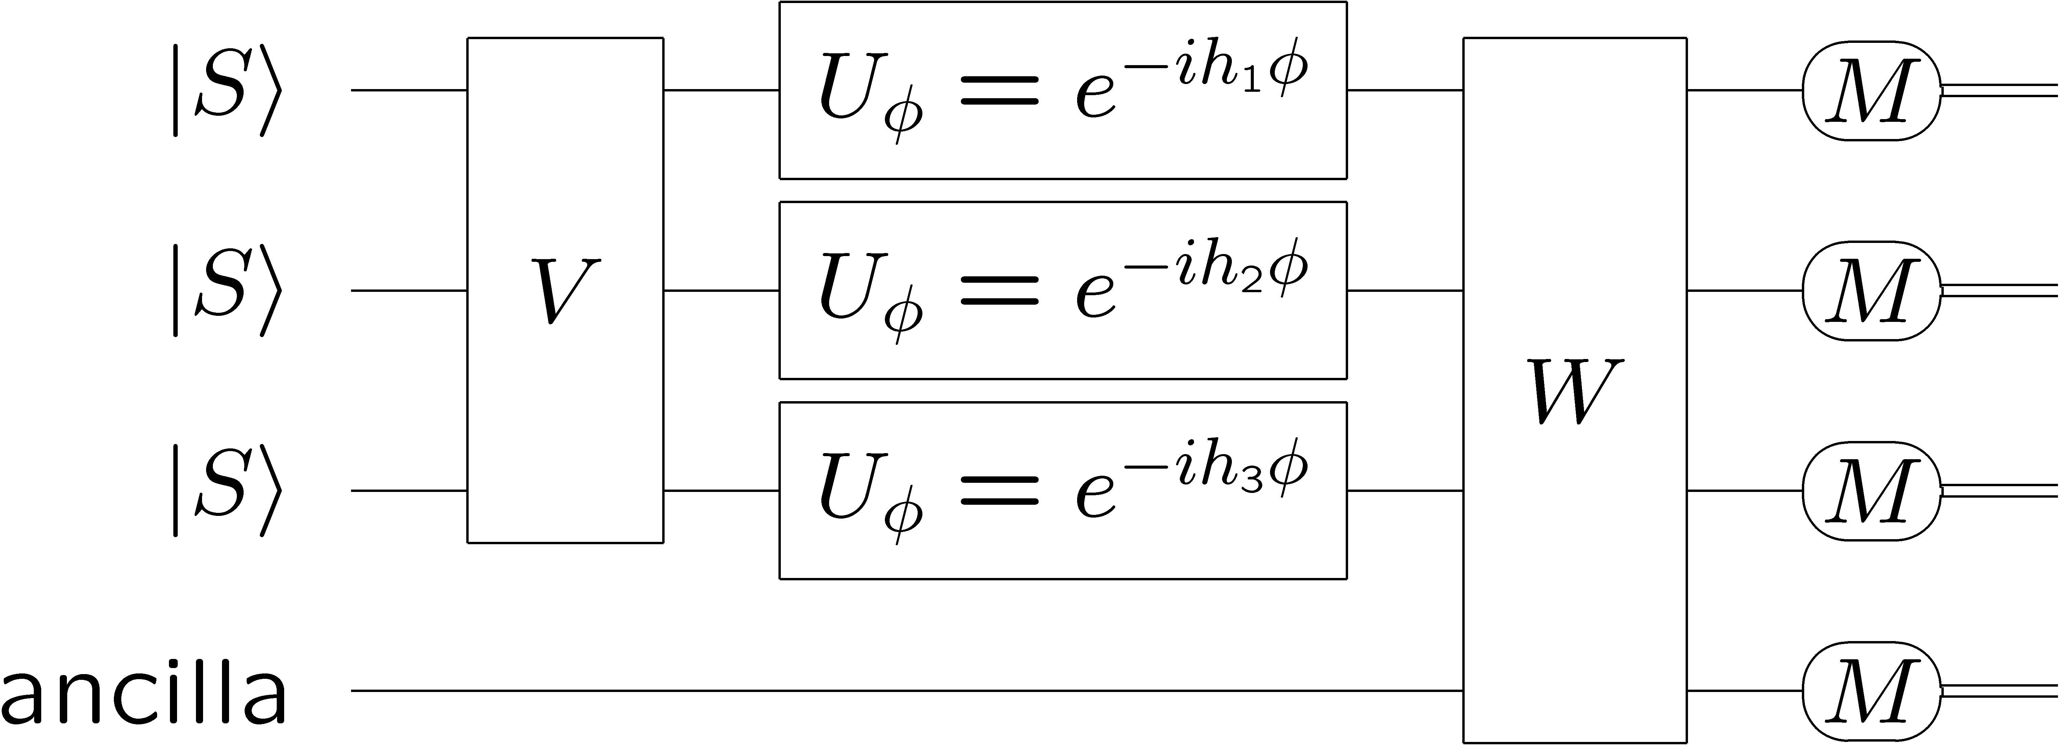
Cat-state interferometer
State
preparation
Measurement
Single-parameter estimation

Slide 5
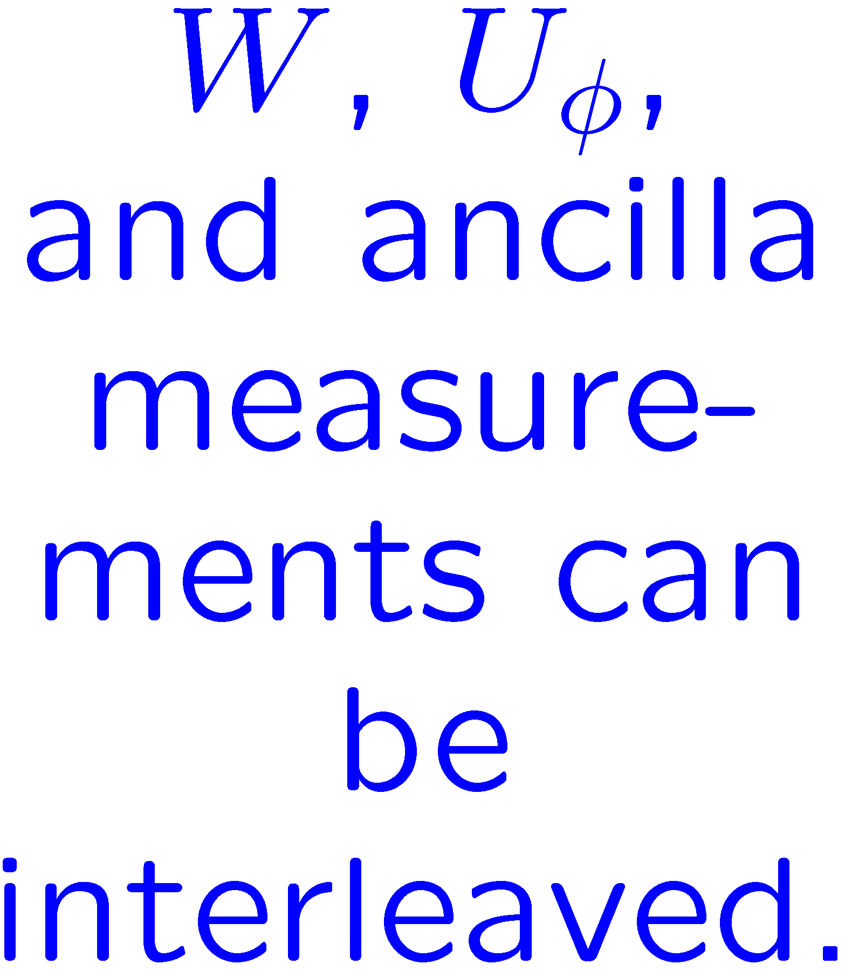
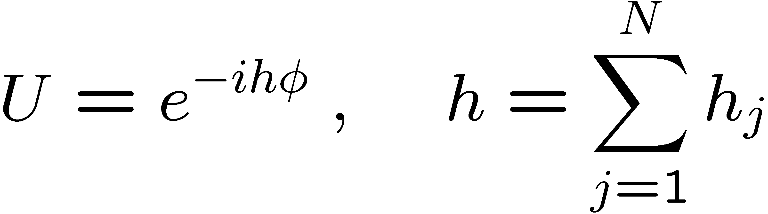
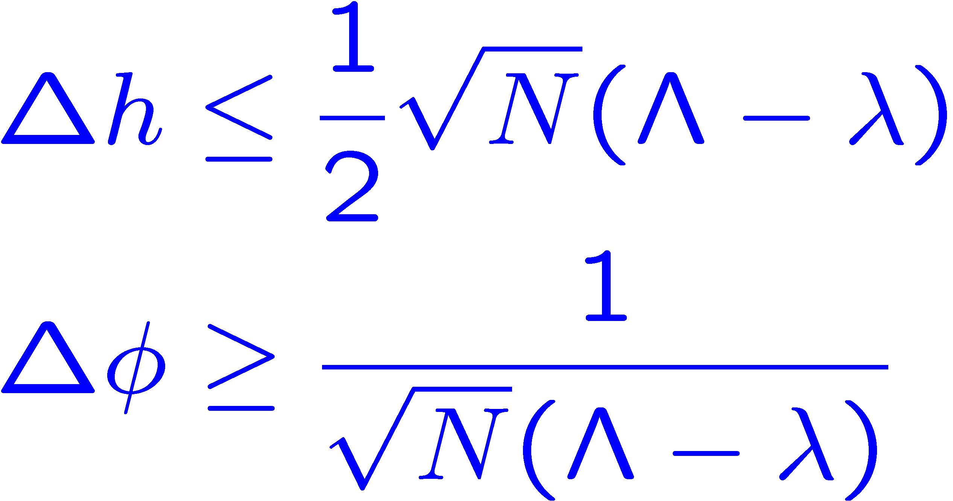
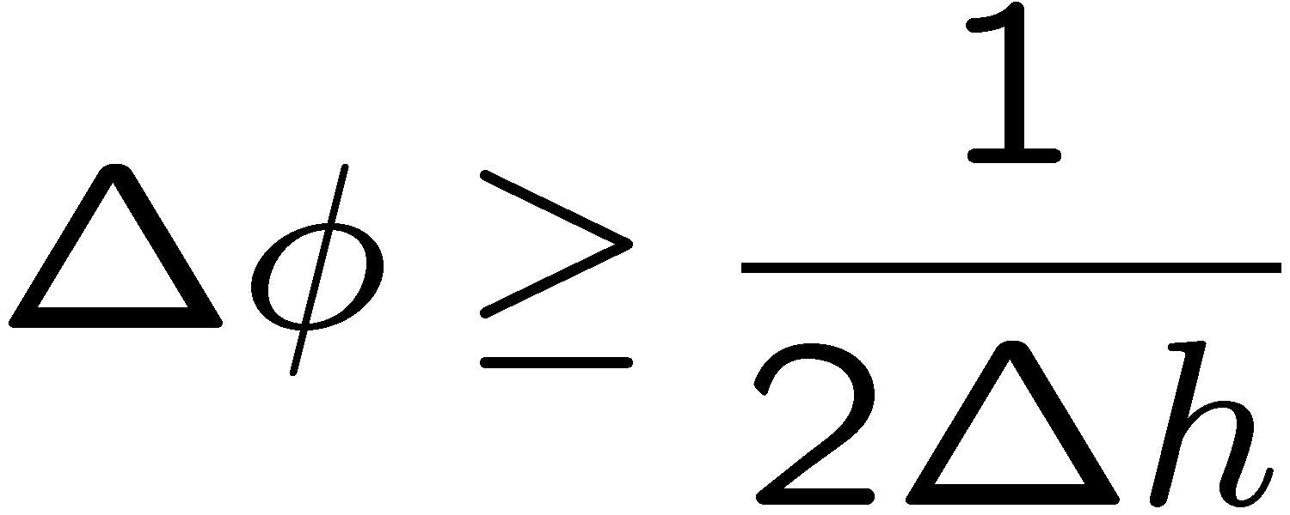
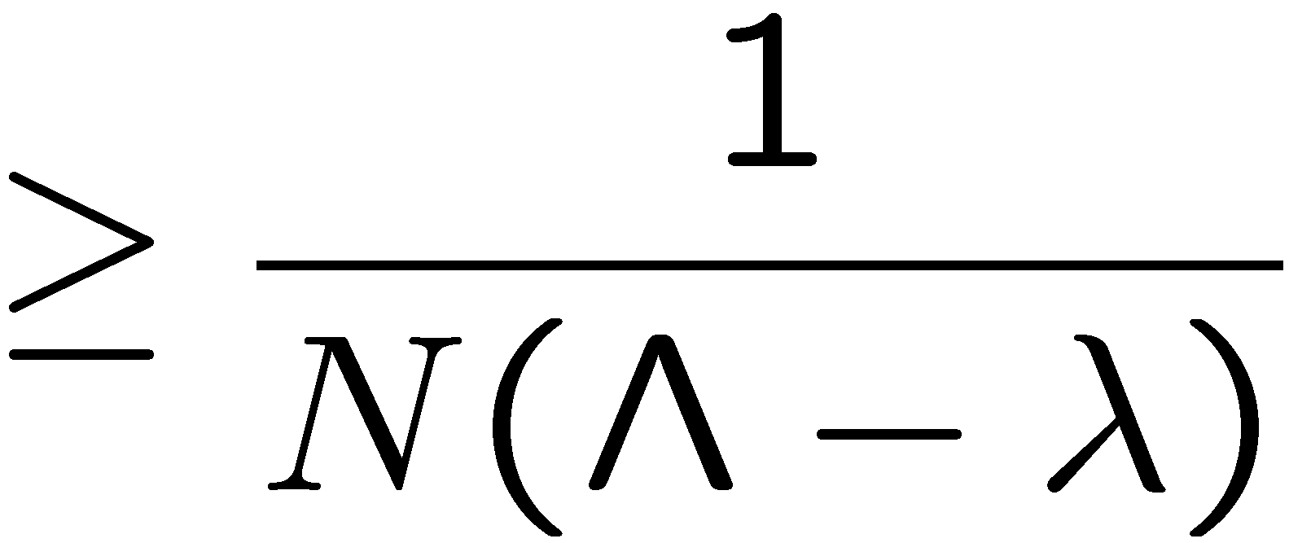
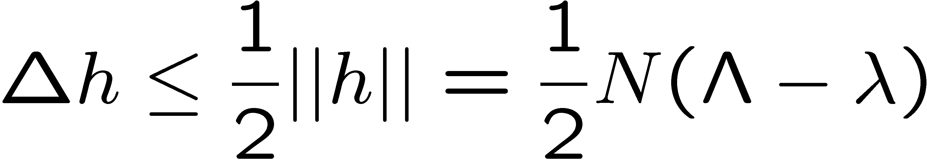
Heisenberg limit
S. L. Braunstein, C. M. Caves, and G. J. Milburn, Ann. Phys. 247, 135 (1996).
V. Giovannetti, S. Lloyd, and L. Maccone, PRL 96, 041401 (2006).
Separable inputs
Generalized
uncertainty principle
(Cramér-Rao bound)

Slide 6
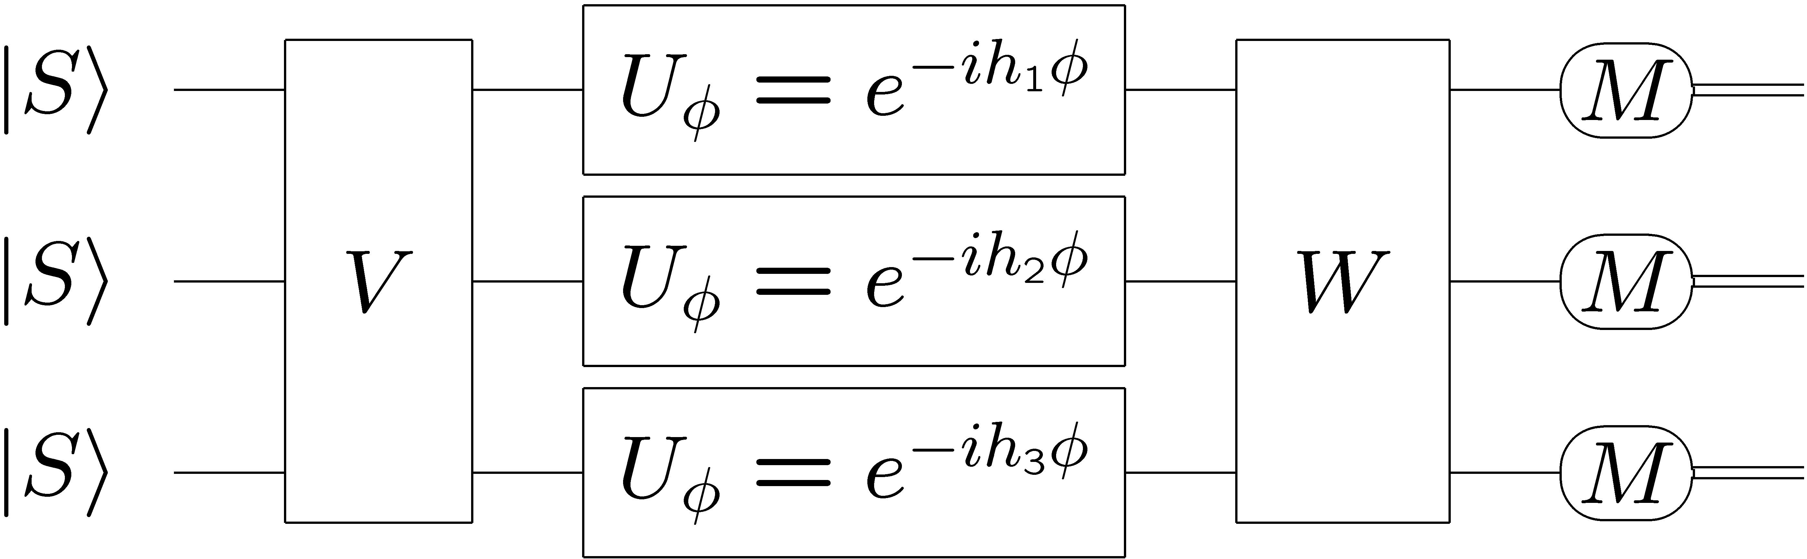
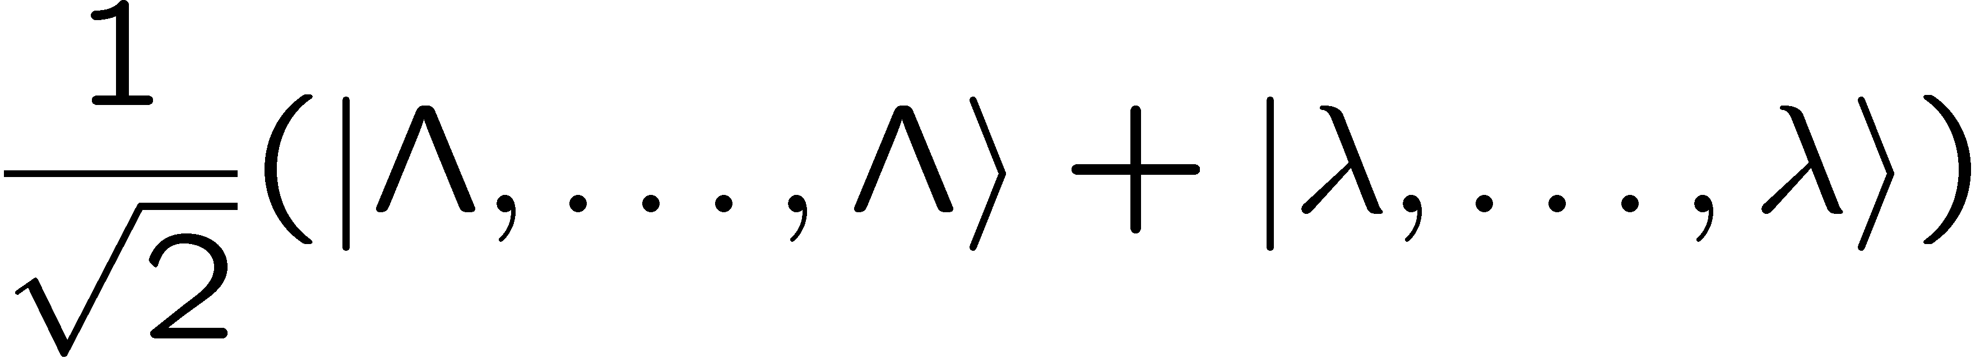
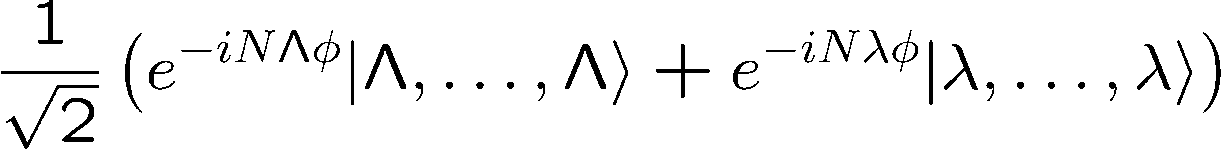
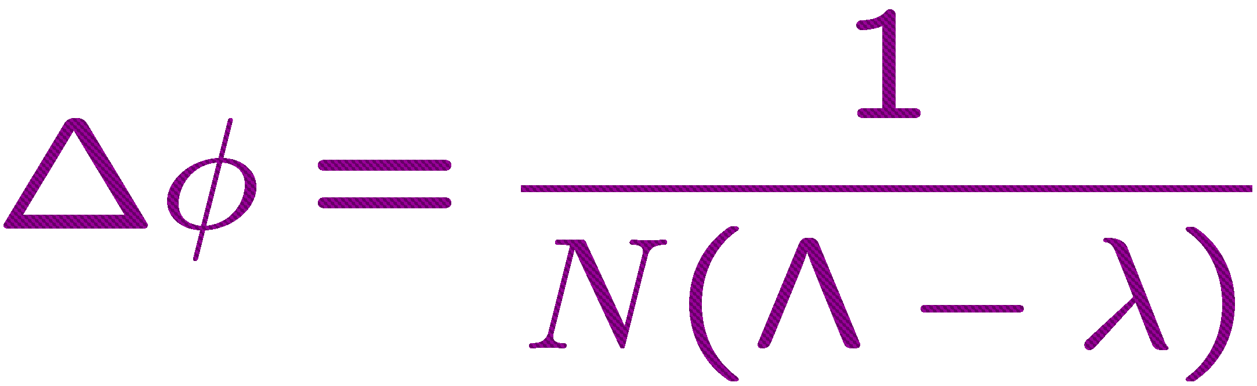

Achieving the Heisenberg limit
cat
state

Slide 7

II. Quantum metrology and resources
Oljeto Wash
Southern Utah

Slide 8
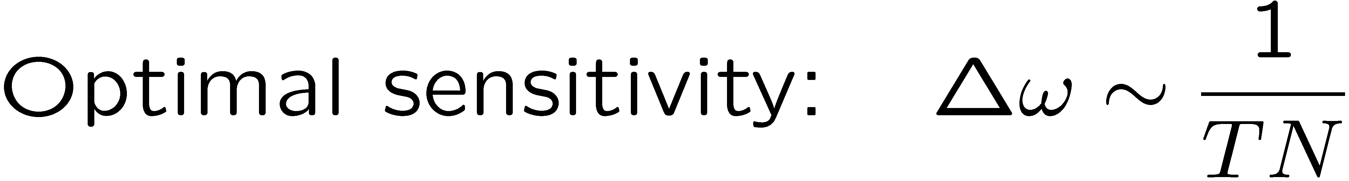
Making quantum limits relevant
The serial resource, T, and the parallel resource, N, are equivalent and interchangeable, mathematically.
The serial resource, T, and the parallel resource, N, are not equivalent and not interchangeable, physically.
Information science perspective
Platform independence
Physics perspective
Distinctions between different physical systems

Slide 9
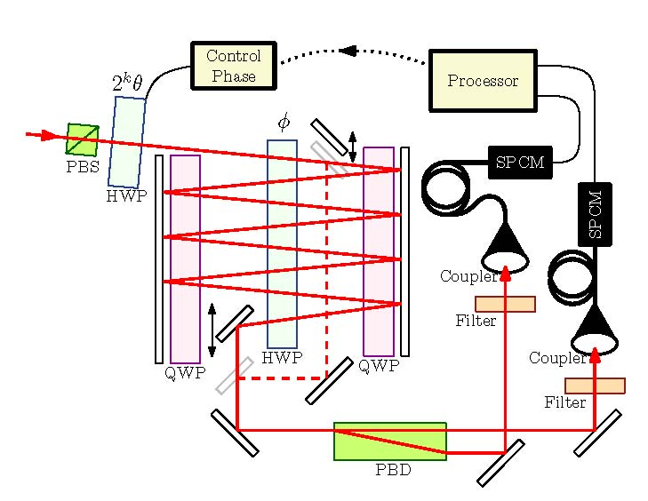
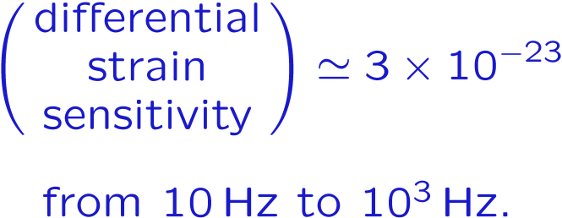
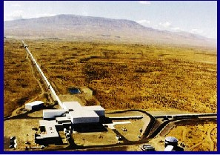

Working on T and N
Laser Interferometer Gravitational Observatory (LIGO)
Advanced LIGO
High-power, Fabry-Perot cavity (multipass), recycling, squeezed-state (?) interferometers
B. L. Higgins, D. W. Berry, S. D. Bartlett, M. W. Mitchell, H. M. Wiseman, and G. J. Pryde, “Heisenberg-limited phase estimation without entanglement or adaptive measurements,” arXiv:0809.3308 [quant-ph].
Livingston, Louisiana
Hanford, Washington

Slide 10
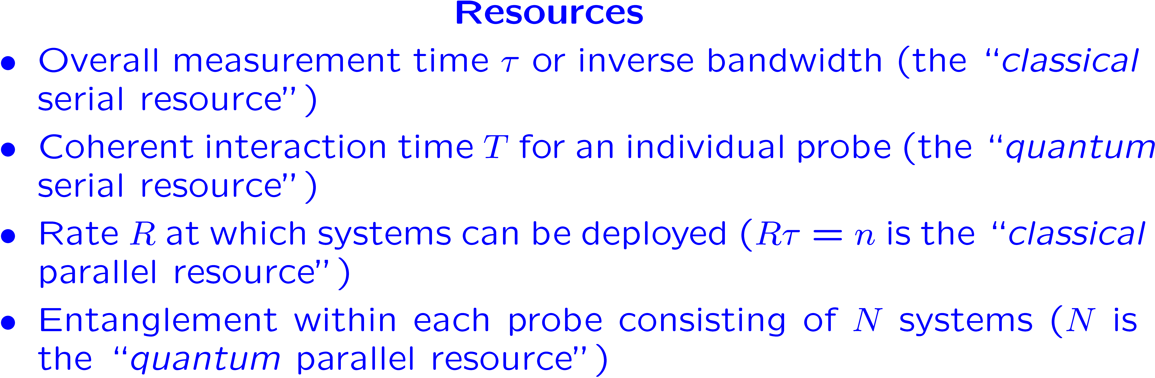
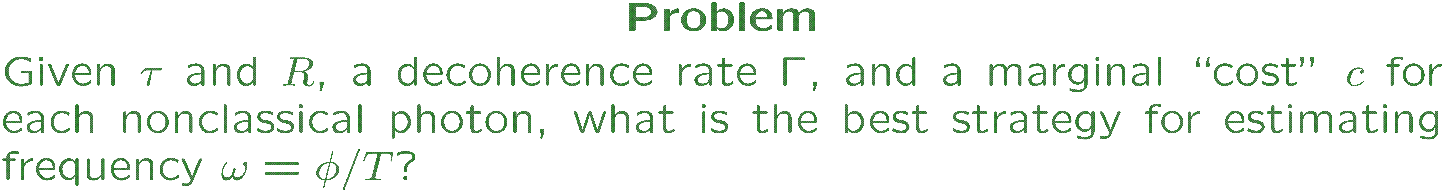
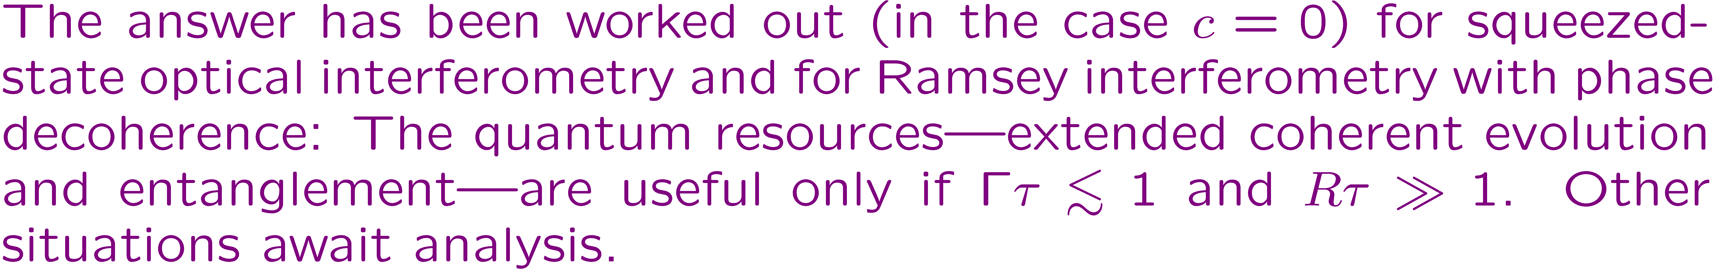
Making quantum limits relevant. One metrology story

Slide 11

III. Beyond the Heisenberg limit
Truchas from East Pecos Baldy
Sangre de Cristo Range
Northern New Mexico

Slide 12
Beyond the Heisenberg limit
The purpose of theorems in physics is to lay out the assumptions clearly so one can discover which assumptions have to be violated.

Slide 13
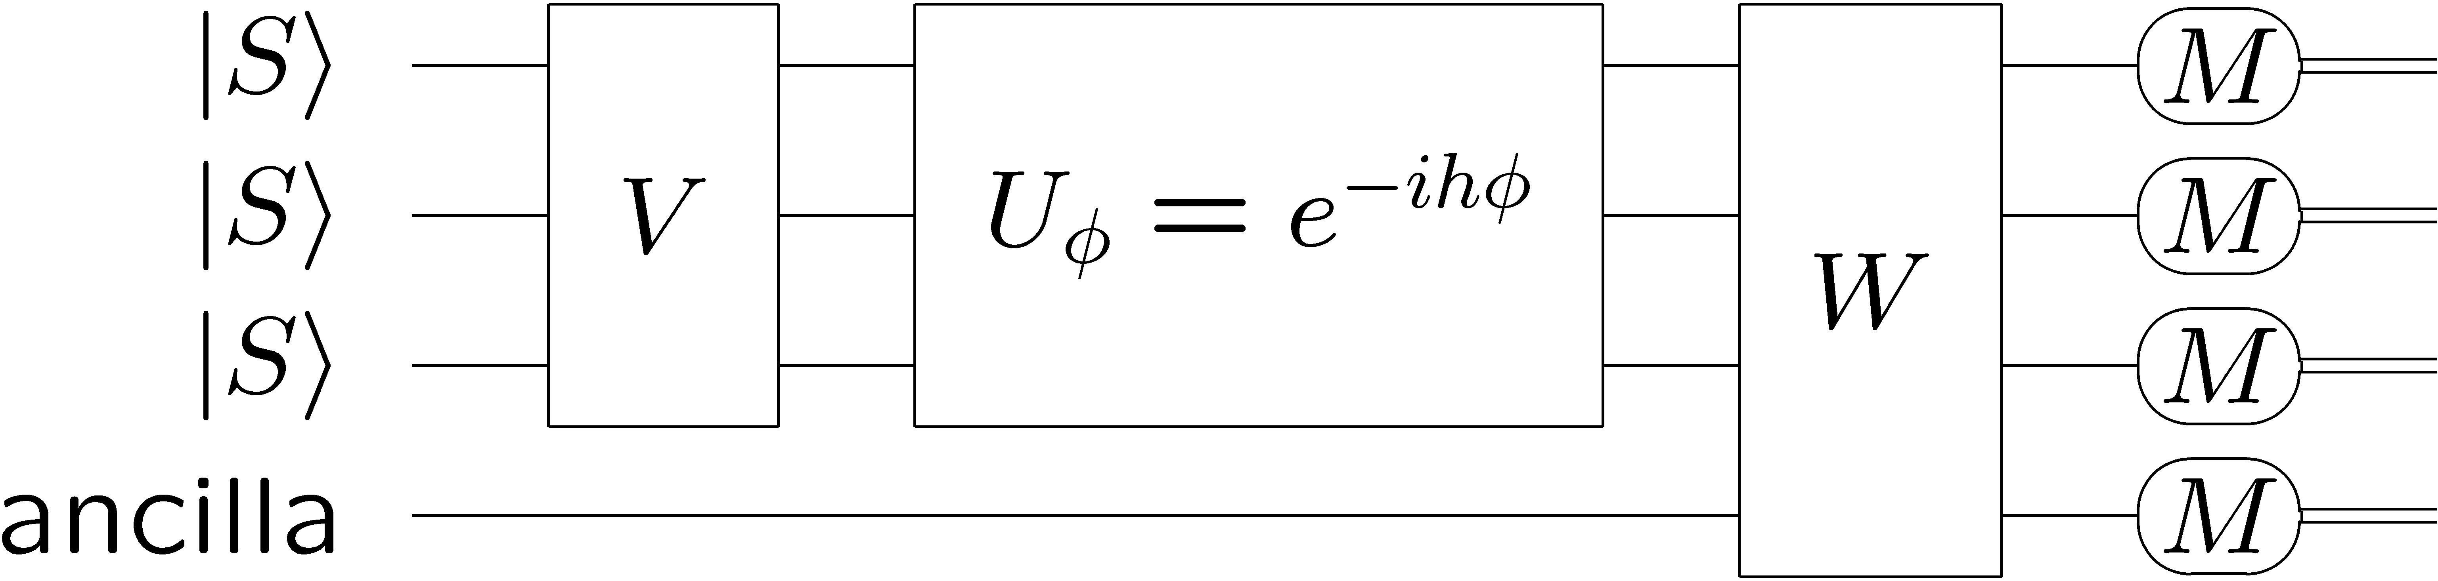
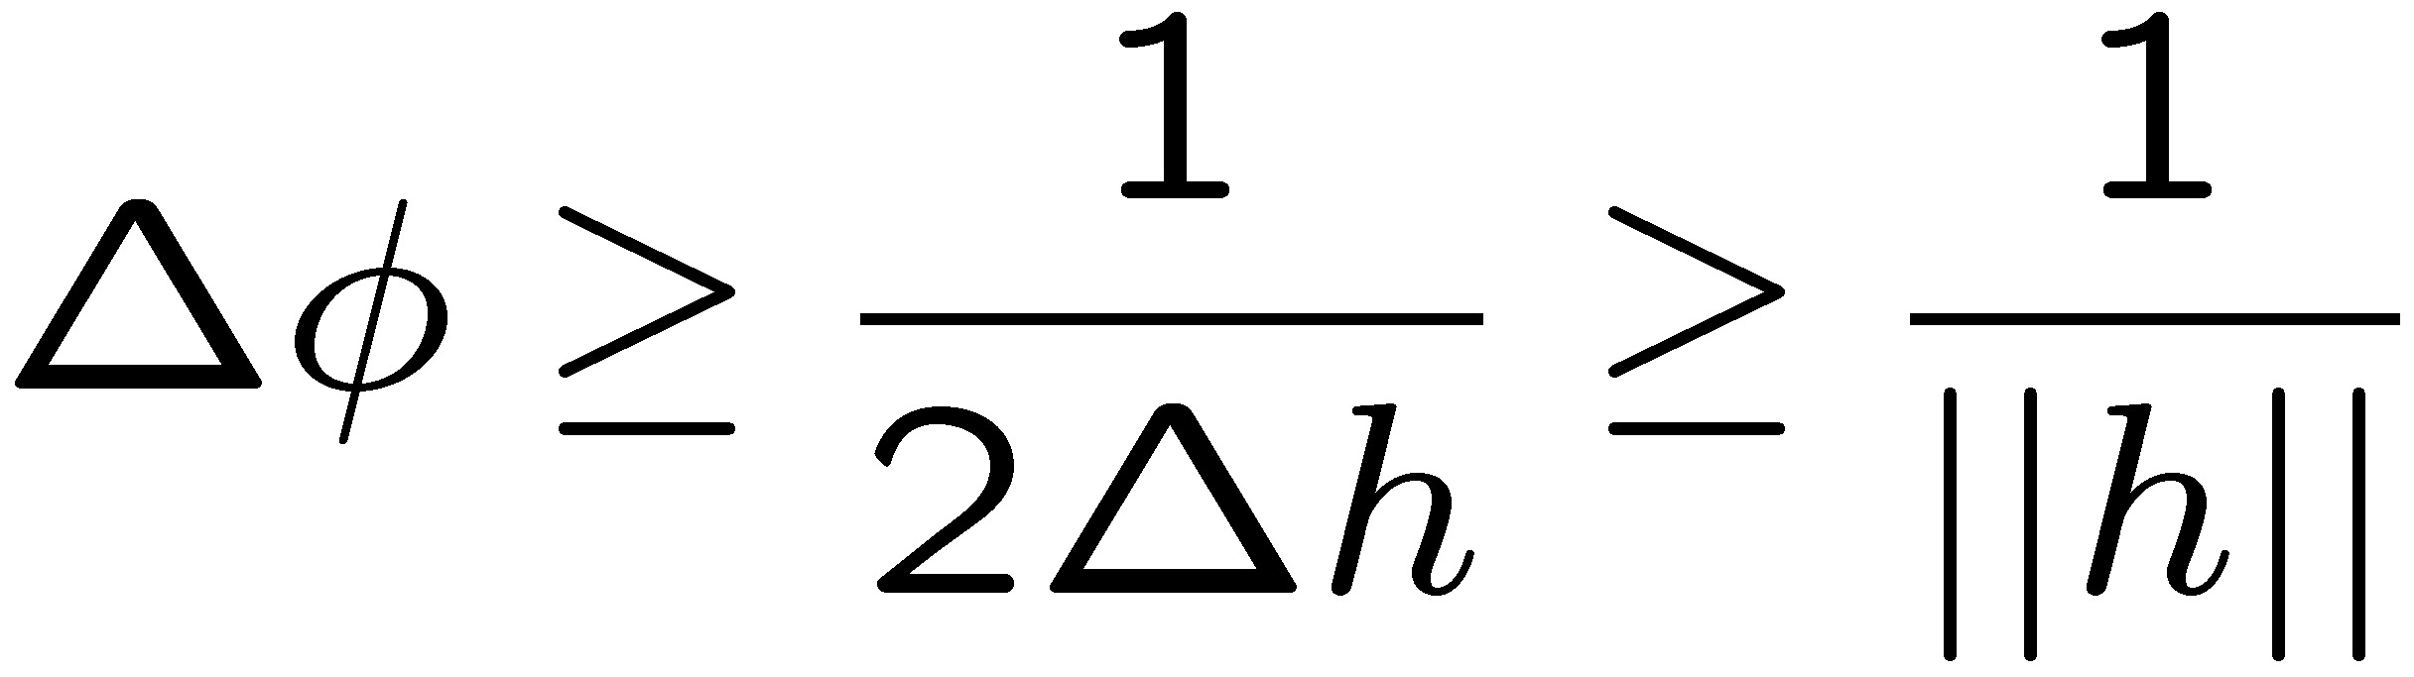
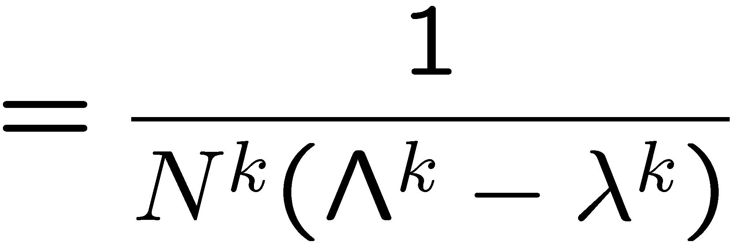
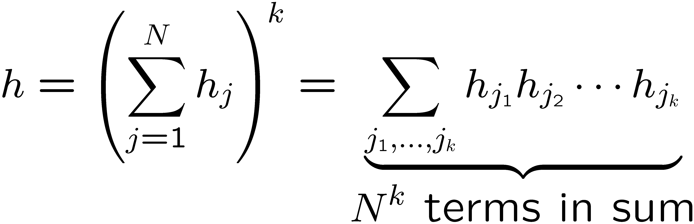
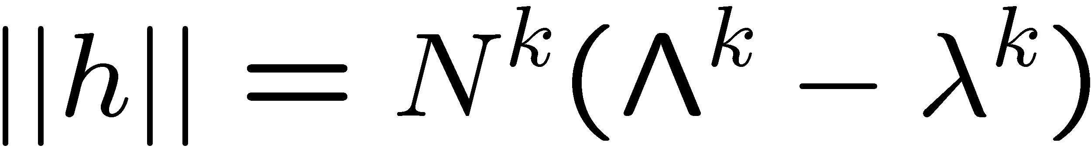
Improving the scaling with N
S. Boixo, S. T. Flammia, C. M. Caves, and
JM Geremia, PRL 98, 090401 (2007).
Cat state does the job.
Nonlinear Ramsey interferometry
Metrologically relevant k-body coupling

Slide 14
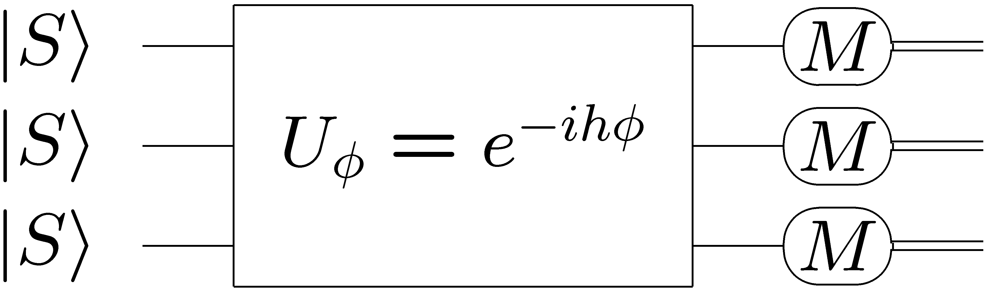
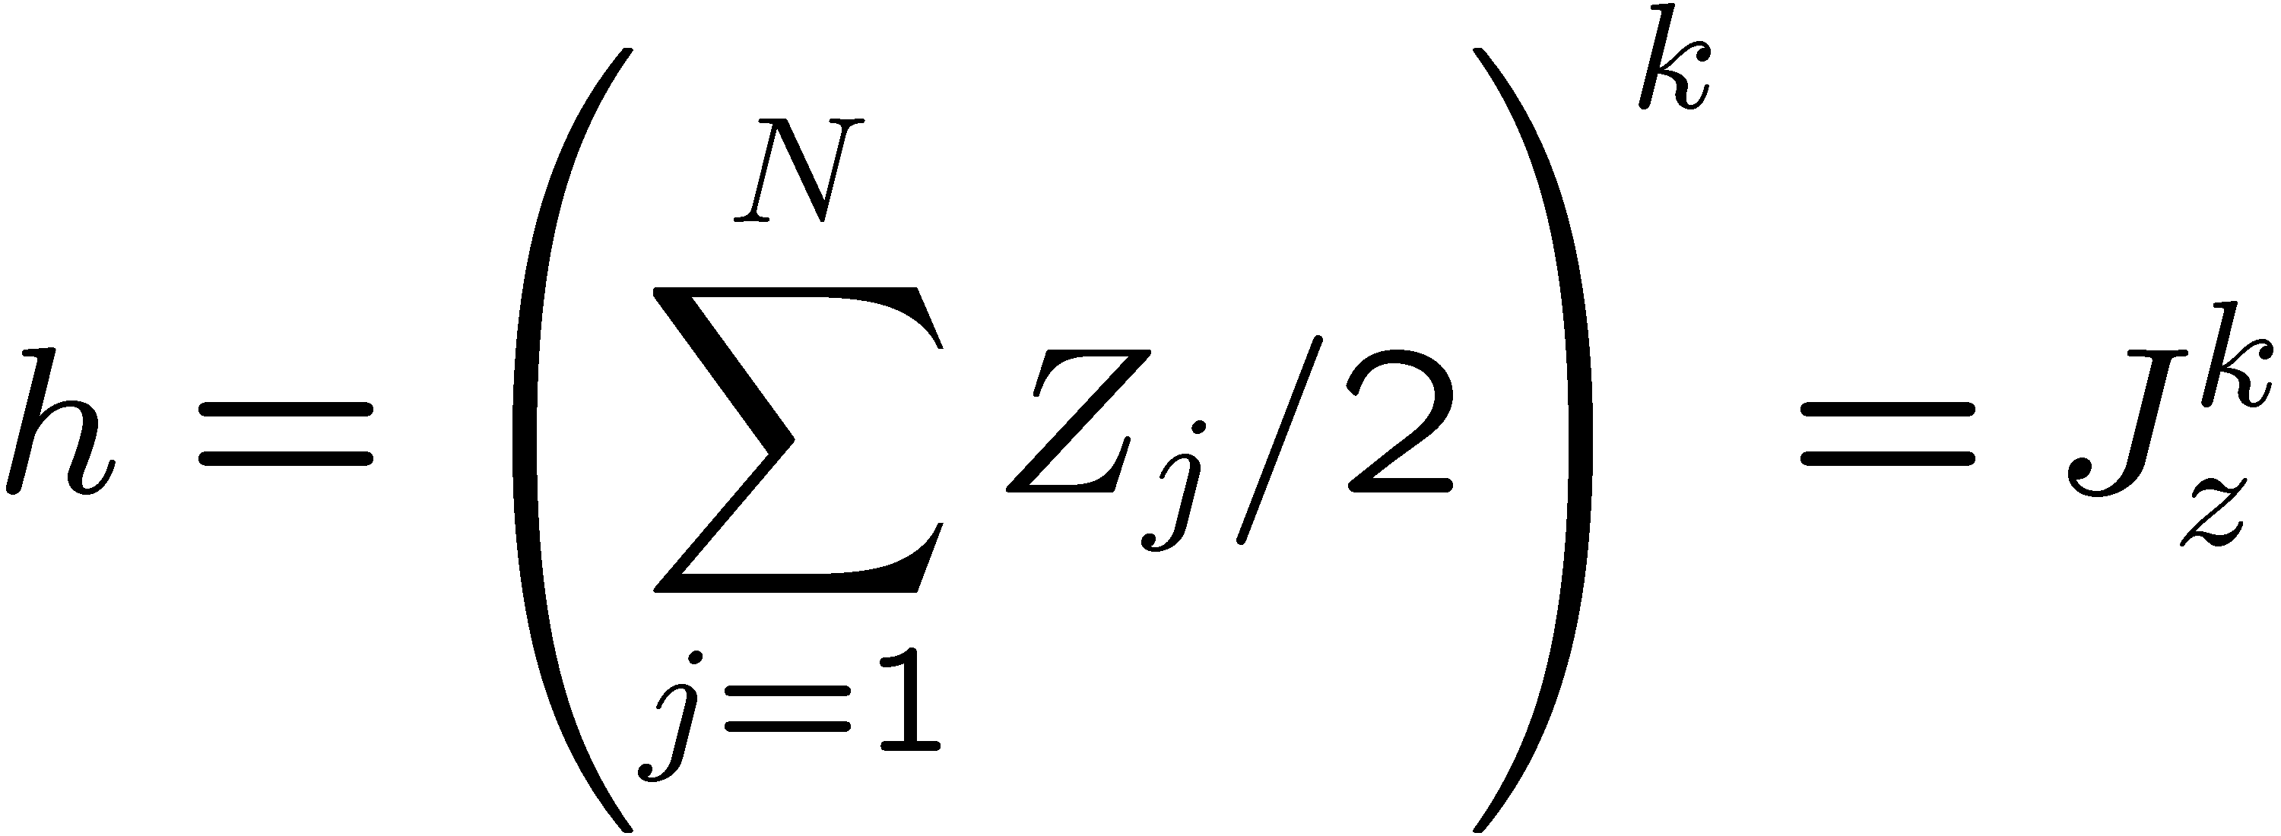
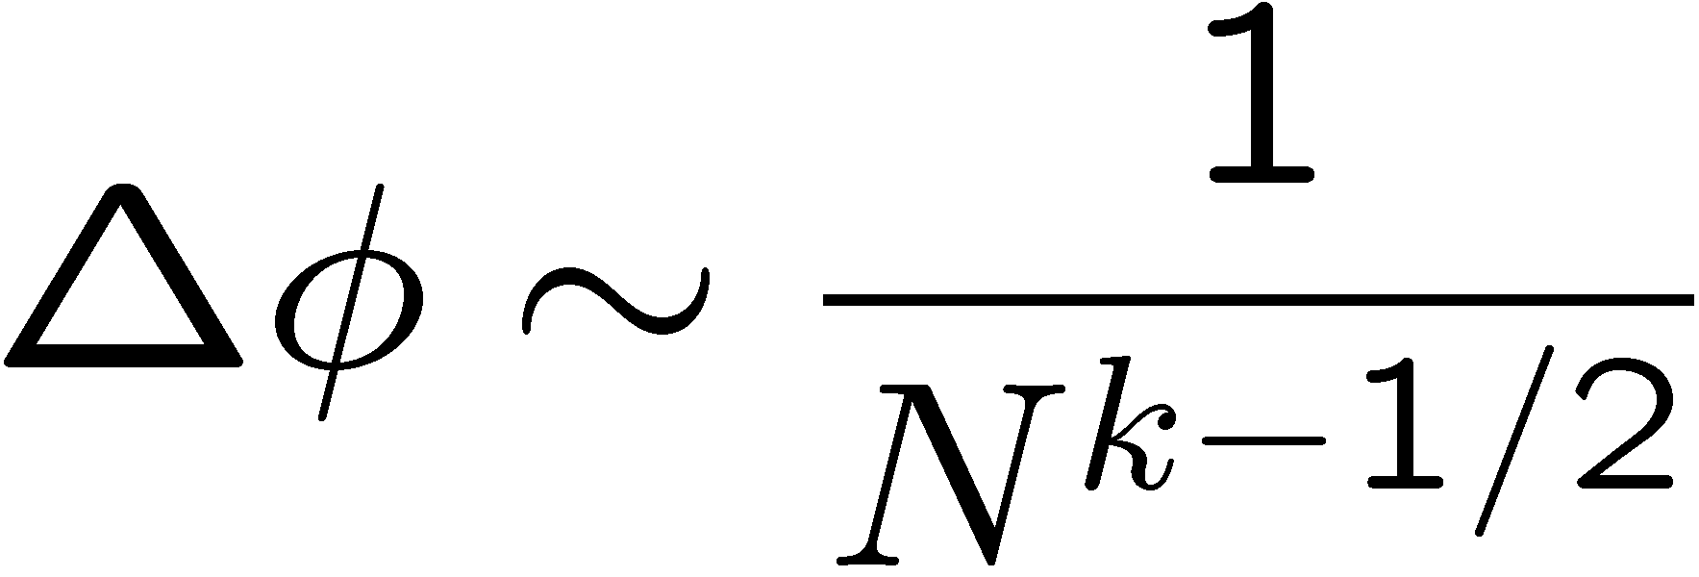
Improving the scaling with N without entanglement
S. Boixo, A. Datta, S. T. Flammia, A. Shaji, E. Bagan, and C. M. Caves, PRA 77, 012317 (2008).
Product
input
Product
measurement

Slide 15
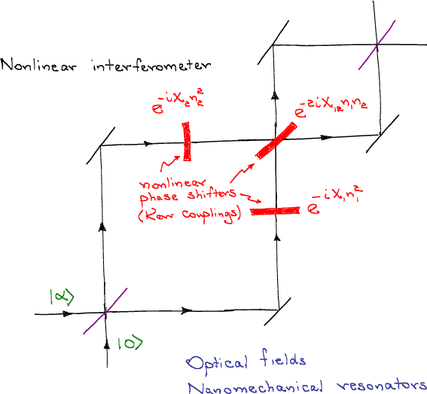
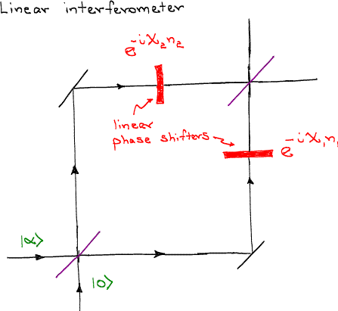
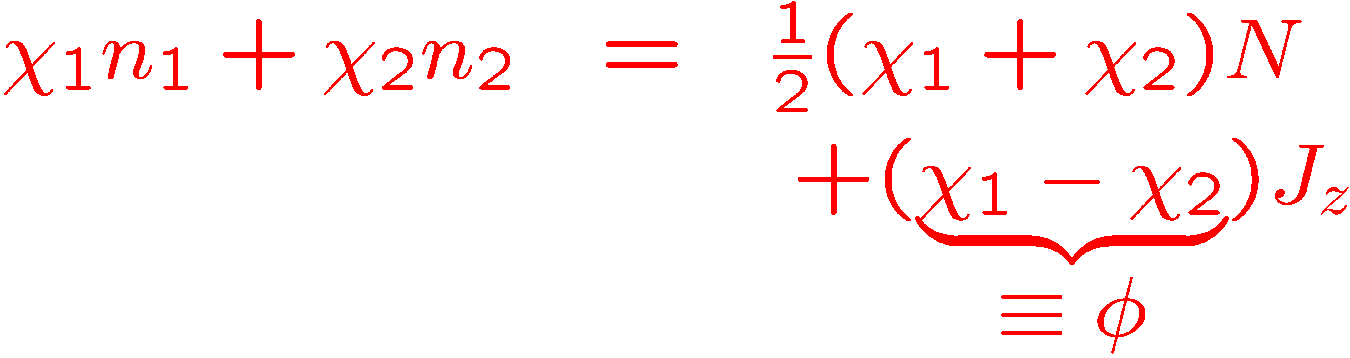
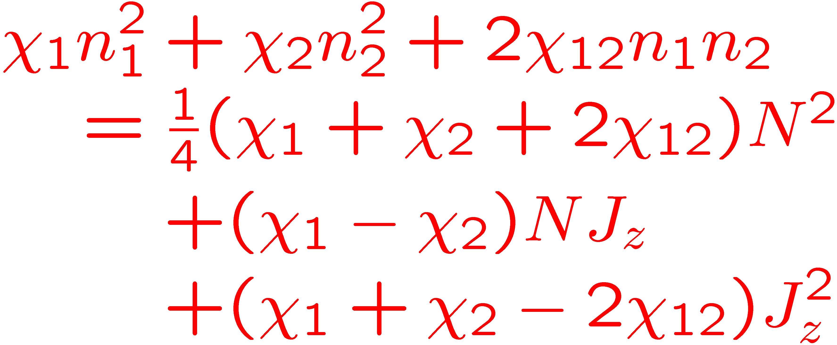
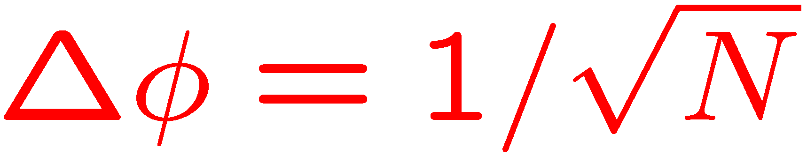
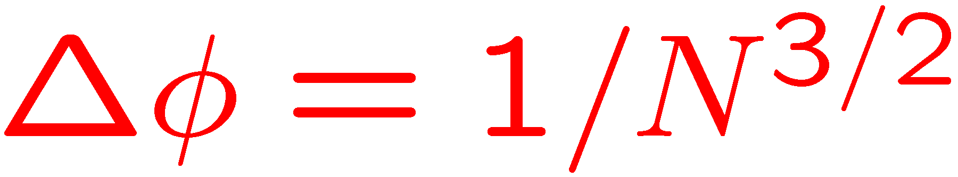
Improving the scaling with N without entanglement. Two-body couplings
S. Boixo, A. Datta, S. T. Flammia, A. Shaji, E. Bagan, and C. M. Caves, PRA 77, 012317 (2008); M. J. Woolley, G. J. Milburn, and C. M. Caves, NJP 10, 125018 (2008);

Slide 16
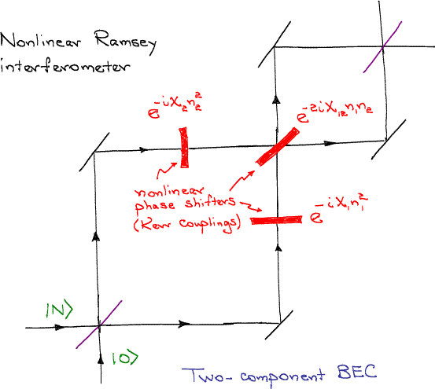
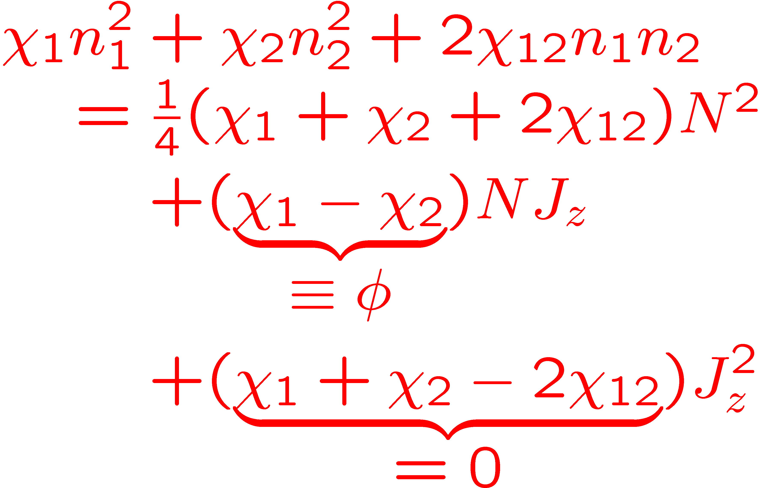
Improving the scaling with N without entanglement. Two-body couplings
Super-Heisenberg scaling from nonlinear dynamics, without any particle entanglement
Scaling robust against decoherence
S. Boixo, A. Datta, M. J. Davis, S. T. Flammia, A. Shaji, and C. M. Caves, PRL 101, 040403 (2008); S. Boixo, A. Datta, M. J. Davis, A. Shaji, A. B. Tacla, and C. M. Caves,PRA 80, 032103 (2009).

Slide 17

Two-component BECs
for quantum metrology
Czarny Staw Gąsienicowy
Tatras
Poland

Slide 18
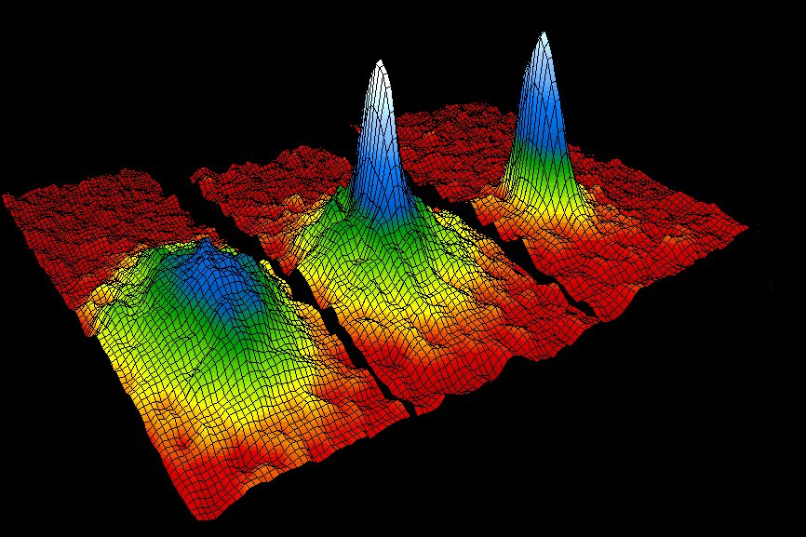
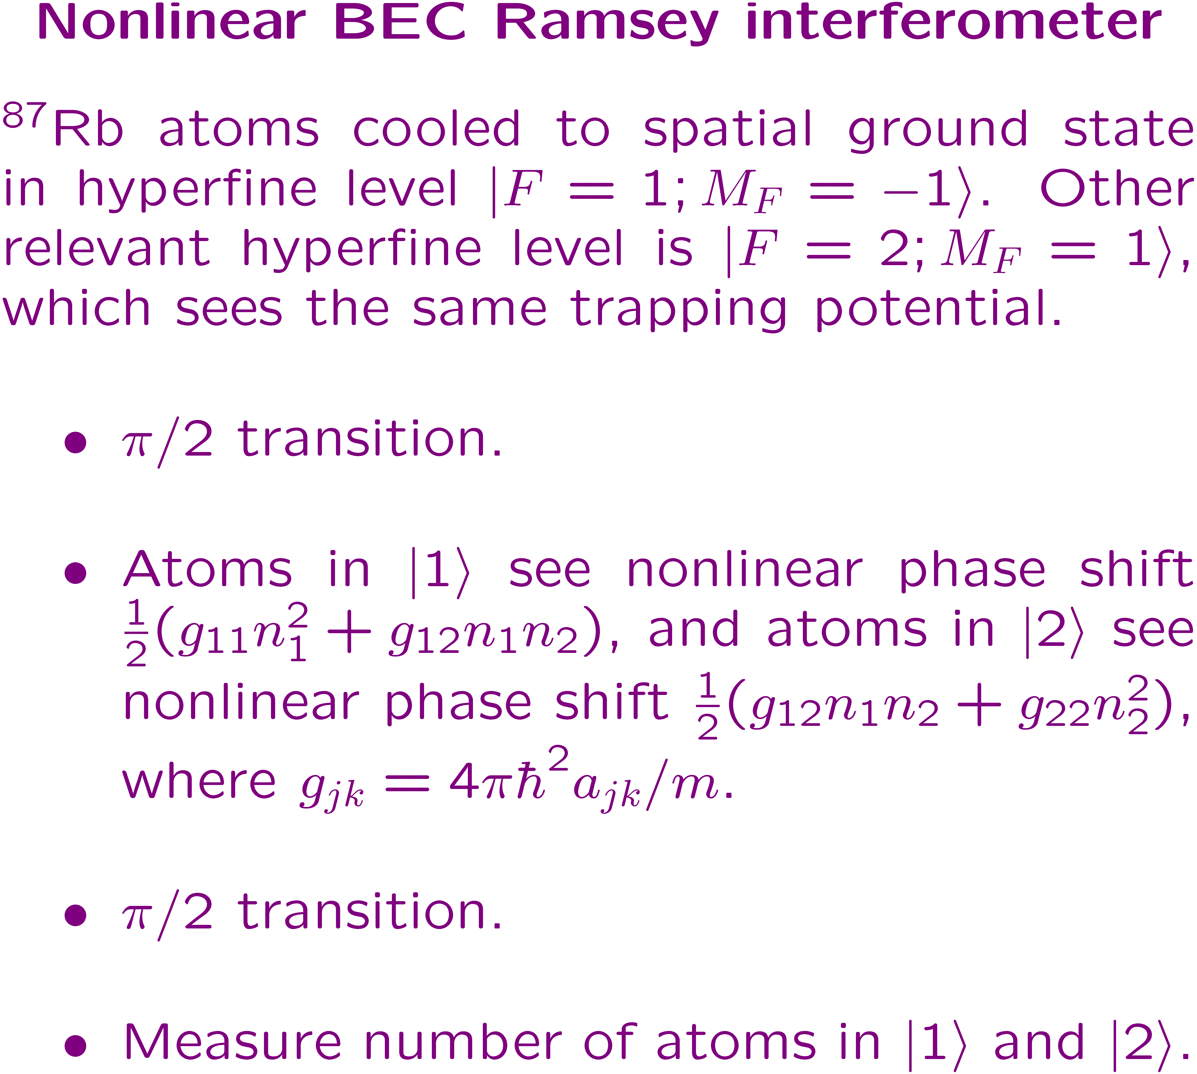
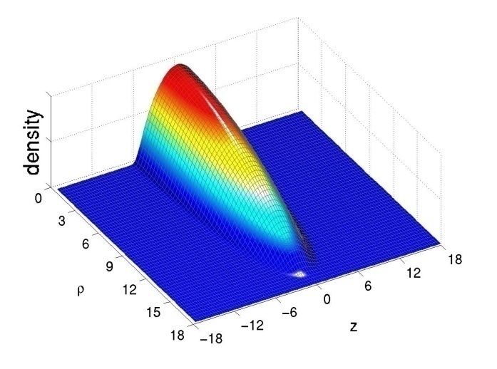
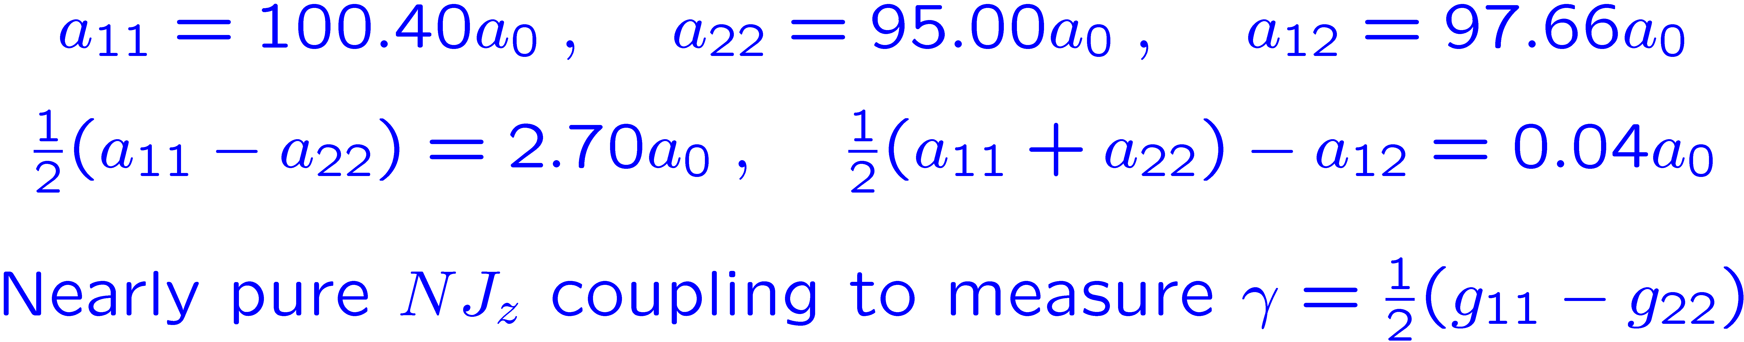
Two-component BECs
S. Boixo, A. Datta, M. J. Davis, S. T. Flammia, A. Shaji, and C. M. Caves, PRL 101, 040403 (2008); S. Boixo, A. Datta, M. J. Davis, A. Shaji, A. B. Tacla, and C. M. Caves, PRA 80, 032103 (2009).

Slide 19
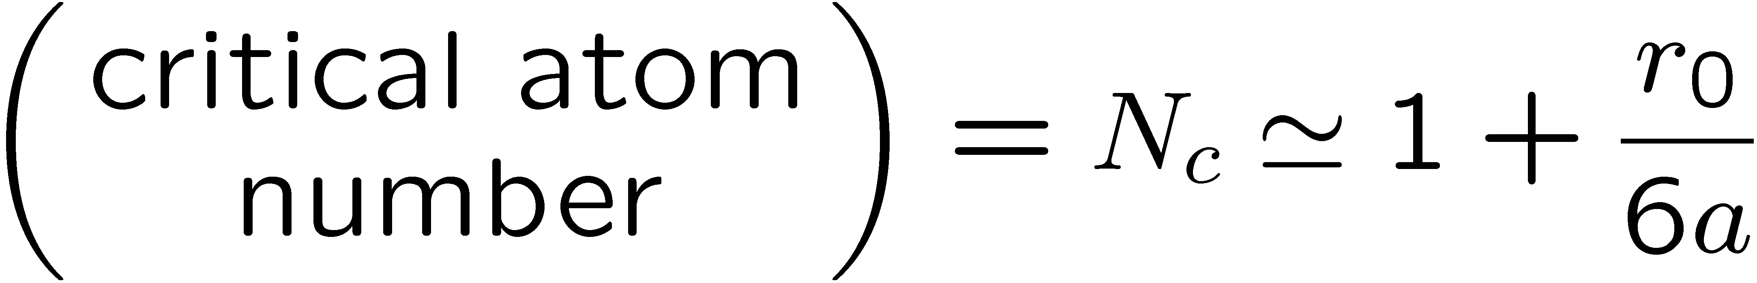
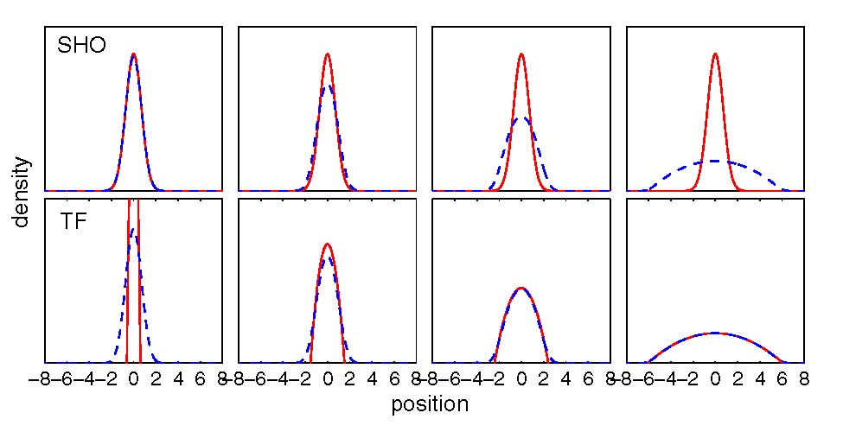

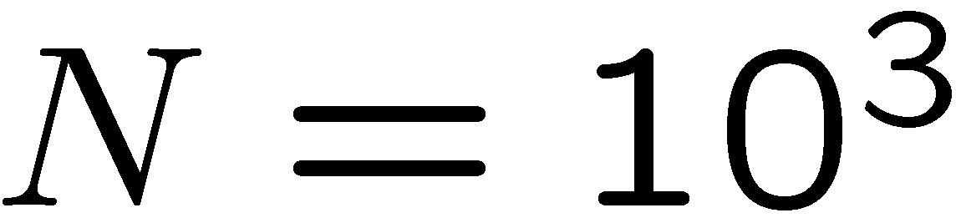

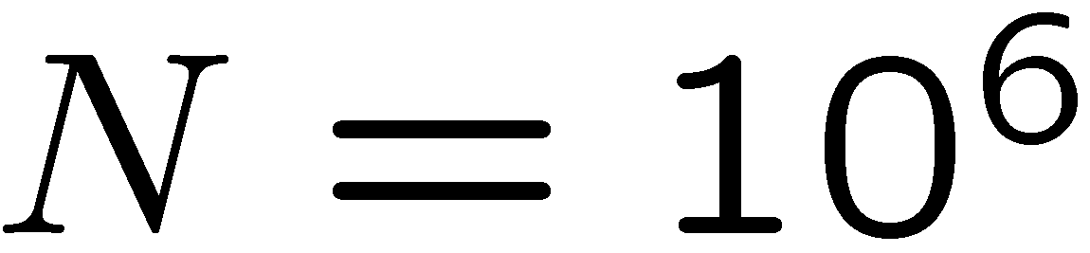
Two-component BECs
J. E. Williams, PhD dissertation, University of Colorado, 1999.

Slide 20



Two-component BECs
Renormalization of scattering strength
Let’s start over.

Slide 21




Two-component BECs
Renormalization of scattering strength

Slide 22






Two-component BECs:
Renormalization of scattering strength
A. B. Tacla, S. Boixo, A. Datta, A. Shaji, and C. M. Caves, “Nonlinear interferometry with Bose-Einstein condensates,” in preparation.

Slide 23

Two-component BECs
Renormalization of scattering strength
Integrated vs. position-dependent phase

Slide 24


Two-component BECs:
Integrated vs. position-dependent phase
A. B. Tacla, S. Boixo, A. Datta, A. Shaji, and C. M. Caves, “Nonlinear interferometry with Bose-Einstein condensates,” in preparation.

Slide 25
Two-component BECs for quantum metrology
? Perhaps ?
With hard, low-dimensional trap or ring
Losses ?
Counting errors ?
Measuring a metrologically relevant parameter ?
S. Boixo, A. Datta, M. J. Davis, A. Shaji, A. B. Tacla, and C. M. Caves, PRA 80, 032103 (2009); A. B. Tacla, S. Boixo, A. Datta, A. Shaji, and C. M. Caves, “Nonlinear interferometry with Bose-Einstein condensates,” in preparation.

