Slide 1




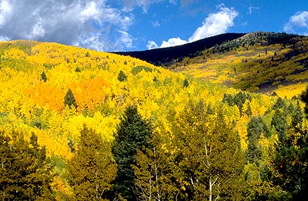
What the #$*! Do We (K)now!?
about Quantum Mechanics
Carlton M. Caves
Center for Quantum Information and Control
University of New Mexico
http://info.phys.unm.edu/~caves
Center for Quantum Information and Control
View from Cape Hauy
Tasman Peninsula,Tasmania
Aspens in the Sangre de Cristo Range
Northern New Mexico

Slide 2
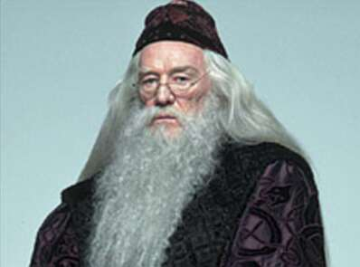
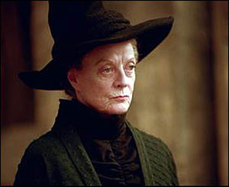
There is magic in the world of the very small.
Use your quantum mechanics, Harry. Feel the quantum reality.
I don’t care if you are at Hogwarts, Harry. You can’t violate the uncertainty principle. Fifty points from Gryffindor.
And that magic is described by quantum mechanics.

Slide 3
Quantum mechanics governs the behavior of the very small, but how small are we talking about?
1 meter m human height
10⁻³ meter millimeter (mm) human hair
size of eukaryotic plant cell
size of eukaryotic animal cell
10⁻⁶ meter micrometer (μm) size of Escherichia coli
wavelength of visible light
thickness of cell membrane
10⁻⁹ meter nanometer (nm) size of amino acid, X-ray wavelength
size of an atom
10⁻¹² meter picometer (pm) gamma-ray wavelength
10⁻¹⁵ meter femtometer (fm) size of atomic nucleus

Slide 4
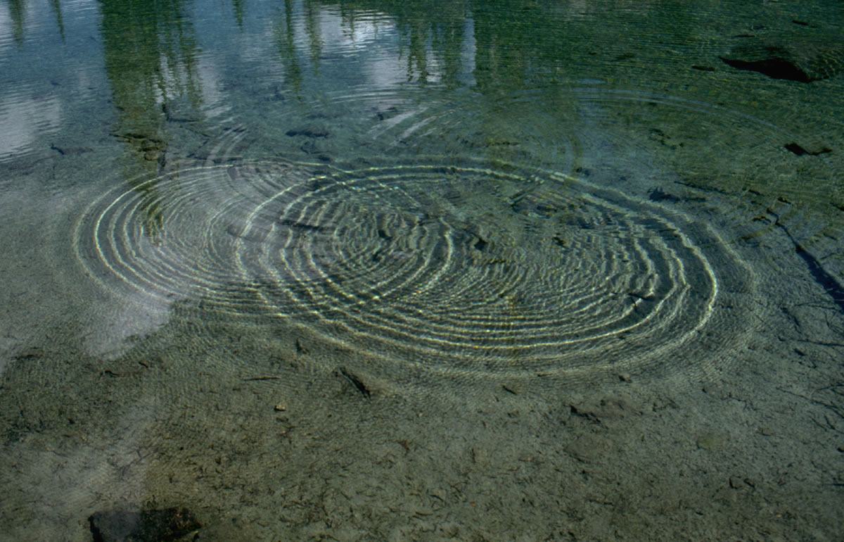
What’s strange about the behavior of quantum systems?
Waves vs. particles
Indeterminacy
Uncertainty principle
Complementarity

Slide 5
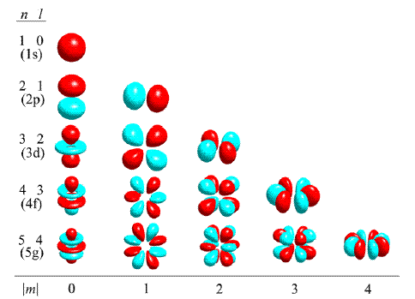
What’s strange about the behavior of quantum systems?
Waves vs. particles
Indeterminacy
Uncertainty principle
Complementarity

Slide 6
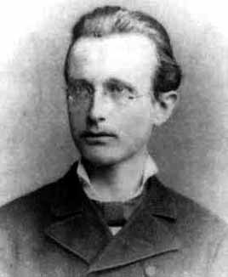
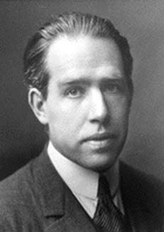
What’s strange about the behavior of quantum systems?
Max Planck
(1858-1947)
Niels Bohr
(1885-1962)
Given a proton and an electron, balancing the electron’s (positive) energy of motion with its (negative) electrical binding energy, within the constraints of the uncertainty principle, determines the size of an atom to be about 0.1 nanometer. Putting the mass of the proton in each volume of this size gives the density of ordinary matter.

Slide 7
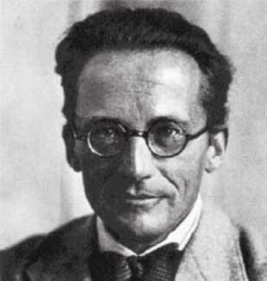
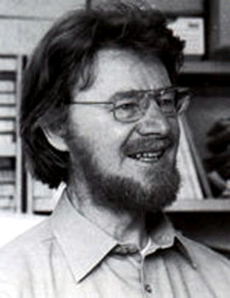
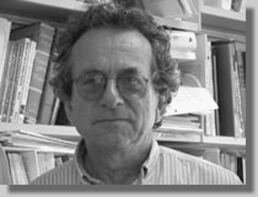
What’s strange about the behavior of quantum systems?
Entanglement
Quantum correlations
“Great! But I might be more impressed if I had a clue what a correlation is, much less a quantum correlation.”
Erwin Schrödinger
(1881-1961)
John S. Bell
(1928-1990)
N. David Mermin
(1935-)

Slide 8

Cable Beach
Western Australia
Get ready! I’m going to try to explain why entanglement is weird, but we’ll need a major detour to get there.

Slide 9

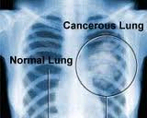



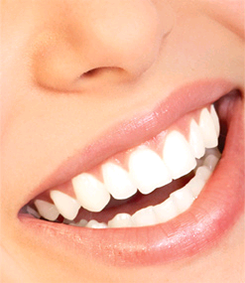
Correlations
Student at Lung cancer
Harvard University
Smoking Politically left
Drinking lattes Good teeth

Slide 10
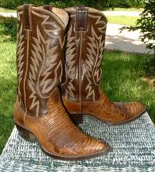
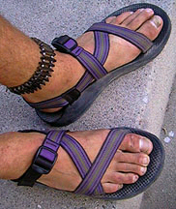
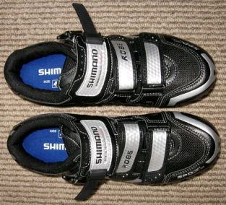
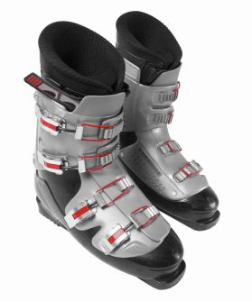
Perfect correlation
Left foot
Cowboy boot
Sandal
Biking shoe
Ski boot
Right foot
Cowboy boot
Sandal
Biking shoe
Ski boot

Slide 11

A correlation is an association between things. It’s perfect when the association always occurs.
Oljeto Wash
Southern Utah

Slide 12
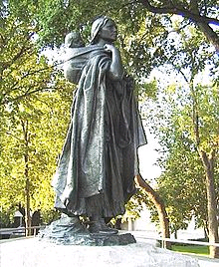
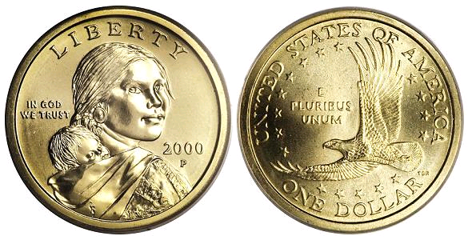
A correlation game
Sacagawea was a Lemhi Shoshone woman, who accompanied the Lewis and Clark Expedition, acting as an interpreter and guide, in their exploration of the Western United States. She traveled thousands of miles from North Dakota to the Pacific Ocean between 1804 and 1806.
Sacagawea 1US$ coin
Sculpture, in Bismarck, North Dakota,of Sacagawea and her baby, Jean-Baptiste Charbonneau.
The face on the coin was modeled on a Shoshone-Bannock woman named Randy'L He-dow Teton, then a student at the University of New Mexico.
Heads Tails
0 Bit 1
Up Down

Slide 13
A correlation game
Correlations between coins held by Alice and Bob can be used to “teleport” the state of Victor’s coin to Bob.
Sacagawea 1US$ coin
Alice only needs to know that her and Bob’s coins are correlated, not whether they are both heads or both tails.
Alice doesn’t need to determine whether Victor’s coin is heads or tails.
The message she sends to Bob doesn’t reveal whether Victor’s coin is heads or tails.
Heads Tails
0 Bit 1
Up Down

Slide 14
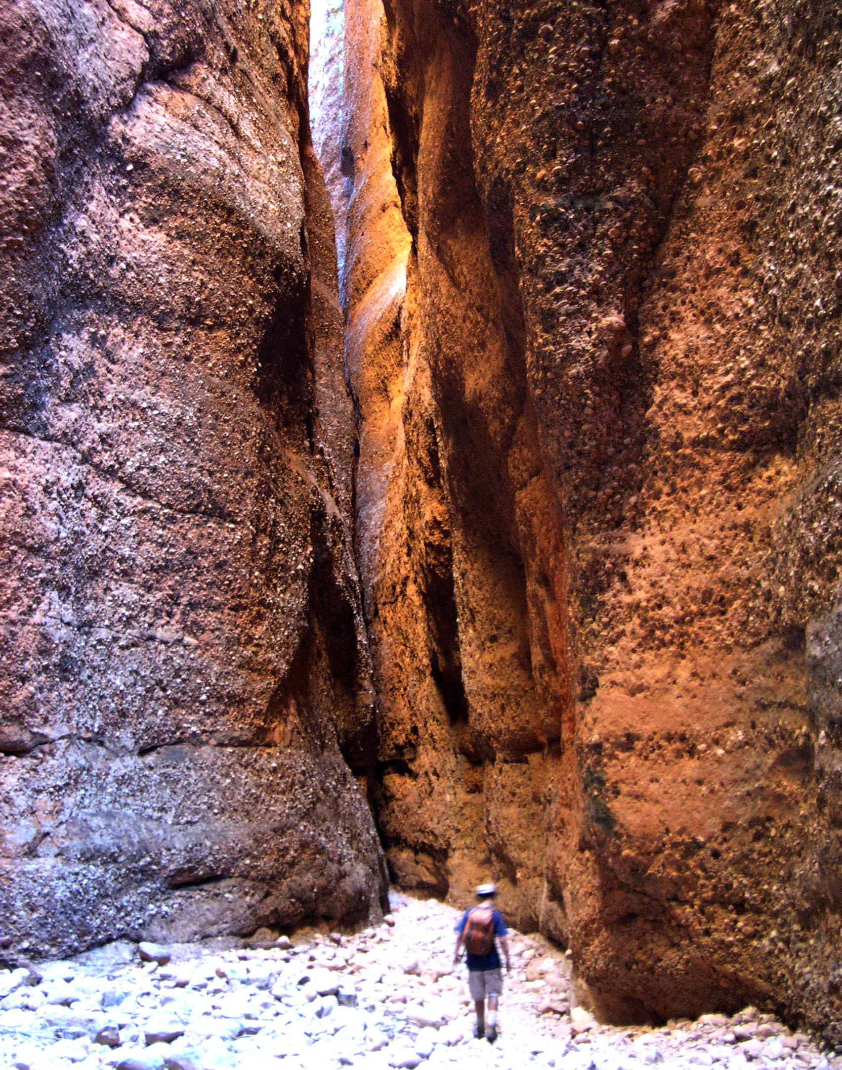
Correlations can be used to send information without actually sending it.
Echidna Gorge
Bungle Bungle Range
Purnululu National Park
Western Australia

Slide 15
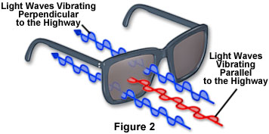

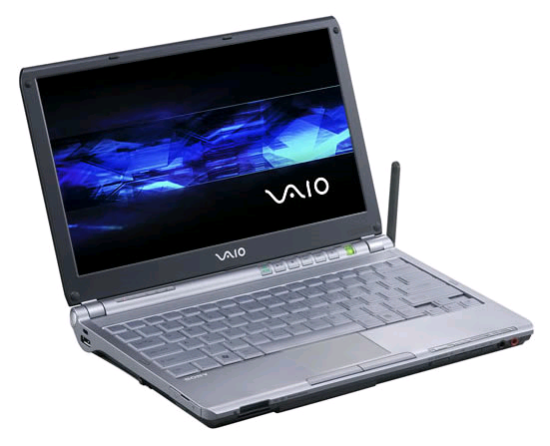
Polarization of light
A source of polarized light
No polarized glasses
Polarized glasses

Slide 16
Polarization of a single photon (particle of light)
1
0
Photon
Photon polarization

Slide 17
Photon polarization
X polarization
1
0
Photon
0
1
X
X

Slide 18
Photon polarization
Y polarization
1
0
Photon
Quantum coin
Two-state quantum system
Qubit
0
1
Y
Y
s
r
X
Y

Slide 19
Quantum coin
Photon polarization
Qubit
1
0
Photon
Quantum rules
Only one polarization at a time can be prepared or measured.
When one polarization is measured, the other is randomized.
s
1
0
r
X
X
Y
Y

Slide 20
Classical bit vs. qubit
A classical bit is either on or off.
A few electrons on a capacitor
A pit on a compact disk
A 0 or 1 on the printed page
A smoke signal rising from a distant mesa
A qubit has a continuum of on-off properties.
V
Y
A quantum state tells you the odds for getting 0 or 1 when you examine any of these one-bit coins (linear polarizations).
U
X
continuum of one-bit coins (linear polarizations)

Slide 21
What happened to Planck’s constant?
Planck initiated the study of quantum mechanics when he announced in 1900 the results of his theoretical research into the radiation and absorption of a “black body.”
Planck’s constant is the scale on which physical phenomena are discrete (or grainy); for example, photons are the expression of the discreteness of the electromagnetic field.
Max Planck (1858-1947)

Slide 22
World of classical physics
World of quantum physics
Continuous, smooth
(analogue)
Discrete, grainy
(digital)
I don’t care if you are at Hogwarts, Harry. You can’t violate the uncertainty principle.
Information-processing perspective
Use your quantum mechanics, Harry. Feel the quantum reality.
Digital devices
(on-off)
Continuum of digital properties

Slide 23
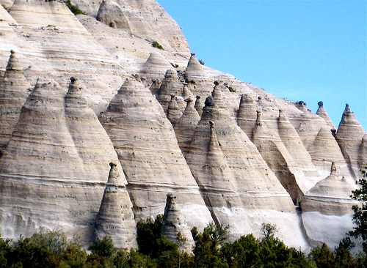
A qubit (photon polarization) is a whole bunch of one-bit coins, but we will only need the two coins corresponding to X and Y polarization. A quantum state gives the odds for each of these coins.
Tent Rocks
Kasha-Katuwe National Monument
Northern New Mexico

Slide 24

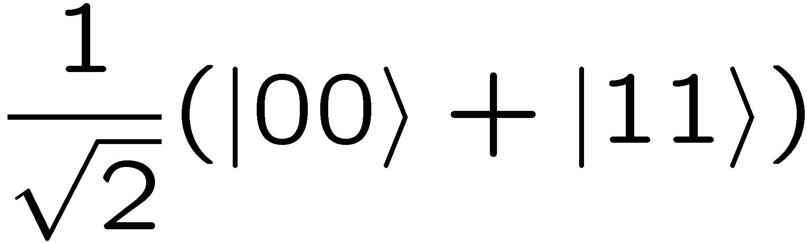

Entanglement (at last):
quantum correlations
Perfect correlation, with the two results, 00 or 11, being equally likely.
1
1
0
Photon A
0
X
X
Alice
Parametric downconverter
Bell entangled quantum state
X polarization
1
1
Photon B
0
0
X
X
Bob

Slide 25
Entanglement (at last):
quantum correlations
Perfect correlation, with the two results, 00 or 11, being equally likely.
1
0
1
0
Photon A
Y
Y
Alice
Parametric downconverter
Bell entangled quantum state
Y polarization
1
0
1
Photon B
0
Y
Y
Bob

Slide 26

A quantum correlation game: Quantum teleportation
Victor
Alice makes a special four-outcome polarization measurement on V and A and then sends one of four messages (two bits) to Bob.
Photon V
Photon A
Alice
Alice never finds out the quantum state of V, the message doesn’t reveal it, and V’s initial quantum state is destroyed by the game.
Bell entangled quantum state
Do nothing.
Flip your Y polarization.
Flip your X polarization.
Flip your X and Y polarizations.
Photon B
Victor runs over to Bob and finds that B now has the same quantum state as V had.
Bob

Slide 27
What’s strange about the behavior of quantum systems?
Entanglement
Quantum correlations
We cannot account for quantum teleportation in terms of the photons’ having pre-existing polarizations that are discovered by the measurements.
But we haven’t shown that yet. Everything so far can be explained in terms of two 1-bit coins (for X and Y polarizations). But to teleport all polarization, not just X and Y, Alice needs to communicate only two bits to Bob; the correlations of all these coins are too strong be explained in terms of coins with pre-existing properties.

Slide 28


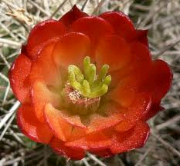
Claret cup cacti
New Mexico
Quantum entanglement can be used for useful tasks such as teleportation of quantum states.

Slide 29
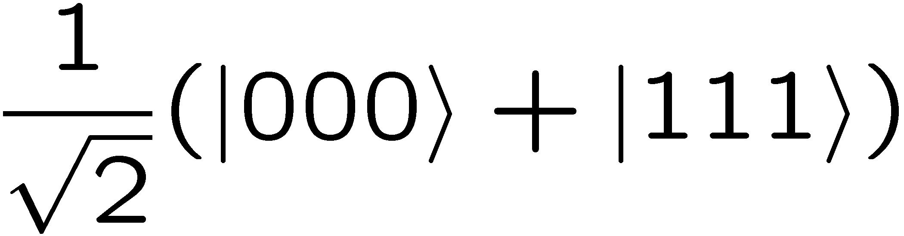

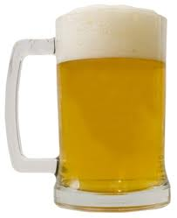

Greenberger-Horne-Zeilinger (GHZ) entanglement
3-qubit GHZ entangled state:
qubit
1st qubit
x
y
x₁
y₁
X
Y
X
Y
Let’s tell a story: a qubit becomes a two-bit person
x=0 (heads) is a MAN.
x=1 (tails) is a WOMAN.
y=0 (heads) drinks BEER.
y=1 (tails) drinks WINE.
2nd qubit
3rd qubit
x₂
y₂
x₃
y₃
X
Y
X
Y

Slide 30
MAN
WOMAN
x₁
y₁
x₁
y₁
OR
X
Y
X
Y
x₂
y₂
x₃
y₃
x₂
y₂
x₃
y₃
X
Y
X
Y
X
Y
X
Y
Drinking ANTAGONISTS
Drinking COMPATRIOTS
2 heads and 1 tail or 3 tails
2 zeroes and 1 one or 3 ones
Ask one person for gender, the other two for drinking preference.

Slide 31
Summarize
Ask one person for gender, the other two for drinking preference.
2 heads and 1 tail or 3 tails
2 zeroes and 1 one or 3 ones
x₁
y₁
X
Y
x₂
y₂
x₃
y₃
X
Y
X
Y
A MAN is always accompanied by two ANTAGONISTS.
A WOMAN is always accompanied by two COMPATRIOTS.

Slide 32
Ask one person for gender, the other two for drinking preference.
2 heads and 1 tail or 3 tails
2 zeroes and 1 one or 3 ones
x₁
y₁
X
Y
x₂
y₂
x₃
y₃
Now ask all three persons for gender.
2 heads and 1 tail or 3 tails
2 zeroes and 1 one or 3 ones
X
Y
X
Y
There must be two MEN and a WOMAN or three WOMEN.

Slide 33
Here’s why
MAN
MAN
x₁
y₁
x₁
y₁
ANTAGONISTS
X
Y
ANTAGONISTS
COMPATRIOTS
X
Y
COMPATRIOTS
MAN
MAN
WOMAN
WOMAN
x₂
y₂
x₃
y₃
x₂
y₂
x₃
y₃
X
Y
X
Y
X
Y
X
Y
ANTAGONISTS
ANTAGONISTS
A MAN is always accompanied by two ANTAGONISTS.
A WOMAN is always accompanied by two COMPATRIOTS.
There must be two MEN and a WOMAN or three WOMEN.

Slide 34
Quantum mechanics: only what we just showed to be impossible occurs.
2 heads and 1 tail or 3 tails
2 zeroes and 1 one or 3 ones
x₁
y₁
X
Y
2 heads and 1 tail or 3 tails
2 zeroes and 1 one or 3 ones
x₂
y₂
x₃
y₃
2 tails and 1 head or 3 heads
2 ones and 1 zero or 3 zeroes
X
Y
X
Y
A MAN is always accompanied by two ANTAGONISTS.
A WOMAN is always accompanied by two COMPATRIOTS.
There must be two MEN and a WOMAN or three WOMEN.
There must be two WOMEN and a MAN or three MEN.

Slide 35
What’s strange about the behavior of quantum systems?
Entanglement
Quantum correlations
Correlations—even perfect correlations— that violate the rules of ordinary existence.
We cannot account for the behavior of quantum systems by imagining that properties have pre-existing values that are discovered by observation.

Slide 36

Bungle Bungle Range
Western Australia
Objects in the world of the very small violate the rules of ordinary existence: either they are not individual objects, or they do not have realistic properties. The result is magic.

Slide 37
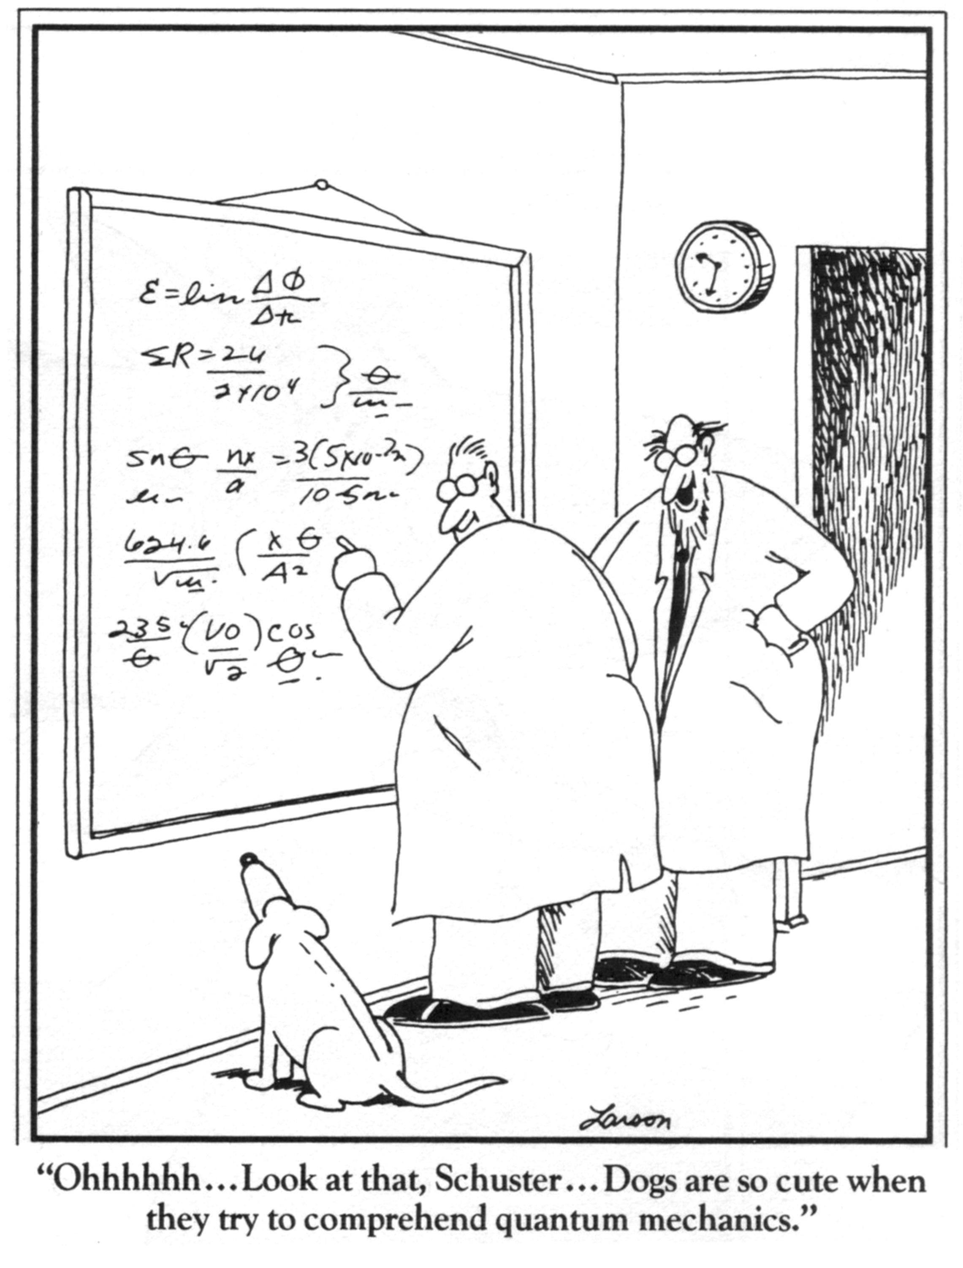

It’s not only dogs that can’t understand quantum mechanics.
Quantum physics leads you to a world of magic, beyond your imagination, but provides a set of rules to manage and control the magic.
Quantum information science is the discipline that explores information processing within the quantum world, where the mundane constraints of realism and determinism no longer apply.

Slide 38
Why not extend the magic into the world of the everyday?
Use your quantum mechanics, Harry. A quantum computer would be real magic.
I don’t care if you are at Hogwarts, Harry. You can’t build a quantum computer. Fifty points from Gryffindor.
The more magic you attempt, the harder it gets.

Slide 39

Quantum information science.
Engineering the magic.
Truchas from East Pecos Baldy
Sangre de Cristo Range
Northern New Mexico

Slide 40
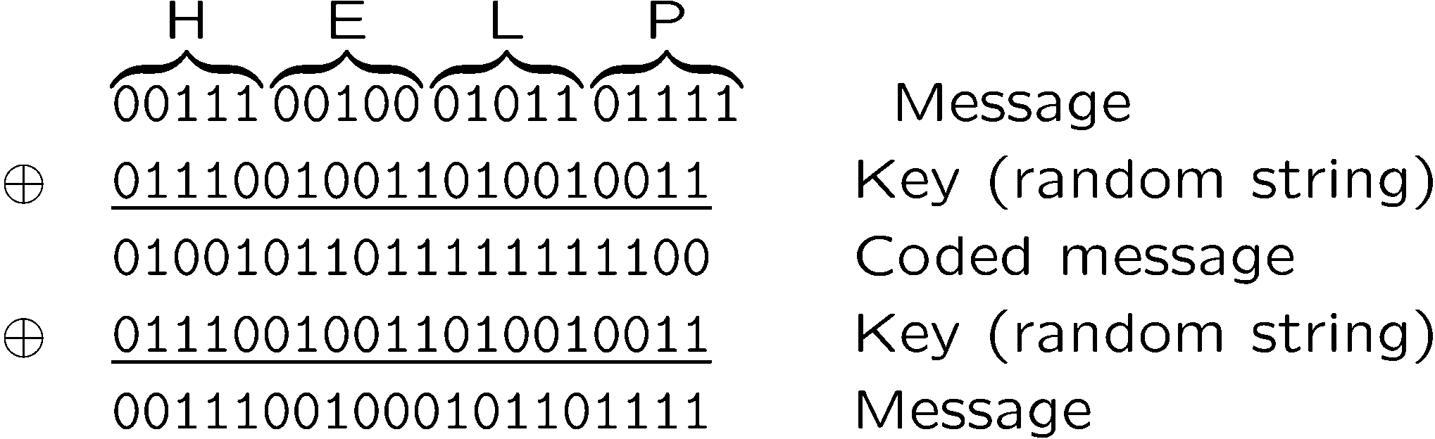
Private communication
Alice and Bob share a one-time pad
(secret random key).
But where do Alice and Bob get the key?

Slide 41
Quantum key distribution using entanglement
Alice measures X, Y, U, or V polarization.
Alice
Photon A
Alice and Bob share the type of measurement they did, not the result. If they measured the same thing, they keep the shared random bit for their key. Otherwise, they use the results to verify a Bell inequality, which can be used to rule out the presence of an eavesdropper.
Bell entangled quantum state
Photon B
Bob measures X, Y, U, or V polarization.
Bob

Slide 42
Quantum key distribution using entanglement
Experiment at Los Alamos National Laboratory (2000): D. S. Naik, C. G. Peterson, A. G. White, A. J. Berglund, and P. G. Kwiat

Slide 43

Why is quantum key distribution secure?
An unmeasured qubit has no bit value waiting to be discovered. Alice and Bob create the key by measuring the polarizations. Before that, there is no key for an eavesdropper to steal.
“There is no there there.”
Gertrude Stein damning her native Oakland and inadvertently describing quantum systems.
Essential ingredient: Entanglement between qubits

