Slide 1
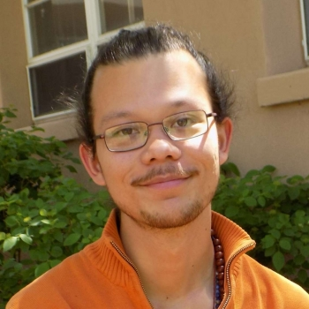
arXiv:1912.12530
arXiv:1912.12530
How to perform the coherent measurement of a curved phase space by
continuous isotropic measurement
Spin and the Kraus-operator
geometry of SL(2,C)
Carlton M. Caves
Distinguished Professor Emeritus, University of New Mexico
This is work carried out with
Christopher S. Jackson,
formerly a postdoc at UNM,
now a postdoc at Sandia Livermore.
Chris Jackson

Slide 2
C. S. Jackson and C. M. Caves, “How to perform the coherent measurement of a curved phase space by continuous isotropic measurement. I. Spin and the Kraus-operator geometry of SL(2,C),” arXiv:2107.12396 [quant-ph].
FOCUS
ON THIS.
From the acknowledgments: This article is the first in a series describing CSJ's vision for understanding curved phase spaces and their role in physics and quantum information. … CMC is honored to be a co-author, provided it takes nothing away from CSJ's accomplishment.
Destination: What “strong” measurement corresponds to weak, continuous, measurement of (noncommuting) observables?
Journey: Exploring the space of Kraus operators and POVMs that goes with phase space.
Chris Jackson
C. S. Jackson and C. M. Caves, “How to perform the coherent measurement of a curved phase space by continuous isotropic measurement. II. The Kraus-operator geometries of complex semisimple Lie groups,” drafted, but needs retrofitting with present understanding.
Much more.

Slide 3
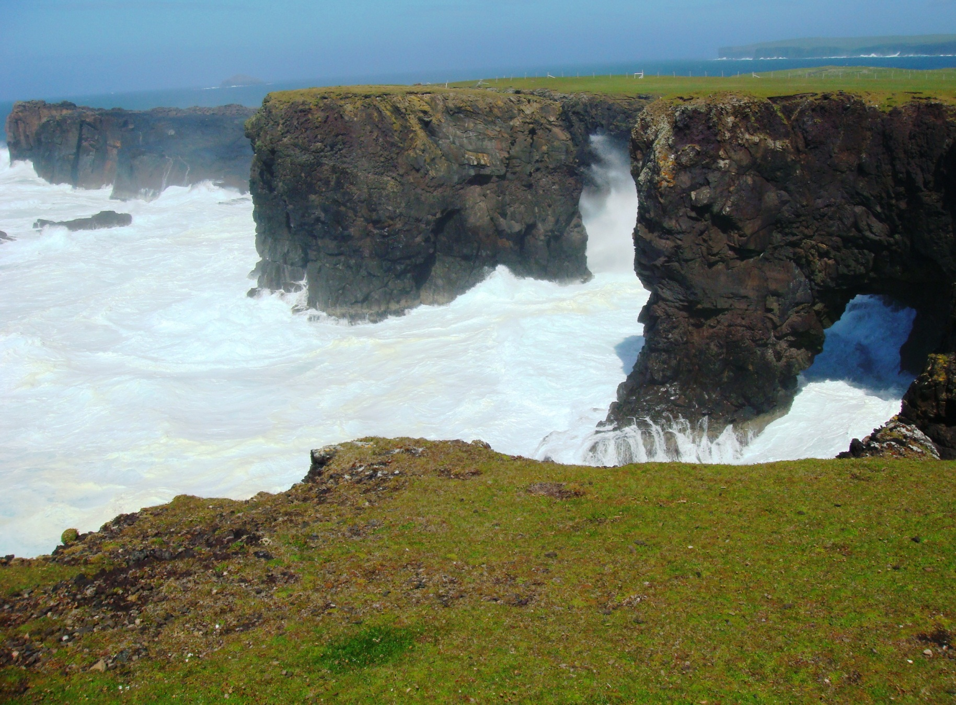
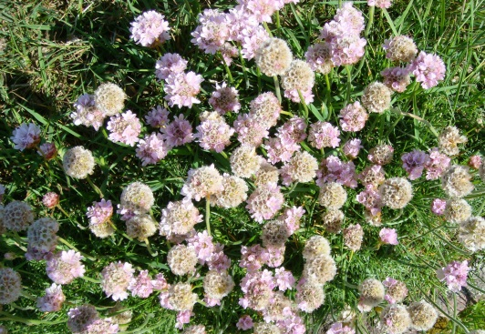
Coherent states and geometry
Moo Stack and the Villians of Ure
Eshaness, Shetland

Slide 4
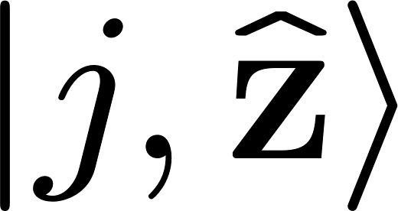
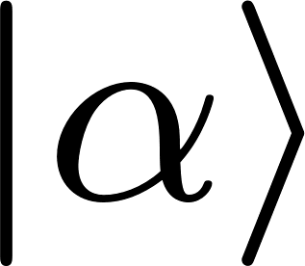
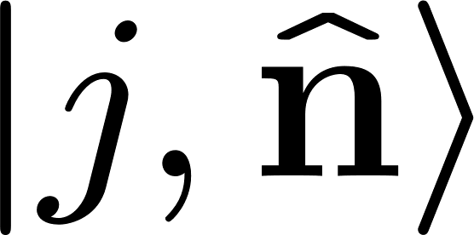
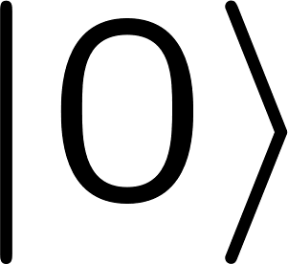
Coherent states
Glauber coherent states of a bosonic mode
Lie group: Weyl-Heisenberg
Spin coherent states (SCS)
Lie group: SU(2)
CS are ground states of “easy” integrable Hamiltonians
Lie-group displacement
Phase space

Slide 5
Coherent states
Glauber coherent states of a bosonic mode
Lie group: Weyl-Heisenberg
Spin coherent states (SCS)
Lie group: SU(2)
Phase space
Ladder operators (Cartan-Weyl basis)
Tensor miracle (classical limit)

Slide 6
Coherent states
Glauber coherent states of a bosonic mode
Lie group: Weyl-Heisenberg
Spin coherent states (SCS)
Lie group: SU(2)
What’s inside?
Phase space
The journey and the destination.
Resolution of the identity (CS POVMs)
Measure by (single-shot) heterodyne:
simultaneous, isotropic measurement
of Q and P.
Not too bad so far, Carl.
Measure by ?
Continuous (weak) isotropic measurement of the three spin components.
E. Shojaee, C. S. Jackson, C. A. Riofrío, A. Kalev, and I. H. Deutsch, PRL 121, 130404 (2018).

Slide 7
Geometry
What’s inside? A type-IV symmetric space, in this case a 3-hyperboloid, consisting of concentric 2-spheres of thermal states with inverse temperature 2a, running from the identity operator at a = 0 to the 2-sphere of SCSs at a = infinity.
What’s inside?
Polar decomposition
Cartan (singular-value) decomposition
Postmeasurement unitary
Premeasurement unitary
U can be restricted to displacements.
Thermal state: inverse temperature 2a
Our analysis of continuous isotropic measurements is Kraus-operator-centric—state-independent and representation-independent and thus geometric. Kraus operators are the triple entendre (CSJ) or trinity (CMC) of quantum theory, simultaneously representing states, measurements (POVMs), and transformations (processes). To include all Kraus operators, one attaches an SU(2) fiber of postmeasurement unitaries at every point in the 3-hyperboloid. One is then studying the Kraus-operator geometry of the complexification of SU(2), which is SL(2,C).

Slide 8
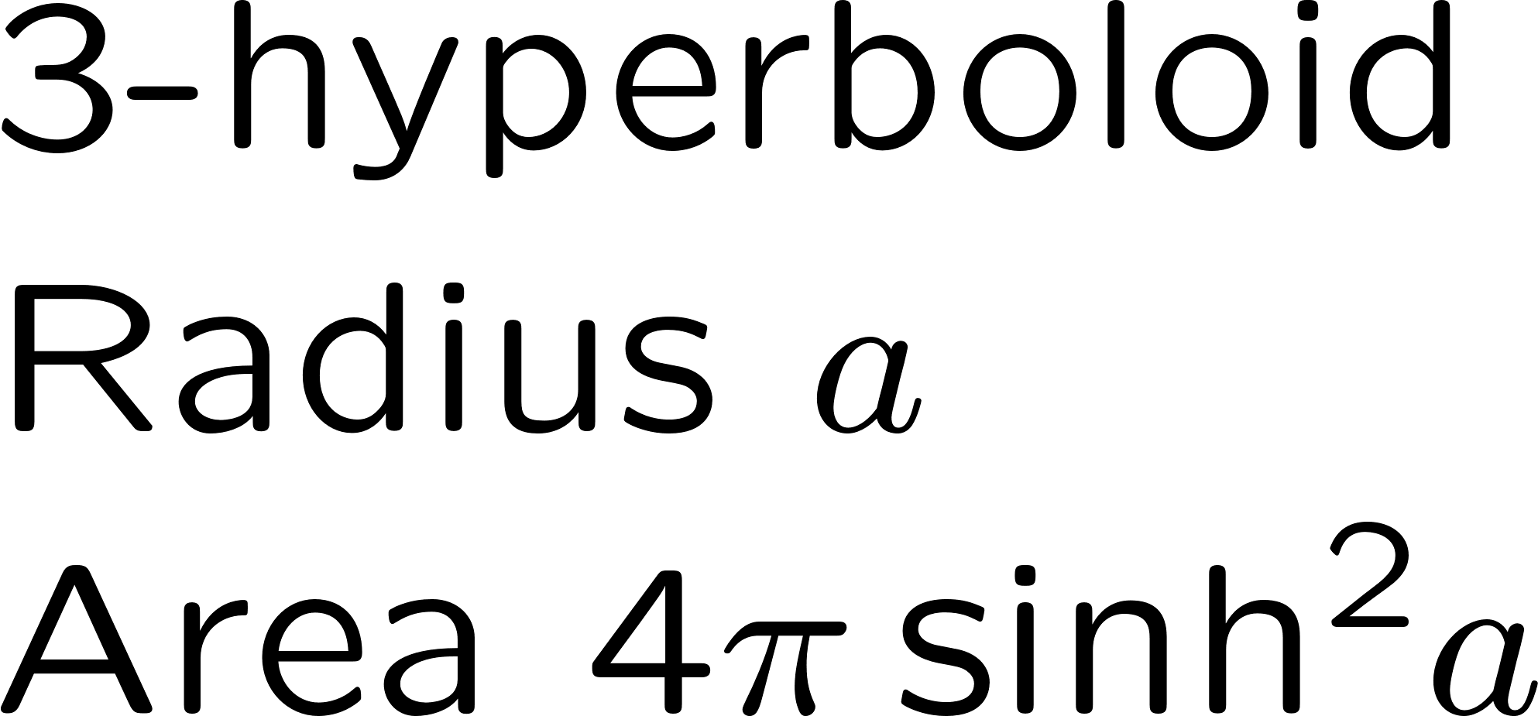
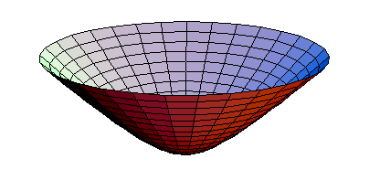
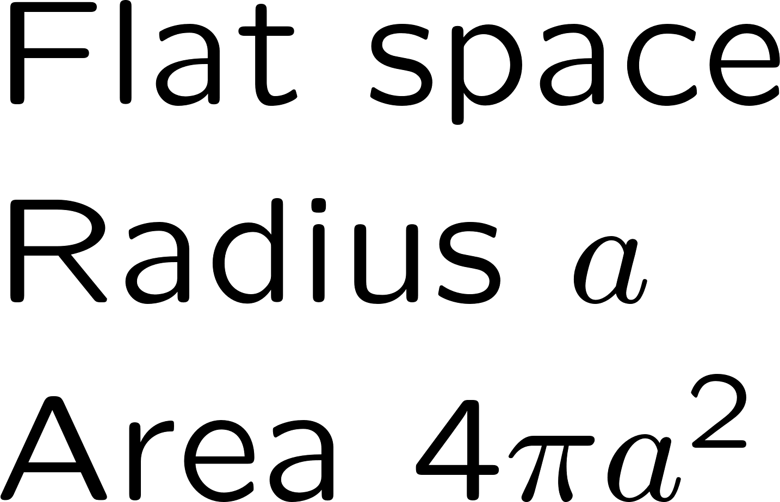
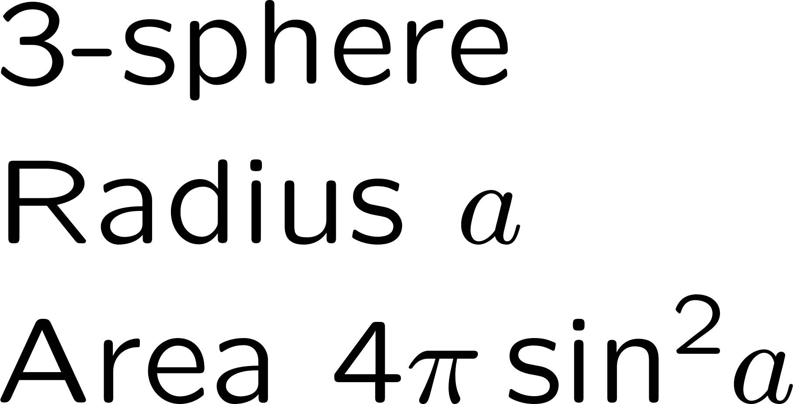
Geometry
What’s inside? A type-IV symmetric space, in this case a 3-hyperboloid, consisting of concentric 2-spheres of thermal states with inverse temperature 2a, running from the identity operator at a = 0 to the 2-sphere of SCSs at a = infinity.
To get the geometry right, one must regard the hyperboloid as embedded in Minkowski space, not Euclidean space.
Get to the point, Carl.

Slide 9
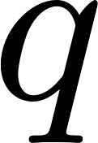
arXiv:1912.12530
arXiv:1912.12530
What’s misleading about
conventional q-p phase space?
The irreducible tensors used for expanding operators
are identical to the displacement operators. This is not
true for generalized coherent states and the curved phase spaces
of compact semisimple Lie groups.
The near commutativity of q and p gives a nearly trivial operator ordering for constructing phase-space correspondences and quasidistributions. For compact semisimple Lie groups, these projects are best approached in a quite different way.
There is no apparent “inside.” Because there is a single-shot heterodyne measurement, there is little motivation to consider weak, continuous measurements. Nonetheless, you should, for the journey it takes through the “inside” symmetric space of displaced thermal states is transformative.

Slide 10
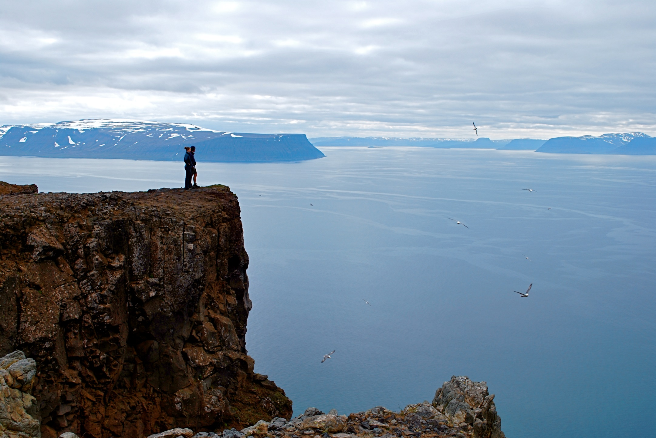
Measuring the SCS POVM
Holstrandir Peninsula overlooking Ísafjarðardjúp
Westfjords, Iceland

Slide 11
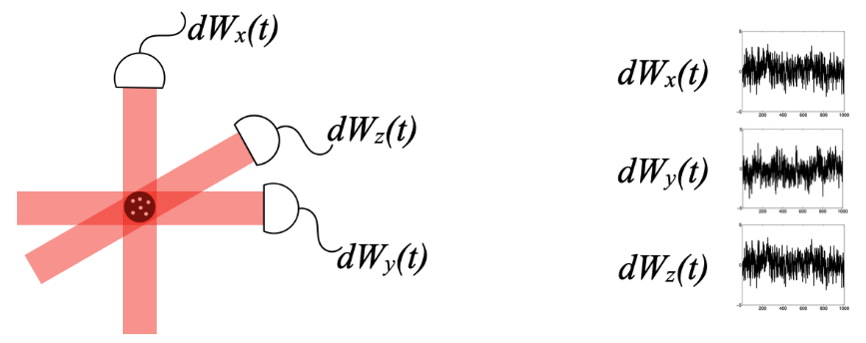
arXiv:1912.12530
arXiv:1912.12530
Measuring the three spin components weakly and simultaneously
The distinctive feature of our analysis is that it is Kraus-operator-centric.
Gaussian Kraus operator for weak, simultaneous measurement of three spin components lasting time dt.
Element of SL(2,C) Submanifold closure

Slide 12
arXiv:1912.12530
Weiner-like path integral
arXiv:1912.12530
QOVM after time T is a Wiener-like outcome-path integral.
Semisimple unraveling of trace-preserving, unconditioned QOVM
Haar measure
It is critical to appreciate that we are not dealing with a probability distribution for outcomes—that would require an initial state—but rather with a distribution over an ensemble of Kraus operators K, drawn from SL(2,C) and labeled by outcomes.
When you see a path integral, you should be thinking diffusion equation and stochastic differential equation (SDE). Deriving the diffusion equation is hard, but worth it, because it teaches about the geometry. Deriving the SDEs is straightforward, but instead of teaching about, is informed by the geometry. Let’s do SDEs first.

Slide 13
arXiv:1912.12530
Stochastic differential equations
arXiv:1912.12530
QOVM after time T is a Wiener-like outcome-path integral.
Maurer-Cartan form
Modified Maurer-Cartan stochastic differential (MMCSD).
Submanifold closure.

Slide 14
arXiv:1912.12530
Stochastic differential equations
arXiv:1912.12530
After a few collapse times, 1/γ,
the radial coördinate moves nearly ballistically, with mean and variance proportional to γt,
The diffusion of U in the angular directions is overwhelmed by the area exponentiation.
Ballistic term
Omitted from Shojaee et al.
Diffusion
the premeasurement unitary freezes out, thereby picking a direction on the 3-hyperboloid,
Diffusion
and the postmeasurement unitary moves randomly on SU(2).
Diffusion

Slide 15
arXiv:1912.12530
arXiv:1912.12530
Measuring the SCS POVM
The continuous isotropic measurement of spin components collapses to the SCS POVM “almost always” and “in no time at all.”
Cool.

Slide 16
arXiv:1912.12530
arXiv:1912.12530
Diffusion equations. Advanced course in geometry
Semisimple unraveling of trace-preserving, unconditioned QOVM
Isotropic measurement Laplacian
SU(2) Killing form
Right-invariant derivatives. Moving basis-vector fields on SL(2,C).
At each K diffusion occurs into a 3-submanifold that looks locally like the 3-hyperboloid. This diffusion is nonintegrable and thus explores all of 6-dimensional SL(2,C) because the local 3-submanifolds do not mesh to form a global 3-surface.

Slide 17
arXiv:1912.12530
arXiv:1912.12530
Diffusion equations. Advanced course in geometry
Isotropic measurement Laplacian
Cartan expression for isotropic measurement Laplacian
Beltrami form relative to 3-hyperboloid metric
Fokker-Planck equation for purity distribution P_{t} (a)
Ballistic term
Diffusion

Slide 18
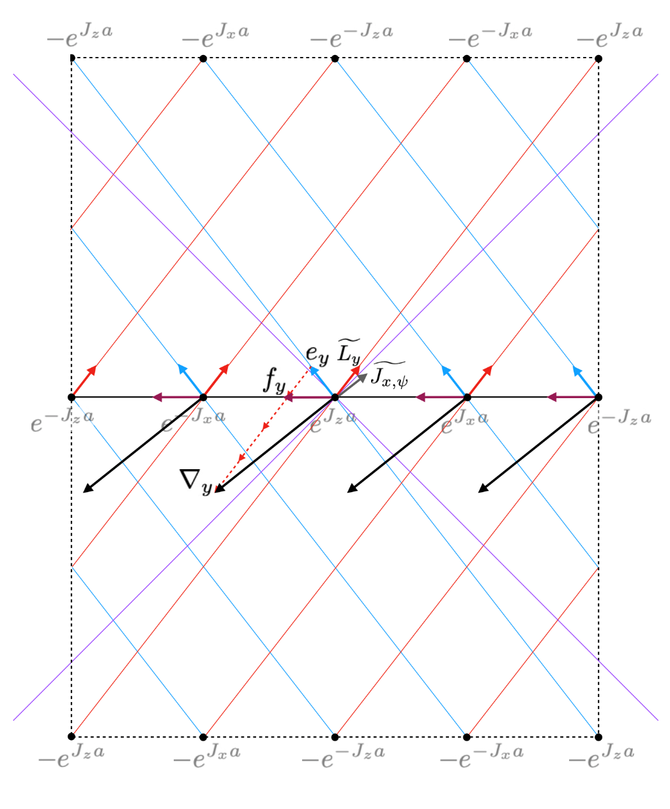
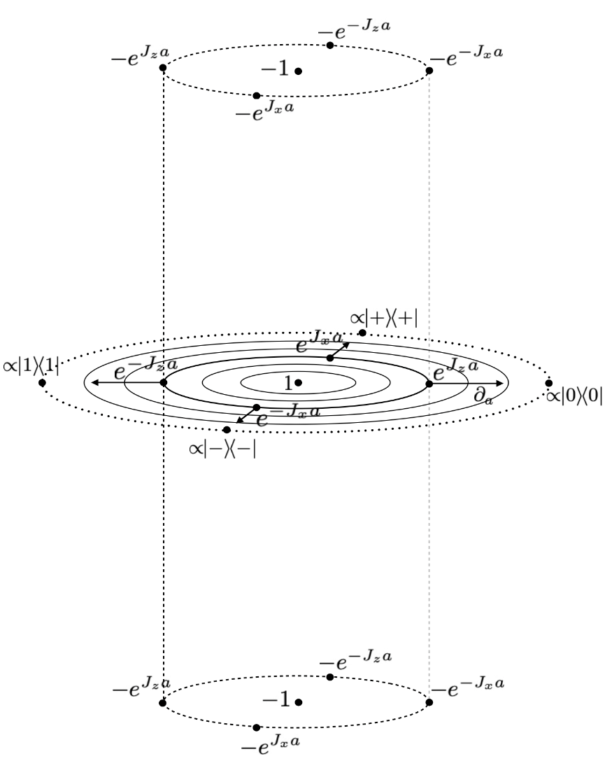
Kraus-operator geometry of SL(2,C)
Orbits of U;
V constant
Fibers:
Orbits of V;
U constant
“Light cone”
Nonintegrable direction of diffusion is “Minkowski-orthogonal” to the fibers.
Really cool.

Slide 19
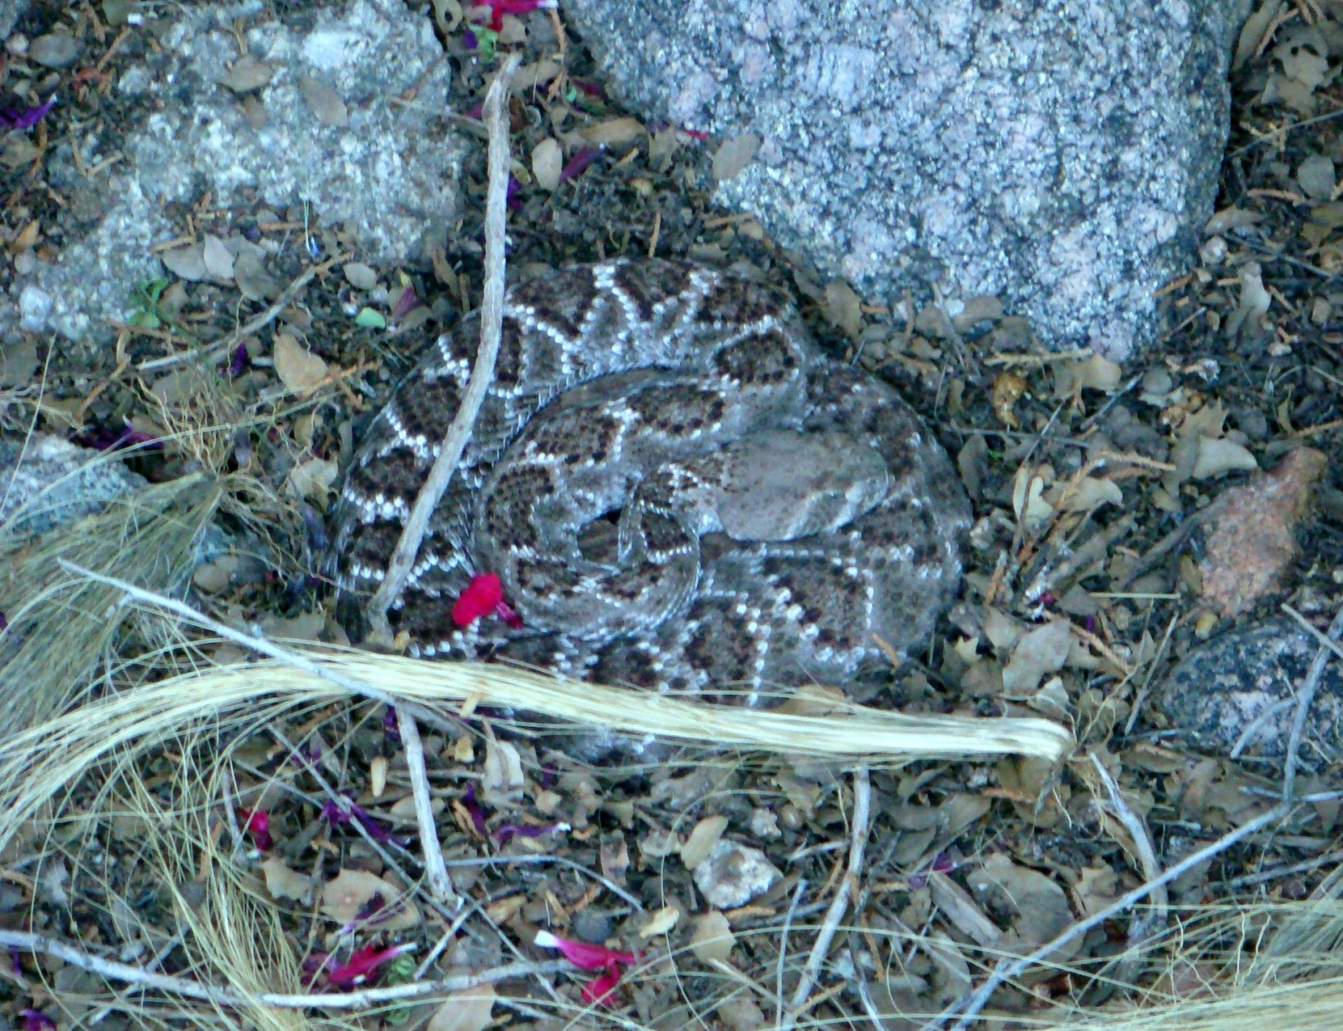
More and much more
Western diamondback rattlesnake
My front yard, Sandia Heights

Slide 20
More
arXiv:1912.12530
arXiv:1912.12530
Get out of Hilbert space. The arena of physics, classical and quantum, is the (curved) phase spaces of compact, connected, semi-simple Lie groups.
What about flat, canonical phase space? It’s for the bosons, misleadingly special, where phase-space quantum mechanics is already appreciated, but needs to be recast in our language.
Chris Jackson
The properties of physical systems are the generators of these Lie groups.
Weak, continuous, isotropic measurement of the generators limits to measurement in the (overcomplete) basis of generalized coherent states, thereby identifying the coherent states. Kraus operators drawn from the (complexified) group describe dynamics; Cartan decomposition identifies the radial directions on a type-IV symmetric space, the angular directions in the premeasurement unitaries (displacement operators), and the fiber of postmeasurement unitaries. The phase space of coherent states occupies the boundary of the symmetric space, a space of constant curvature, made up of thermal states with Hamiltonians linear in the generators. Kraus operators are the unifying mathematical object, the quantum trinity, the triple entendre, encompassing states, transformations, and measurements.
Putting the Weyl-Heisenberg group and its flat space in the language of curved phase spaces, thus elucidating its universal properties and its special properties.

Slide 21
arXiv:1912.12530
arXiv:1912.12530
Much more
Get out of Hilbert space. The arena of physics, classical and quantum, is the (curved) phase spaces of compact, connected, semi-simple Lie groups.
What about flat, canonical phase space? It’s for the bosons, misleadingly special, but where phase-space quantum mechanics is already appreciated.
Chris Jackson
Harmonic functions span the space of phase-space functions. Associated irreducible tensors span the operator space. Phase-space correspondences and “s-ordered” quasiprobabilities, which connect harmonic functions to coherent states, are founded on the “quartic twirl” of generalized coherent states.
Quantization is omission of fine-scale harmonic functions (i.e., working in a finite-dimensional irrep). The classical limit is keeping all the harmonic functions, down to the finest scales (i.e., working in an infinite-dimensional irrep). Linear Hilbert-space structure of quantum mechanics arises naturally from the group representation.
Dynamical complexity (nonlinear dynamics and chaos) is stepping outside the complexified group. Complexity should be measured relative to phase space. Linear evolution, Hamiltonian or dissipative, stays in the group and respects the scales of the harmonic functions. Nonlinear evolution steps outside the group by mixing large and small scales, leading to the sensitivity to initial conditions of classical chaos and to hypersensitivity to perturbation both classically and quantum mechanically.

