Slide 1
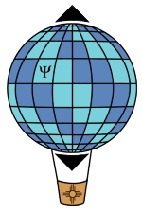
High-impact factor syndrome: What, why, and what to do
Carlton M. Caves
Center for Quantum Information and Control, University of New Mexico
Centre for Engineered Quantum Systems, University of Queensland
http://info.phys.unm.edu/~caves
2016 May 5
This is opinion, and the opinions are mine.
Center for Quantum Information and Control

Slide 2
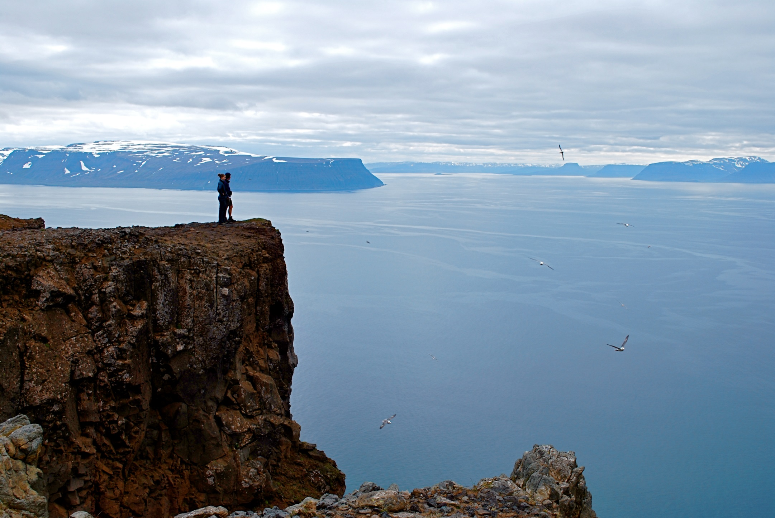
Parable of the physics prize
Holstrandir Peninsula overlooking Ísafjarðardjúp
Westfjords, Iceland
Notes:
You are on a five-person panel that awards a prestigious prize for a junior physicist (within five years of the PhD) who has made a significant contribution to physics in any sub-field. Much is at stake: a substantial monetary award, certainly, but more importantly, a ringing endorsement that will likely ensure a job and initial funding for the recipient. There is also a problem: you’re a great physicist, no doubt, but physics is a big field, and most of it lies well outside your own interests and expertise. How can you judge among the several outstanding nominations, all of which are outside your expertise? And there does look to be several highly competitive nominations.
When the panel meets, you are personally gratified that none of the other panelists knows what he/she is doing either, but your gratification is tempered by the realization that a decision must be made, and none of the panel has the required expertise for the one apparently outstanding interdisciplinary-physics nomination. There is much discussion, without resolution, and finally the panel decides---what else can it do?---to let a simple criterion break the impasse: count the number of publications in HIF journals---Nature and its babies, Science, and to a lesser extent PRL---and give the prize to the nominee with the highest number. The interdisciplinary nomination wins. The winner is undoubtedly outstanding, but everybody is left with a vague sense of unease, a suspicion that, maybe, interdisciplinary work is more welcome in the Nature suite and Science than is hard-core physics. Does that make it better? And what does better mean anyway? How does one evaluate a junior scientist outside one’s expertise? Does publication in HIF journals have anything to do with it?

Slide 3
High-impact-factor syndrome (HIFS)
High-impact-factor syndrome (HIFS) is a disease of scientists and administrators. The most virulent manifestation of the disease lies in judging the accomplishments of individual scientists, especially junior scientists, in terms of the number of publications in high-impact-factor (HIF) journals.
C. M. Caves, “High-impact-factor syndrome,” APSNews 23(10), 8,6 (2014 November). Back-page opinion piece on HIFS.
R. Werner, “The focus on bibliometrics makes papers less useful,” Nature 517, 245 (2010 January 15). Focus on use of citation metrics; peculiar anti-PRL animus, displayed unambiguously in subsequent blog posts.
PI Predictor, in Science Careers (simplified version of original in Current Biology), as summarized by J. Austin, “What it takes,” Science 344, 1422 (2014 June 20):
Be male.
Be selfish (insist on being first author).
Be elite (from one of the top ten institutions in the Shanghai Academic Ranking of World Universities).
Publish in HIF journals.

Slide 4
High-impact-factor syndrome (HIFS) is the practice of using number of publications in HIF journals as a proxy for individual research accomplishment or potential.
San Francisco Declaration on Research Assessment (DORA): Putting Science into the Assessment of Research.
Chief recommendation: Do not use journal-based metrics, such as Journal Impact Factors, as a surrogate measure of the quality of individual research articles, to assess an individual scientist’s contributions, or in hiring, promotion, or funding decisions.
D. Hicks, P. Wouters, L. Waltman, S. de Rijcke, and I. Rafols, “Bibliometrics: The Leiden manifesto for research metrics,” Nature 520, 429–431 (2015 April 23):
Several universities base promotion decisions on threshold h-index values and on the number of articles in “high-impact” journals. Researchers' CVs have become opportunities to boast about these scores, notably in biomedicine. Everywhere, supervisors ask PhD students to publish in high-impact journals … . In Scandinavia and China, some universities allocate research funding or bonuses on the basis of a number: for example, by calculating individual impact scores to allocate “performance resources” or by giving researchers a bonus for a publication in a journal with an impact factor higher than 15.

Slide 5
High-impact-factor syndrome (HIFS)
I am not talking for the present about
The purpose of scientific publication in the age of the arXiv.
Whether an individual should publish a particular paper in Nature or its babies, Science, or even PRL or PRX.
The use of impact factor to assess the quality of a journal.
Using publication in HIF journals as a proxy for assessing countries, states, institutions, and units within institutions.
The general use of citation metrics (bibliometrics) as a tool for assessing research accomplishment.
I will have something to say about each of these in a bit, because they are all related to HIFS.

Slide 6
Parable of the two physicists
Cable Beach
Western Australia
Notes:
Do you have HIFS? Here is a simple test. You are given a list of publications, rank-ordered by number of citations, for two physicists working in the same subdiscipline. All of the first physicist’s publications are in PRL and PRA, and all of the second’s are in Nature and Nature Physics. In terms of publication dates and citation numbers, the two records are identical. You are asked which physicist has had more impact. You cannot decline to participate by saying you need more information. Any reasonable assessor would indeed insist on gathering additional information, for example, by reading some of the papers, but by excluding additional information, we isolate the effect of IF on your judgment. If you have even the slightest inclination to give the nod to the second physicist, you are suffering from HIFS. Given just the specified information, I would come to the opposite conclusion: The first physicist’s record is more impressive because the citation record has not received the artificial boost of publishing in the high-visibility Nature suite.

Slide 7
What is journal impact factor (IF)?
How to get the 2013 IF for Physical Review Letters
Take all the papers published in PRL in 2011 and 2012. The standard (two-year) 2013 IF is the average number of citations accumulated by these papers in 2013, in a list of “indexed journals” maintained by Thomson Reuters Web of Science.
Web of Science indexes over 8,000 science and technology journals and issues an annual report, called the Journal Citation Reports (JCR), which lists IFs and other measures of journal impact. For example, you will also see five-year IFs, which are computed using a time horizon of five years instead of the two years for standard IF. For a given journal, IF (five-year IF) is the average annual citation rate for papers that are on average 1.5 (3) years old.

Slide 8
2013 IF
Journal | 2-year IF | 5-year IF
Nature | 42.351 | 40.783
Nature Physics | 20.603 | 20.059
Nature Photonics | 29.958 | 32.342
Nature Medicine | 28.054 | 26.501
Nature Geoscience | 11.668 | 13.930
Nature Communications | 10.742 | 11.023
Science | 31.477 | 34.463
Cell | 33.116 | 35.020
Reviews of Modern Physics | 42.860 | 52.577
Physical Review Letters | 7.728 | 7.411
Physical Review A | 2.991 | 2.729
Physical Review B | 3.664 | 3.564
Physical Review C | 3.881 | 3.551
Physical Review D | 4.864 | 4.046
Physical Review E | 2.326 | 2.302
Physical Review X | 8.385 | -
New Journal of Physics | 3.673 | 3.678
Lessons
There is variation across
Disciplines. Interdisciplinary journals vs. disciplinary journals.
Types of articles. Review journals and those with a mix of article types vs. just research articles.
Types of journals. Cherry-picking mags vs. journals of record.
Variation across papers in any journal. Even if you love bibliometrics, IF is a poor metric for assessing individuals.
Who ordered 4 or 5 figures?.

Slide 9
IF
M. Antonoyiannakis and S. Mitra, “Editorial: Is PRL too large to have an ‘impact’?” PRL 102, 060001 (2009).
Research articles published in Nature Physics
in 2011 and 2012
312 research papers
18,050 citations on Web of Science as of May 1, 2015 (3.25 years since publication on average)
57 citations/paper
2013 IF: 18.8 (compare to reported 20.6)
All 312 papers: 17.8 citations/paper-year
The 38% of the papers with 58 citations or more account for 68% of the citations, with a rate of 32.6 citations/paper-year.
The bottom 50% of the papers have a citation rate of 7.4/paper-year, about the PRL impact factor.

Slide 10
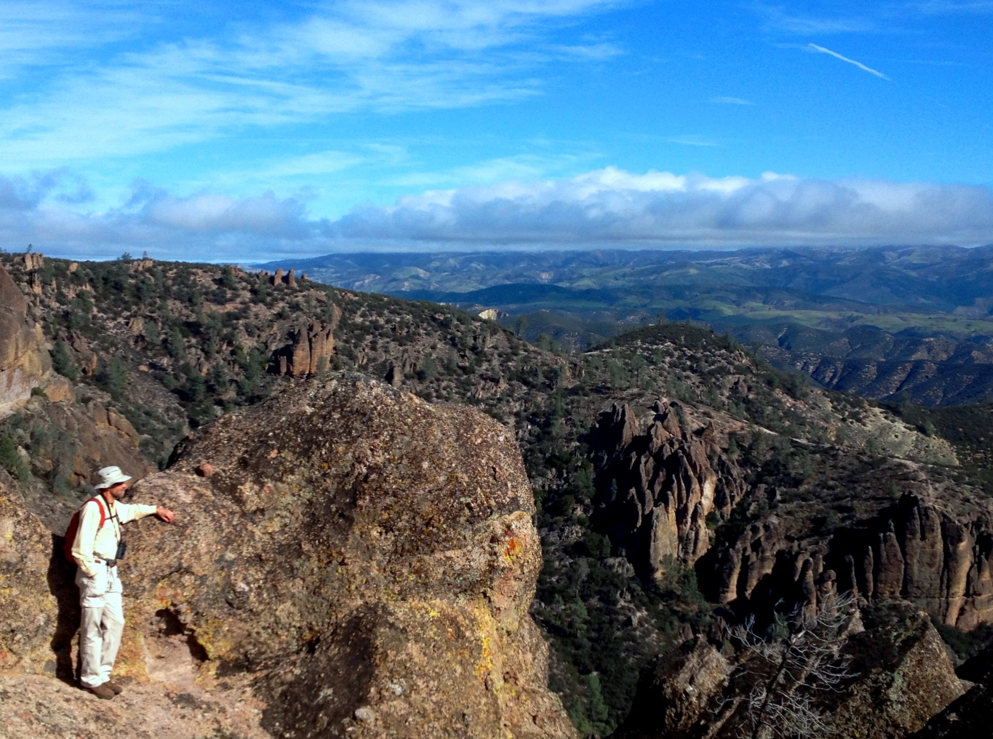
Parable of the formal research assessment
Pinnacles National Park
Central California
Notes:
HIFS can be traced to the rise of formal assessments of the collective research impact of institutions, departments, and other units within institutions. These assessments strive for objectivity, partly because objectivity seems like something to be strived for and partly because the scope of the assessment is large enough both to make objective measures somewhat informative and to make subjective evaluations difficult to assemble and to interpret uniformly across institutions or units. The number of published papers seems an obvious objective metric, but not all papers are created equal. Citations might be brought in to measure the impact of a paper, but since these assessments are meant to be snapshots, the citation record is generally too recent to be very informative. Publications in HIF journals are then weighted more heavily than other papers because these papers have more potential for substantial impact, as measured, for example, by future citations. HIF thus emerges as a mildly informative tool for assessment of departments and larger entities, although those in charge of these assessments usually misread “mildly informative” as “wildly informative.”
With HIF accepted as an objective component of unit-wide assessments, it is only a short step to applying it to smaller and smaller units and individuals. Surely, it is said, if the department needs publications in HIF journals for its own assessment, it should hire and value most highly those people who have demonstrated the capacity to produce those publications. As science becomes broader and researchers more specialized, we all become less equipped to assess the contributions of our colleagues, and this increases the temptation to adopt a shorthand proxy like HIFS. Administrators, even more distant from particular research areas and thus weaker on the technical expertise needed to assess individuals, welcome the convenient and objective HIFS proxy, especially since it is free of the explicit and implicit biases that plague subjective evaluations.
Middle-career and senior scientists, sensing a need to secure their reputations, opt to aim their research at what they think can be published in HIF journals. Junior scientists, highly attuned to the direction the wind is blowing, get the message that job and funding prospects are tied to publication in HIF journals. Students and postdocs ask their mentors, “Don’t you think we can get this paper into Nature?” Some mentors lead the charge, and others acquiesce; motives range from personal advancement to the desire to help mentees get a job. And so it goes: A structure of incentives and rewards entrenches itself.
Making individual hiring and funding decisions on the basis of HIF will lead to poor decisions that exact a price down the road. But I worry that the mechanisms of scientific feedback---exacting the price---are becoming too slow to keep up and that HIF-based decisions are becoming a self-fulfilling prophecy. We could end up with sales force instead of scientists, and science itself will suffer.

Slide 11
HIF incentive structure
Governments and funding agencies.
$$$$
Research institutions.
$$$$$
$$
Research
assessments
$$$
Reputation (credentialing)
Validation (certification)
Scientists.
HIF journals.
Papers
$
$$
The data are available:
TR Web of Science
Google Scholar
Pre-massaged:
Nature Index

Slide 12
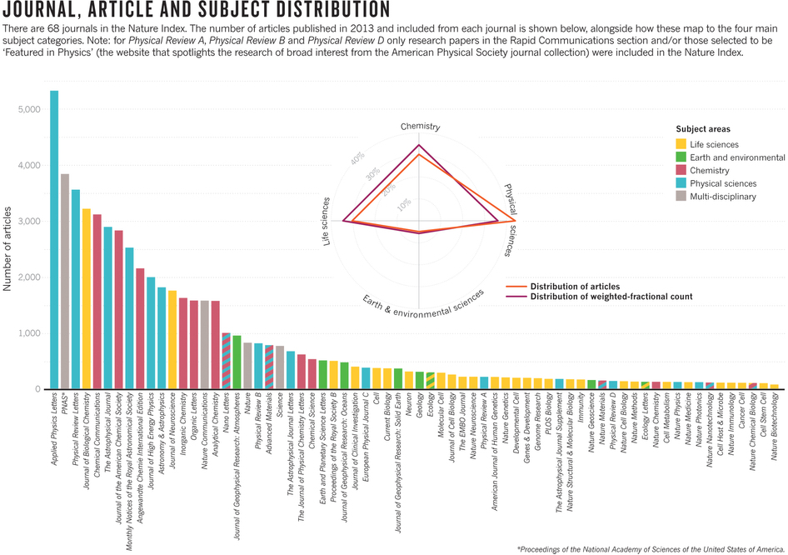
Nature index global
Nature 515, S49 (November 13, 2014)
Nature 522, S1 (June 18, 2015)

Slide 13
HIF incentive structure
Governments and funding agencies.
$$$$
Research institutions.
$$$$$
$$
Research
assessments
$$$
Reputation (credentialing)
Validation (certification)
Scientists.
HIF journals.
Papers
$
$$
The data are available:
TR Web of Science
Google Scholar
Pre-massaged:
Nature Index
And trumpeted

Slide 14
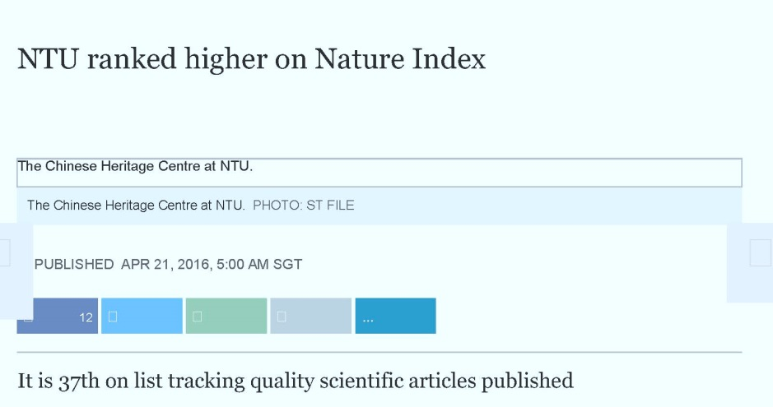
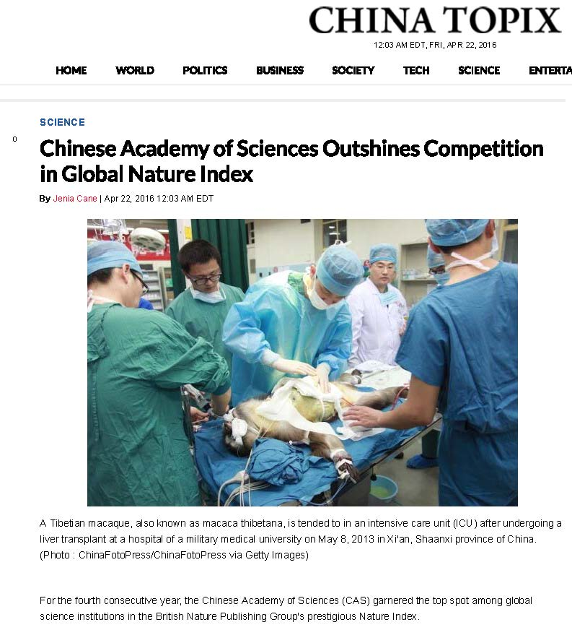
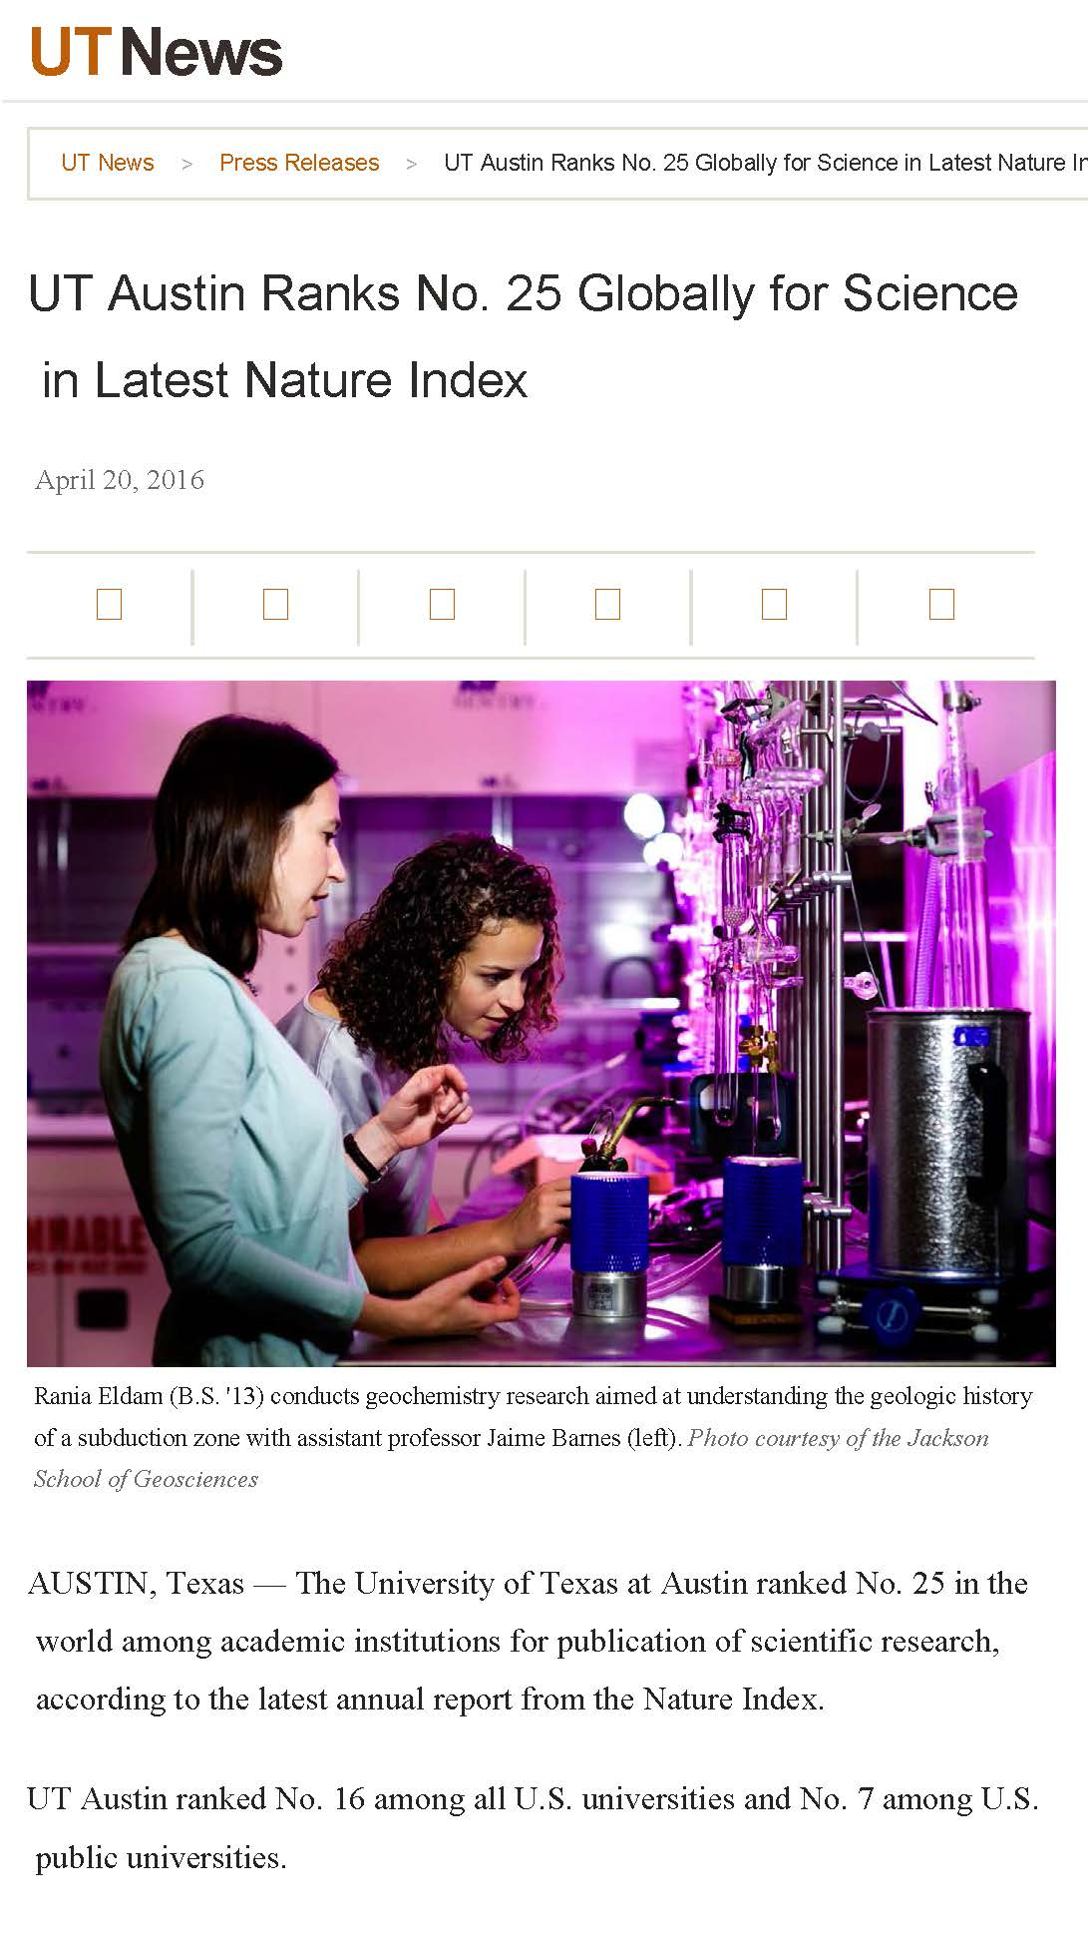
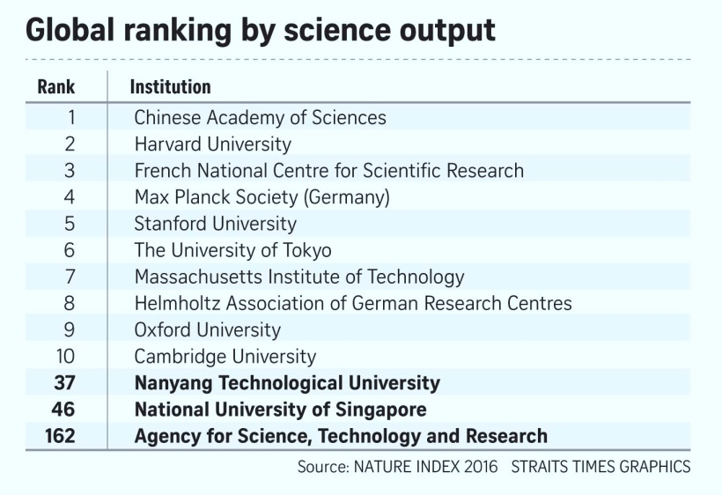
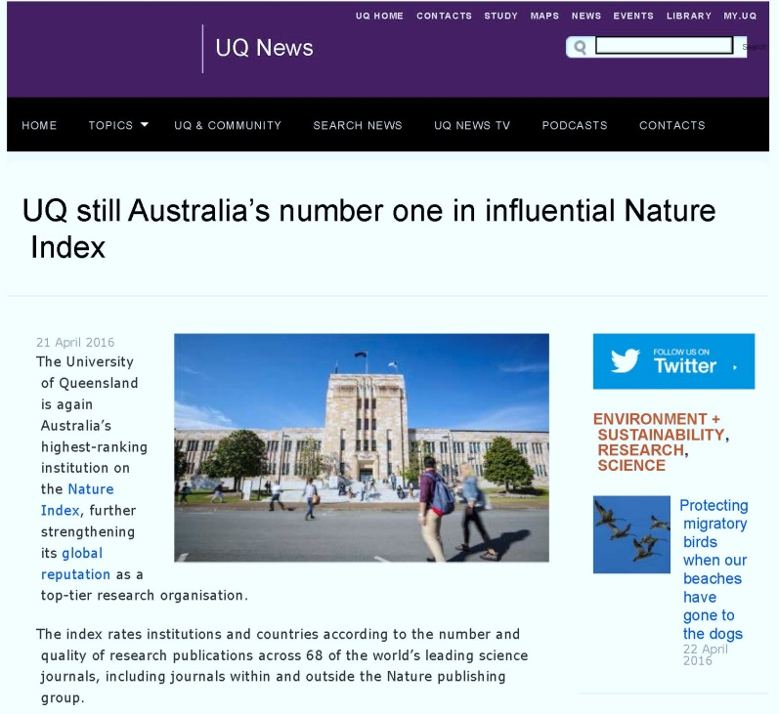
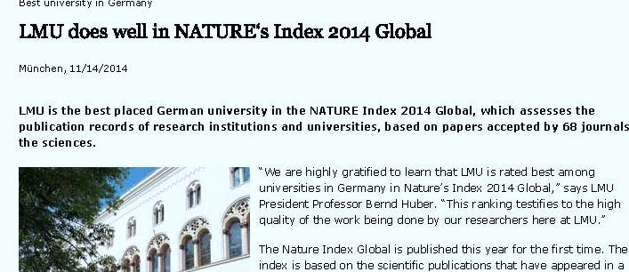
Nature index
Nanyang Technical
University
Chinese Academy of Sciences
UQ Brisbane
LMU München
UT Austin

Slide 15
Consequences of HIFS
Poor decisions in hiring, funding, promotions, and prizes and awards, especially when administrators without technical expertise are inserted into the process or when an institution hires in a field new to it.
Should we eschew bibliometric data in assessing research impact?

Slide 16
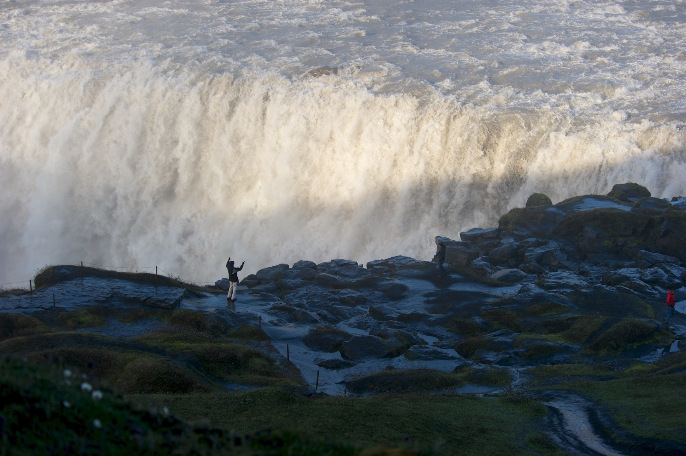
Articles | Citations | Per article | h-index | 100h-index
331 | 15,796 | 48 | 60 | 3
135 | 11,825 | 88 | 46 | 5
135 | 10,137 | 75 | 47 | 4
199 | 8,627 | 43 | 42 | 4
124 | 8,442 | 68 | 37 | 3
93 | 8,220 | 88 | 44 | 4
Six QI theorists
Dettifoss
Iceland

Slide 17
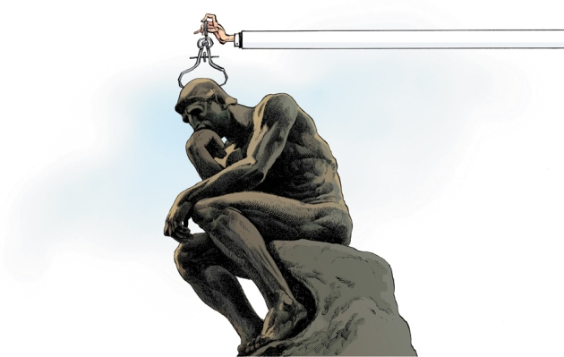
Bibliometrics
The Leiden manifesto
Nature 520, 429–431 (2015 April 23)
Quantitative evaluation should support qualitative, expert assessment.
Measure performance against the research missions of the institution, group, or researcher.
Protect excellence in locally relevant research.
Keep data collection and analytical processes open, transparent, and simple.
Allow those evaluated to verify data and analysis.
Account for variation by field in publication and citation practices.
Base assessment of individual researchers on a qualitative judgement of their portfolio.
Avoid misplaced concreteness and false precision.
Recognize the systemic effects of assessment and indicators.
Scrutinize indicators regularly and update them.

Slide 18
Consequences of HIFS
Poor decisions in hiring, funding, promotions, and prizes and awards.
Should we eschew bibliometric data in assessing research impact?
Bibliometrics, used carefully within a suite of assessment tools and calibrated appropriately, can provide useful information in assessing an extended research record, as in promotion decisions.
But hiring and funding decisions want a snapshot, weighted toward potential instead of accomplishment. This is where the temptation to succumb to HIFS is greatest, but it is marginally informative at best and nearly useless as a measure of individual potential.
You are more likely to assemble a team of individuals who can satisfy an institutional imperative for researchers who have high impact by doing a complete, well-rounded evaluation of individual research records.

Slide 19
Consequences of HIFS
Poor decisions in hiring, funding, promotions, and prizes and awards, especially when administrators without technical expertise are inserted into the process or when an institution hires in a field new to it.
Surrender of the scientific research agenda to the editors of Nature and its babies, Science, and Cell.
Fragmentation of the scientific literature into short, punchy, hit-and-run papers aimed at HIF journals. Literature becomes a jungle for students and junior researchers.
Trend toward hype, fluff, and salesmanship as primary values in scientific research and a reduction in commitment to scientific integrity and the search for truth, the two things that set science apart as a social enterprise.
All these exact a price down the road. I worry that the mechanisms of scientific feedback—exacting the price—are now too slow, making HIF-based decisions a self-fulfilling prophecy. We could end up with a sales force instead of scientists.

Slide 20
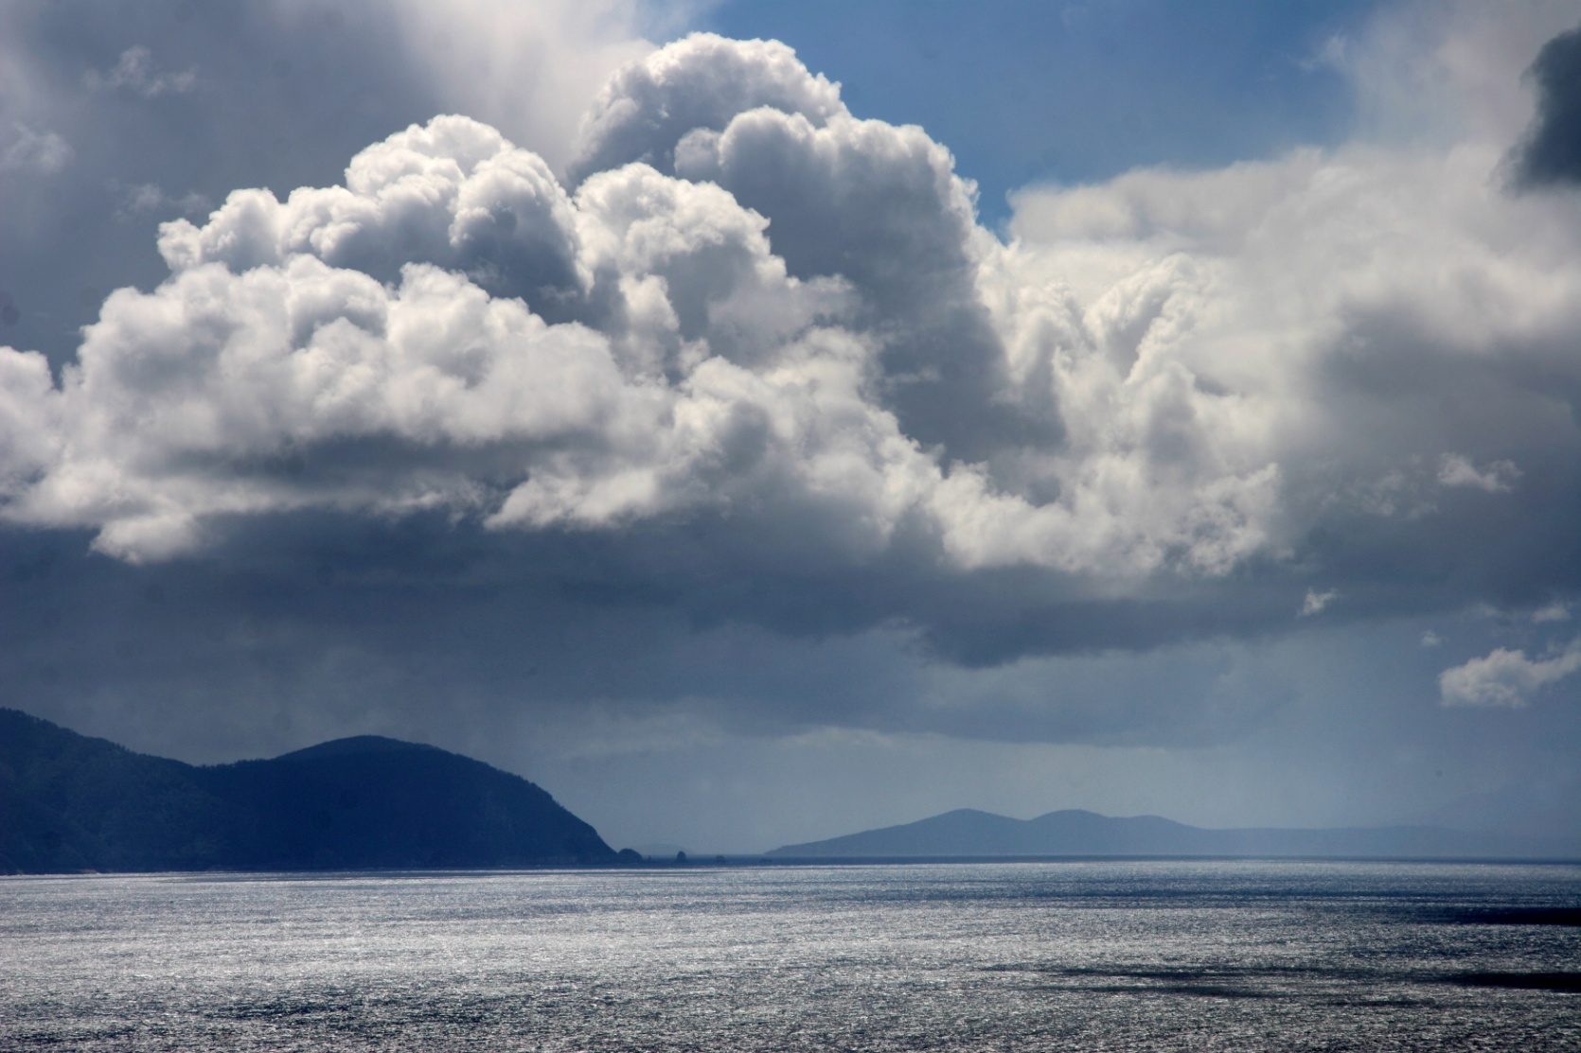
Campbell’s law
The more any quantitative social indicator is used for social decision-making, the more subject it will be to corruption pressures and the more apt it will be to distort and corrupt the social processes it is intended to monitor.
D. T. Campbell, “Assessing the impact of planned social change,” Journal of MultiDisciplinary Evaluation 7(15), 3 (2011); originally published as Paper #8, Occasional Paper Series, Public Policy Center, Dartmouth College, December 1976.
Gaming any single indicator is inevitable.
View from Cape Hauy
Tasman Peninsula, Tasmania
Notes:
Lior Pachter, “To some a citation is worth $3 per year,” https://liorpachter.wordpress.com/2014/10/31/to-some-a-citation-is-worth-3-per-year/.
Yudhijit Bhattacharjee, “Saudi universities offer cash in exchange for academic prestige,’’ Science 334, 1344-1345 (9 December 2011). DOI: 10.1126/science.334.6061.1344
2014 USNWR 2014 global ranking of universities in mathematics: including rankings by subject area.
1. Berkeley 2. Stanford 3. Princeton 4. UCLA 5. University of Oxford 6. Harvard 7. King Abdulaziz University (Jeddah, Saudi Arabia) 8. Pierre and Marie Curie – Paris 6 9. University of Hong Kong 10. University of Cambridge
The USNWR rankings are based on 8 attributes: global research reputation, regional research reputation, publications, normalized citation impact, total citations, number of highly cited papers, percentage of highly cited papers, international collaboration
KAU’s Math Department began its PhD program in 2012. KAU has achieved its remarkable ranking through a “Distinguished Adjunct Professors” program, which offers $72k/year for, mainly, KAU affiliation on papers and addition of KAU as a secondary affiliation at ISIhighlycited.com .
In fact, in “normalized citation impact” KAU’s math department is the top ranked in the world. This amazing statistic is due to the fact that KAU employs (as adjunct faculty) more than a quarter of the highly cited mathematicians at Thomson Reuters.

Slide 21
Consequences of HIFS
Poor decisions in hiring, funding, promotions, and prizes and awards, especially when administrators without technical expertise are inserted into the process or when an institution hires in a field new to it.
Surrender of the scientific research agenda to the editors of Nature and its babies, Science, and Cell.
Fragmentation of the scientific literature into short, punchy, hit-and-run papers aimed at HIF journals. Literature becomes a jungle for students and junior researchers.
Trend toward hype and salesmanship as primary values in scientific research and a reduction in commitment to scientific integrity and the search for truth, the two things that set science apart as a social enterprise.
Campbell’s law. Gaming and goal displacement.

Slide 22
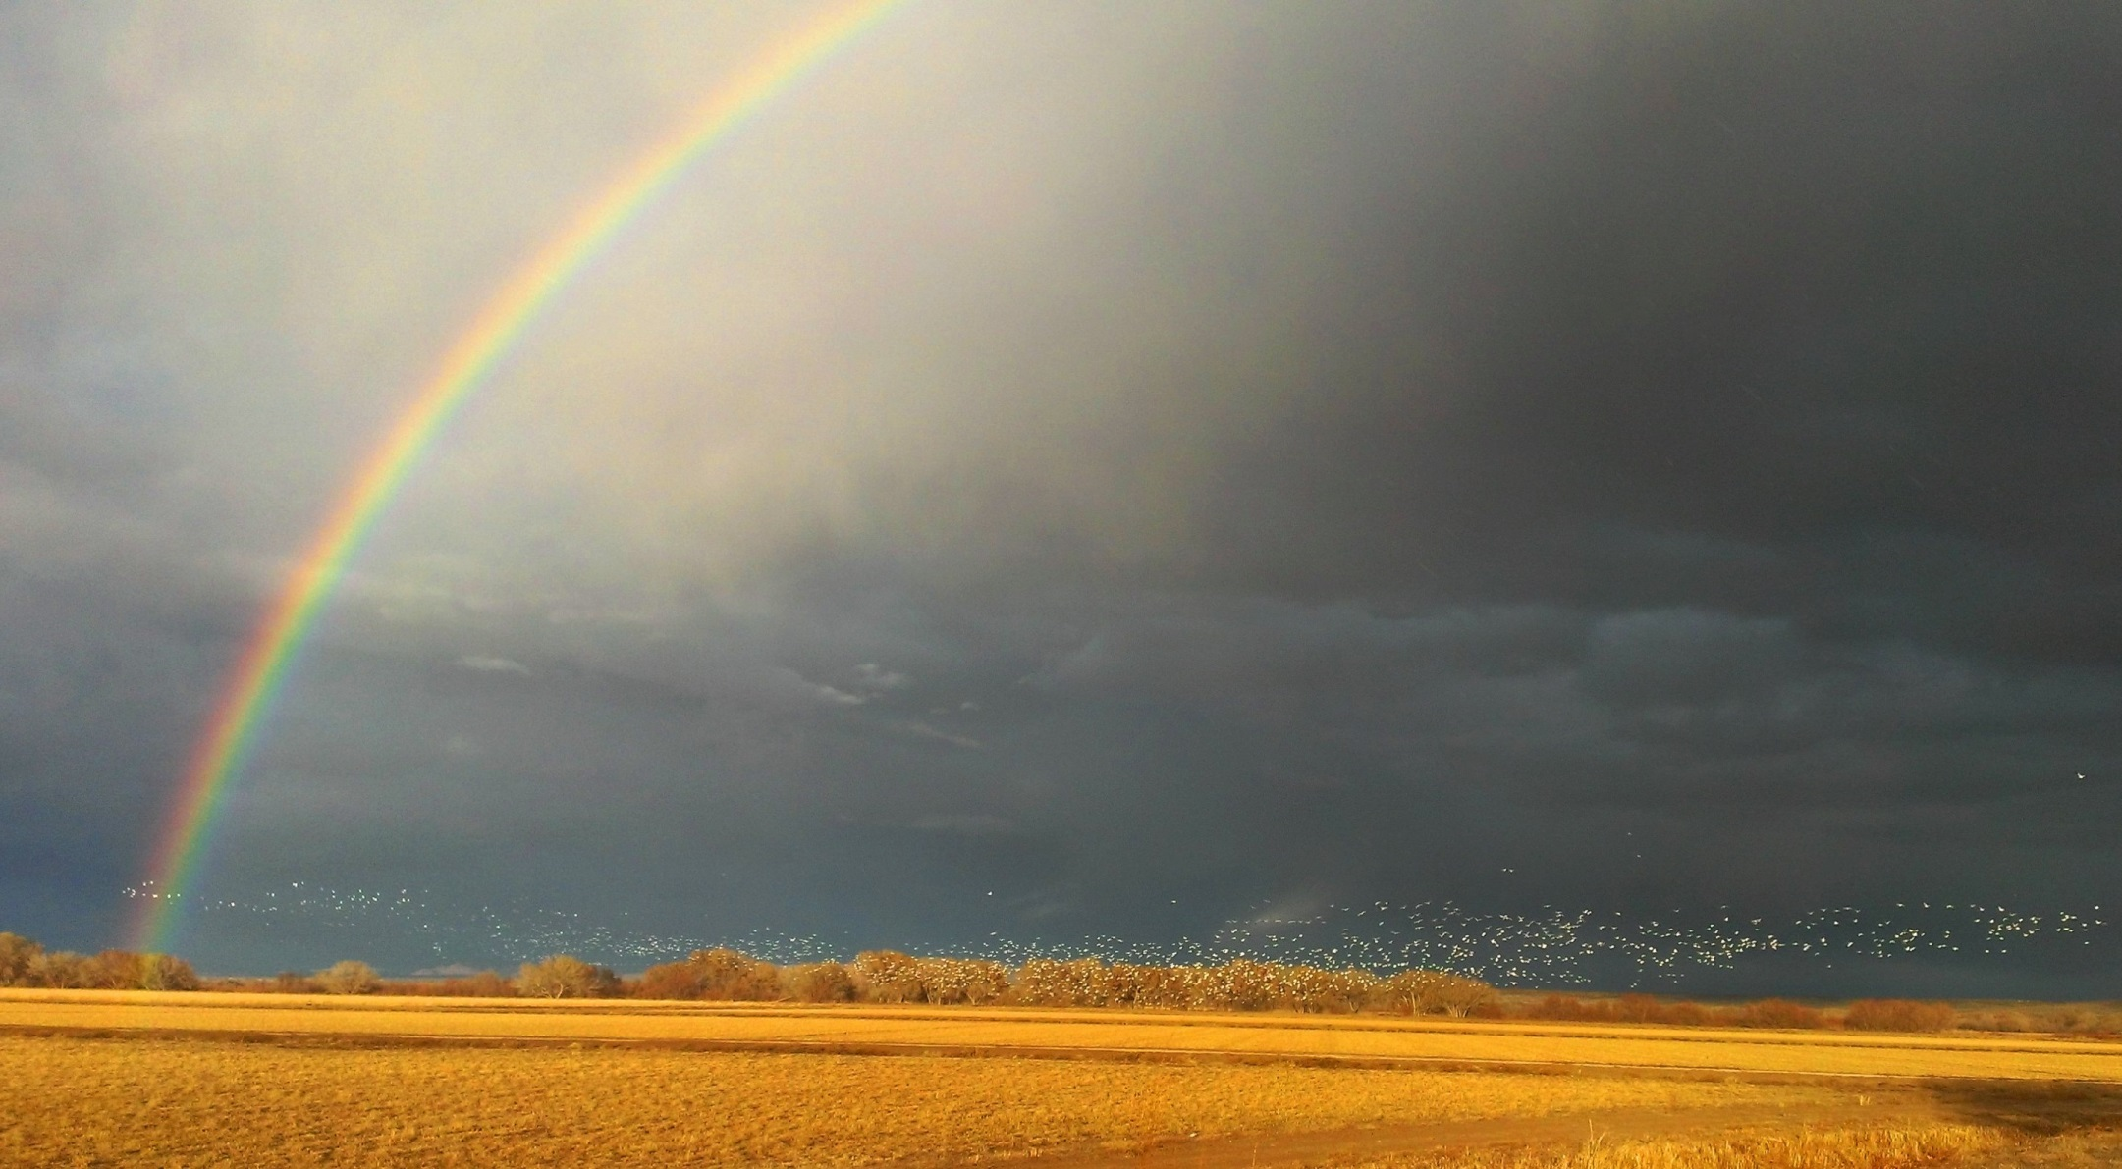
What to do?
● Scientists
● Society journals
Snow geese
Bosque del Apache, central New Mexico

Slide 23
What to do? Scientists
Appeals to good behavior and scientific integrity
Renew your commitment to effective scientific communication.
When evaluating candidates for positions, promotions, and prizes or awards, commit to a technically informed evaluation of each candidate’s record.
When writing letters of recommendation, write a technically informed evaluation of a candidate’s capabilities and impact, including a description and evaluation of important research.
Educate administrators that the HIF shortcut, though not devoid of information, is only marginally useful.
If you are a senior or mid-career scientist who advertises yourself by categorizing your publications in terms of HIF journals, stop doing that.
Help the public-relations people at your institution to identify and publicize important research contributions, independent of where they are published.
Take a look at the San Francisco Declaration on Research Assessment (DORA), which is aimed directly at combating HIFS.

Slide 24
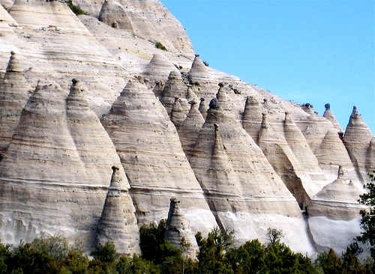
What to do? Scientists
Include in ads for positions a standard statement along the following lines: “Number of publications in high-impact-factor journals will not be a factor in assessing research accomplishments or potential.”
Support social scientists working with scientists in developing a suite of discipline-specific tools for assessing individual research accomplishment and potential and for assessing journals.
Tent Rocks
Kasha-Katuwe National Monument
Northern New Mexico

Slide 25
What to do? Society journals
What is the point of scientific publication?
Dissemination of knowledge
Most effective communication of knowledge
Certification and credentialing
Taking advantage of online, electronic publishing: interactive graphics, pop-up supplemental material, videos, video abstracts, invitations to similar papers, more effective search that uses cites, downloads, etc. to rate.
But how is all of this to be made archival? There is a danger of turning science into performance art.
This is the value-added of publication in scientific journals. It needs constant attention.

Slide 26
Value-added certification and credentialing
Parties: authors, editors (staff editors, associate editors, editorial boards), referees
How to allocate a scarce resource accurately, fairly, and efficiently? Issues are especially acute for journals that provide a higher level of credentialing, by publishing important or key papers, but are accountable to the scientific community in ways the commercial journals are not (i.e., cannot retreat to the criterion of what sells the mag). How to make the process accurate and fair without being absurdly tedious?
Authors:
Help in writing effective papers
Editorial affirmation when a referee is off base
Effective peer review:
Rejection without review
Feedback to referees
Culling unreliable reviewers and reviews
Training in reviewing
Rewarding good referees (annual report with grade; top x%)
Avoiding fad bubbles

