Slide 1
Everything I know I learned by doing
physics homework problems
Tips for solving physics homework problems
How long does something last? Predicting future duration from present age
Temporal Copernican principle and Gott’s rule
Doom and Bayesian inference
Parting shots
Carlton M. Caves
University of New Mexico
http://info.phys.unm.edu/~caves
C. M. Caves, “Predicting future duration from present age: A critical assessment,” Contemporary Physics 41, 143 (2000).
C. M. Caves, “Predicting future duration from present age: Revisiting a critical assessment of Gott’s rule, arXiv:0806.3538 [astro-ph].

Slide 2
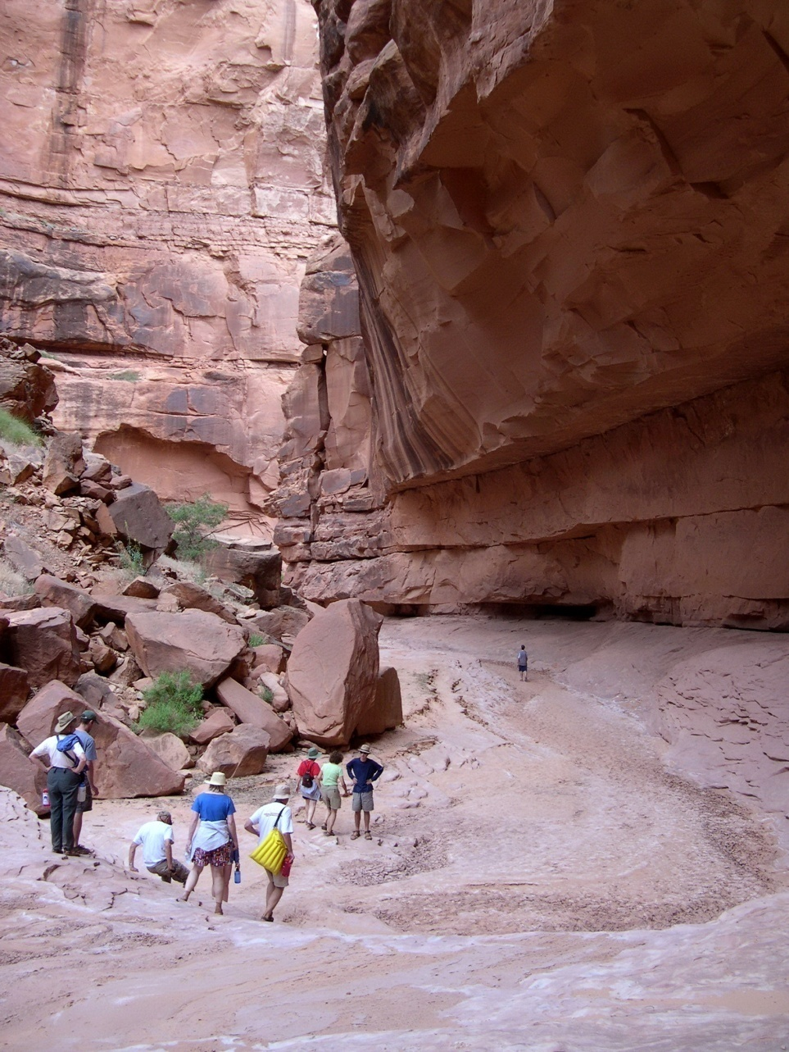
I. Tips for solving physics homework problems
Oljeto Wash
Southern Utah

Slide 3
Tips for solving physics homework problems
http://info.phys.unm.edu/~caves/courses/probtech.pdf
Getting started
Try to develop a picture—something you can visualize—that captures the essence of the problem.
Use symmetries to simplify your work.
Identify the important scales—i.e., the important quantities with dimensions—before you start.
Reason backward from the answer you are asked to supply to the concepts and information you need.
Guess the answer, using any technique at your disposal, before you begin.
If you don't need to know the answer exactly (you never really do), think about whether an easier approximate technique can be used.
Before using advanced techniques, think whether the problem—or at least part of the problem—can be solved using elementary methods.
Pause before you start work on a problem to try to think of a clever way to do it.

Slide 4
Tips for solving physics homework problems
http://info.phys.unm.edu/~caves/courses/probtech.pdf
Doing the problem
Don't put in numerical values till the end.
Always use vector signs on vectors.
Checking your answer
Test your solution in any limiting case where you know the right answer from other considerations.
Do the problem in two or more independent ways.
Check that your answer has the proper units.
Think about your answer critically, to see if it makes sense in light of other things you know.

Slide 5
Real-life problems are often hard because they are poorly formulated and nobody knows the answer. It is even more important to know how to formulate the problem and to check your answer critically. Thinking critically about what you do is the foundation of scientific integrity.

Slide 6
II. How long does something last? Predicting future duration from present age
Cape Hauy
Tasman Peninsula

Slide 7
Predicting future duration from present age
You observe a phenomenon some time after it begins. How long do you predict it will last?
Phenomenon:
Decaying atom
Egg timer set for 10 minutes
Person
Homo sapiens

Slide 8
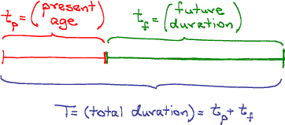
Predicting future duration from present age
Try to develop a picture—something you can visualize—that captures the essence of the problem.

Slide 9
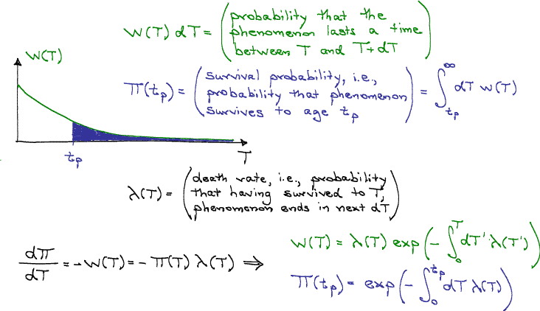
Predicting future duration from present age
Check that your answer has the proper units.

Slide 10
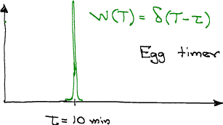
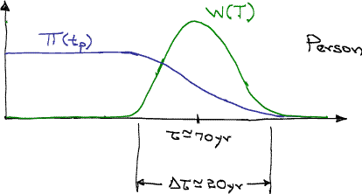
Predicting future duration from present age
Identify the important scales—i.e., the important quantities with dimensions—before you start.

Slide 11
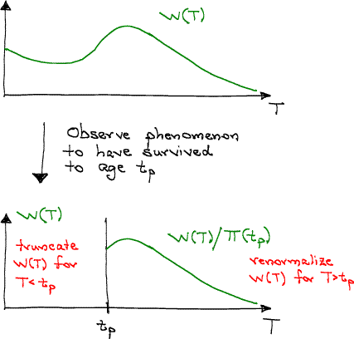
Predicting future duration from present age
Guess the answer, using any technique at your disposal, before you begin.

Slide 12
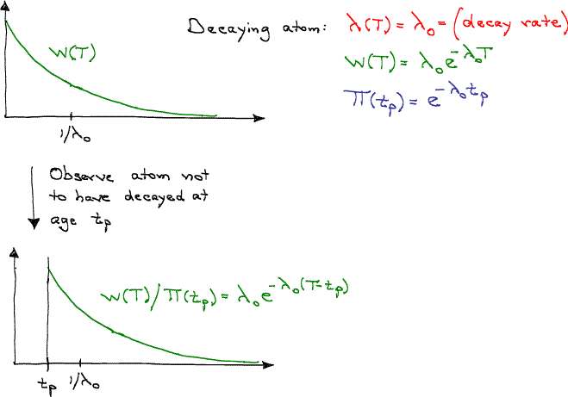
Predicting future duration from present age
Test your solution in any limiting case where you know the right answer from other considerations.
Think about your answer critically, to see if it makes sense in light of other things you know.

Slide 13
III. Temporal Copernican principle and Gott’s rule
Cable Beach
Western Australia

Slide 14
Gott’s temporal Copernican principle
Copernican principle:
We are not at a special place.
Temporal Copernican principle:
We are not at a special time.
J. R. Gott III, “Implications of the Copernican principle for our future prospects,” Nature 363, 315 (1993).

Slide 15
Temporal Copernican principle and Gott’s rule
Standing at the (Berlin) Wall in 1969, I made the following argument, using the Copernican principle. I said, Well, there's nothing special about the timing of my visit. I'm just travelling—you know, Europe on five dollars a day—and I'm observing the Wall because it happens to be here. My visit is random in time. So if I divide the Wall's total history, from the beginning to the end, into four quarters, and I'm located randomly somewhere in there, there's a fifty-per-cent chance that I'm in the middle two quarters—that means, not in the first quarter and not in the fourth quarter.
Let's suppose that I'm at the beginning of that middle fifty per cent. In that case, one quarter of the Wall's ultimate history has passed and there are three quarters left in the future. In that case, the future's three times as long as the past. On the other hand, if I'm at the other end, then three quarters have happened already, and there's one quarter left in the future. In that case, the future is one-third as long as the past. …
(The Wall was) eight years (old in 1969). So I said to a friend, “There's a fifty-per-cent chance that the Wall's future duration will be between (two and) two-thirds of a year and twenty-four years.” Twenty years later, in 1989, the Wall came down, within those two limits that I had predicted. I thought, Well, you know, maybe I should write this up.
T. Ferris, “How to predict everything: Has the physicist J. Richard Gott found a way?” The New Yorker 75(18) 35 (1999 July 12).

Slide 16
Temporal Copernican principle and Gott’s rule
“Homo sapiens has been around for two hundred thousand years,” Gott said. … “That's how long our past is. Two and half per cent is equal to one-fortieth, so the future is probably at least one-thirty-ninth as long as the past but not more than thirty-nine times the past. If we divide two hundred thousand years by thirty-nine, we get about fifty-one hundred years. If we multiply it by thirty-nine, we get 7.8 million years. So if our location in human history is not special, there's a ninety-five-per-cent chance we're in the middle ninety-five per cent of it. Therefore the human future is probably going to last longer than fifty-one hundred years but less than 7.8 million years.
“Now, those numbers are interesting, because they give us a total longevity that's comparable to that of other species.”
T. Ferris, “How to predict everything: Has the physicist J. Richard Gott found a way?” The New Yorker 75(18) 35 (1999 July 12).

Slide 17
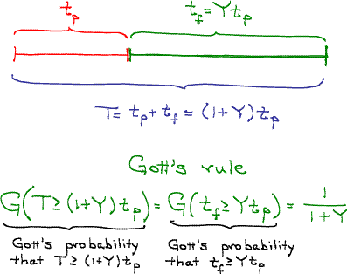
Gott’s rule

Slide 18
Gott’s rule
Picture? Clever approach? Units?
Cases: Decaying atom? Egg timer? Person?
Scales? Two ways? Think critically?
This is a professor who didn’t do his homework. Should we try to figure out where he went wrong?
Himself
Stonehenge
Thatcher-Major government in the UK
Christianity
The Seven Wonders
of the World
The former
Soviet Union
The New York Stock
Exchange
The Pantheon
The Third Reich
Oxford University
The United States
The Great Wall of China
The Internet
Canada
The Berlin Wall
Microsoft
World leaders
The Astronomical Society of the Pacific
Nature
General Motors
Wall Street Journal
The 44 Broadway and off-Broadway plays open and running on 1993 May 27
The human spaceflight program
The New York Times
Homo sapiens

Slide 19
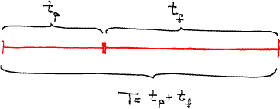
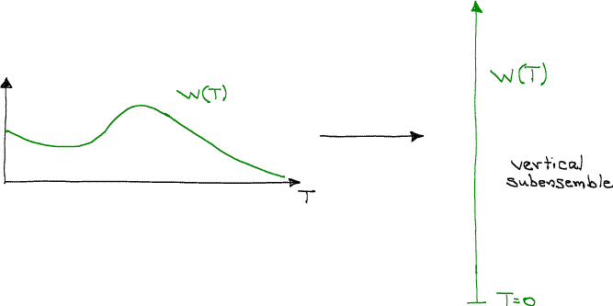
Explicating Gott’s rule
Gott’s line

Slide 20
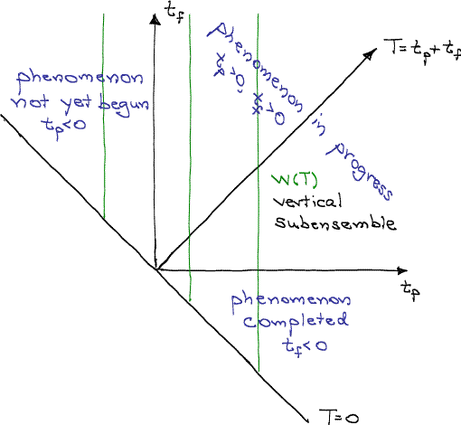
Explicating Gott’s rule
Unrestricted Copernican ensemble
Try to develop a picture—something you can visualize—that captures the essence of the problem.

Slide 21
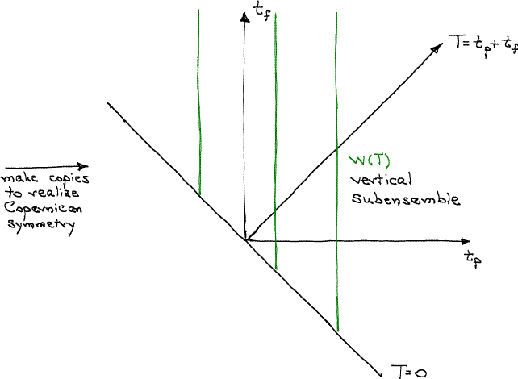
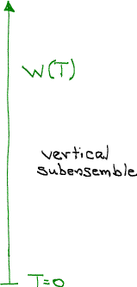
Explicating Gott’s rule
Unrestricted Copernican ensemble
Use symmetries to simplify your work.

Slide 22
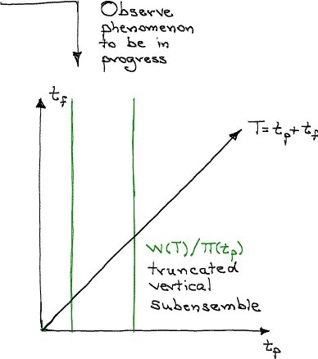
Explicating Gott’s rule
Truncated Copernican ensemble

Slide 23
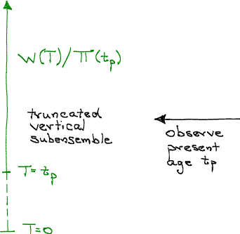
Explicating Gott’s rule

Slide 24
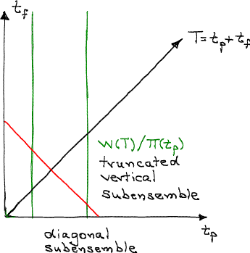
Explicating Gott’s rule: A baseball game
Truncated Copernican ensemble
The diagonal subensemble for total duration T is a realization of Gott’s line, but it does not warrant making predictions of future duration based on present age.
The total population of a diagonal subensemble is proportional to Tw(T), not w(T).

Slide 25
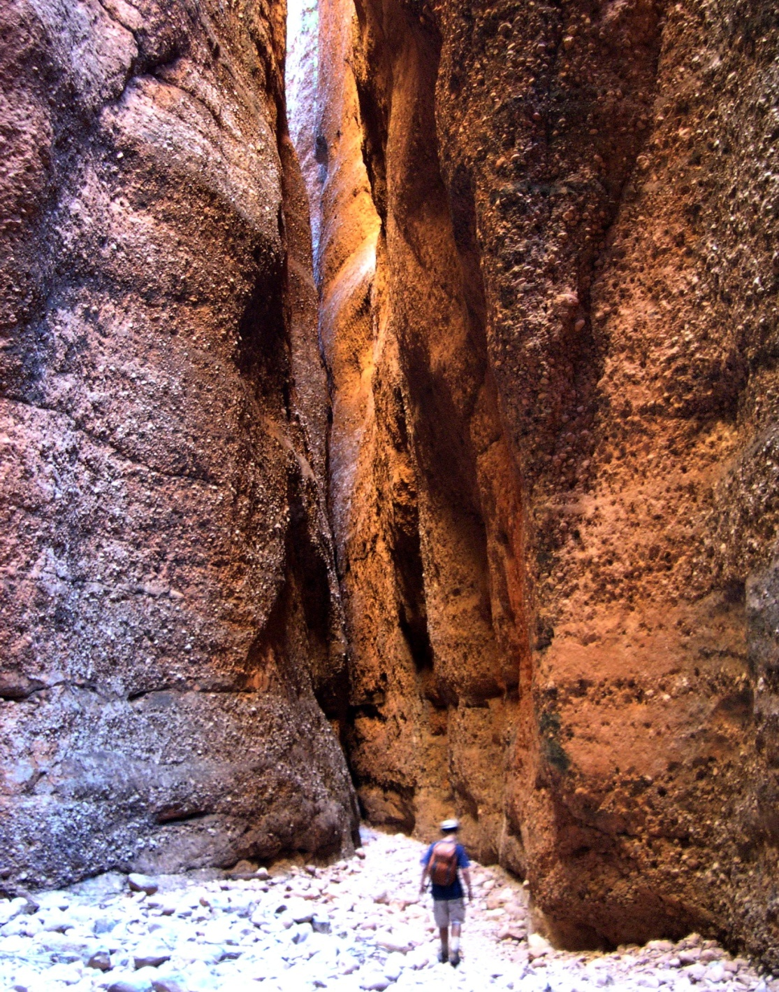
IV. Doom and Bayesian inference
Echidna Gorge
Bungle Bungle Range
Western Australia

Slide 26
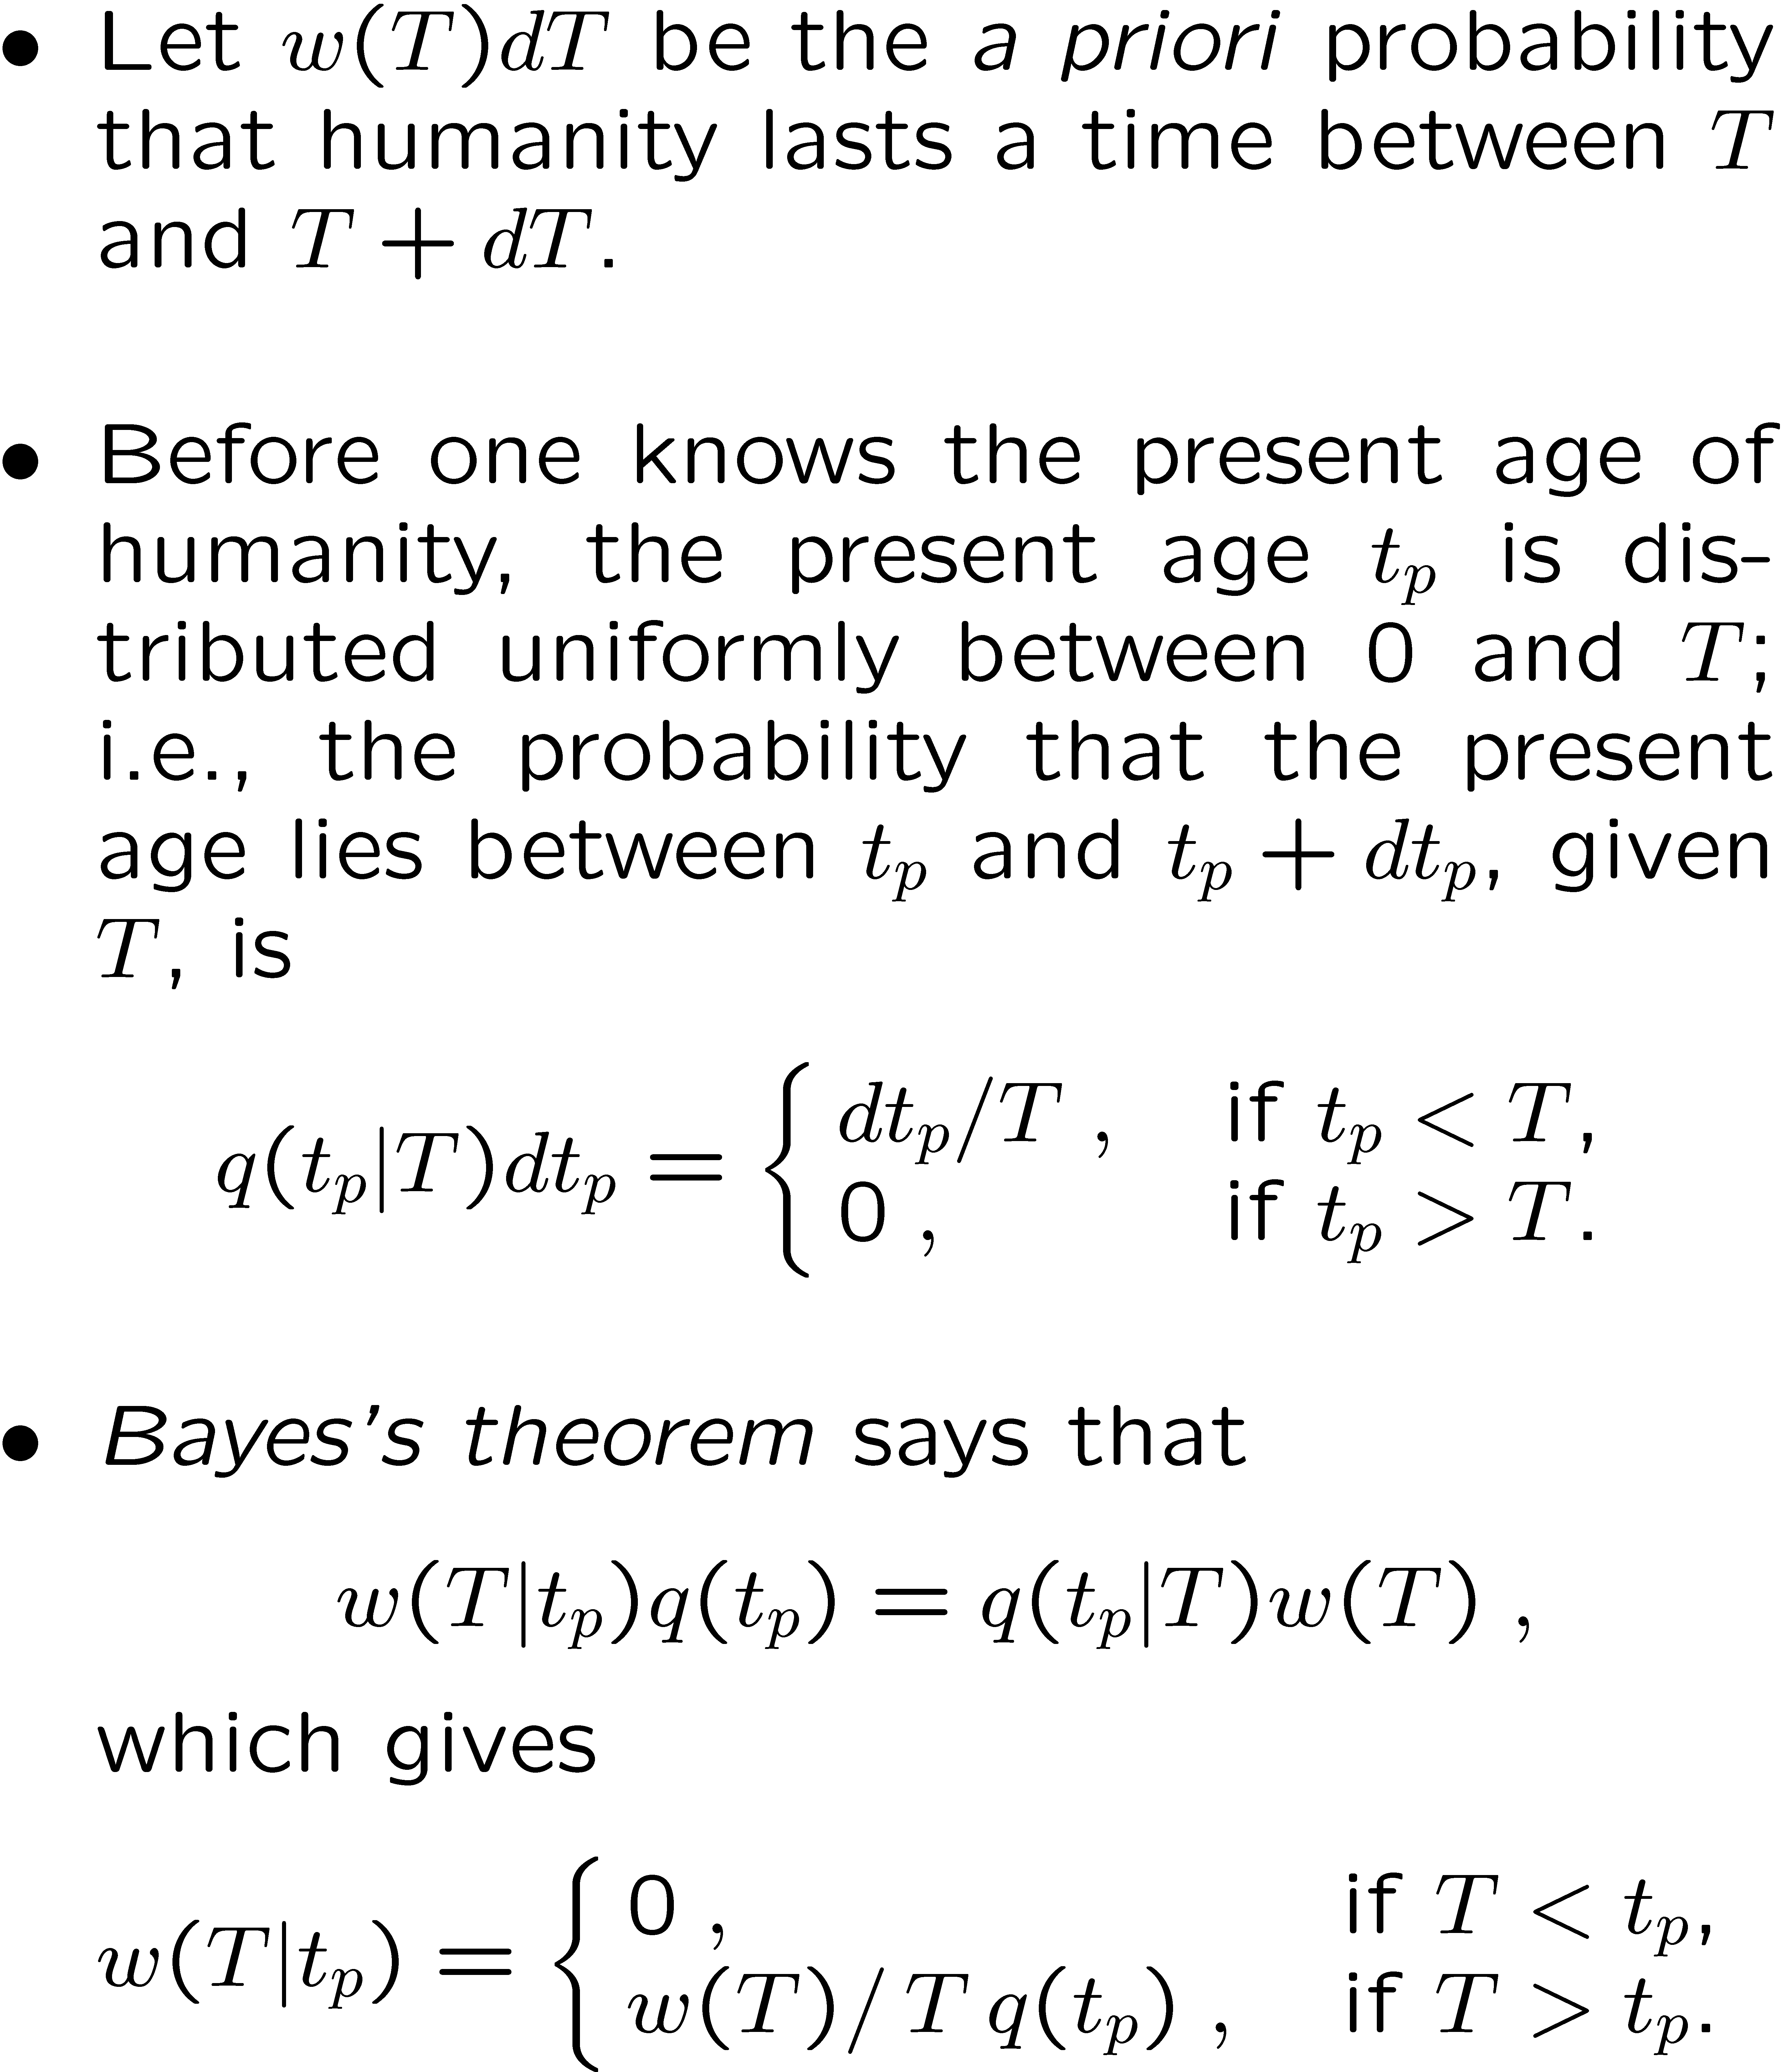
The doomsday argument
J. Leslie, The End of the World: The Science and Ethics of Human Extinction (Routledge, London, 1996)..
Clever approach? Units?
Cases: Decaying atom? Egg timer? Person?
Scales? Two ways? Think critically? Updates?
DOOM

Slide 27
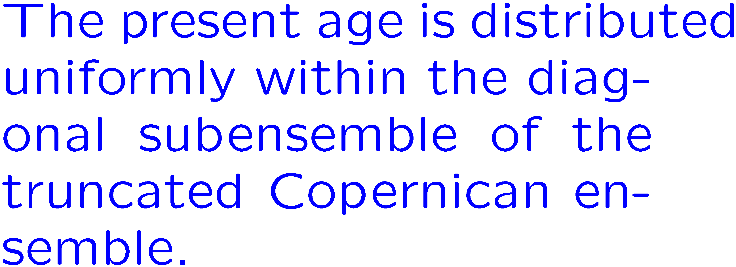
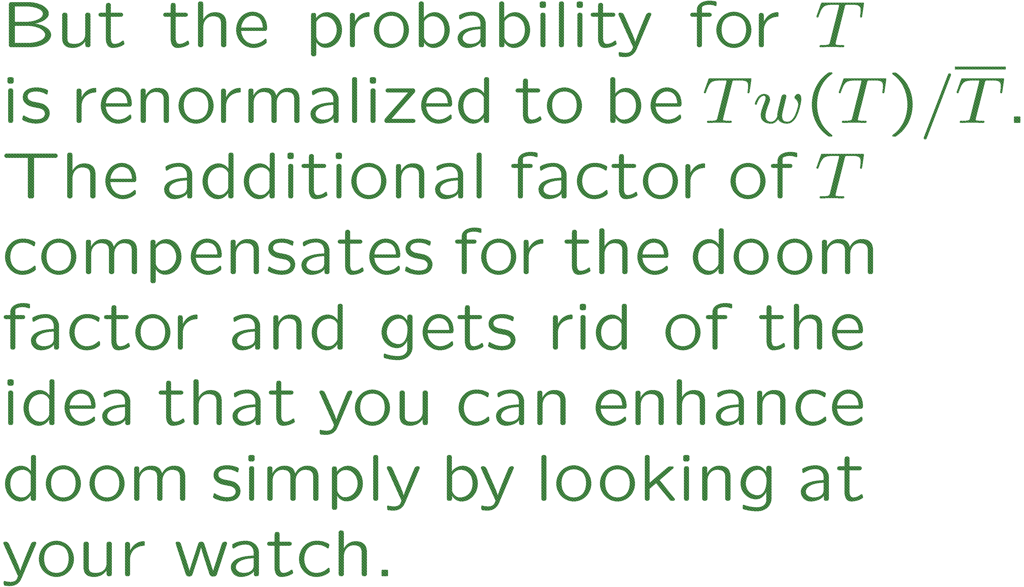
The doomsday argument
DOOM

Slide 28
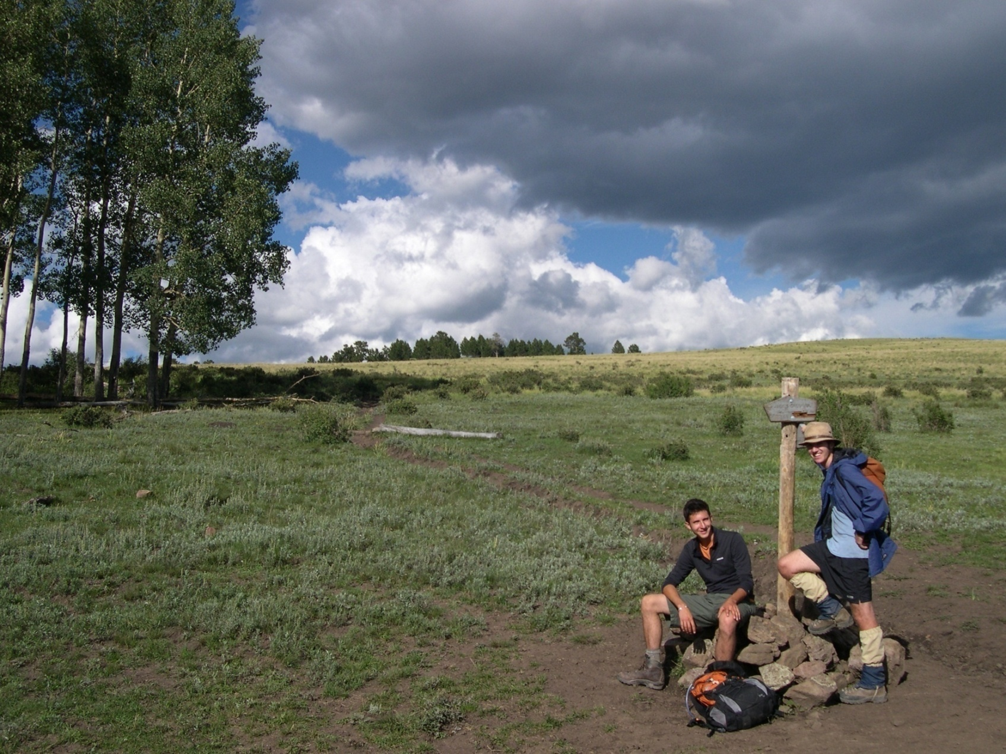
V. Parting shots
Pecos Wilderness
Sangre de Cristo Range
Northern New Mexico

Slide 29
More baseball
White Sox
Gott predicted in 1996 that the Sox, having not won a World Series title since 1917, would, with 95% confidence, win a Series sometime between 1999 and 5077.
Gott would have predicted a World Series title in 2005 or before with probability 0.10, considerably less than the probability, 1 - (29/30)⁹ = 0.26, that comes from assuming that the Sox had the same chance each year as the 30 other major-league ball clubs.
The Sox won the 2005 World Series title.

Slide 30
More baseball
Cubs
The Cubs have now had a World Series drought of a century. Gott would predict that with probability ½ they will not a win a Series for the next century.
Giving the Cubs the same chance each year as all the other clubs gives a probability (29/30)¹⁰⁰ = 0.034 of having a further 100-year drought. Gott’s prediction corresponds to giving the Cubs a probability 1 - 1/2^{0.01} = 0.007 of winning each year, about a factor of 5 less than 1/30.

