Slide 1
Diving Deep into a
Quantum-Information-Processing Problem:
Quantum Limits on the Performance of Linear Amplifiers
What’s the problem?
Quantum limits on noise in
(deterministic) phase-preserving linamps. The whole story
Nondeterministic immaculate linamps
Carlton M. Caves
Center for Quantum Information and Control, University of New Mexico
http://info.phys.unm.edu/~caves
Co-workers: J. Combes, Z. Jiang, A. P. Lund, S. Pandey, M. Piani, T. C. Ralph, N. Walk
Center for Quantum Information and Control
TexPoint fonts used in EMF.
Read the TexPoint manual before you delete this box.: AAA

Slide 2
I. What’s the problem?
Pinnacles National Park
Central California

Slide 3
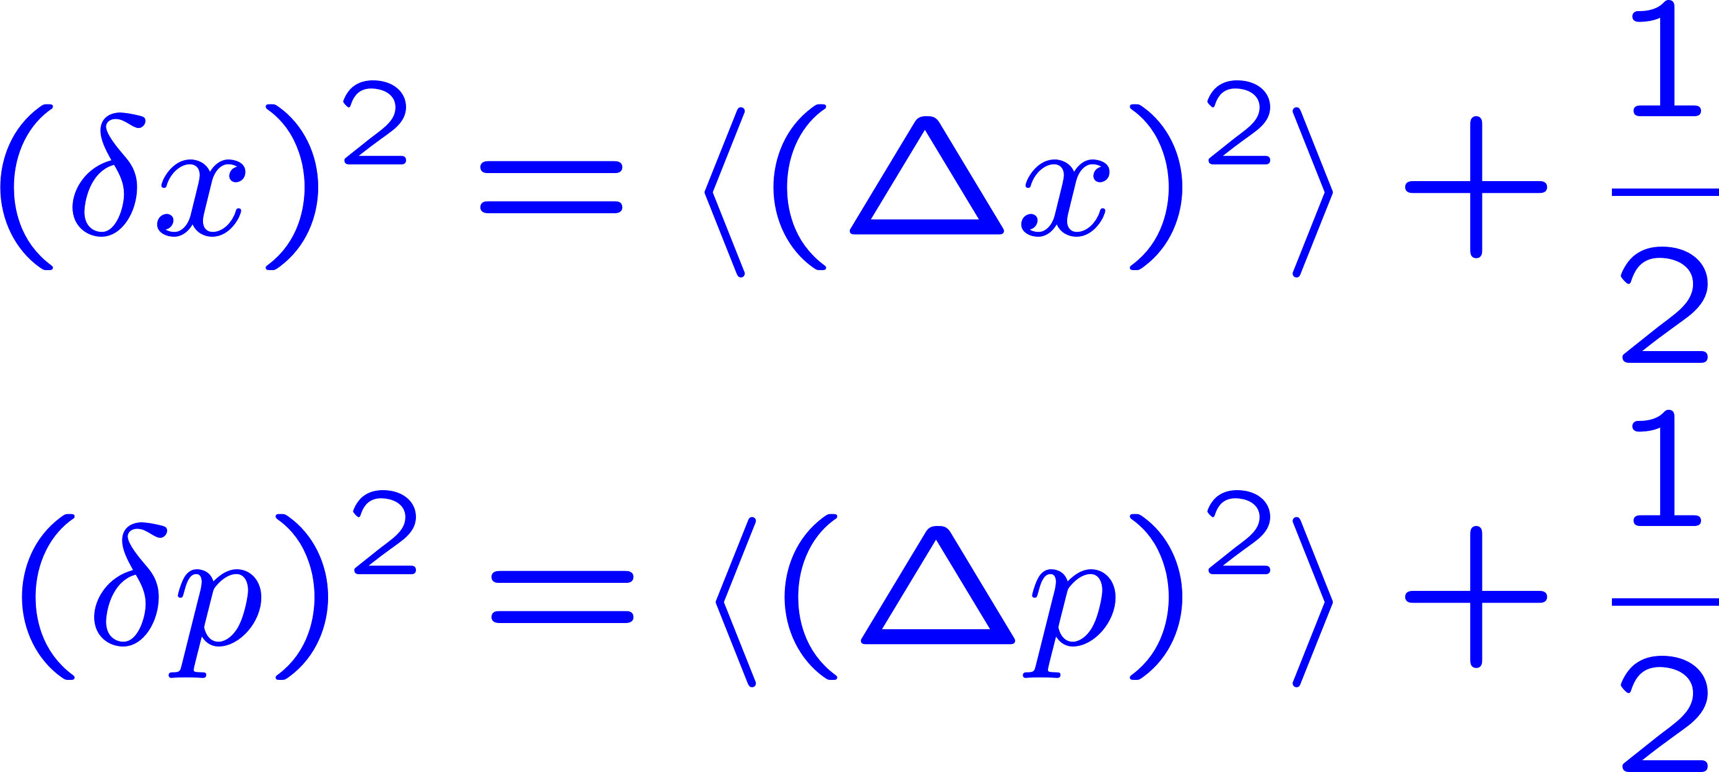
(Deterministic) phase-preserving linear amplifiers
Ball-and-stick (lollipop) diagram

Slide 4
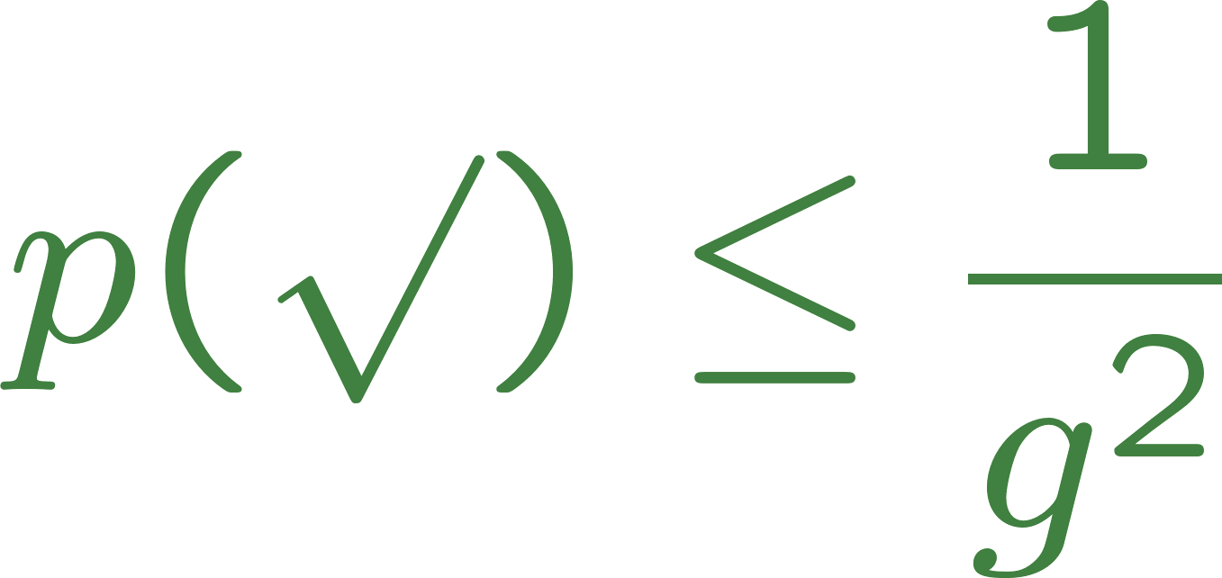
(Nondeterministic) immaculate linear amplifiers
Ball-and-stick (lollipop) diagram
This is a distinguishability argument that turns out to be radically inadequate.

Slide 5
II. Quantum limits on noise in (deterministic) phase-preserving linamps. The whole story
Holstrandir Peninsula overlooking Ísafjarðardjúp
Westfjords, Iceland

Slide 6
Phase-preserving linear amplifiers
Ball-and-stick (lollipop) diagram

Slide 7
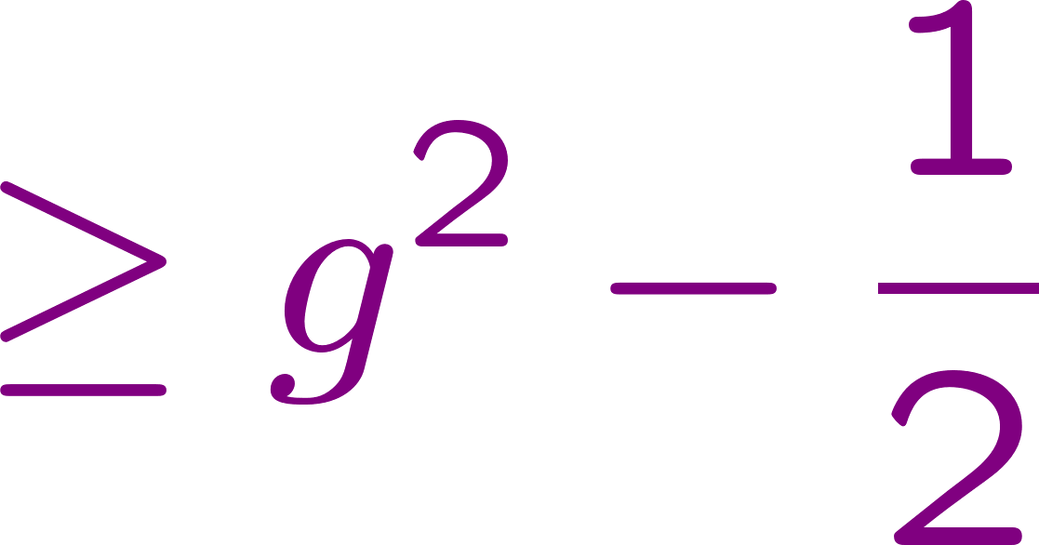
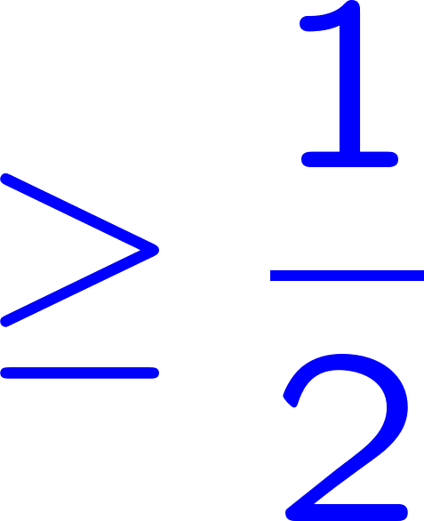
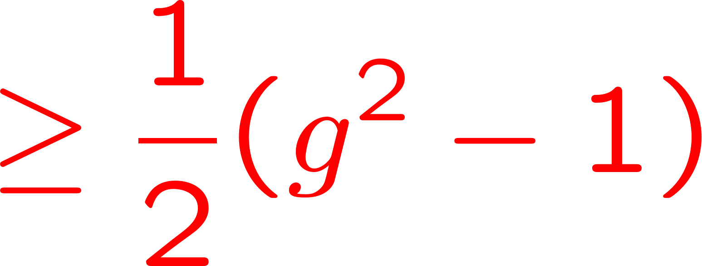
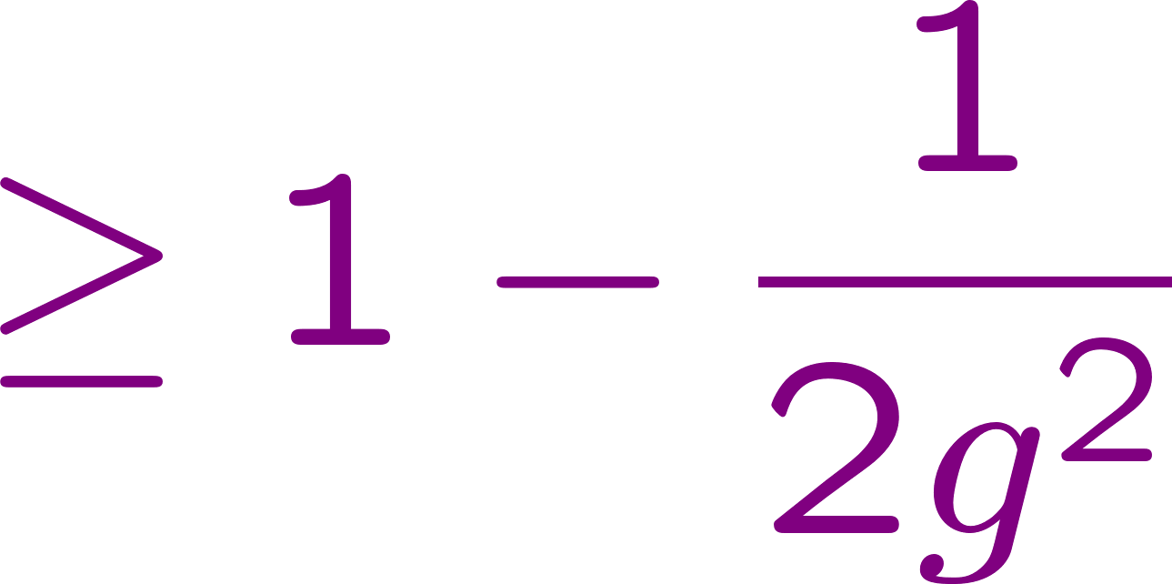
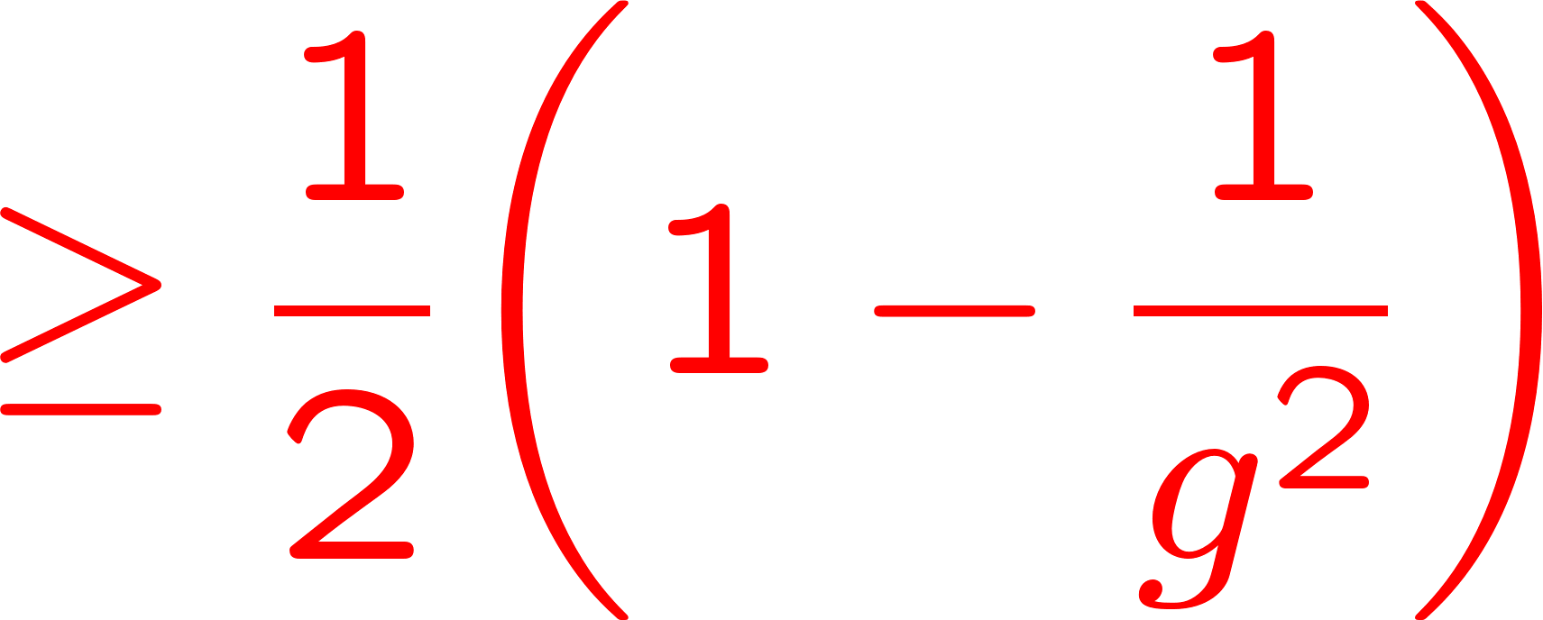
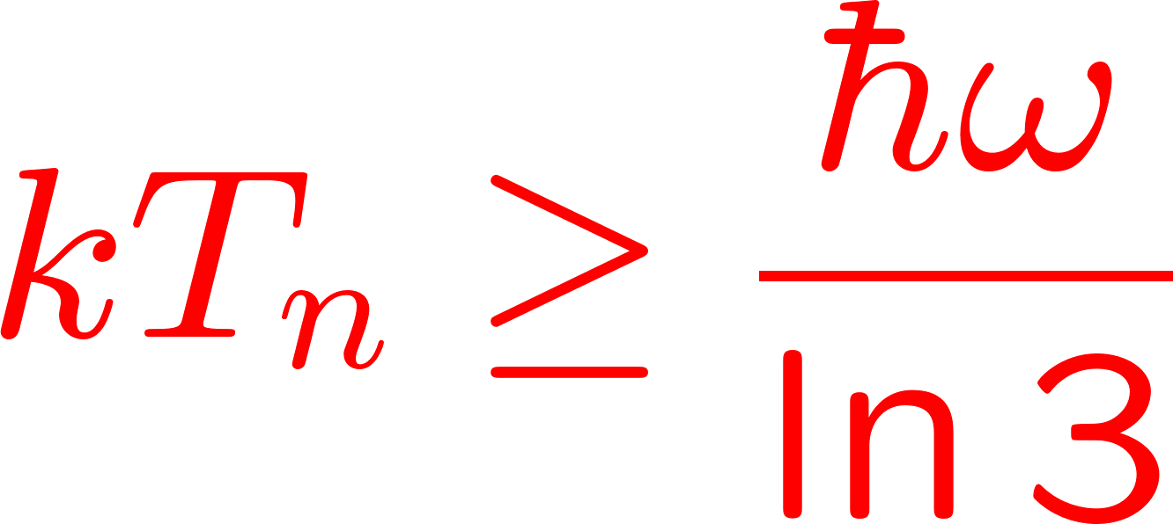
Phase-preserving linear amplifiers
added-noise operator
output
noise
input
noise
added
noise
gain
Zero-point noise
Refer
noise
to input
Added noise number
C. M. Caves, PRD 26, 1817 (1982).
C. M. Caves, J. Combes, Z. Jiang, and S. Pandey, PRA 86, 063802 (2012).
Noise temperature

Slide 8
Ideal phase-preserving linear amplifier. Parametric amplifier
To other models

Slide 9
Ideal phase-preserving linear amplifier
The noise is Gaussian. Circles are drawn here at half the standard deviation of the Gaussian.
A perfect linear amplifier, which only has the (blue) amplified input noise, is not physical.
An immaculate linear amplifier, which only has the (blue) input noise, is not physical.

Slide 10
Phase-preserving linear amplifiers
Microwave-frequency amplifiers using superconducting technology are at quantum limits and are being used as linear detectors in photon-coherence experiments. This requires more than second moments of amplifier noise.
What about nonGaussian added noise?
What about higher moments of added noise?
THE BIGGER PROBLEM
What are the quantum limits on the entire distribution of added noise?

Slide 11
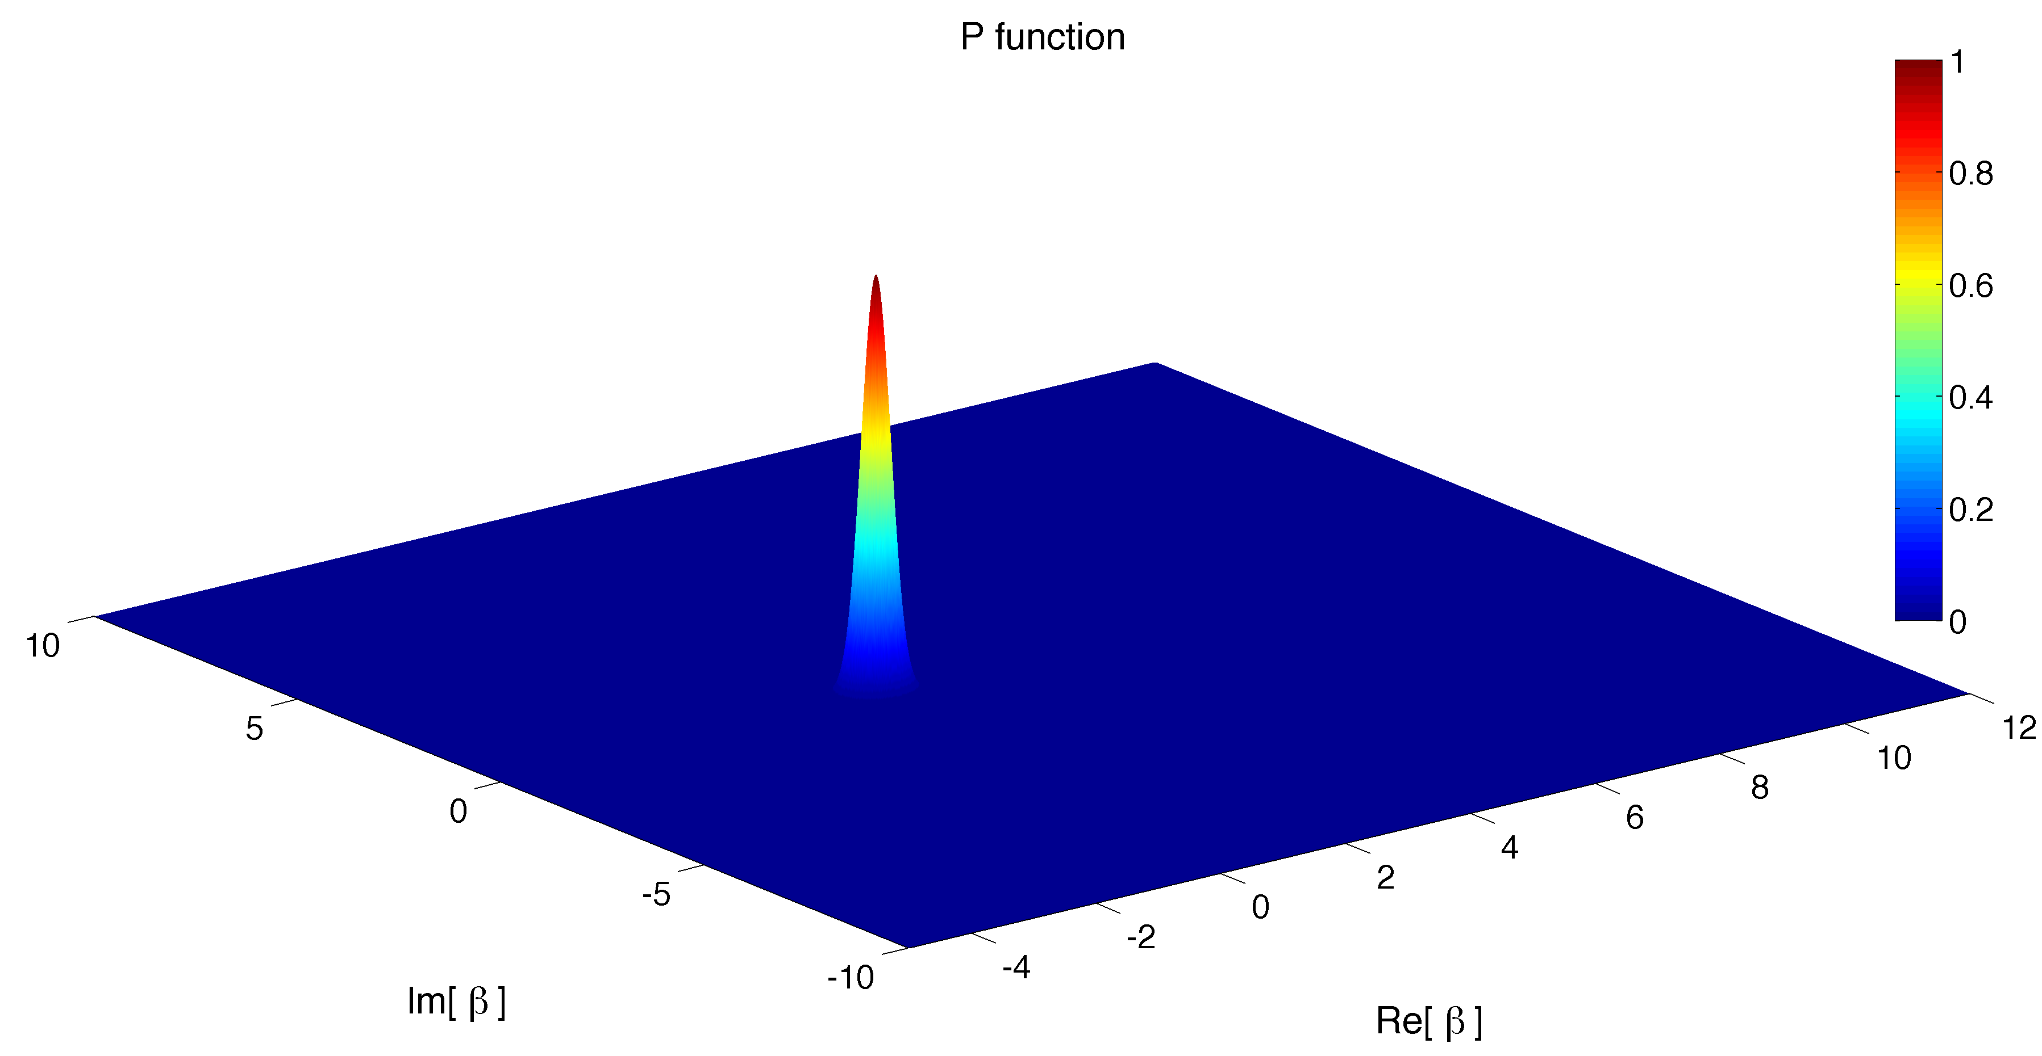
Initial coherent state

Slide 12
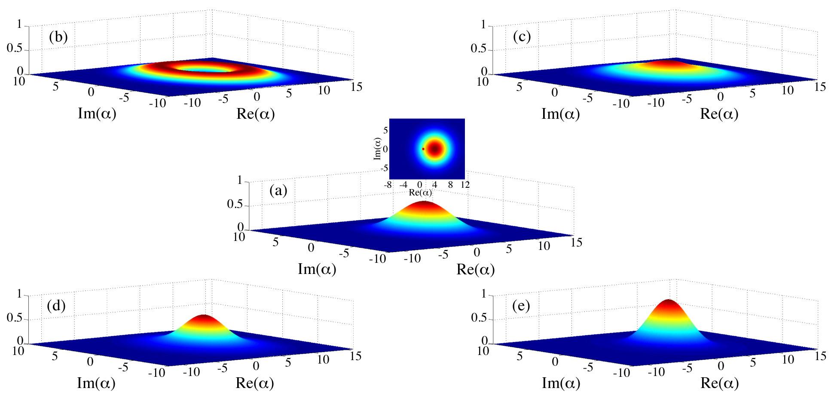
NonGaussian amplification of initial coherent state
Which of these are legitimate linear amplifiers?

Slide 13
What is a phase-preserving linear amplifier?
Immaculate amplification of input coherent state
Smearing probability distribution. Smears out the amplified coherent state and includes amplified input noise and added noise.
For coherent-state input, it is the P function of the output.
THE PROBLEM
What are the restrictions on the smearing probability distribution that ensure that the amplifier map is physical (completely positive)?

Slide 14
Attacking the problem. Tack 1
This is hopeless.
If your problem requires a determination of when a class of linear operators is positive,
FIND YOURSELF A NEW PROBLEM.

Slide 15
Attacking the problem. Tack 2
But we have no way to get from this to general statements about the smearing distribution, because the joint unitary and ancilla state are too general.

Slide 16
Attacking the problem. Tack 3, the right tack

Slide 17
Attacking the problem. Tack 3, the right tack
THE PROBLEM TRANSFORMED
Given that the amplifier map must be physical (completely positive), what are the quantum restrictions on the ancillary mode’s initial “state” σ?

Slide 18
Attacking the problem. Tack 3, the right tack
THE ANSWER
Any phase-preserving linear amplifier is equivalent to a two-mode squeezing paramp with the smearing function being a rescaled Q function of a physical initial state σ of the ancillary mode.
C. M. Caves, J. Combes, Z. Jiang, and S. Pandey, PRA 86, 063802 (2012).

Slide 19
NonGaussian amplification of initial coherent state

Slide 20
Quantum limits on
phase-preserving linear amplifiers
The problem of characterizing an amplifier’s performance, in absolute terms and relative to quantum limits, becomes a species of “indirect quantum-state tomography” on the effective, but imaginary ancillary-mode state σ.

Slide 21
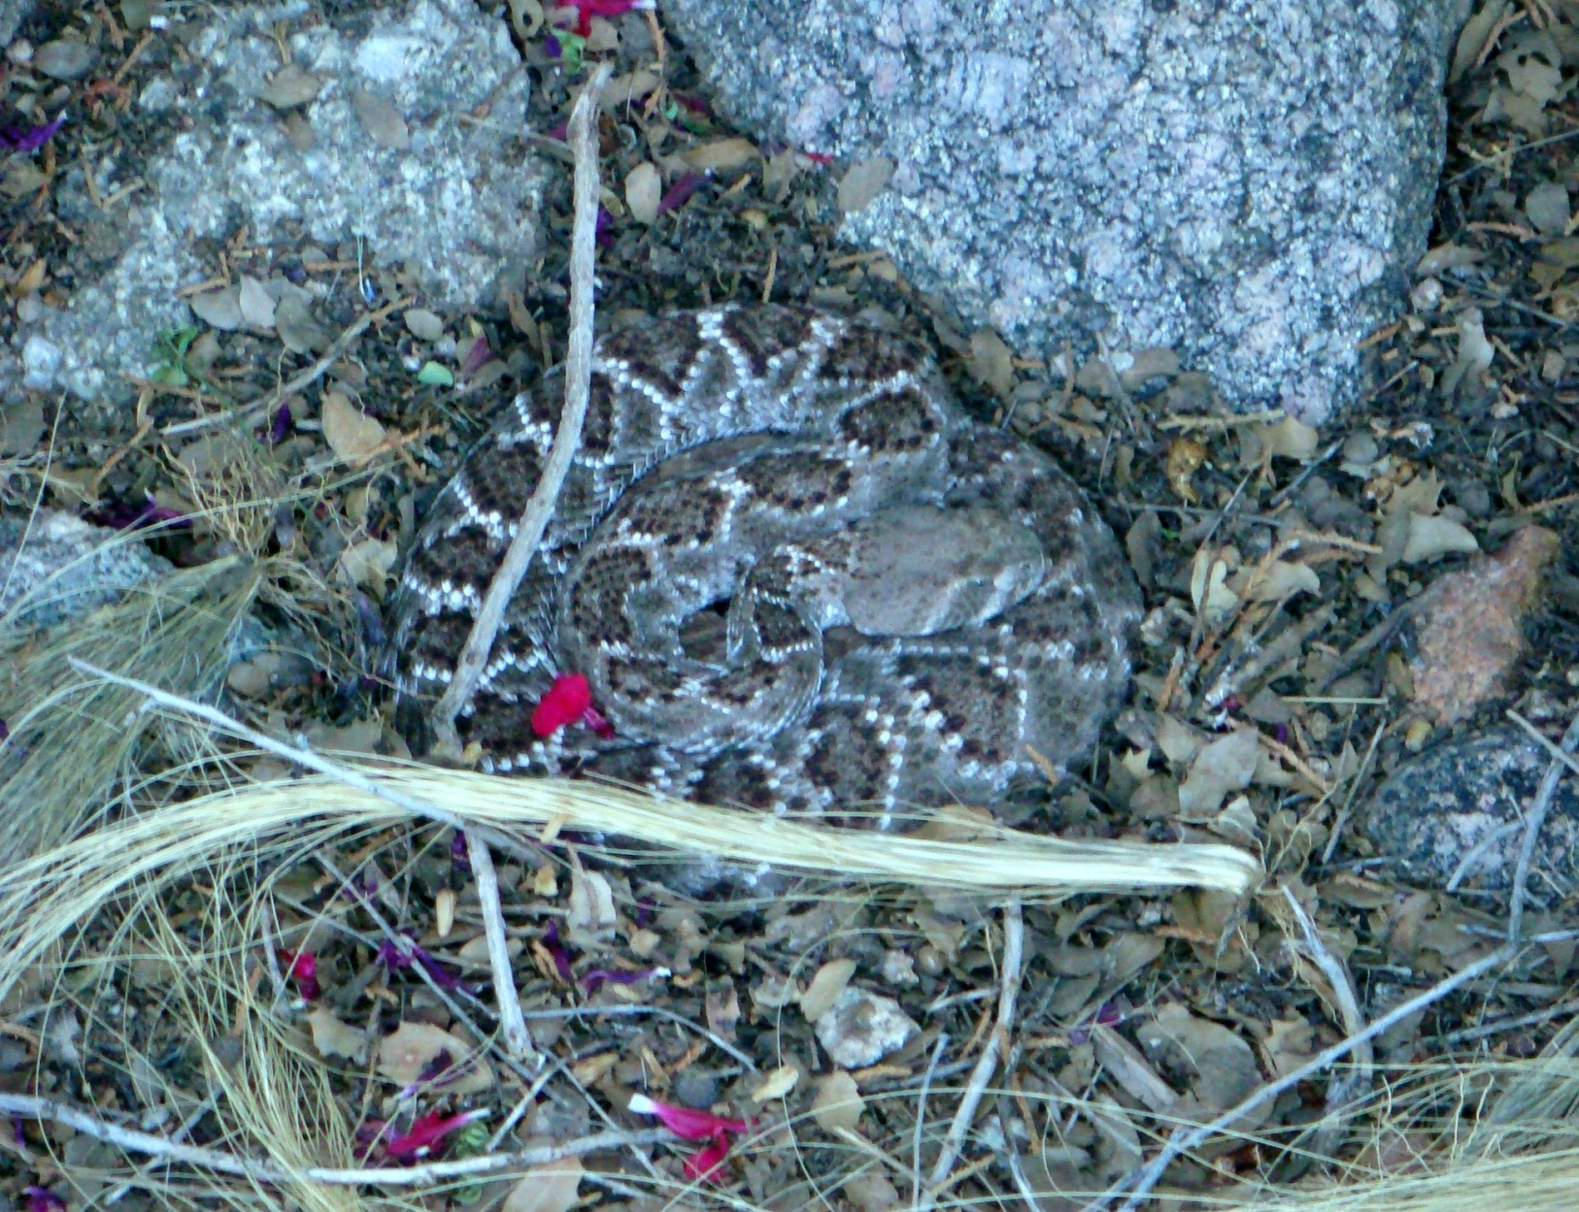
III. Nondeterministic immaculate linamps
Western diamondback rattlesnake
My front yard, Sandia Heights

Slide 22
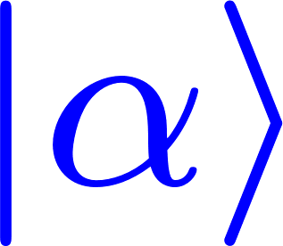
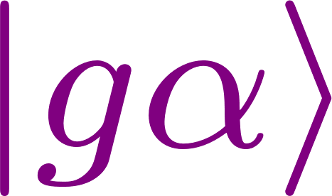
Immaculate linear amplifier
Original idea (Ralph and Lund): When presented with an input coherent state, a nondeterministic linear amplifier amplifies immaculately with probability p and punts with probability 1 – p.
T. C. Ralph and A. P. Lund, in QCMC, edited by A. Lvovsky (AIP, 2009), p. 155.
.
This is an immaculate linear amplifier, more perfect than perfect; it doesn’t even have the amplified input noise.

Slide 23
Immaculate linear amplifier
If the amplifier works immaculately on any input circle of coherent states, then its probability of working is zero.
Theoretical tool: Unambiguous state discrimination applied to uniformly spaced states on the circle.

Slide 24
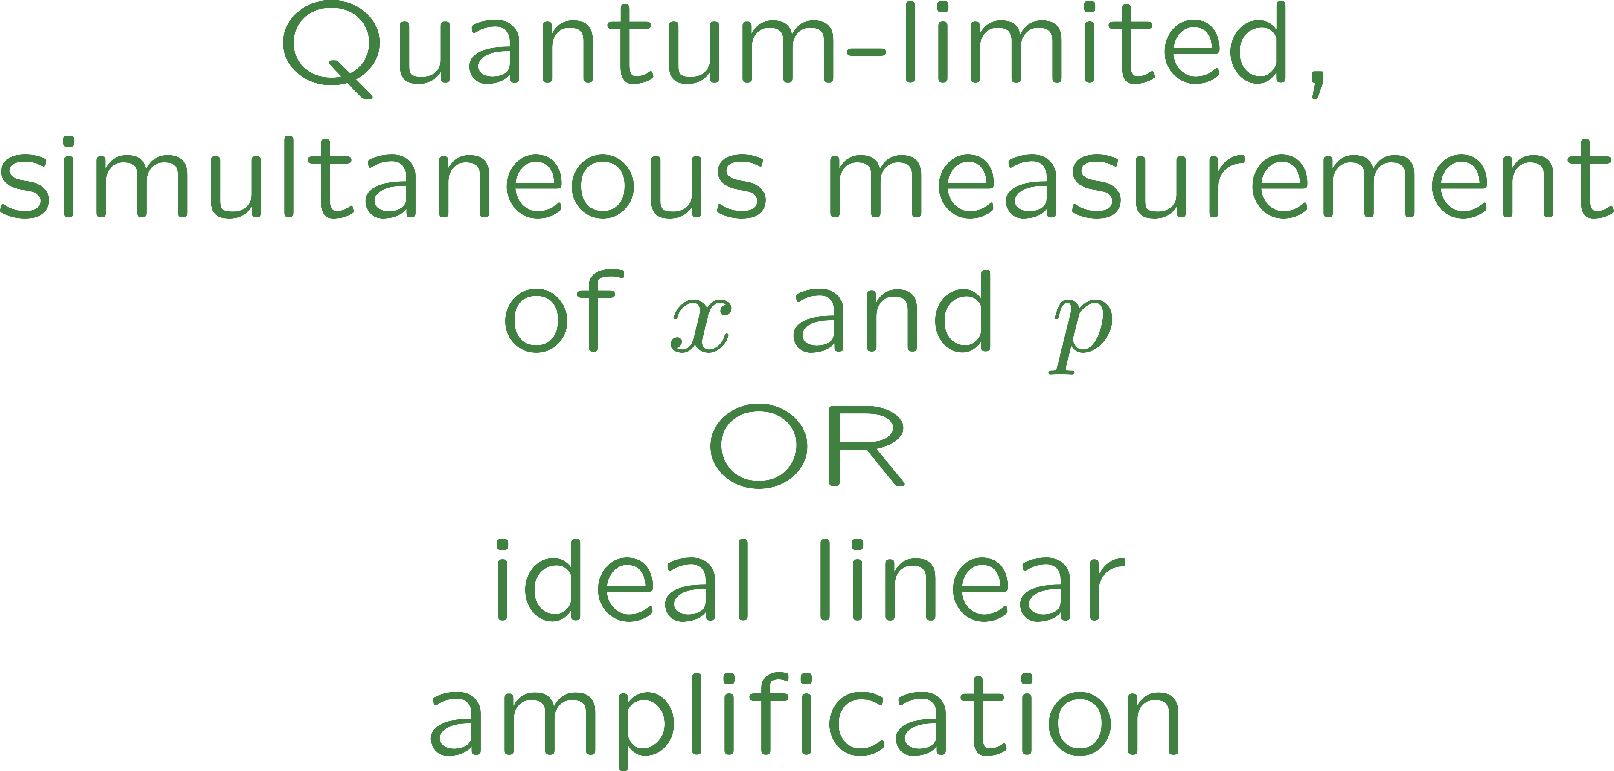
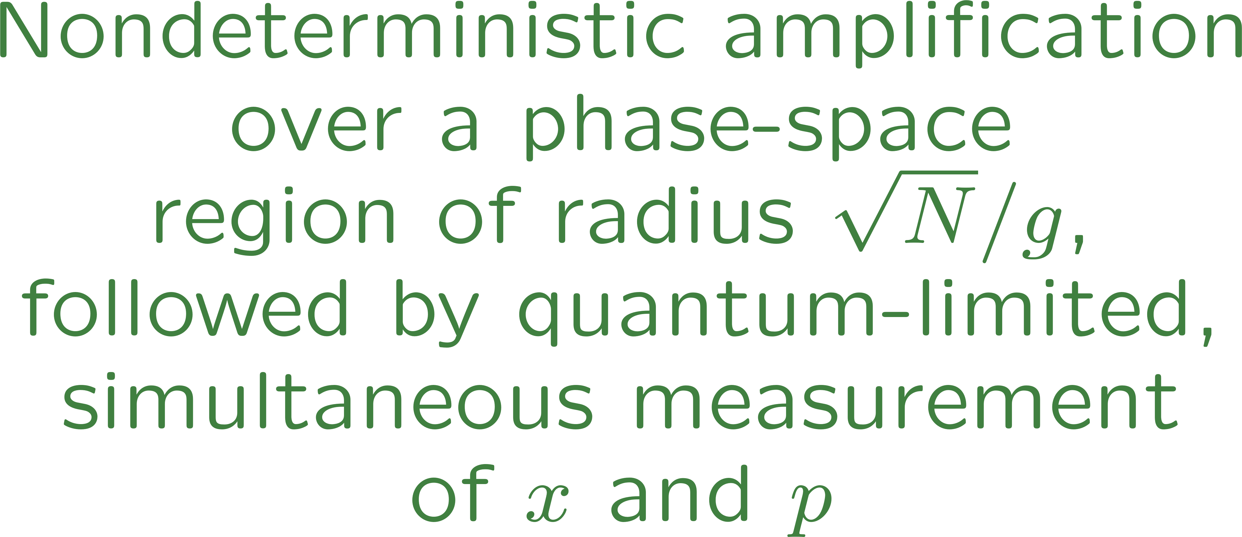
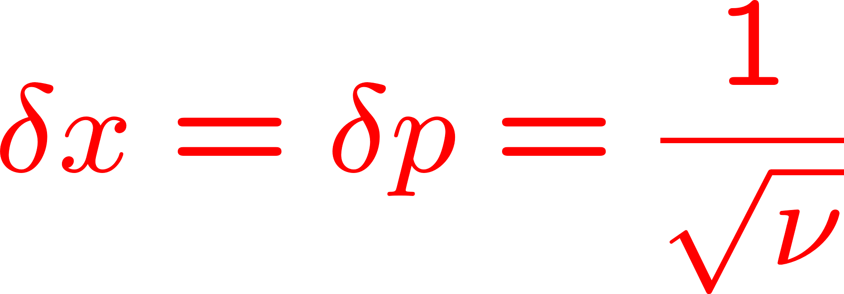
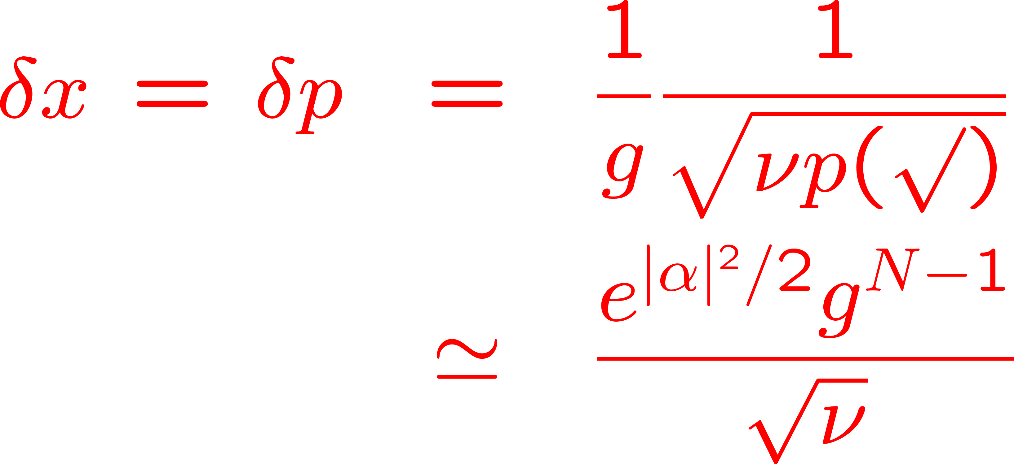
Probabilistic, approximate, phase-insensitive,
immaculate linear amplifier
S. Pandey, Z. Jiang, J. Combes, and C. M. Caves, PRA 88, 033852 (2013).

Slide 25
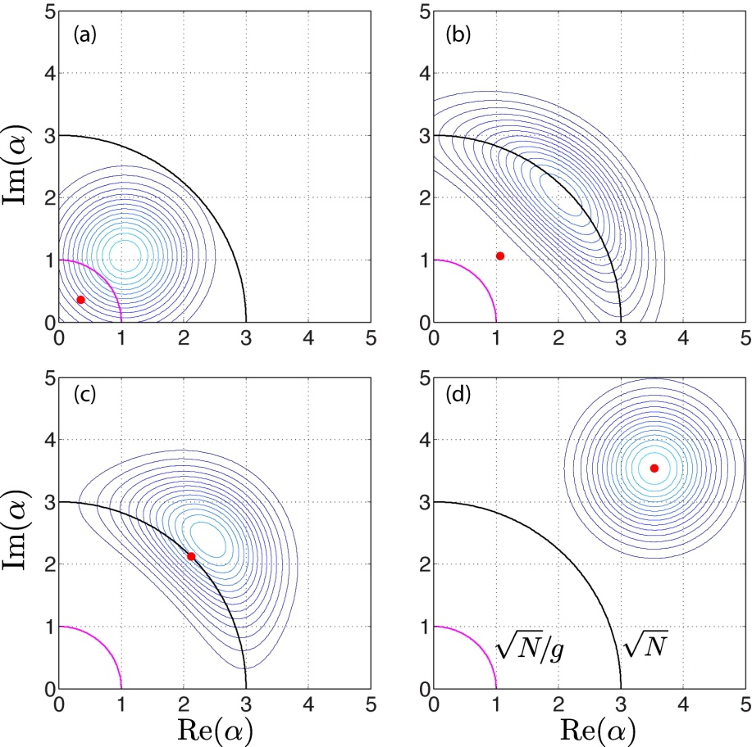
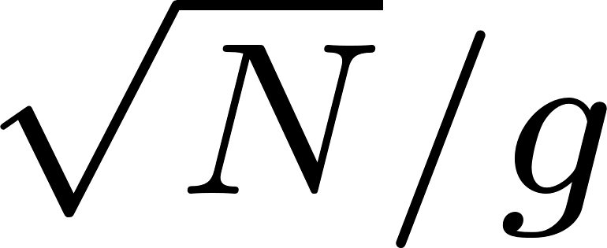
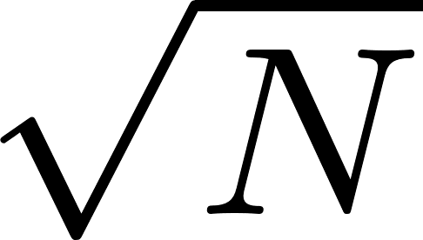
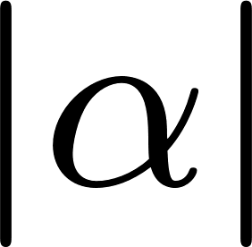
Probabilistic, approximate, phase-insensitive,
immaculate linear amplifier

Slide 26
Probabilistic, approximate, phase-insensitive,
immaculate linear amplifier
A phase-insensitive immaculate amplifier doesn’t do the job of linear amplification as well as an ideal linear amplifier or, indeed, even as well as doing nothing.
Interpolating between ideal and immaculate linamps by concatenating the two—such an amplifier adds less noise than an ideal linamp and works more often than an immaculate linamp, perfect linamps being an example—never works as well as an ideal linear amplifier.
J. Combes, N. Walk, A. P. Lund, T. C. Ralph, and C. M. Caves, PRA 93, 052310 (2016).

Slide 27
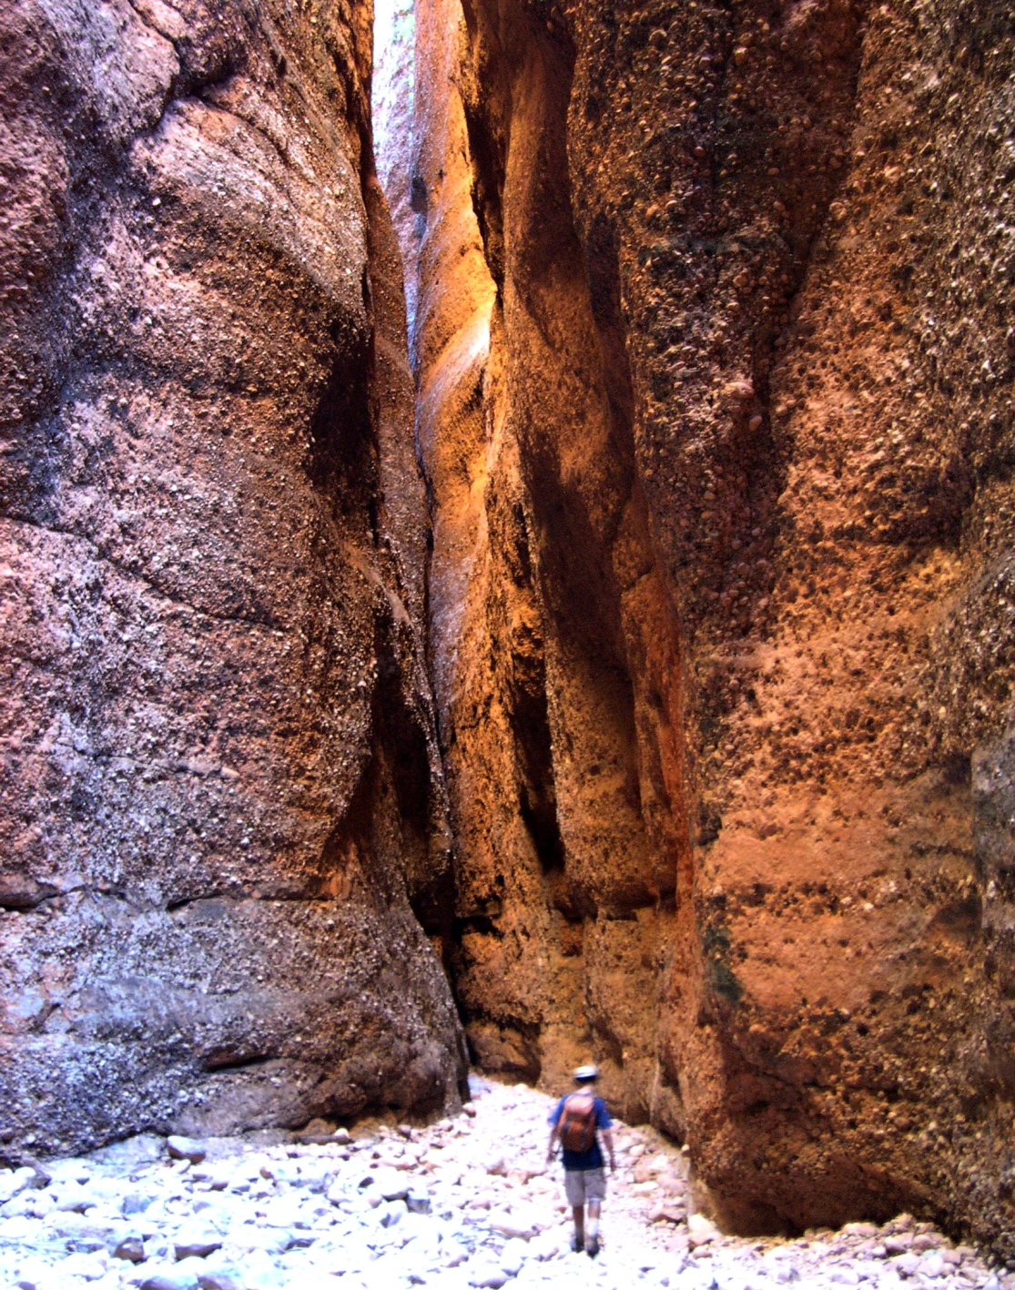
That’s it, folks! Thanks for your attention.
Echidna Gorge
Bungle Bungle Range
Western Australia

Slide 28
Ideal phase-preserving linear amplifier
Models
● Parametric amplifier with ancillary mode in vacuum
● Simultaneous measurement of x and p followed by creation
of amplified state
● Negative-mass (inverted-oscillator) ancillary mode in vacuum
● Master equation
E. Arthurs and J. L. Kelly, Jr., Bell Syst. Tech. J. 44, 725 (1965).
R. J. Glauber, in New Techniques and Ideas in Quantum Measurement Theory, edited by D. M. Greenberger (NY Acad Sci, 1986), p. 336.
C. W. Gardiner and P. Zoller, Quantum Noise, 3rd Ed. (Springer, 2004).
Back

Slide 29
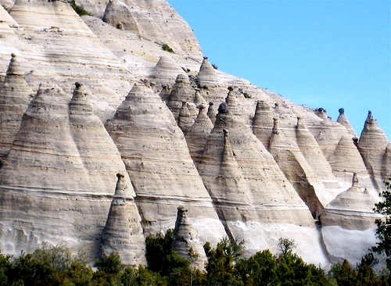
Completely positive maps and physical ancilla states
Tent Rocks
Kasha-Katuwe National Monument
Northern New Mexico

Slide 30
When does the ancilla state have to be physical?
(orthogonal) Schmidt operators

Slide 31
When does the ancilla state have to be physical?
Z. Jiang, M. Piani, and C. M. Caves, Quantum Information Processing 12, 1999 (2013).

Slide 32
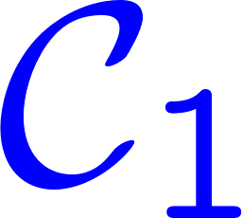
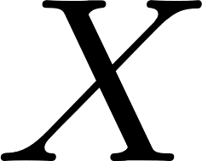
When does the ancilla state have to be physical?
Bloch sphere
Cone of positive operators

Slide 33
Why does the ancilla state for a linear amplifier have to be physical?

Slide 34
Gratuitous advice
Human “reasoning” problems
Making probabilistic judgments
Reducing problems to dichotomies
Confusing correlation with causation
Assuming the converse
Goal displacement
Among these tribal idols of human nature itself, we must prominently include both our legendary difficulty in acknowledging, or even conceiving, the concept of probability, and also the motivating theme of this article: our lamentable tendency to taxonomize complex situations as dichotomies of conflicting opposites.
S. J. Gould, Science 287, 253 (2000).
Inadequate risk assessment. Overweighting of anecdotal evidence. Letting ideology, religion, or prejudice trump evidence.
In human affairs, there are no hard boundaries—all arguments have a slippery slope—and essentially all problems are more than a bit and generally multi-parameter.

Slide 35
Gratuitous advice
Human “reasoning” problems
Making probabilistic judgments
Reducing problems to dichotomies
Confusing correlation with causation
Assuming the converse
Almost all discussion in the public sphere founders on some combination of 1 to 4.
As scientists, we can and should do better!

Slide 36
Gratuitous advice
Human “reasoning” problem
5. Goal displacement
Campbell’s Law
The more any quantitative social indicator is used for social decision-making, the more subject it will be to corruption pressures and the more apt it will be to distort and corrupt the social processes it is intended to monitor.
D. T. Campbell, Journal of MultiDisciplinary Evaluation 7(15), 3 (2011); originally published as Paper #8, Occasional Paper Series,
Public Policy Center, Dartmouth College, December 1976.
Gaming and goal displacement are inevitable with any single indicator. For scientists, the result is high-impact-factor syndrome, the judging of people in terms of number of publications in high-impact-factor journals.

Slide 37
Gratuitous advice
Human “reasoning” problems
Making probabilistic judgments
Reducing problems to dichotomies
Confusing correlations with causation
Implying or assuming the converse
Special advice to physicists
(from John Wheeler)
Guess, by any method, the answer to a problem before you start.
Make mistakes as fast as possible.

