Slide 1
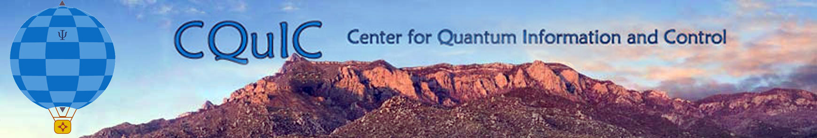
Quantum-limited measurements:
One physicist’s crooked path from
relativity theory to quantum optics to
quantum information
Introduction
Squeezed states and optical interferometry
Quantum limits on parameter estimation
Carlton M. Caves
Center for Quantum Information and Control, University of New Mexico
http://info.phys.unm.edu/~caves
TexPoint fonts used in EMF.
Read the TexPoint manual before you delete this box.: AAA

Slide 2
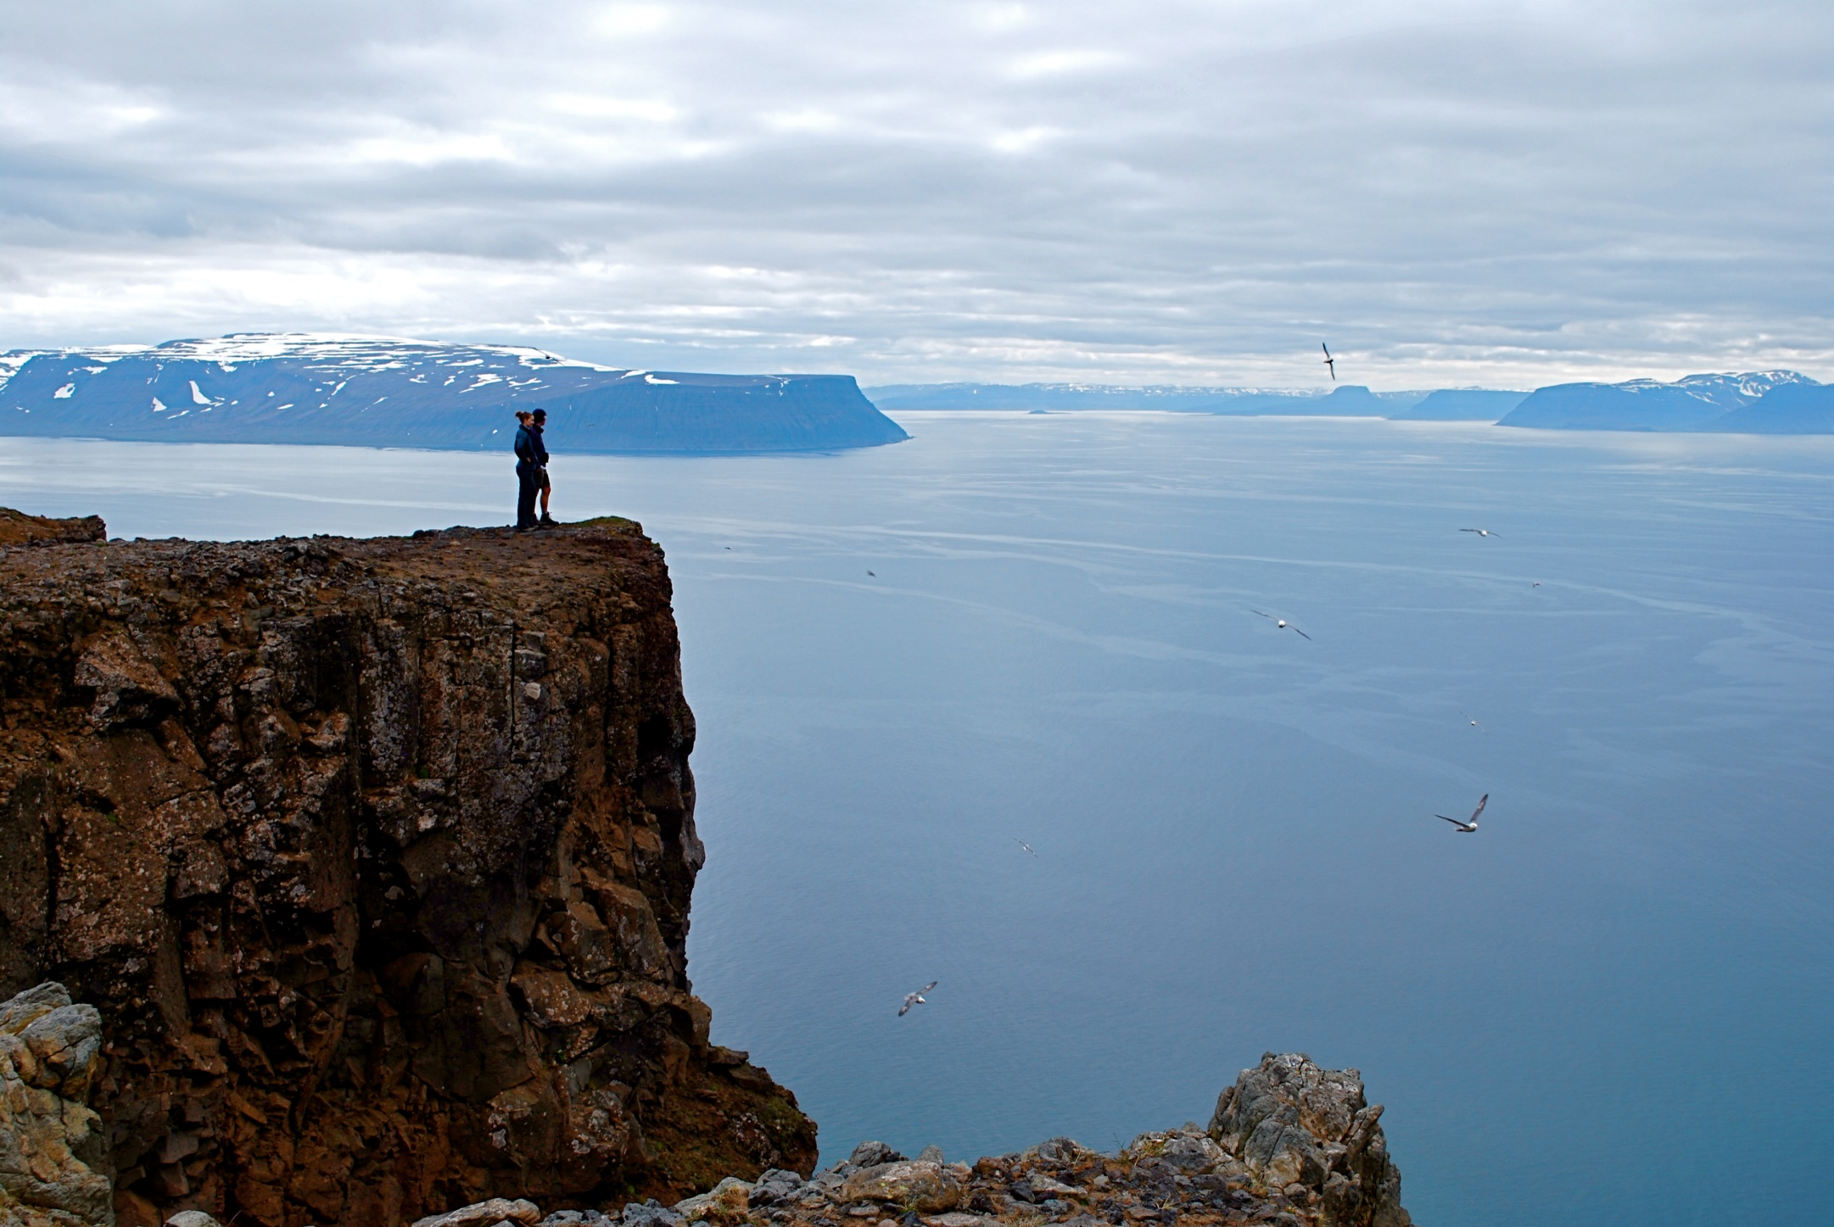
I. Introduction
Holstrandir Peninsula overlooking Ísafjarðardjúp
Westfjords, Iceland

Slide 3
Quantum information science
A new way of thinking
Computer science
Computational complexity
depends on physical law.
New physics
Quantum mechanics as liberator. What can be accomplished with quantum systems that can’t be done in a classical world?
Explore what quantum systems can do, instead of being satisfied with what Nature hands us.
Quantum engineering
Old physics
Quantum mechanics as nag.
The uncertainty principle
restricts what can be done.

Slide 4
Metrology
Taking the measure of things
The heart of physics
Extracting information from physical systems
New physics
Quantum mechanics as liberator.
Explore what quantum systems can do, instead of being satisfied with what Nature hands us.
Quantum engineering
Old physics
Quantum mechanics as nag.
The uncertainty principle
restricts what can be done.
Old conflict in new guise
Stories about noise vs. rigorous analytic techniques with proofs

Slide 5
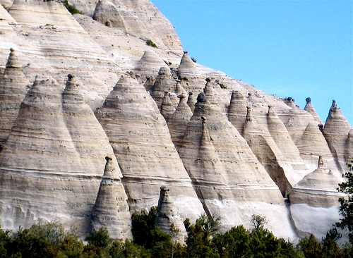
Squeezed states and optical interferometry
Tent Rocks
Kasha-Katuwe National Monument
Northern New Mexico

Slide 6
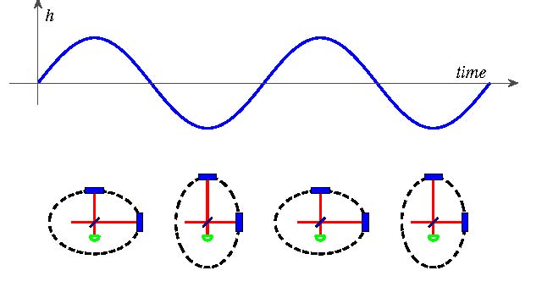
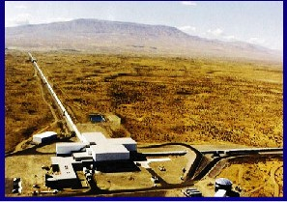
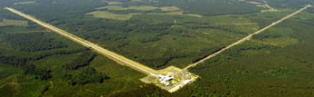
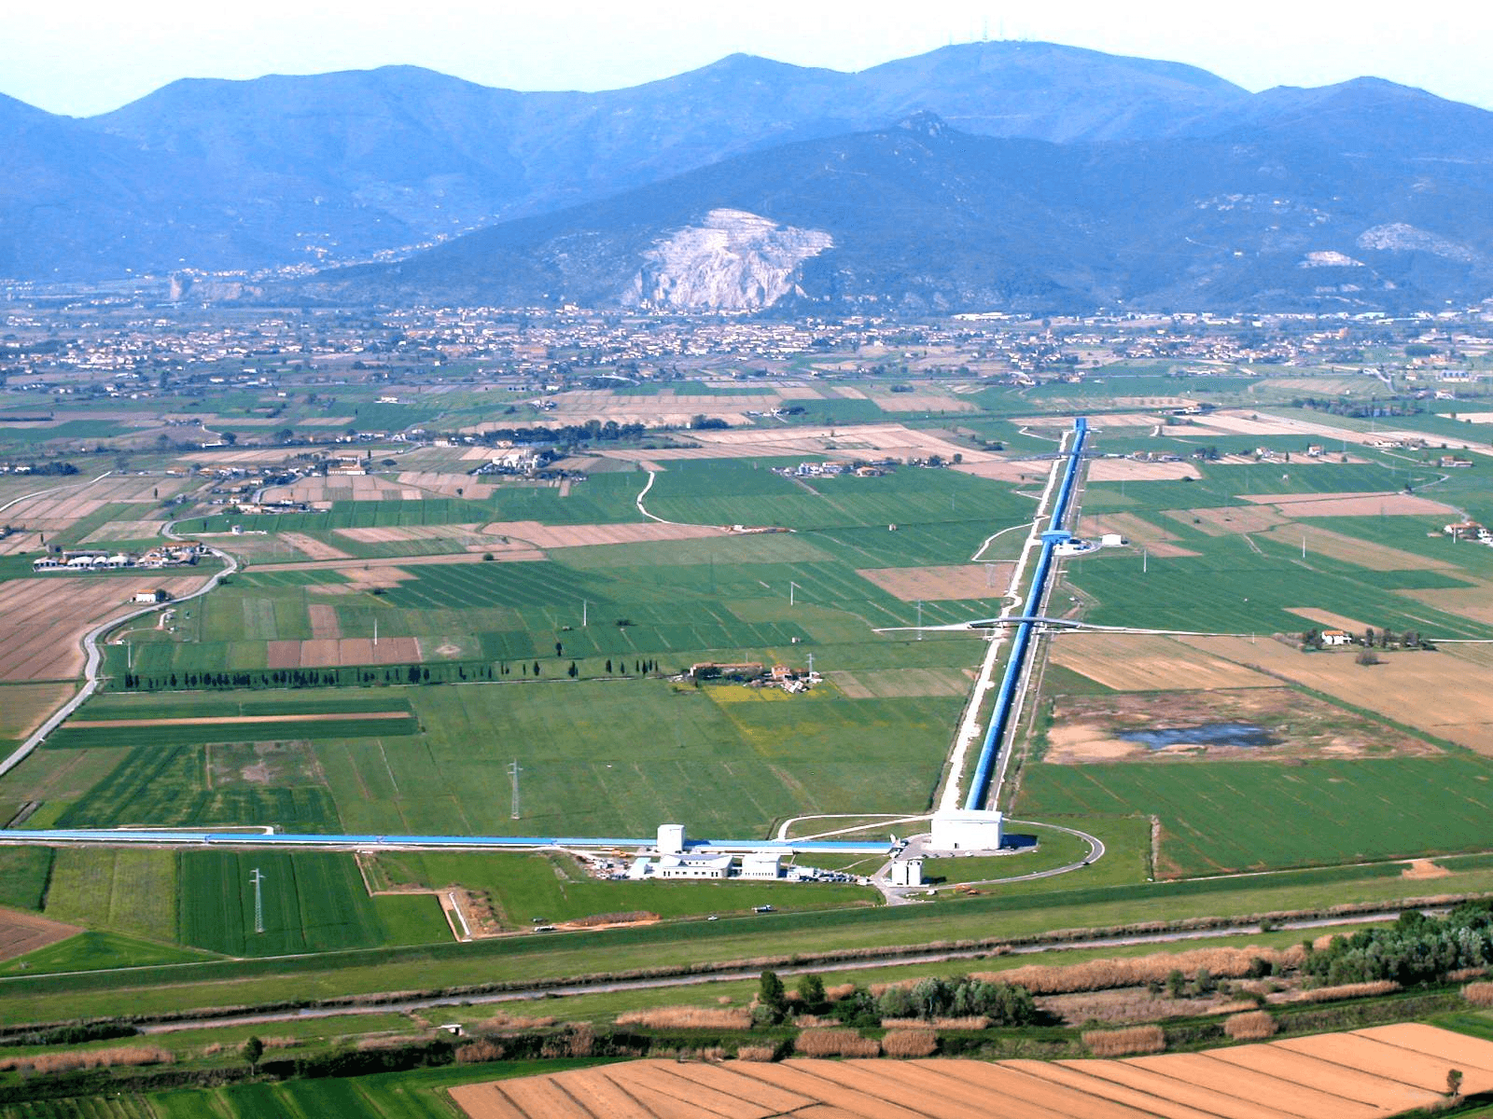
(Absurdly) high-precision interferometry
Hanford, Washington
The LIGO Scientific Collaboration, Rep. Prog. Phys. 72, 076901 (2009).
Laser Interferometer Gravitational Observatory (LIGO)
4 km
3 km
Livingston, Louisiana
VIRGO
Cascina, Italy

Slide 7
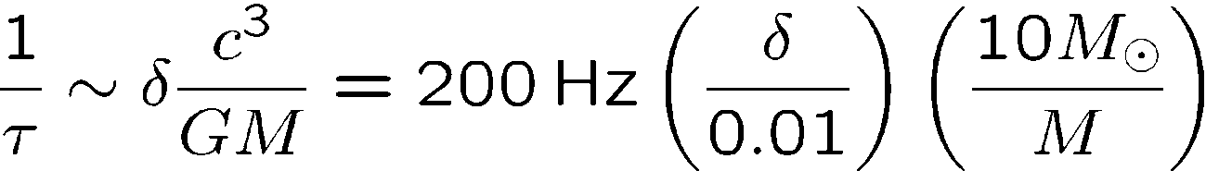
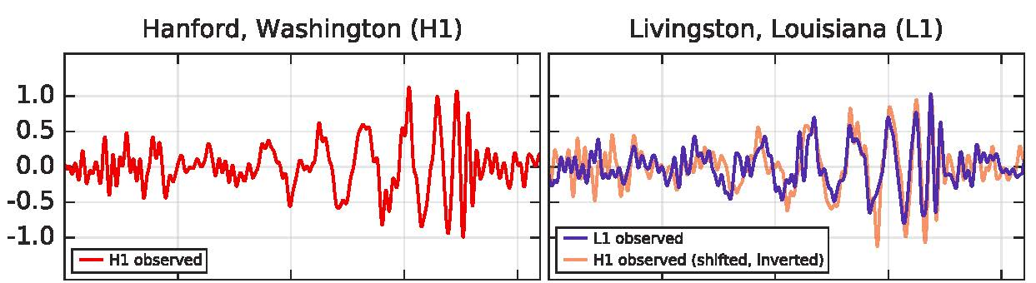
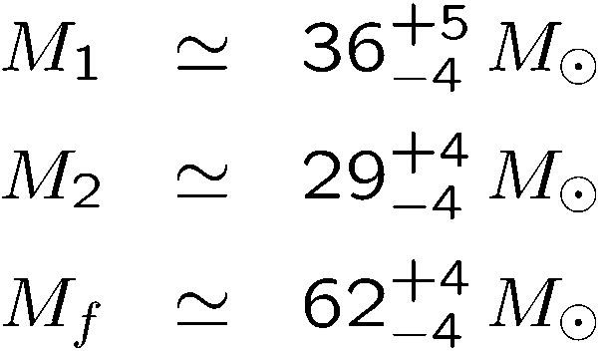
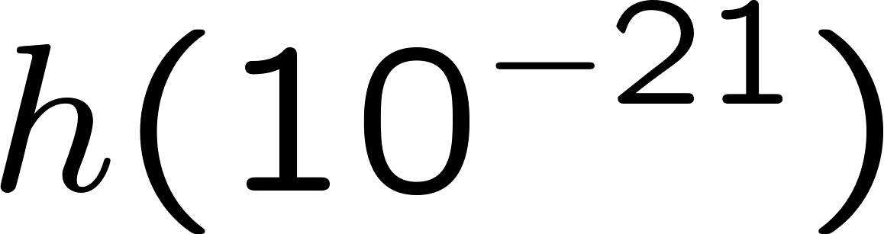
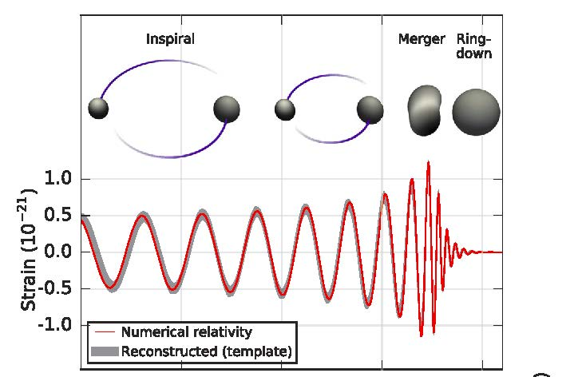
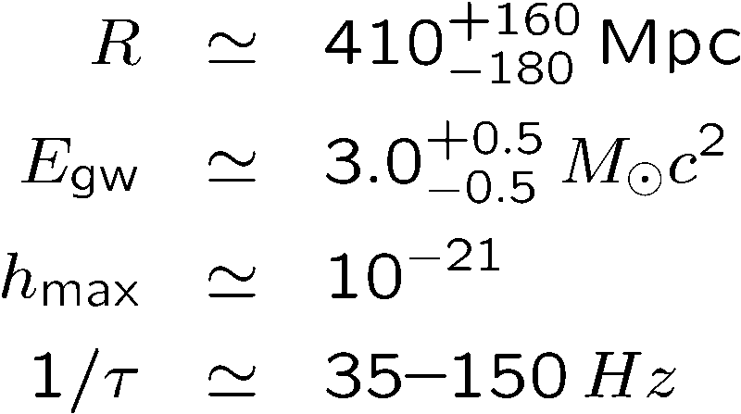
Digression on gravitational waves
Strong-field burst sources
Coalescence of two black holes
The LIGO Scientific Collaboration and Virgo Collaboration, PRL 116, 061102 (2016).
0.30s
0.35s
0.40s
0.45s
0.30s
0.35s
0.40s
0.45s

Slide 8
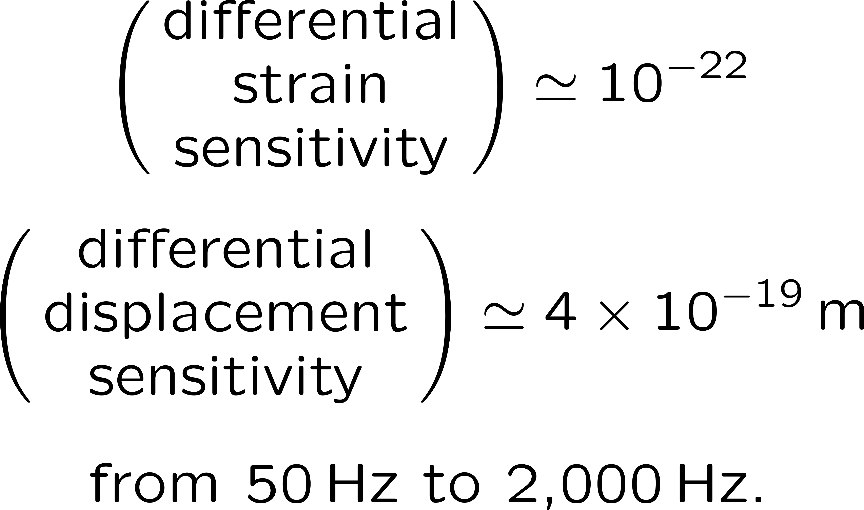
(Absurdly) high-precision interferometry
Advanced LIGO
Hanford, Washington
Laser Interferometer Gravitational Observatory (LIGO)
High-power, Fabry-Perot Michelson (multipass), power-and signal-recycled, squeezed-light interferometers
4 km
Livingston, Louisiana

Slide 9
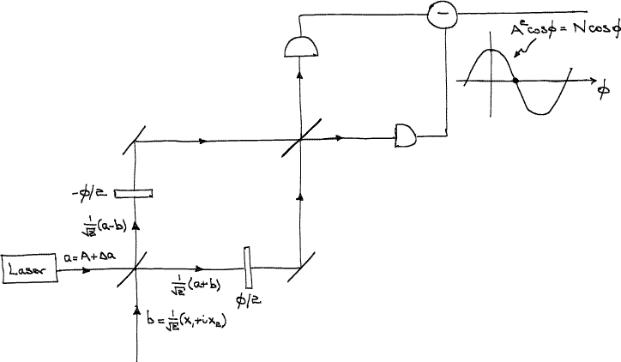
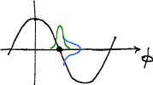
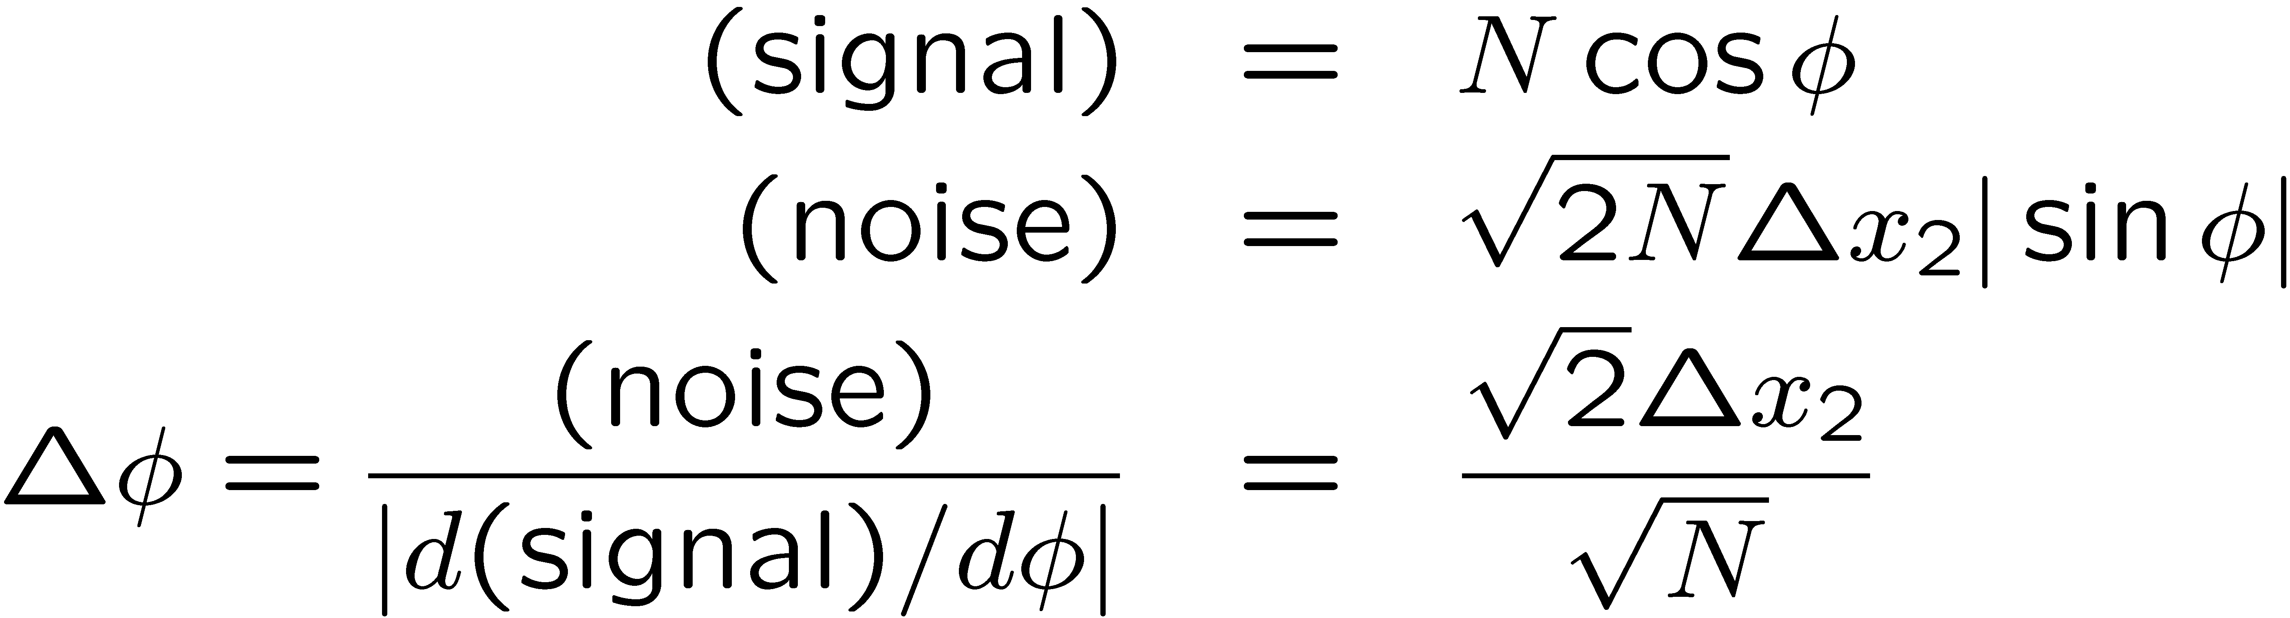
Mach-Zehnder interferometer
C. M. Caves, PRD 23, 1693 (1981).
Take note: I am not here talking about back action (radiation-pressure noise).

Slide 10
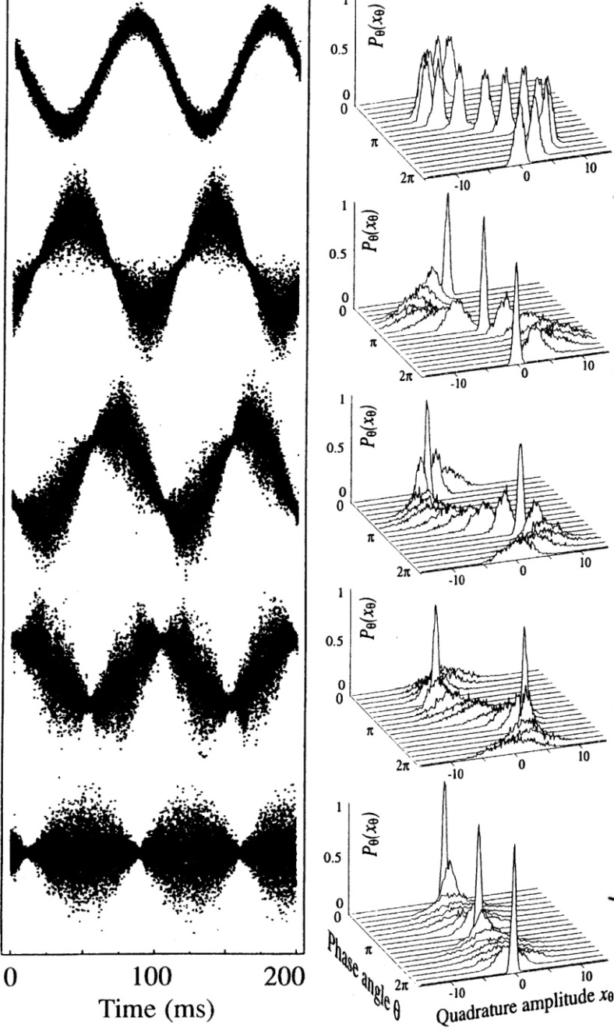
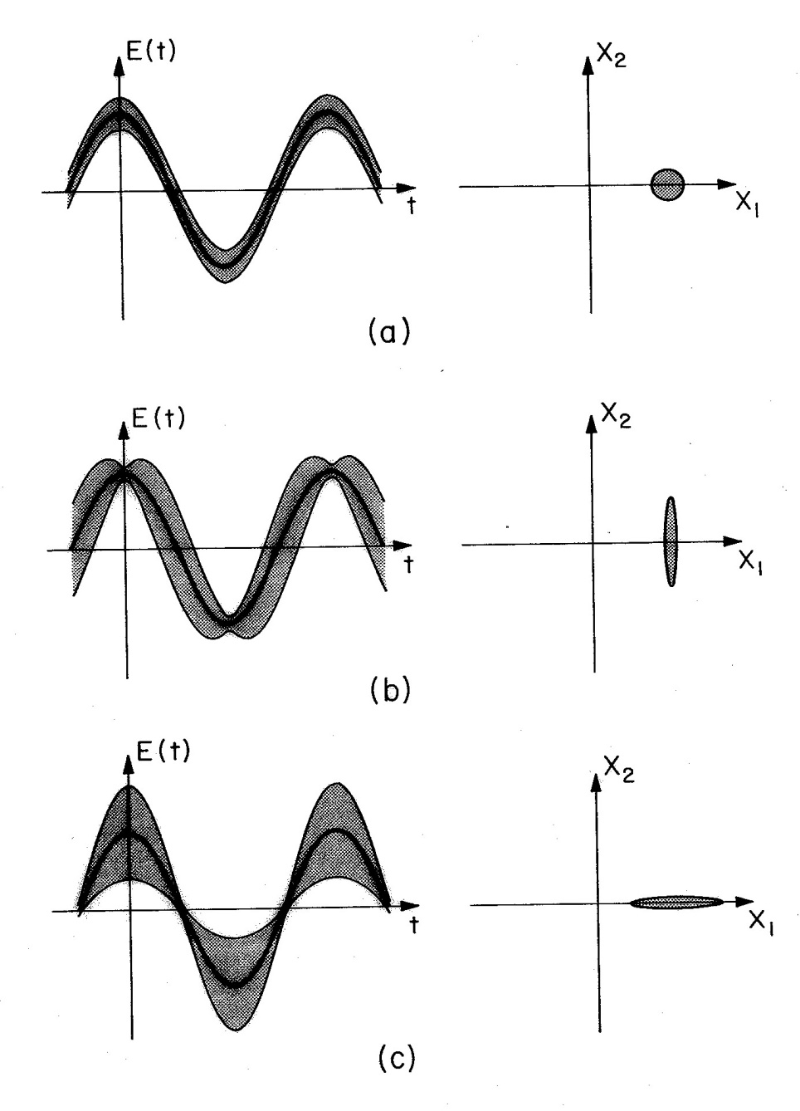
Squeezed states of light
Groups at ANU, Hannover, Tokyo, and MIT continued to push for greater squeezing (at audio frequencies) for use in Advanced LIGO, VIRGO, and GEO and other quantum metrology and quantum information jobs.
Squeezing by a factor of about 3.5
G. Breitenbach, S. Schiller, and
J. Mlynek, Nature 387, 471 (1997).

Slide 11
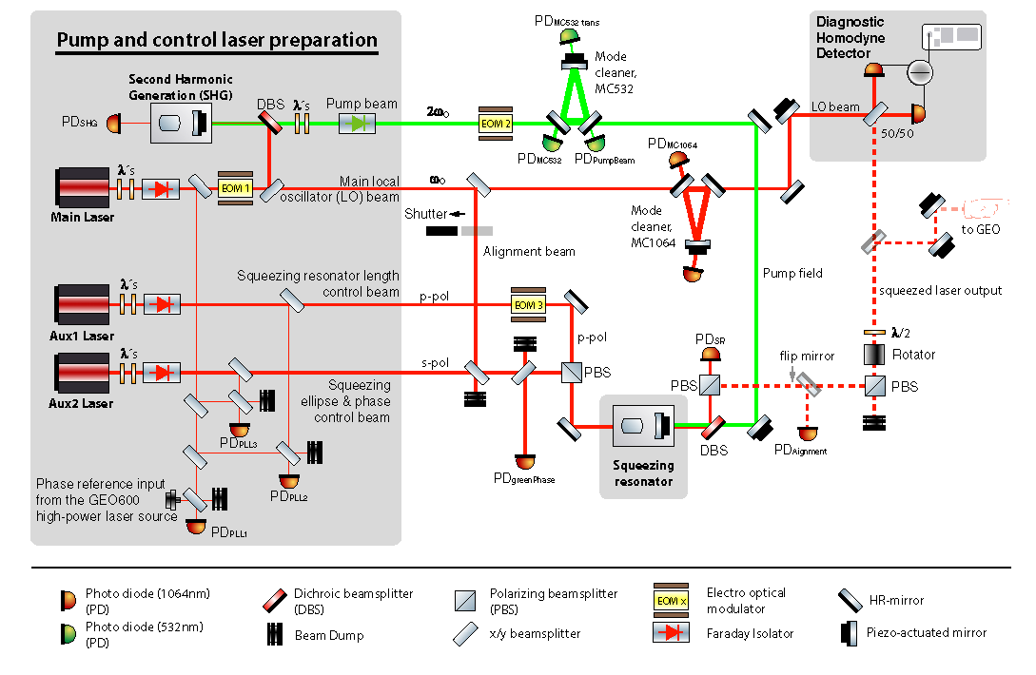
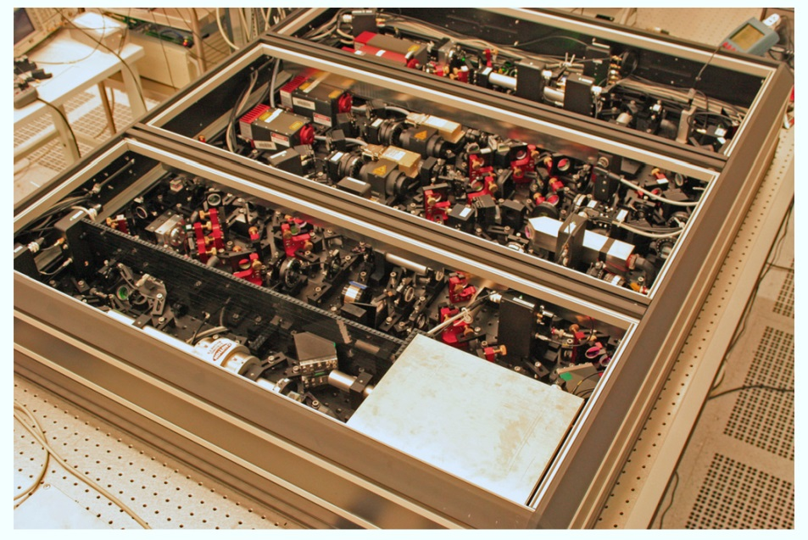
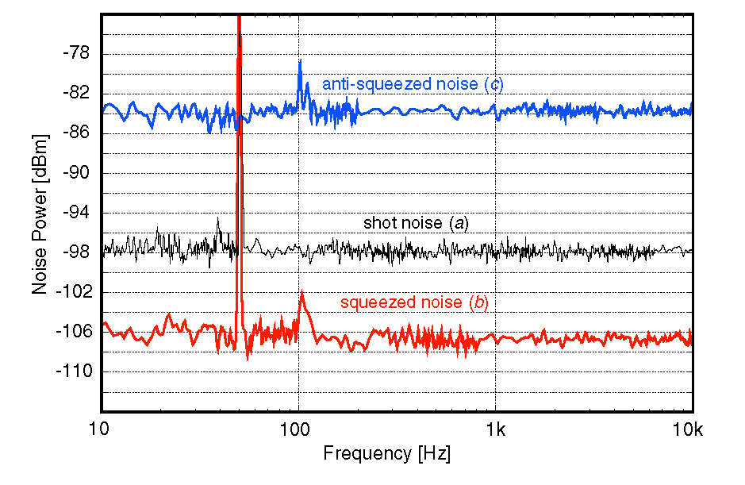
Squeezed states of light
Squeezed light in Hannover
H. Vahlbruch et al., Class. Quant. Grav. 27, 084027 (2010).
8–9 dB below shot noise at audio frequencies

Slide 12
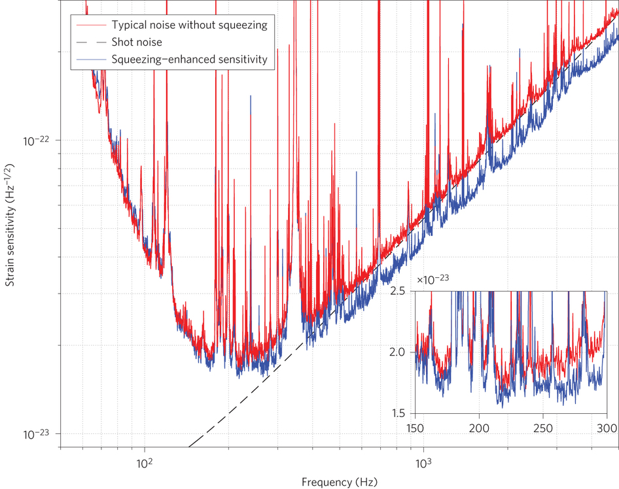
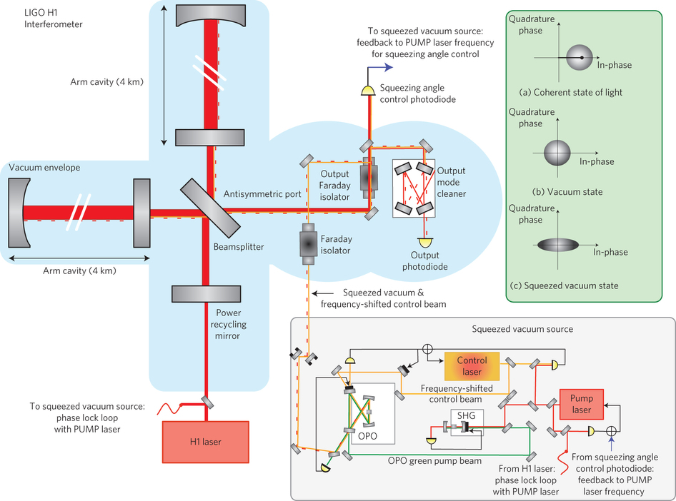
Quantum metrology (nearly) making a difference
Squeezed light in the
LIGO Hanford detector
The LIGO Scientific Collaboration, Nat. Phot. 7, 613 (2013).
~ 2 dB of shot-noise reduction

Slide 13
Quantum metrology making a difference
Virgo: F. Acernese et al., PRL 123, 231108 (2019).
LIGO: M. Tse et al., PRL 123, 231107 (2019).
During the ongoing O3 observation run, squeezed states are improving the sensitivity of the LIGO interferometers to signals above 50 Hz by up to 3 dB, thereby increasing the expected detection rate by 40% (H1: Hanford) and 50% (L1: Livingston).

Slide 14
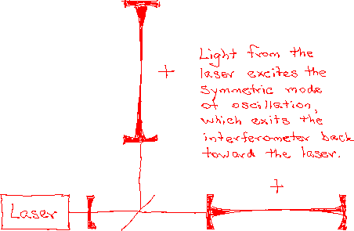
Fabry-Perot Michelson interferometer
20-30W
700W-1kW
100-150kW circulating; design ~ 1MW
10dB squeezing
Motion of the mirrors produced by a gravitational wave induces a transition from the symmetric mode to the antisymmetric mode; the resulting tiny signal at the vacuum port is contaminated by quantum noise that entered the vacuum port.

Slide 15
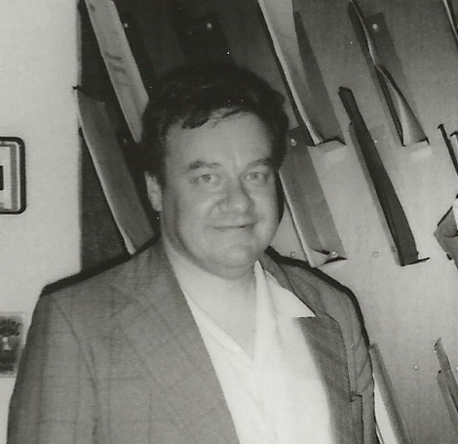

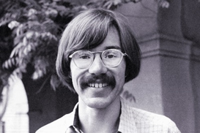
Fabry-Perot Michelson
PDH locking
Nested cavities (recycling)
CMC
Squeezed-light interferometry
When Ron’s ideas run out of gas (after 35 years, they have),
Experimenters might then (now) be forced to learn how to very gently squeeze the vacuum before it can contaminate the light in their interferometers.

Slide 16
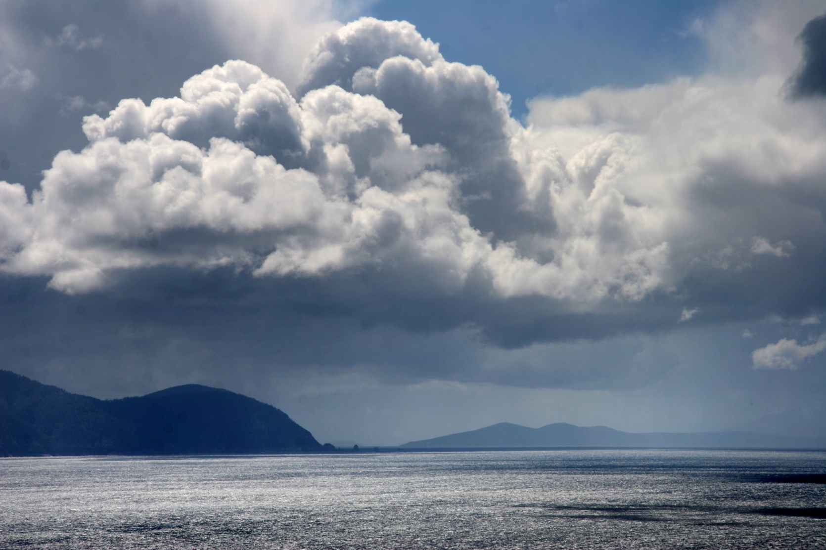
III. Quantum limits on parameter estimation
View from Cape Hauy
Tasman Peninsula, Tasmania

Slide 17
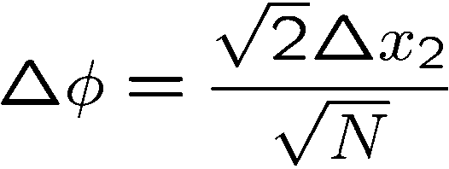
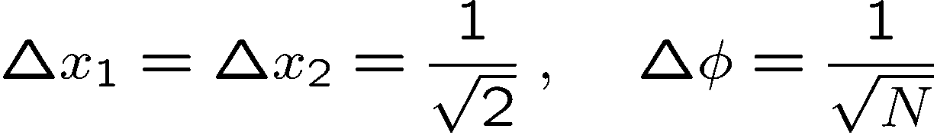
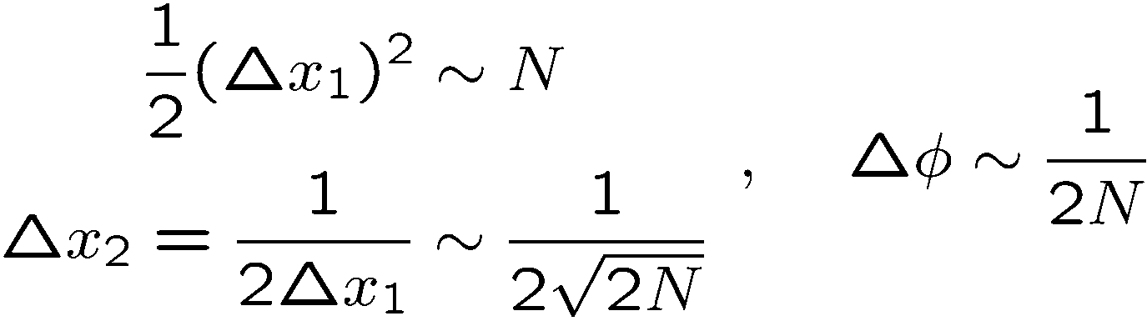
Quantum limits on optical interferometry
Quantum Noise Limit (Shot-Noise Limit)
Reminder: I am not here talking about back action (radiation-pressure noise).
Heisenberg Limit
As much power in the squeezed light as in the main beam
When do these limits hold? Do we think they’re limits only because we haven’t thought hard enough?

Slide 18

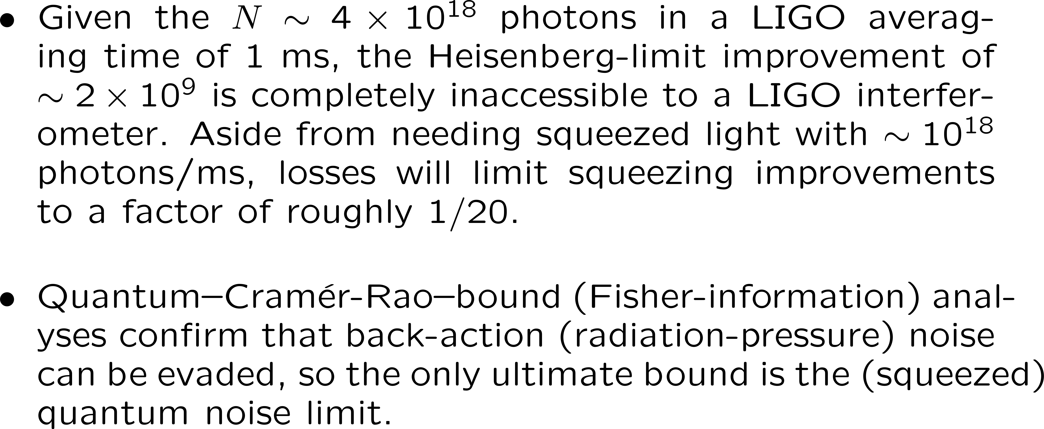
Cable Beach
Western Australia

Slide 19
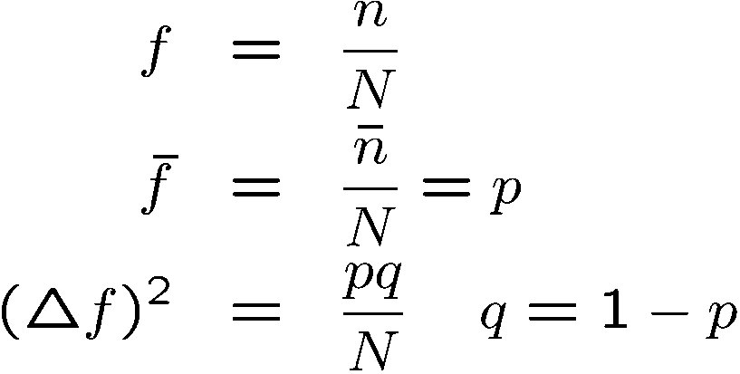



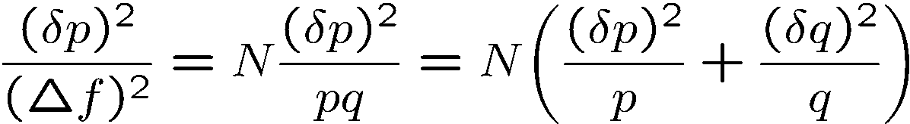
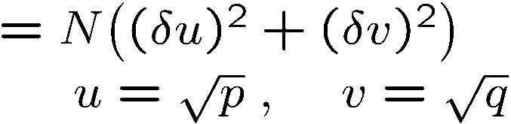
Fisher information
Estimating a probability p from N trials (random walk, polling)
Measuring the “distance” between neighboring probability distributions in units of their distinguishability
Fisher information

Slide 20
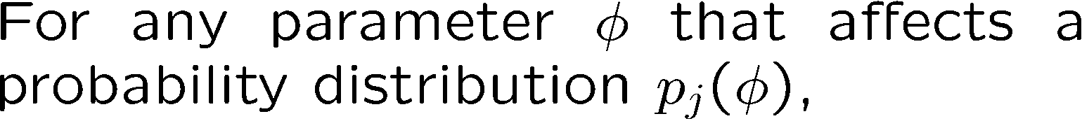
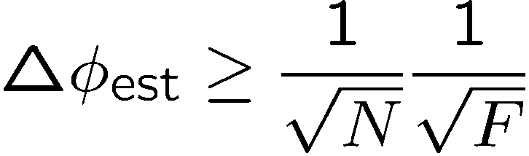
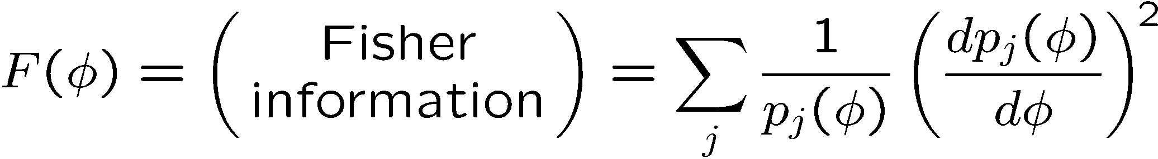
(Classical) Cramér-Rao bound

Slide 21
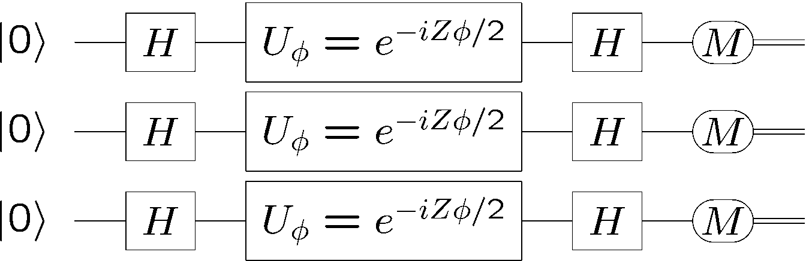
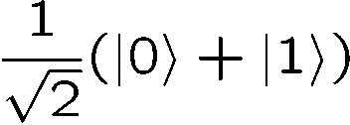
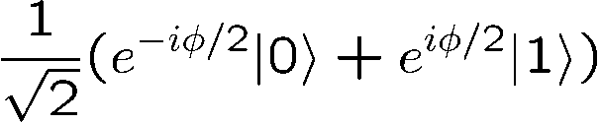
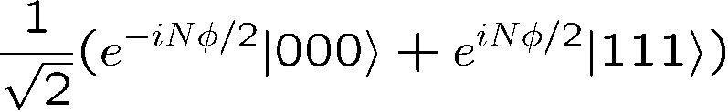
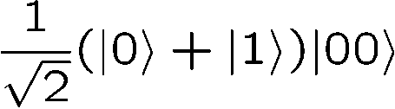
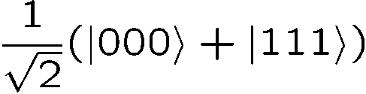
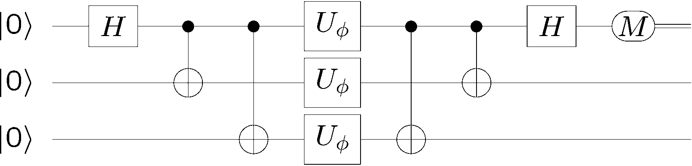
Quantum information version of interferometry
Qubits:
Photons with two modes
Atoms with two levels
Quantum noise limit
“cat state”
N = 3
Heisenberg limit
Fringe pattern with period 2π/N

Slide 22
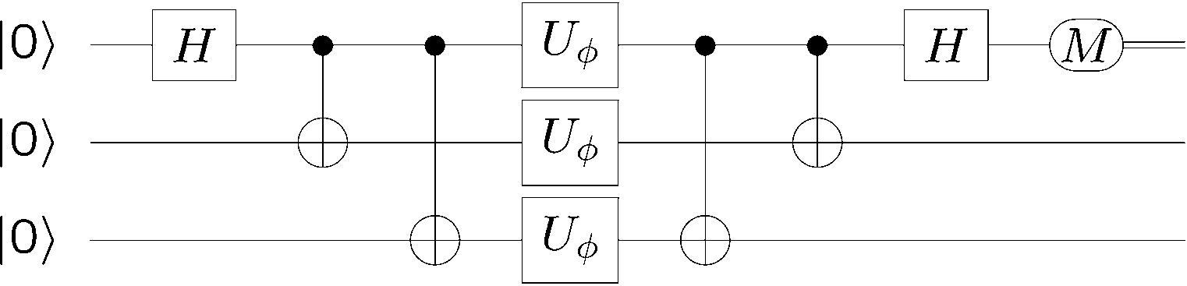
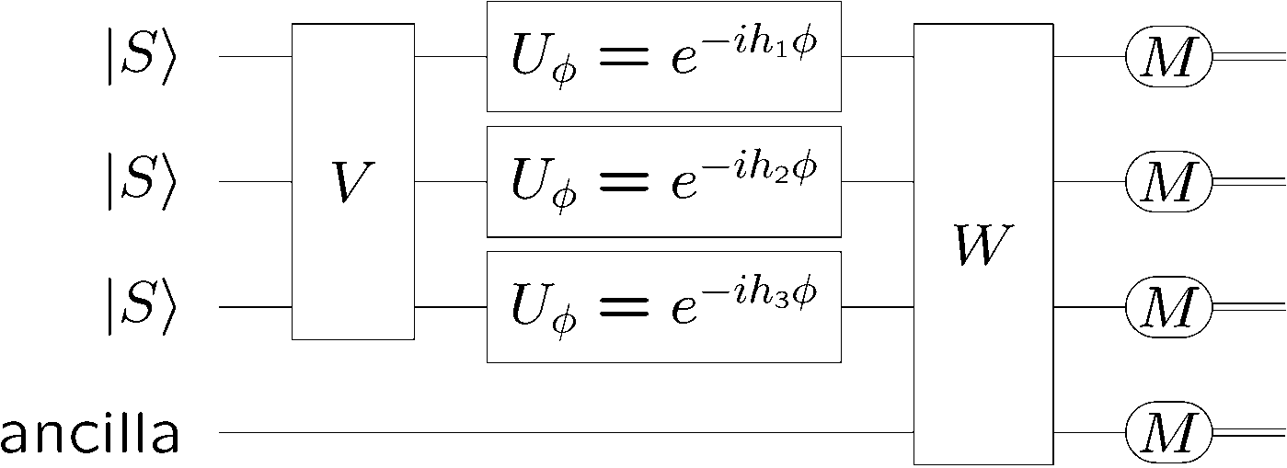
Cat-state interferometer
State
preparation
Dynamics
Measurement
Single-parameter estimation

Slide 23
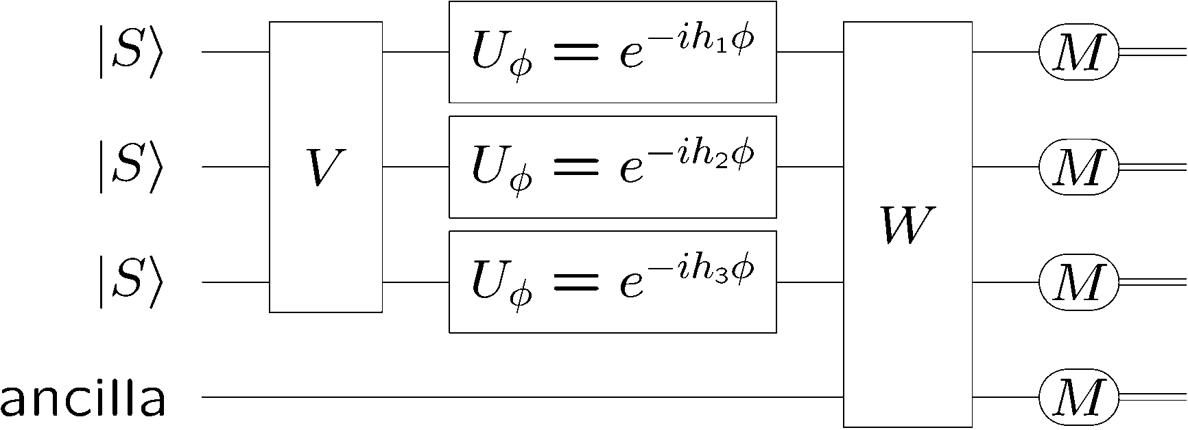
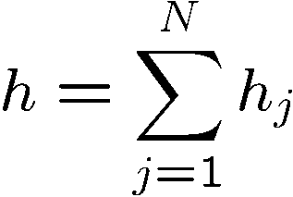
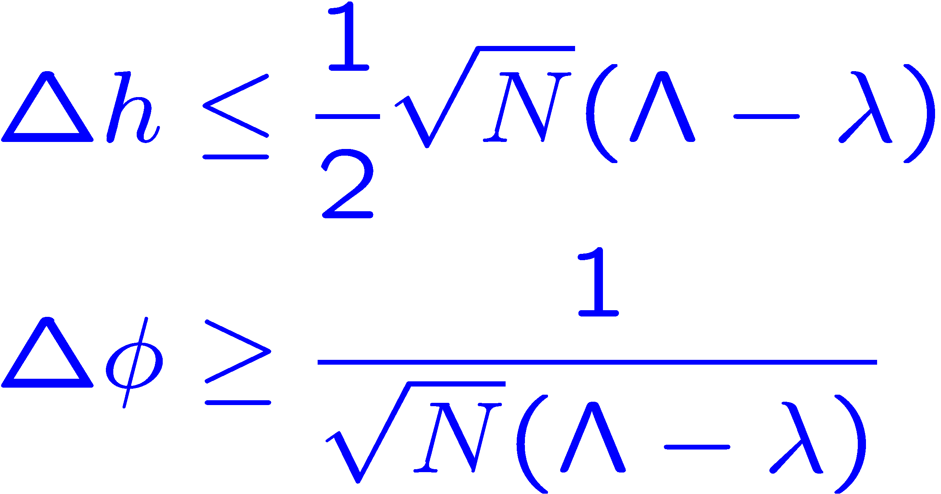



Quantum
limits
S. L. Braunstein, C. M. Caves, and G. J. Milburn, Ann. Phys. 247, 135 (1996).
V. Giovannetti, S. Lloyd, and L. Maccone, PRL 96, 041401 (2006).
S. Boixo, S. T. Flammia, C. M. Caves, and JM Geremia, PRL 98, 090401 (2007).
Dynamics
Product inputs
Generalized
uncertainty principle
Quantum Cramér-Rao bound

Slide 24





Achieving the Heisenberg limit
cat
state

Slide 25




What we really do:
Real-life quantum Cramér-Rao bound
M. D. Lang, UNM PhD dissertation, 2015.
Z. Jiang, PRA 89, 032128 (2014).

Slide 26

What we really do:
Cramér-Rao bound on estimating parameters of classical spacetimes
The generators corresponding to spacetime parameters are stress-energy components of probe fields.
T. G. Downes, J. R. van Meter, E. Knill, G. J. Milburn, and C. M. Caves, PRD 96, 105004 (2017).

Slide 27
Telling explanatory stories is what physics is about.
The squeezed-light narrative is about understanding fringe patterns and sources of noise and designing devices to improve phase sensitivity based on this understanding. This is telling stories.
The quantum Cramér-Rao bound is misleading and clueless on practicality, but it verifies whether the stories, always of limited validity, are fooling us.
Which then is better, stories or proofs? You need both, but to design something, you need a story.

Slide 28

Squeezed light into the vacuum (antisymmetric) port is the optimal strategy for optical interferometry.
The (scientific) truth shall make you free.
Pinnacles National Park
Central California

Slide 29


Thanks for your attention.
Dettifoss
Iceland

Slide 30



Quantum limit on practical optical interferometry
Cheap photons from a laser (coherent state)
Low, but nonzero losses on the detection timescale
Beamsplitter to make differential phase detection insensitive to laser fluctuations
Freedom: state input to the second input port; optimize relative to a mean-number constraint.
Entanglement: mixing this state with coherent state at the beamsplitter.
Generalized
uncertainty principle
QCRB
Optimum achieved by differenced photodetection in a Mach-Zehnder configuration.
M. D. Lang and C. M. Caves, PRL 111, 17360 (2013).
Achieved by squeezed vacuum into the second input port

Slide 31









Practical optical interferometry: Photon losses
M. D. Lang , UNM PhD dissertation, 2015.
B. M. Escher, R. L. de Matos Filho, and L. Davidovich, Nat. Phys. 7, 406‒411 (2011).
Z. Jiang, PRA 89, 032128 (2014).
Optimum achieved by differenced photodetection in a Mach-Zehnder configuration.

Slide 32



Ramsey (atomic) interferometry
N independent “atoms”
Frequency measurement
Time measurement
Clock synchronization

Slide 33


Cat-state Ramsey interferometry
J. J. Bollinger, W. M. Itano, D. J. Wineland, and D. J. Heinzen, Phys. Rev. A 54, R4649 (1996).
Fringe pattern with period 2π/N
N cat-state atoms

Slide 34



The Milieu: Caltech TAPIR
late 70s-early 80s
Kip Thorne
Vladimir Braginsky
Ron Drever
Quantum nondemolition
Back-action evasion
Fabry-Perot Michelson
PDH locking
Nested cavities (recycling)
Drever interferometer
Vern Sandberg
Mark Zimmermann
CMC
Dana Anderson
Yekta Gürsel
Mark Hereld
Siu-Au Lee
Bob Spero
Stan Whitcomb
Squeezed-light interferometry
Bonny Schumaker

