Slide 1
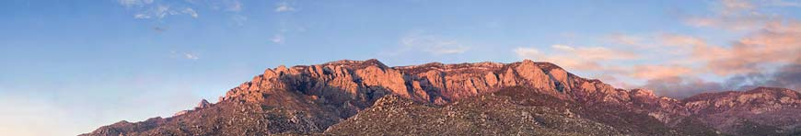
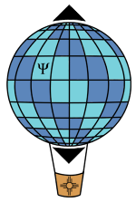
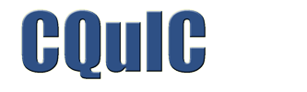

Quantum metrology:
An information-theoretic perspective
in three two lectures
Carlton M. Caves
Center for Quantum Information and Control, University of New Mexico
http://info.phys.unm.edu/~caves
Center for Quantum Information and Control

Slide 2
Quantum metrology:
An information-theoretic perspective
Lecture 1
Introduction. What’s the problem?
Squeezed states and optical interferometry
Ramsey interferometry, cat states, and spin squeezing
Carlton M. Caves
Center for Quantum Information and Control, University of New Mexico
http://info.phys.unm.edu/~caves
Center for Quantum Information and Control

Slide 3
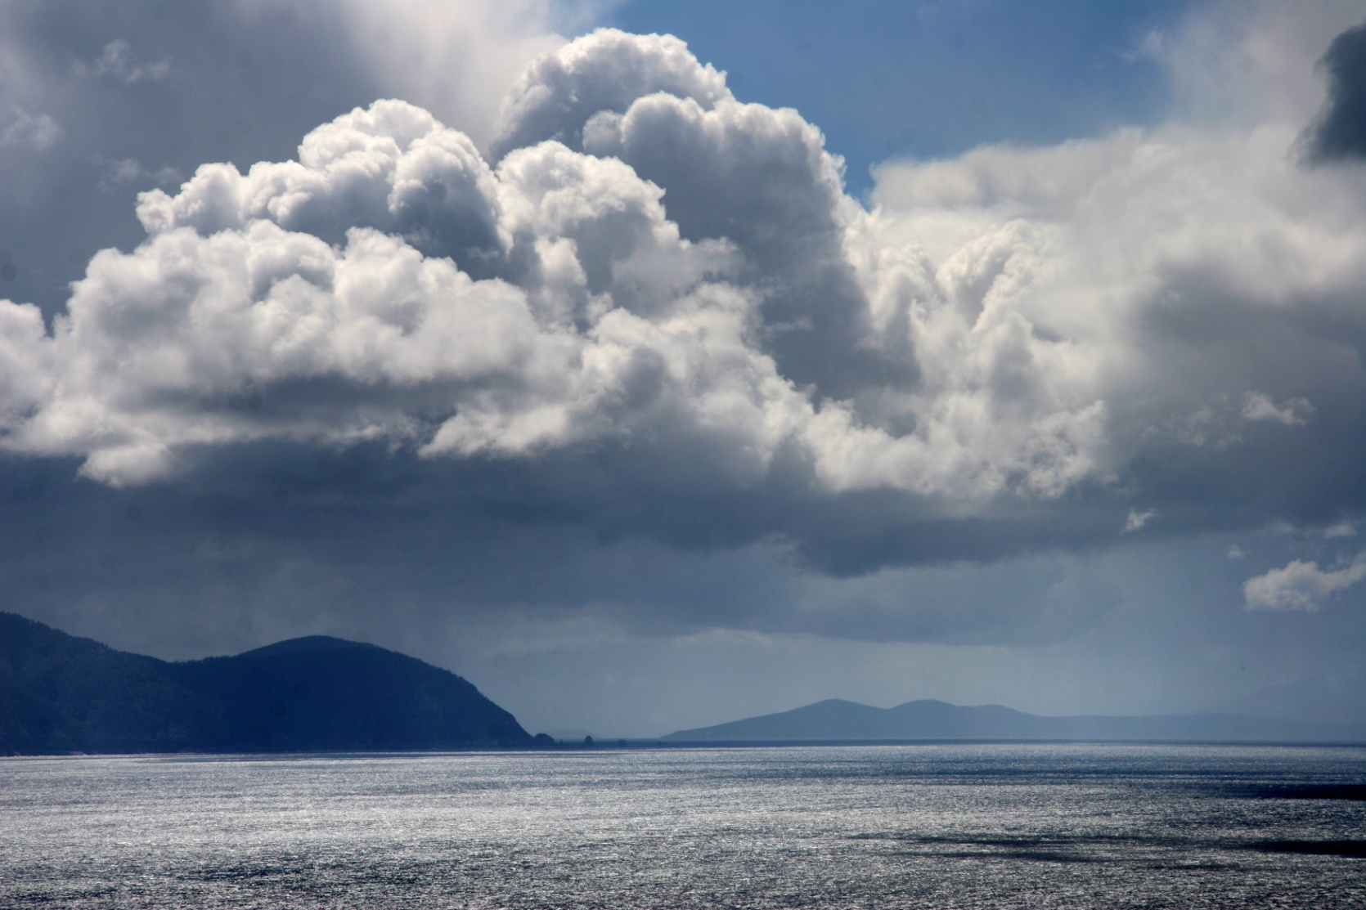
I. Introduction. What’s the problem?
View from Cape Hauy
Tasman Peninsula
Tasmania

Slide 4
Quantum information science
A new way of thinking
Computer science
Computational complexity
depends on physical law.
New physics
Quantum mechanics as liberator. What can be accomplished with quantum systems that can’t be done in a classical world?
Explore what can be done with quantum systems, instead of being satisfied with what Nature hands us.
Quantum engineering
Old physics
Quantum mechanics as nag.
The uncertainty principle
restricts what can be done.

Slide 5
Metrology
Taking the measure of things
The heart of physics
New physics
Quantum mechanics as liberator.
Explore what can be done with quantum systems, instead of being satisfied with what Nature hands us.
Quantum engineering
Old physics
Quantum mechanics as nag.
The uncertainty principle
restricts what can be done.
Old conflict in new guise

Slide 6
Measuring a classical parameter
Phase shift in an (optical) interferometer
Readout of anything that changes optical path lengths
Michelson-Morley experiment
Gravitational-wave detection
Planck-scale, holographic uncertainties in positions
Torque on or free precession of a collection of spins
Magnetometer
Atomic clock
Force on a linear system
Gravitational-wave detection
Accelerometer
Gravity gradiometer
Electrometer
Strain meter
Lectures 1 and 2
Lecture 3

Slide 7
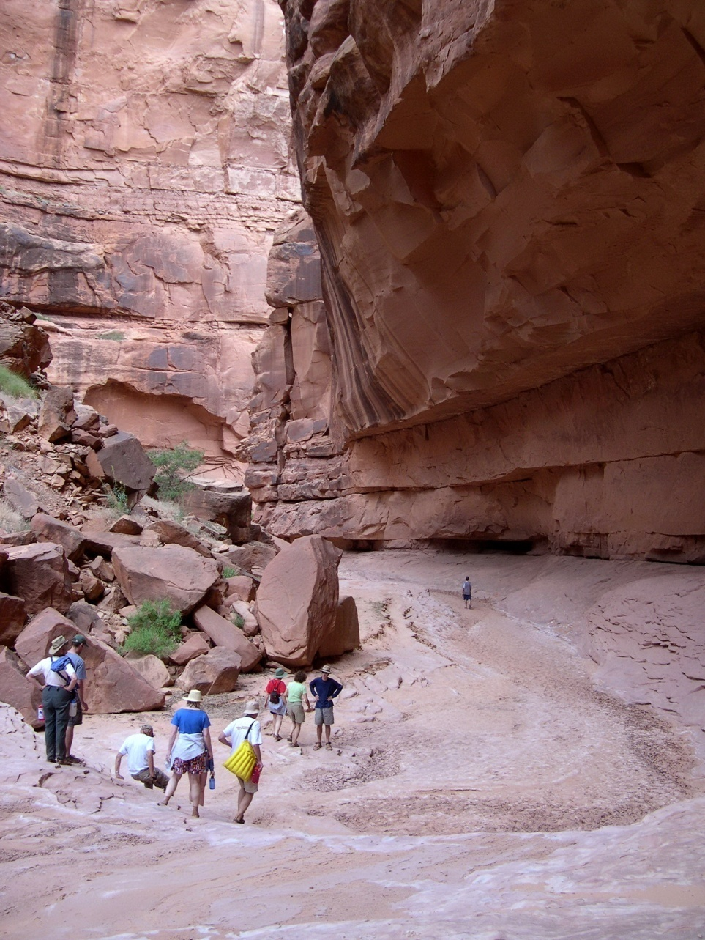
II. Squeezed states and optical interferometry
Oljeto Wash
Southern Utah

Slide 8
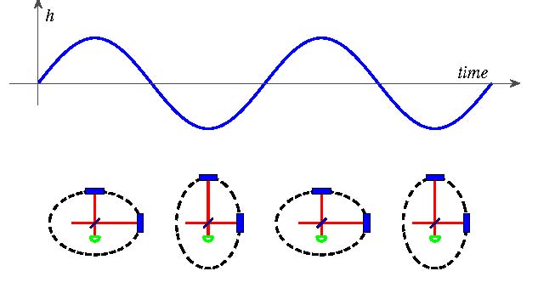
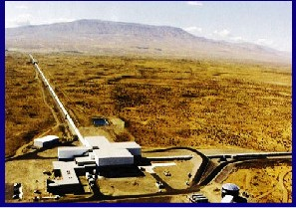
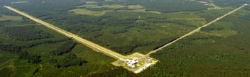
(Absurdly) high-precision interferometry
Hanford, Washington
The LIGO Collaboration, Rep. Prog. Phys. 72, 076901 (2009).
Laser Interferometer Gravitational Observatory (LIGO)
4 km
Livingston, Louisiana

Slide 9
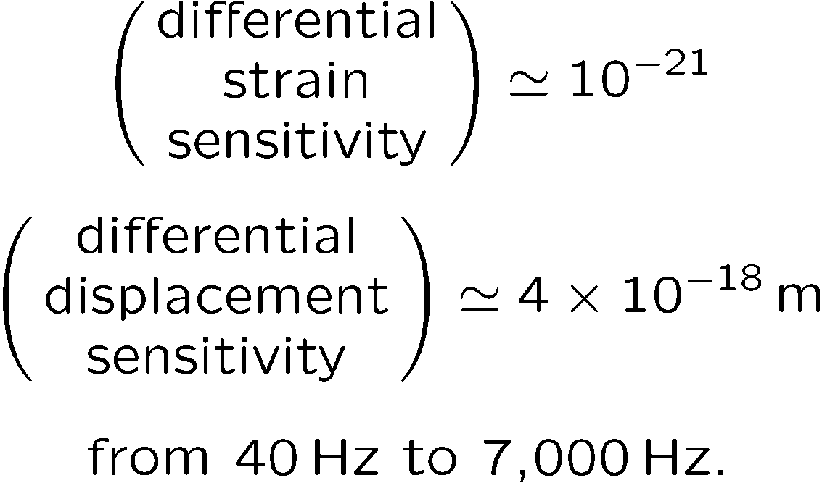
(Absurdly) high-precision interferometry
Initial LIGO
Hanford, Washington
Laser Interferometer Gravitational Observatory (LIGO)
High-power, Fabry-Perot-cavity (multipass), power-recycled interferometers
4 km
Livingston, Louisiana

Slide 10
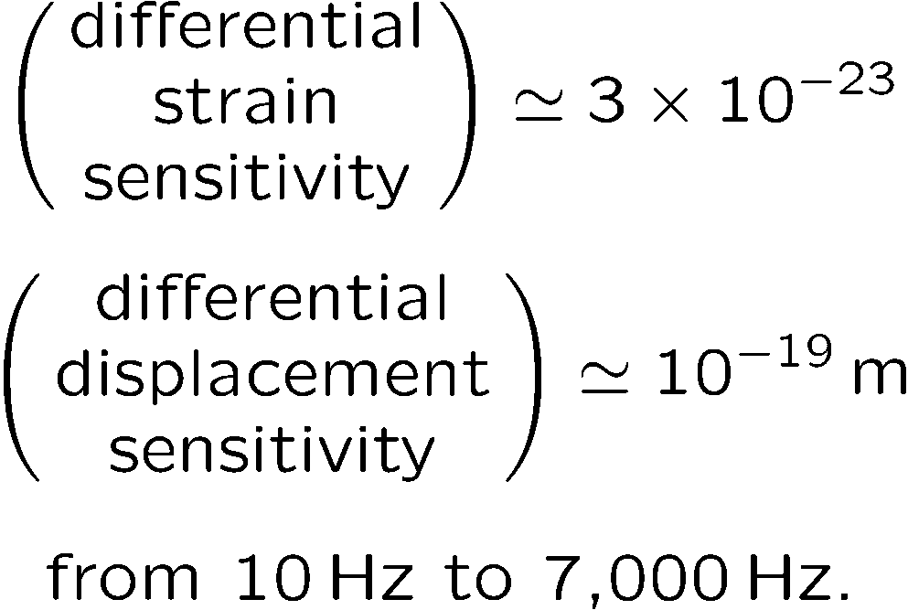
(Absurdly) high-precision interferometry
Advanced LIGO
Hanford, Washington
Currently a factor of 3 short of this design goal.
Laser Interferometer Gravitational Observatory (LIGO)
High-power, Fabry-Perot-cavity (multipass), power-and signal-recycled, squeezed-light interferometers
4 km
Livingston, Louisiana

Slide 11
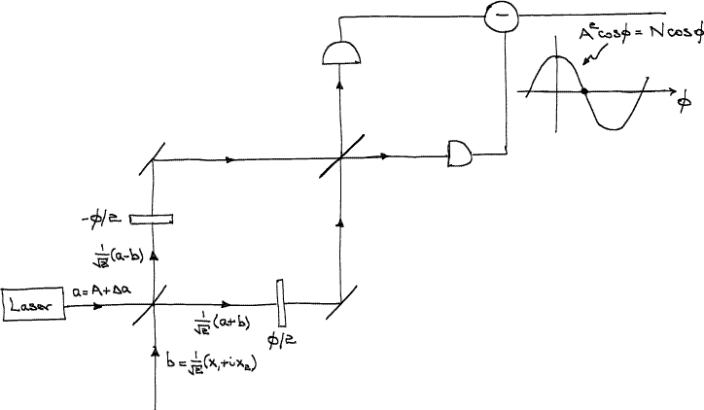
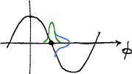
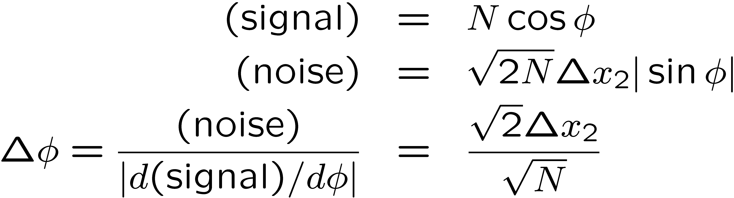
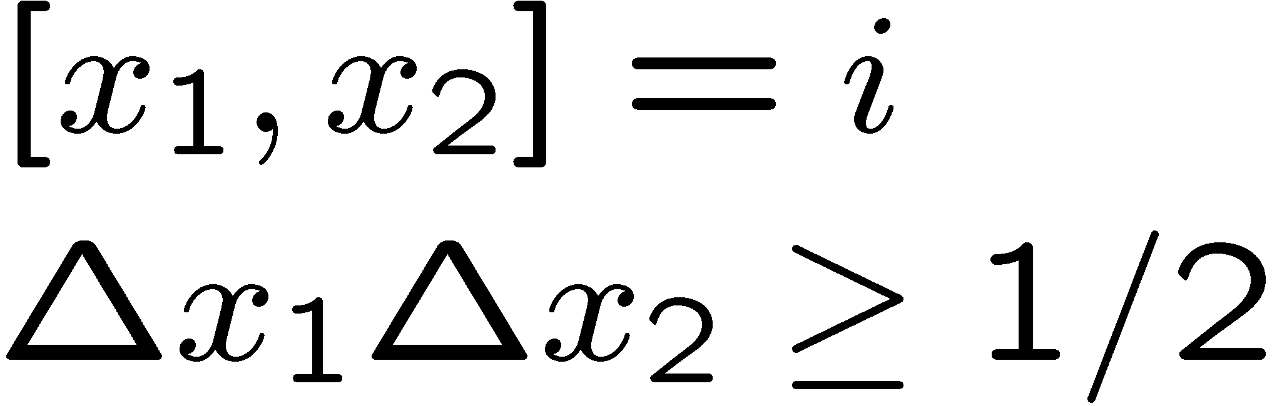
Mach-Zender interferometer
C. M. Caves, PRD 23, 1693 (1981).

Slide 12
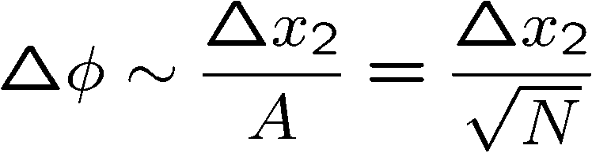
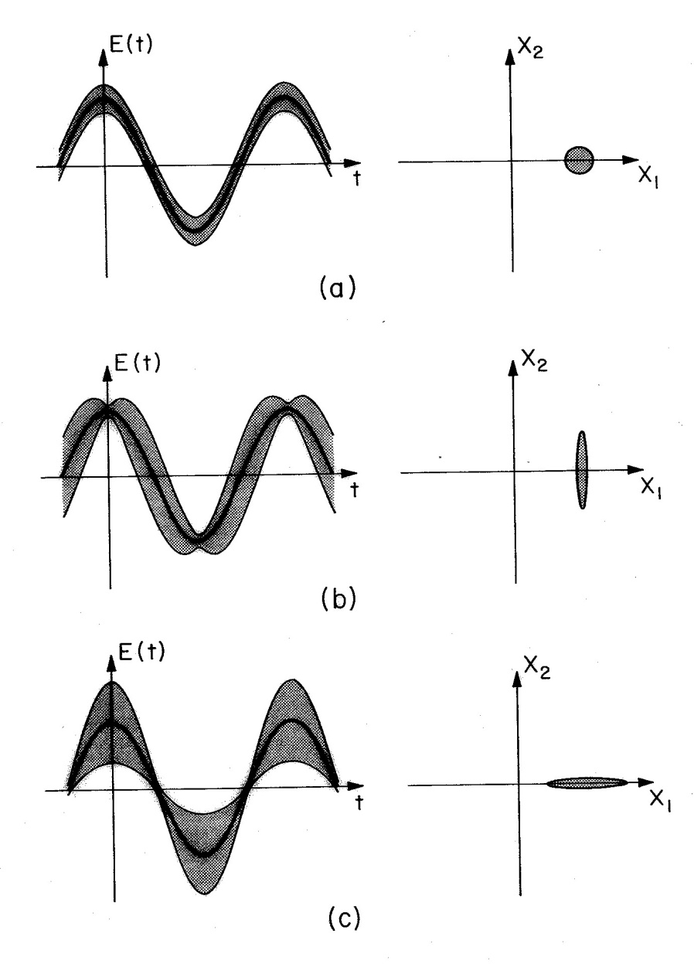
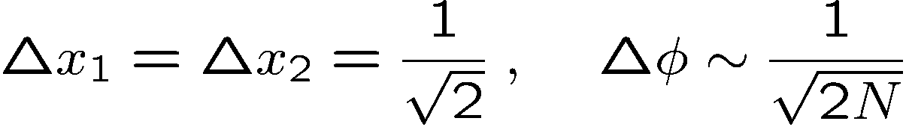
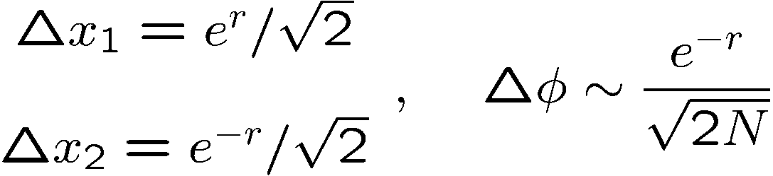
Squeezed states of light

Slide 13
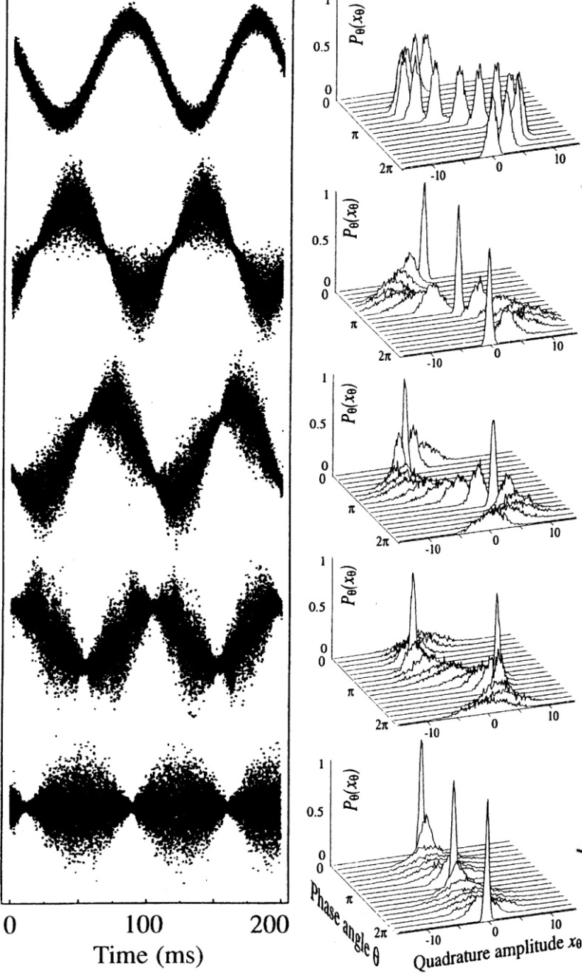

Squeezed states of light
Squeezing by a factor of about 3.5
Groups at Australian National University, Hannover, and Tokyo have achieved up to 15 dB of squeezing at audio frequencies for use in Advanced LIGO, VIRGO, and GEO.
G. Breitenbach, S. Schiller, and J. Mlynek, Nature 387, 471 (1997).

Slide 14
Fabry-Perot Michelson interferometer
Motion of the mirrors produced by a gravitational wave induces a transition from the symmetric mode to the antisymmetric mode; the resulting tiny signal at the vacuum port is contaminated by quantum noise that entered the vacuum port.

Slide 15
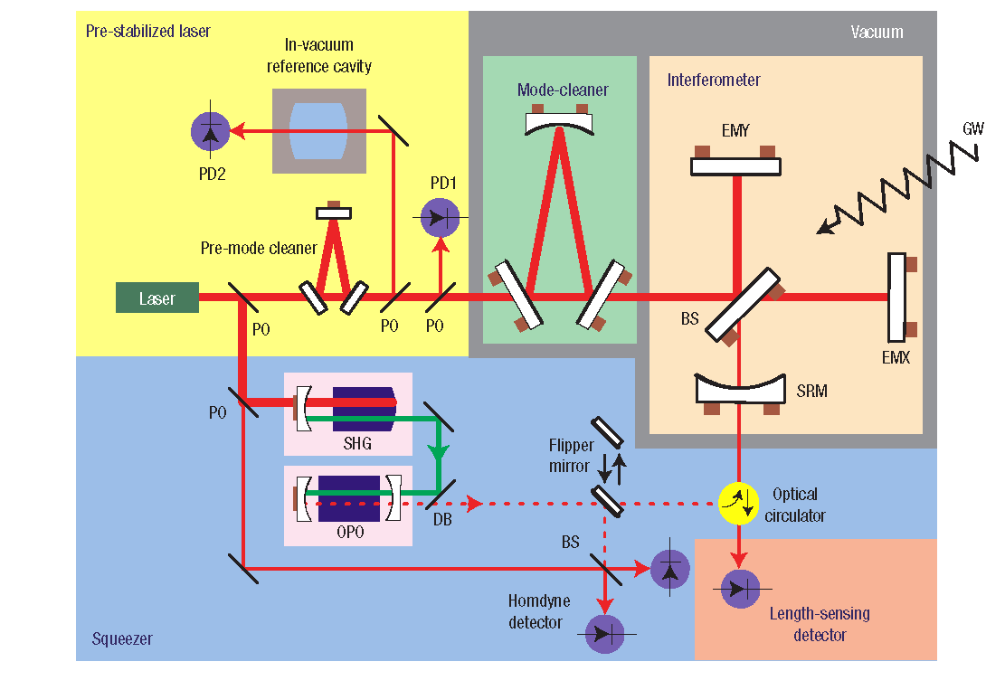
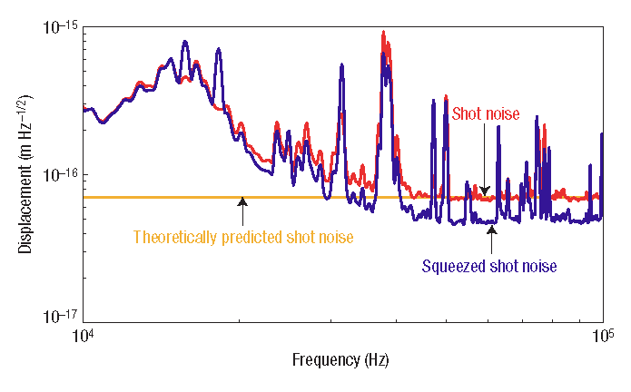
Squeezed states and optical interferometry
K. Goda, O. Miyakawa, E. E. Mikhailov, S. Saraf. R. Adhikari, K. McKenzie, R. Ward, S. Vass, A. J. Weinstein, and N. Mavalvala, Nature Physics 4, 472 (2008).
44% improvement in displacement sensitivity

Slide 16
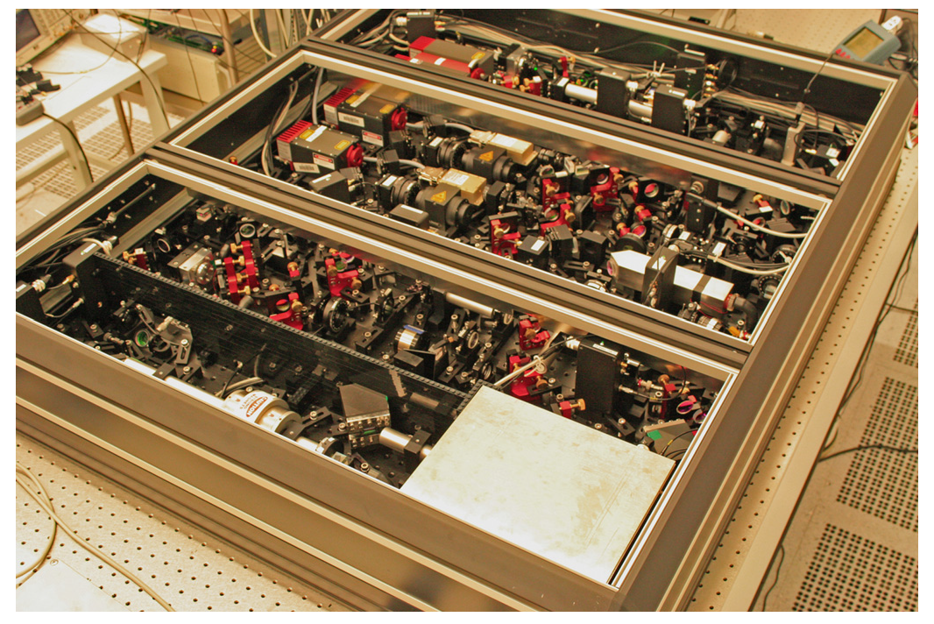
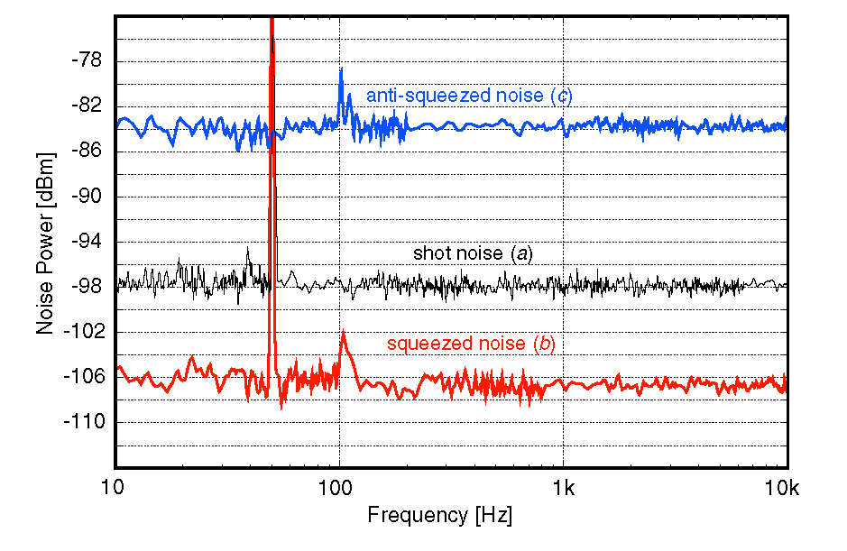
Squeezed states for optical interferometry
H. Vahlbruch, A. Khalaidovski, N. Lastzka,
C. Graef, K. Danzmann, and R. Schnabel, Classical and Quantum Gravity 27, 084027 (2010).
9dB below shot noise from 10 Hz to 10 kHz

Slide 17
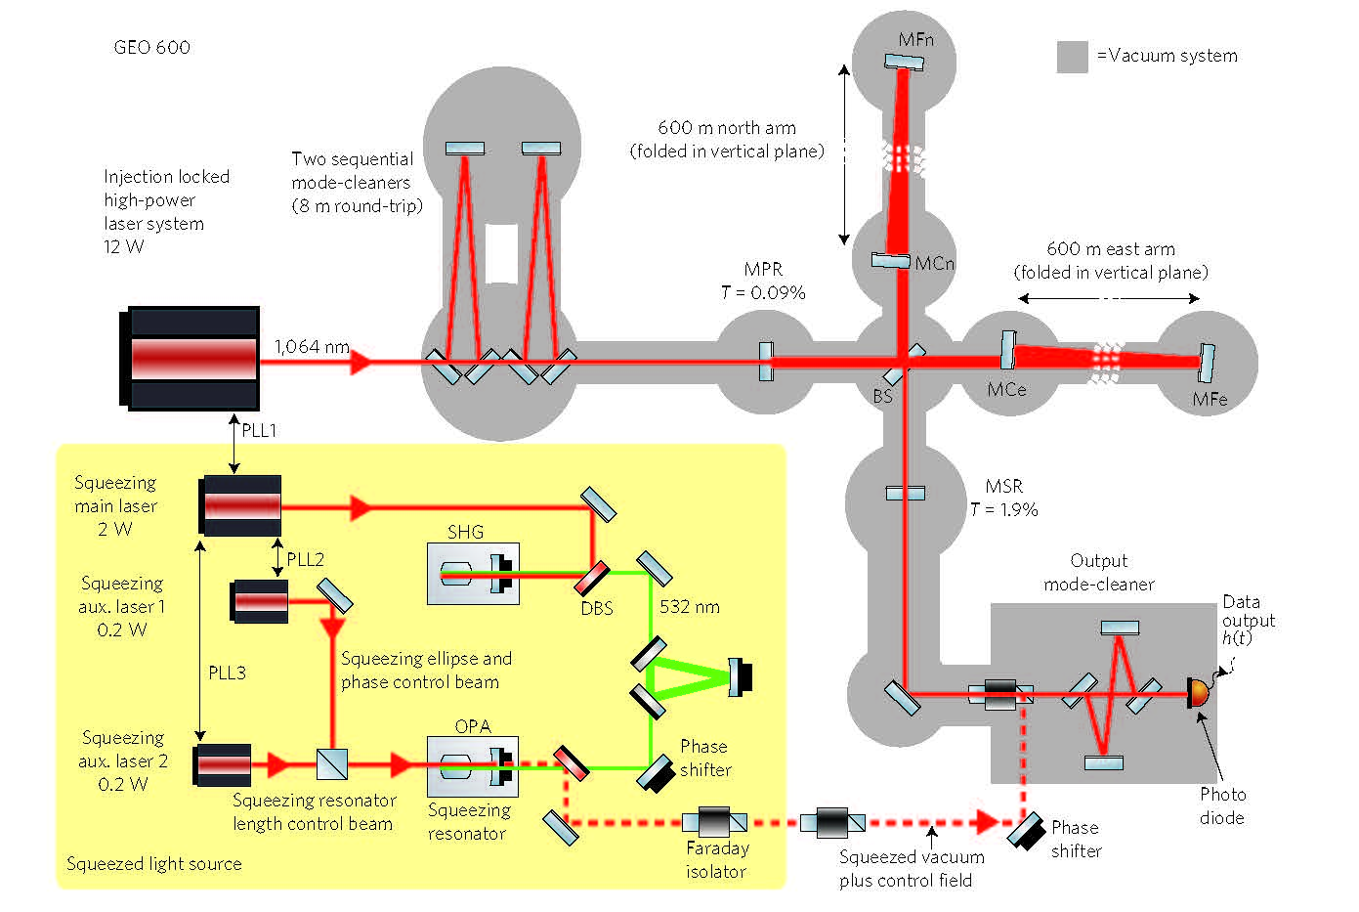
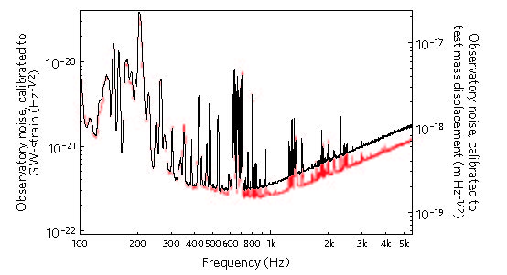
Squeezed states and optical interferometry
GEO 600 laser interferometer
The LIGO Scientific Collaboration, Nature Physics 7, 962 (2011).
Up to 3.5dB improvement in sensitivity in the shot-noise-limited frequency band

Slide 18
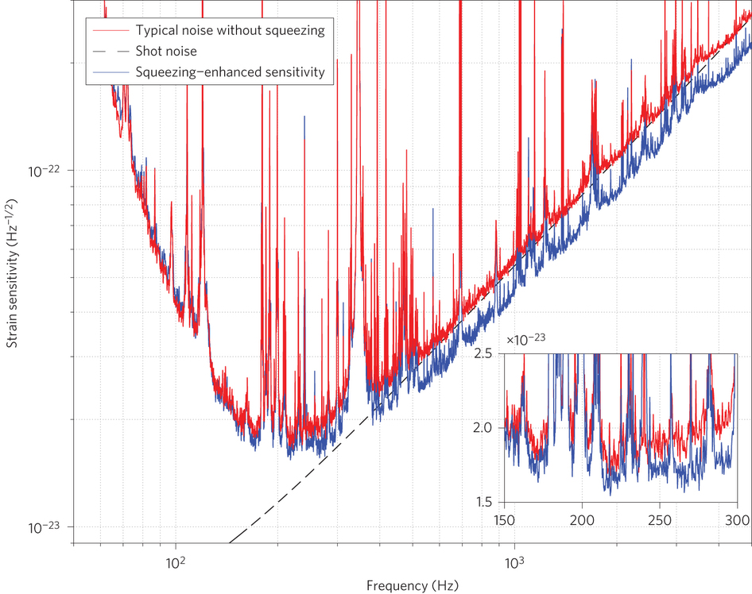
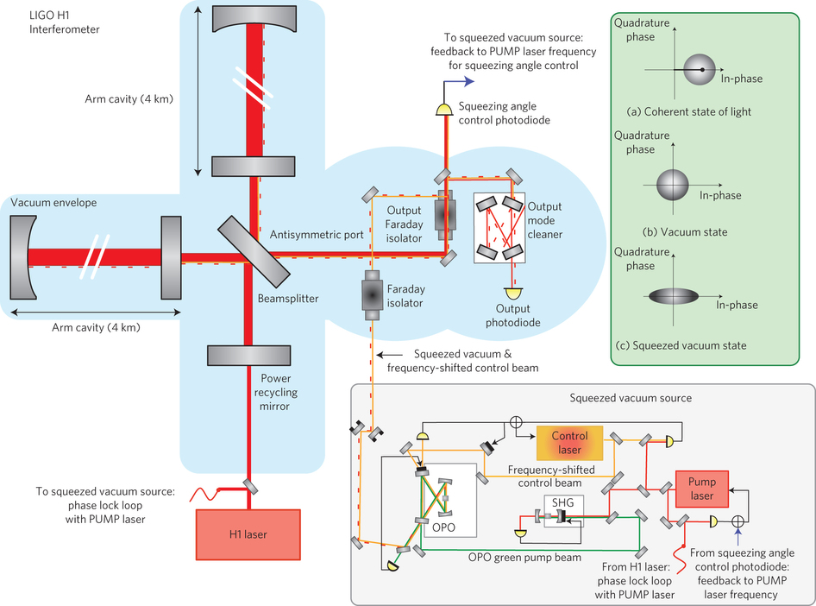
Squeezed states and optical interferometry
~ 2 dB of shot-noise reduction
Squeezed light in the
LIGO Hanford detector
The LIGO Scientific Collaboration, Nat. Phot. 7, 613 (2013).

Slide 19
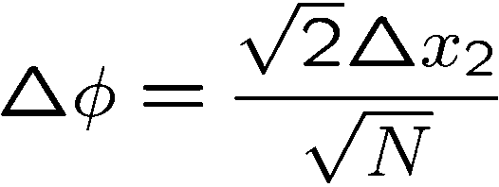
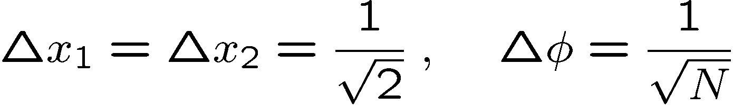
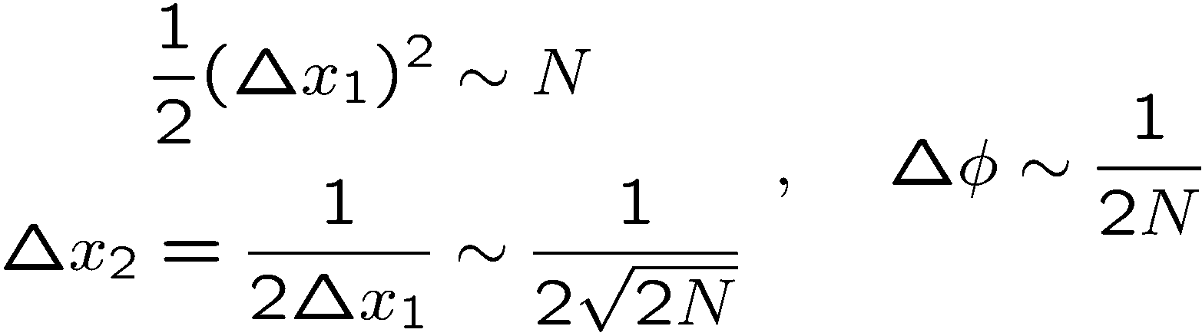
Quantum limits on optical interferometry
Quantum Noise Limit (Shot-Noise Limit)
As much power in the squeezed light as in the main beam
Heisenberg Limit

Slide 20
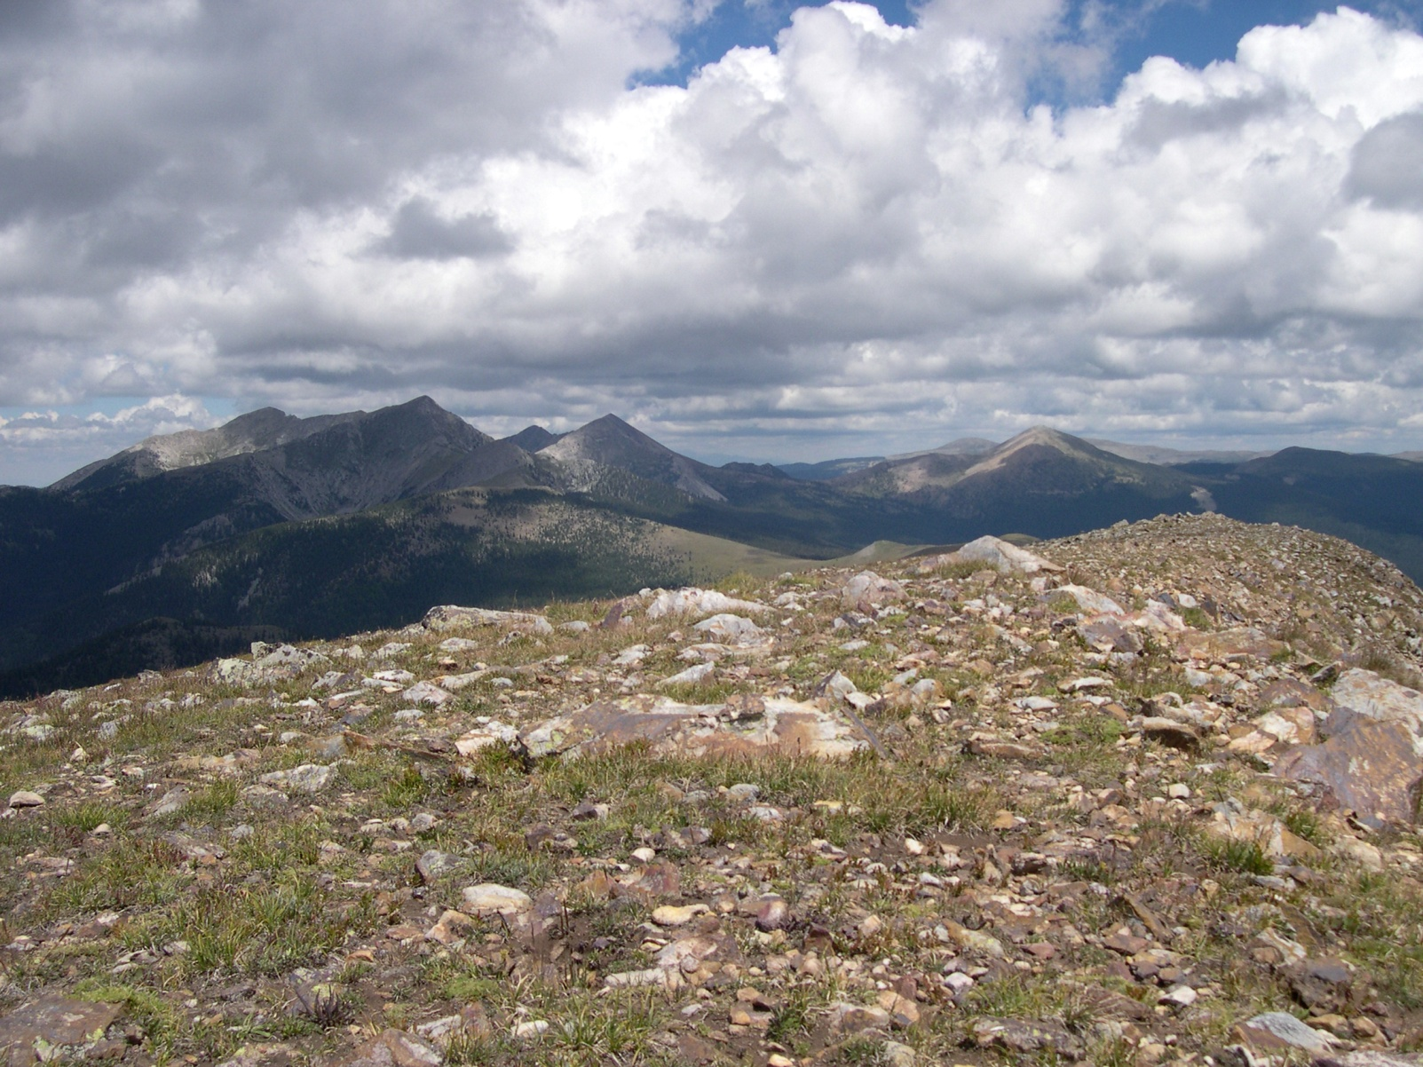
III. Ramsey interferometry, cat states, and spin squeezing
Truchas from East Pecos Baldy
Sangre de Cristo Range
Northern New Mexico

Slide 21
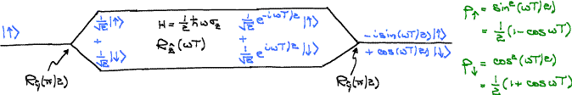

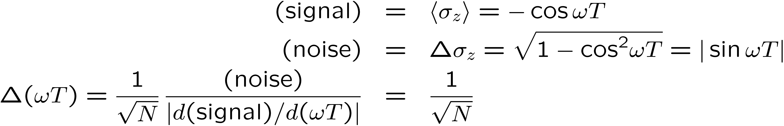
Ramsey interferometry
N independent “atoms”
Frequency measurement
Time measurement
Clock synchronization

Slide 22
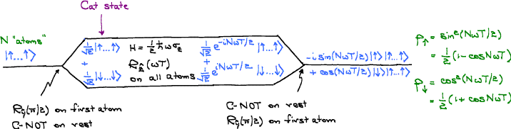
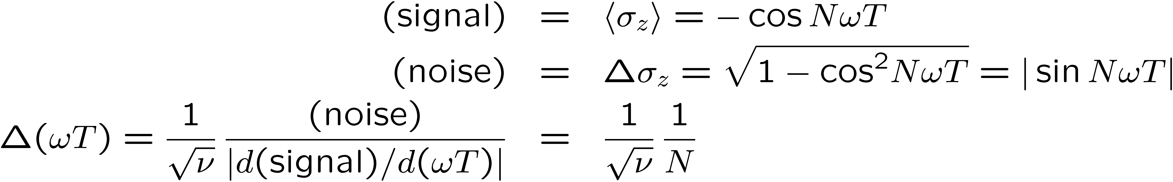
Cat-state Ramsey interferometry
J. J. Bollinger, W. M. Itano, D. J. Wineland, and D. J. Heinzen, Phys. Rev. A 54, R4649 (1996).
Fringe pattern with period 2π/N
N cat-state atoms

Slide 23
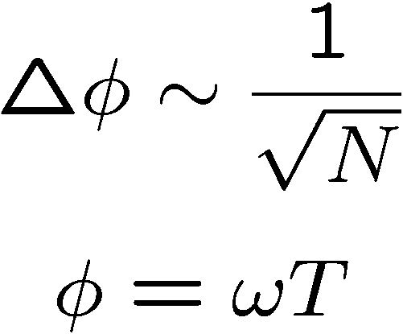
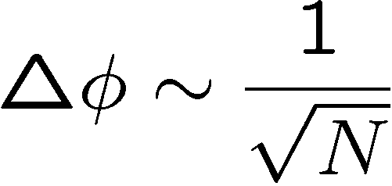
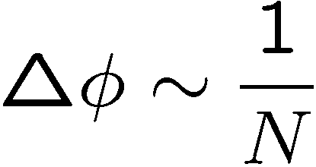
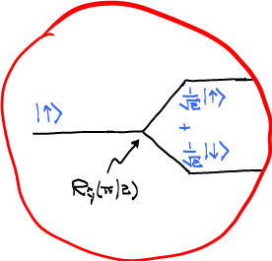
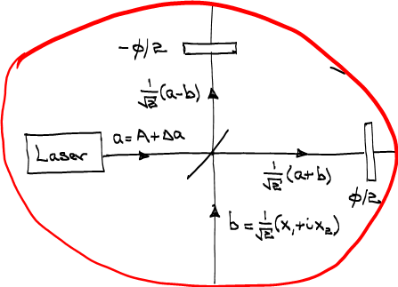
Optical interferometry
Ramsey interferometry
Quantum Noise Limit
(Shot-Noise Limit)
Heisenberg Limit
Something’s going on here.

Slide 24

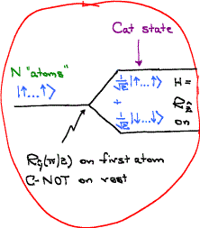
Squeezed-state optical interferometry
Cat-state Ramsey interferometry
Entanglement before “beamsplitter”
Between arms Between atoms
(wave or modal entanglement) (particle entanglement)
Between photons Between arms
(particle entanglement) (modal entanglement)

Slide 25


Squeezed-state optical interferometry
Cat-state Ramsey interferometry
Entanglement after “beamsplitter”
Between arms Between atoms
(wave or modal entanglement) (particle entanglement)
Between photons Between arms
(particle entanglement) (modal entanglement)

Slide 26
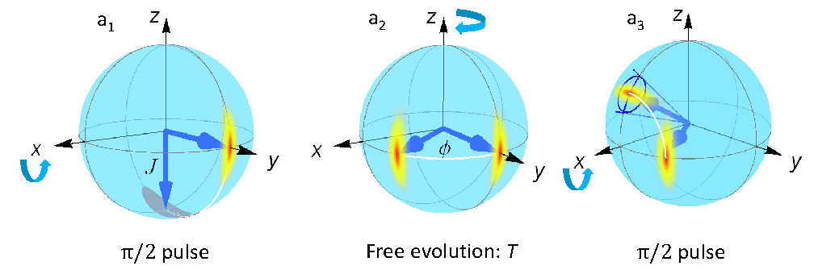
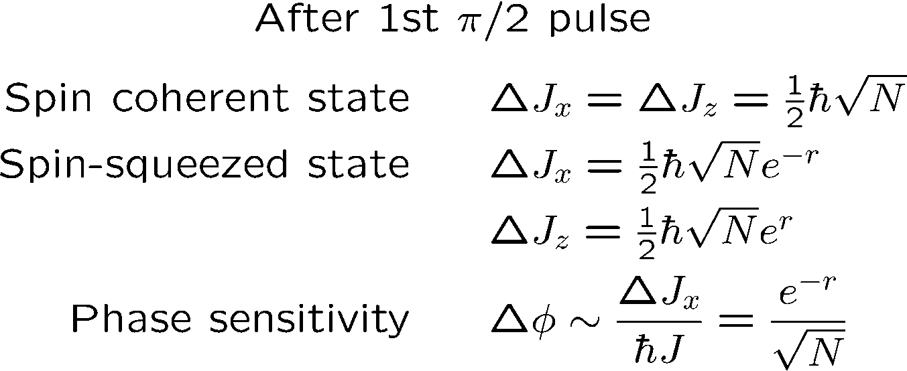
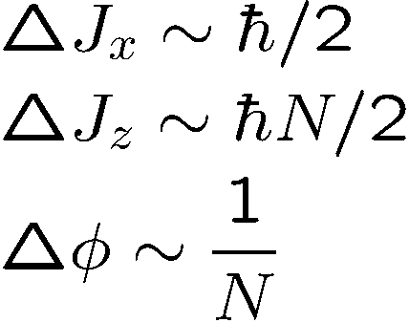
Spin-squeezing Ramsey interferometry
J. Ma, X. Wang, C. P. Sun, and F. Nori, Phys. Rep. 509, 89‒165 (2011).
Heisenberg Limit
This is really a cat state.

Slide 27
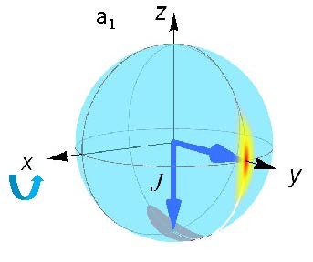
Spin-squeezing Ramsey interferometry
What’s squeezed?
What’s entangled?
The +y spin state has N particles; the –y spin state has single-mode squeezing. This is like the state of the two arms prior to the beamsplitter in an optical interferometer. The up and down spin states have correlated squeezing like that in the arms of a squeezed-state optical interferometer.
No entanglement of +y and –y spin states.
Modal entanglement of up and down spin states.
Particle entanglement.

Slide 28
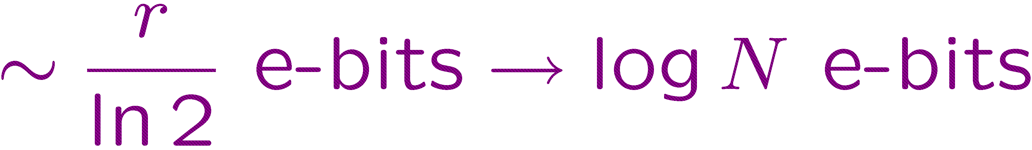
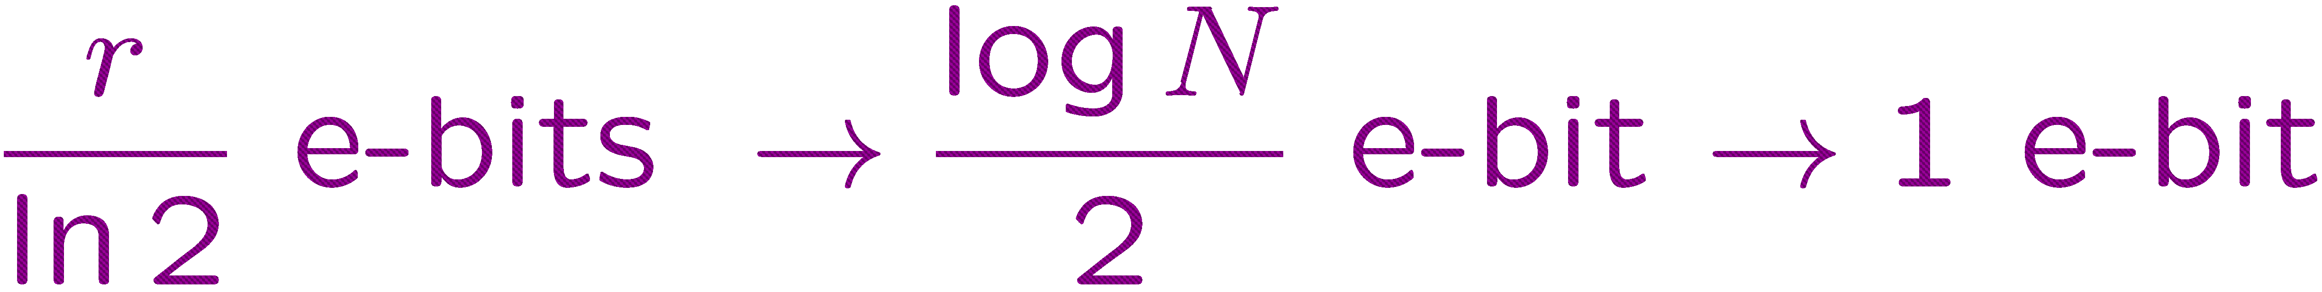
Squeezed-state optical interferometry
Spin-squeezing Ramsey interferometry
Entanglement
Between arms Between atoms
(wave or modal entanglement) (particle entanglement)
Between photons Between arms
(particle entanglement) (modal entanglement)

Slide 29
Role of entanglement
Entanglement is a resource …
for getting my paper into Nature.
Don’t accept facile explanations.
Ask questions.

Slide 30
Transition
Telling stories is what physics is about.
Lecture 1 has been about understanding fringe patterns and sources of noise and designing devices to improve phase sensitivity based on this understanding. This is telling stories.
Lecture 2 is about proving that the stories aren’t fooling us.
Which is better, stories or proofs? You need them both, but stories are going to get you farther.

Slide 31
Quantum metrology:
An information-theoretic perspective
Lecture 2
Quantum Cramér-Rao Bound (QCRB)
Making quantum limits relevant. Loss and decoherence
Beyond the Heisenberg limit. Nonlinear interferometry
Carlton M. Caves
Center for Quantum Information and Control, University of New Mexico
http://info.phys.unm.edu/~caves
Center for Quantum Information and Control

Slide 32
Transition
Telling stories is what physics is about.
Lecture 1 has been about understanding fringe patterns and sources of noise and designing devices to improve phase sensitivity based on this understanding. This is telling stories.
Lecture 2 is about proving that the stories aren’t fooling us.
Which is better, stories or proofs? You need them both, but stories are going to get you farther.

Slide 33

I. Quantum Cramér-Rao Bound (QCRB)
Cable Beach
Western Australia

Slide 34
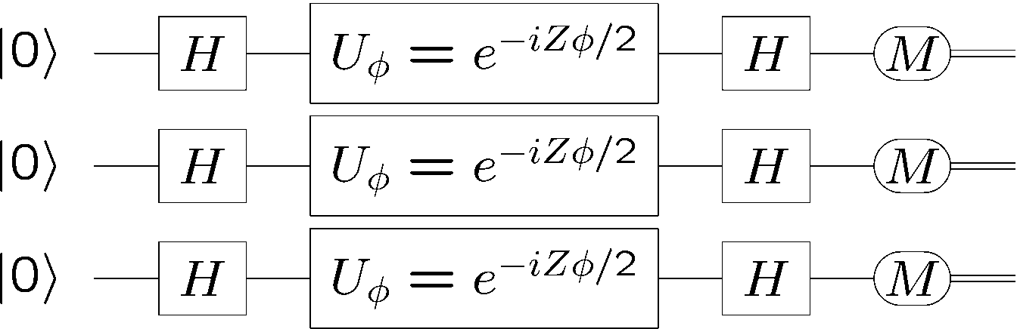
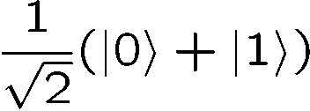
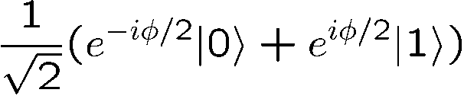




Quantum information version of interferometry
Quantum noise limit
Quantum
circuits
cat state
N = 3
Heisenberg limit
Fringe pattern with period 2π/N

Slide 35



Cat-state interferometer
State
preparation
Measurement
Single-parameter estimation

Slide 36







Heisenberg
limit
S. L. Braunstein, C. M. Caves, and G. J. Milburn, Ann. Phys. 247, 135 (1996).
V. Giovannetti, S. Lloyd, and L. Maccone, PRL 96, 041401 (2006).
S. Boixo, S. T. Flammia, C. M. Caves, and JM Geremia, PRL 98, 090401 (2007).
Separable inputs
Generalized
uncertainty principle
Quantum Cramér-Rao bound

Slide 37





Achieving the Heisenberg limit
cat
state
Proof of
QCRB

Slide 38

Is it entanglement?
It’s the entanglement, stupid.
But what about?
For metrology, entanglement is part of the story, but only part. We need a generalized notion of entanglement/resources that includes information about the physical situation, particularly the relevant Hamiltonian.

Slide 39

II. Making quantum limits relevant. Loss and decoherence
Bungle Bungle Range
Western Australia

Slide 40

Making quantum limits relevant
Quantum
circuits
The serial resource, T, and the parallel resource, N, are equivalent and interchangeable, mathematically.
The serial resource, T, and the parallel resource, N, are not equivalent and not interchangeable, physically.
Information science perspective
Platform independence
Physics perspective
Distinctions between different physical systems

Slide 41


Making quantum limits relevant. One metrology story
A. Shaji and C. M. Caves, PRA 76, 032111 (2007).

Slide 42

Making quantum limits relevant
Rule of thumb for photon losses for large N
S. Knysh, V. N. Smelyanskiy and G. A. Durkin, PRA 83, 021804(R) (2011).
Heisenberg limit: less than one photon lost.
Typically, beat shot noise by square of root of fractional loss.

Slide 43



Quantum limit on practical optical interferometry
Cheap photons from a laser (coherent state)
Low, but nonzero losses on the detection timescale
Beamsplitter to make differential phase detection insensitive to laser fluctuations
Freedom: state input to the second input port; optimize relative to a mean-number constraint.
Entanglement: mixing this state with coherent state at the beamsplitter.
Generalized
uncertainty principle
QCRB
Optimum achieved by differenced photodetection in a Mach-Zehnder configuration.
M. D. Lang and C. M. Caves, PRL 111, 17360 (2013).
Achieved by squeezed vacuum into the second input port

Slide 44







Practical optical interferometry: Photon losses
M. D. Lang , UNM PhD dissertation, 2015.
B. M. Escher, R. L. de Matos Filho, and L. Davidovich, Nat. Phys. 7, 406‒411 (2011).
Z. Jiang, PRA 89, 032128 (2014).
Optimum achieved by differenced photodetection in a Mach-Zehnder configuration.

Slide 45

III. Beyond the Heisenberg limit. Nonlinear interferometry
Echidna Gorge
Bungle Bungle Range
Western Australia

Slide 46
Beyond the Heisenberg limit
The purpose of theorems in physics is to lay out the assumptions clearly so one can discover which assumptions have to be violated.

Slide 47





Improving the scaling with N
S. Boixo, S. T. Flammia, C. M. Caves, and
JM Geremia, PRL 98, 090401 (2007).
Cat state does the job.
Nonlinear Ramsey interferometry
Metrologically relevant k-body coupling

Slide 48



Improving the scaling with N without entanglement
S. Boixo, A. Datta, S. T. Flammia, A. Shaji, E. Bagan, and C. M. Caves, PRA 77, 012317 (2008).
Product
input
Product
measurement

Slide 49






Improving the scaling with N without entanglement. Two-body couplings
S. Boixo, A. Datta, S. T. Flammia, A. Shaji, E. Bagan, and C. M. Caves, PRA 77, 012317 (2008); M. J. Woolley, G. J. Milburn, and C. M. Caves, NJP 10, 125018 (2008).
Loss and decoherence?

Slide 50


Improving the scaling with N without entanglement. Two-body couplings
Super-Heisenberg scaling from nonlinear dynamics (N-enhanced rotation of a spin coherent state), without any particle entanglement
S. Boixo, A. Datta, M. J. Davis, S. T. Flammia, A. Shaji, and C. M. Caves, PRL 101, 040403 (2008); A. B. Tacla, S. Boixo, A. Datta, A. Shaji, and C. M. Caves, PRA 82, 053636 (2010).
Loss and decoherence?

Slide 51


Improving the scaling with N without entanglement. Optical experiment
M. Napolitano, M. Koschorreck, B. Dubost, N. Behbood, R. J. Sewell, and M. W. Mitchell, Nature 471, 486 (2011).

Slide 52
Quantum metrology:
An information-theoretic perspective
Lecture 3
Introduction. What’s the problem?
Standard quantum limit (SQL) for force detection. The right wrong story
Beating the SQL. Three strategies
Carlton M. Caves
Center for Quantum Information and Control, University of New Mexico
Centre for Engineered Quantum Systems, University of Queensland
http://info.phys.unm.edu/~caves
Center for Quantum Information and Control

Slide 53

I. Introduction. What’s the problem?
Pecos Wilderness
Sangre de Cristo Range
Northern New Mexico

Slide 54
Measuring a classical parameter
Phase shift in an (optical) interferometer
Readout of anything that changes optical path lengths
Michelson-Morley experiment
Gravitational-wave detection
Planck-scale, holographic uncertainties in positions
Torque on or free precession of a collection of spins
Magnetometer
Atomic clock
Force on a linear system
Gravitational-wave detection
Accelerometer
Gravity gradiometer
Electrometer
Strain meter
Lectures 1 and 2
Lecture 3

Slide 55
(Absurdly) high-precision interferometry for force sensing
Hanford, Washington
The LIGO Collaboration, Rep. Prog. Phys. 72, 076901 (2009).
Laser Interferometer Gravitational Observatory (LIGO)
4 km
Livingston, Louisiana

Slide 56

(Absurdly) high-precision interferometry for force sensing
Initial LIGO
Hanford, Washington
Laser Interferometer Gravitational Observatory (LIGO)
High-power, Fabry-Perot-cavity (multipass), power-recycled interferometers
4 km
Livingston, Louisiana

Slide 57

(Absurdly) high-precision interferometry for force sensing
Advanced LIGO
Hanford, Washington
Laser Interferometer Gravitational Observatory (LIGO)
High-power, Fabry-Perot-cavity (multipass), power-and signal-recycled, squeezed-light interferometers
4 km
Livingston, Louisiana

Slide 58



Opto,atomic,electro micromechanics
30 μm long
170 nm wide
140 nm thick
Beam microresonator
10 μm
T. Rocheleau, T. Ndukum, C. Macklin , J. B. Hertzberg, A. A. Clerk, and K. C. Schwab, Nature 463, 72 (2010).
Atomic force microscope
Dielectric micromembrane
J. C. Sankey, C. Yang, B. M. Zwickl, A. M. Jayich, and J. G. E. Harris, Nature Physics 6, 707 (2010).

Slide 59



Opto,atomic, electro micromechanics
Zipper-cavity microresonator
Drum microresonator
A. D. O’Connell et al., Nature 464, 697 (2010).
M. Eichenfield, R. Camacho, J. Chan, K. J. Vahala, and O. Painter, Nature 459, 550 (2009).
A. Schliesser and T. J. Kippenberg, Advances in Atomic, Molecular, and Optical Physics, Vol. 58, (Academic Press, San Diego, 2010), p. 207.
Toroidal microresonator

Slide 60


Mechanics for force sensing
T. J. Kippenberg and K. J. Vahala, Science 321, 172 (2008).
Notes:
Experimental cavity optomechanical systems. (Top to Bottom) Gravitational wave detectors [photo credit LIGO Laboratory], harmonically suspended gram-scale mirrors (28), coated atomic force microscopy cantilevers (29), coated micromirrors (14, 15), SiN3 membranes dispersively coupled to an optical cavity (31), optical microcavities (13, 16), and superconducting microwave resonators coupled to a nanomechanical beam (33). The masses range from kilograms to picograms, whereas frequencies range from tens of megahertz down to the hertz level. CPW, coplanar waveguide.

Slide 61

Standard quantum limit (SQL)
Wideband detection of force f on free mass m
LIGO interferometer
Back action

Slide 62


Standard quantum limit (SQL)
Narrowband, on-resonance detection of force f on
oscillator of mass m and resonant frequency ω₀
Nanoresonator
Back action?

Slide 63



SQL
Wideband force f on free mass m
On-resonance force f on oscillator of
mass m and resonant frequency ω₀
It’s wrong.
It’s not even the right wrong story.
The right wrong story. Waveform estimation.

Slide 64

II. Standard quantum limit (SQL) for force detection. The right wrong story
San Juan River canyons
Southern Utah

Slide 65







SQL for force detection
Monitor position
Back-action force
Langevin force
measurement (shot) noise
Notes:
Need a graph of the SQL. Explain that this is not a graph one ever sees, because to achieve it requires xi and eta to have nonflat spectra, and typically they don’t. So what one sees is graphs with shot noise dominating on one side, back action on the other, and one point where you achieve the SQL.

Slide 66
Interferometric readout
—
Laser

Slide 67
Interferometric readout
—
Laser

Slide 68
Interferometric readout
—
Vacuum input port
measurement
(shot) noise
Laser
Back-action noise
If shot noise dominates, squeeze the phase quadrature.

Slide 69

SQL for force detection
Back-action force
Time domain
Langevin force
measurement noise
Frequency domain
Back-action force
Langevin force
measurement noise

Slide 70

Noise-power spectral densities
Zero-mean, time-stationary random process u(t)
Noise-power spectral density of u
Notes:
Need a graph of the SQL. Explain that this is not a graph one ever sees, because to achieve it requires xi and eta to have nonflat spectra, and typically they don’t. So what one sees is graphs with shot noise dominating on one side, back action on the other, and one point where you achieve the SQL.

Slide 71




SQL for force detection
Back-action force
Langevin force
measurement noise

Slide 72










SQL for force detection

Slide 73







Langevin force

Slide 74


SQL for force detection
The right wrong story.
In an opto-mechanical setting, achieving the SQL at a particular frequency requires squeezing at that frequency, and achieving the SQL over a wide bandwidth requires frequency-dependent squeezing.
Notes:
Need a graph of the SQL. Explain that this is not a graph one ever sees, because to achieve it requires xi and eta to have nonflat spectra, and typically they don’t. So what one sees is graphs with shot noise dominating on one side, back action on the other, and one point where you achieve the SQL.

Slide 75
III. Beating the SQL. Three strategies
Truchas from East Pecos Baldy
Sangre de Cristo Range
Northern New Mexico

Slide 76
Beating the SQL. Strategy 1
Couple parameter to observable h, and monitor observable o conjugate to h.
Arrange that h and o are conserved in the absence of the parameter interaction; o is the simplest sort of quantum nondemolition (QND) or back-action-evading (BAE) observable.
Give o as small an uncertainty as possible, thereby giving h as big an uncertainty as possible (back action).
Strategy 1. Monitor a quadrature component.
Downsides
Detect only one quadrature of the force.
Mainly narrowband (no convenient free-mass version).
Need new kind of coupling to monitor oscillator.

Slide 77
Strategy 2. Interferometric readout
—
Vacuum input port
Output noise
Laser
All the output noise comes from the (frequency-dependent) purple quadrature. Squeeze it.
W. G. Unruh, in Quantum Optics, Experimental Gravitation, and Measurement Theory, edited by P. Meystre and M. O. Scully (Plenum, 1983), p. 647; F. Ya. Khalili, PRD 81, 122002 (2010).
Notes:
Need a graph of the SQL. Explain that this is not a graph one ever sees, because to achieve it requires xi and eta to have nonflat spectra, and typically they don’t. So what one sees is graphs with shot noise dominating on one side, back action on the other, and one point where you achieve the SQL.

Slide 78


Beating the SQL. Strategy 2
Strategy 2. Squeeze the entire output noise by correlating the measurement and back-action noise.

Slide 79
Quantum Cramér-Rao Bound (QCRB)
Single-parameter estimation: Bound on the error in estimating a classical parameter that is coupled to a quantum system in terms of the inverse of the quantum Fisher information.
Multi-parameter estimation: Bound on the covariance matrix in estimating a set of classical parameters that are coupled to a quantum system in terms of the inverse of a quantum Fisher-information matrix.
Waveform estimation: Bound on the continuous covariance matrix for estimating a continuous waveform that is coupled to a quantum system in terms of the inverse of a continuous, two-time quantum Fisher-information matrix.

Slide 80



Waveform QCRB.
Spectral uncertainty principle
M. Tsang, H. M. Wiseman, and C. M. Caves, PRL 106, 090401 (2011).
Prior-information term
At frequencies where there is little prior information,
Minimum-uncertainty noise
No hint of SQL—no back-action noise, only measurement noise—but can the bound be achieved?

Slide 81








Beating the SQL. Strategy 3
Strategy 3. Quantum noise cancellation (QNC) using oscillator and negative-mass oscillator.
Primary oscillator
Negative-mass oscillator
Monitor collective position Q
Conjugate pairs
QCRB
Oscillator pairs

Slide 82

Quantum noise cancellation
M. Tsang and C. M. Caves, PRL 105,123601 (2010).
Conjugate pairs
Oscillator pairs
Paired sidebands about a carrier frequency
Paired collective spins, polarized along opposite directions
W. Wasilewski , K. Jensen, H. Krauter, J. J. Renema, M. V. Balbas, and E. S. Polzik, PRL 104, 133601 (2010).

Slide 83

That’s all. Thanks for your attention.
Tent Rocks
Kasha-Katuwe National Monument
Northern New Mexico

Slide 84









Using quantum circuit diagrams
Cat-state interferometer
2.I
Cat-state interferometer
2.II
C. M. Caves and A. Shaji, Opt. Commun. 283, 695 (2010) .

Slide 85





Proof of QCRB. Setting

Slide 86

Proof of QCRB. Classical CRB

Slide 87



Proof of QCRB. Classical CRB

Slide 88

Proof of QCRB.
Classical Fisher information

Slide 89


Proof of QCRB. Quantum mechanics

Slide 90



Proof of QCRB. Quantum mechanics

Slide 91





Proof of QCRB. Quantum mechanics

