Slide 1
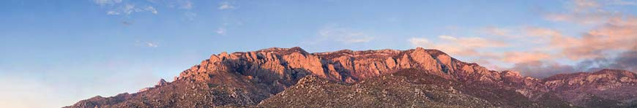
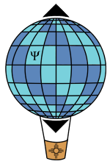
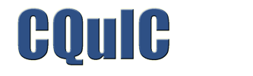
Quantum limits on estimating
a waveform
Introduction. What’s the problem?
Standard quantum limit (SQL) for force detection. The right wrong story
Beating the SQL. Three strategies
Carlton M. Caves
Center for Quantum Information and Control, University of New Mexico
Centre for Engineered Quantum Systems, University of Queensland
http://info.phys.unm.edu/~caves
Center for Quantum Information and Control

Slide 2
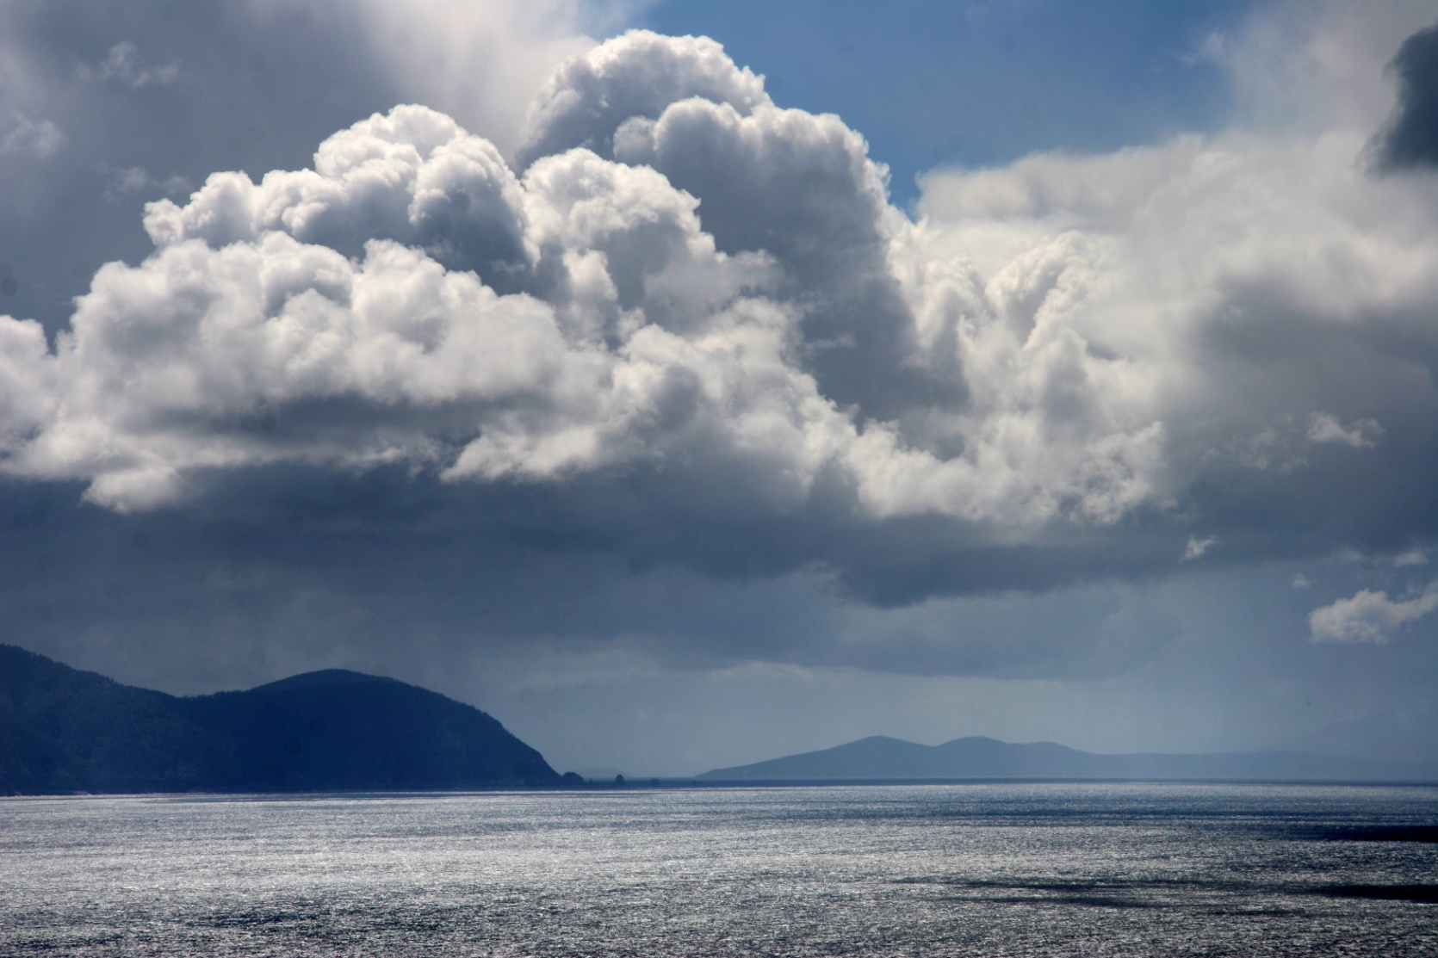
I. Introduction. What’s the problem?
View from Cape Hauy
Tasman Peninsula
Tasmania

Slide 3
Measuring a classical parameter
Phase shift in an (optical) interferometer
Readout of anything that changes optical path lengths
Michelson-Morley experiment
Gravitational-wave detection
Planck-scale, holographic uncertainties in positions
Torque on or free precession of a collection of spins
Magnetometer
Atomic clock
Force on a linear system
Gravitational-wave detection
Accelerometer
Gravity gradiometer
Electrometer
Strain meter

Slide 4
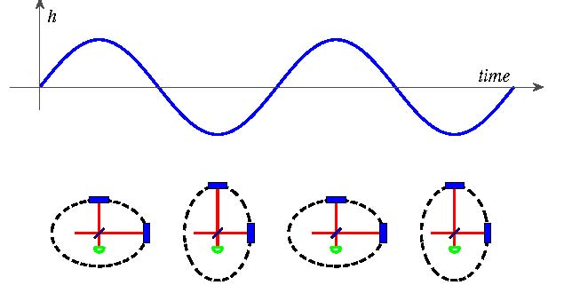
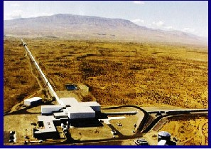
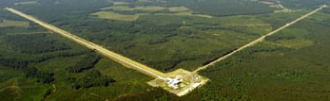
(Absurdly) high-precision interferometry for force sensing
Hanford, Washington
The LIGO Collaboration, Rep. Prog. Phys. 72, 076901 (2009).
Laser Interferometer Gravitational Observatory (LIGO)
4 km
Livingston, Louisiana

Slide 5
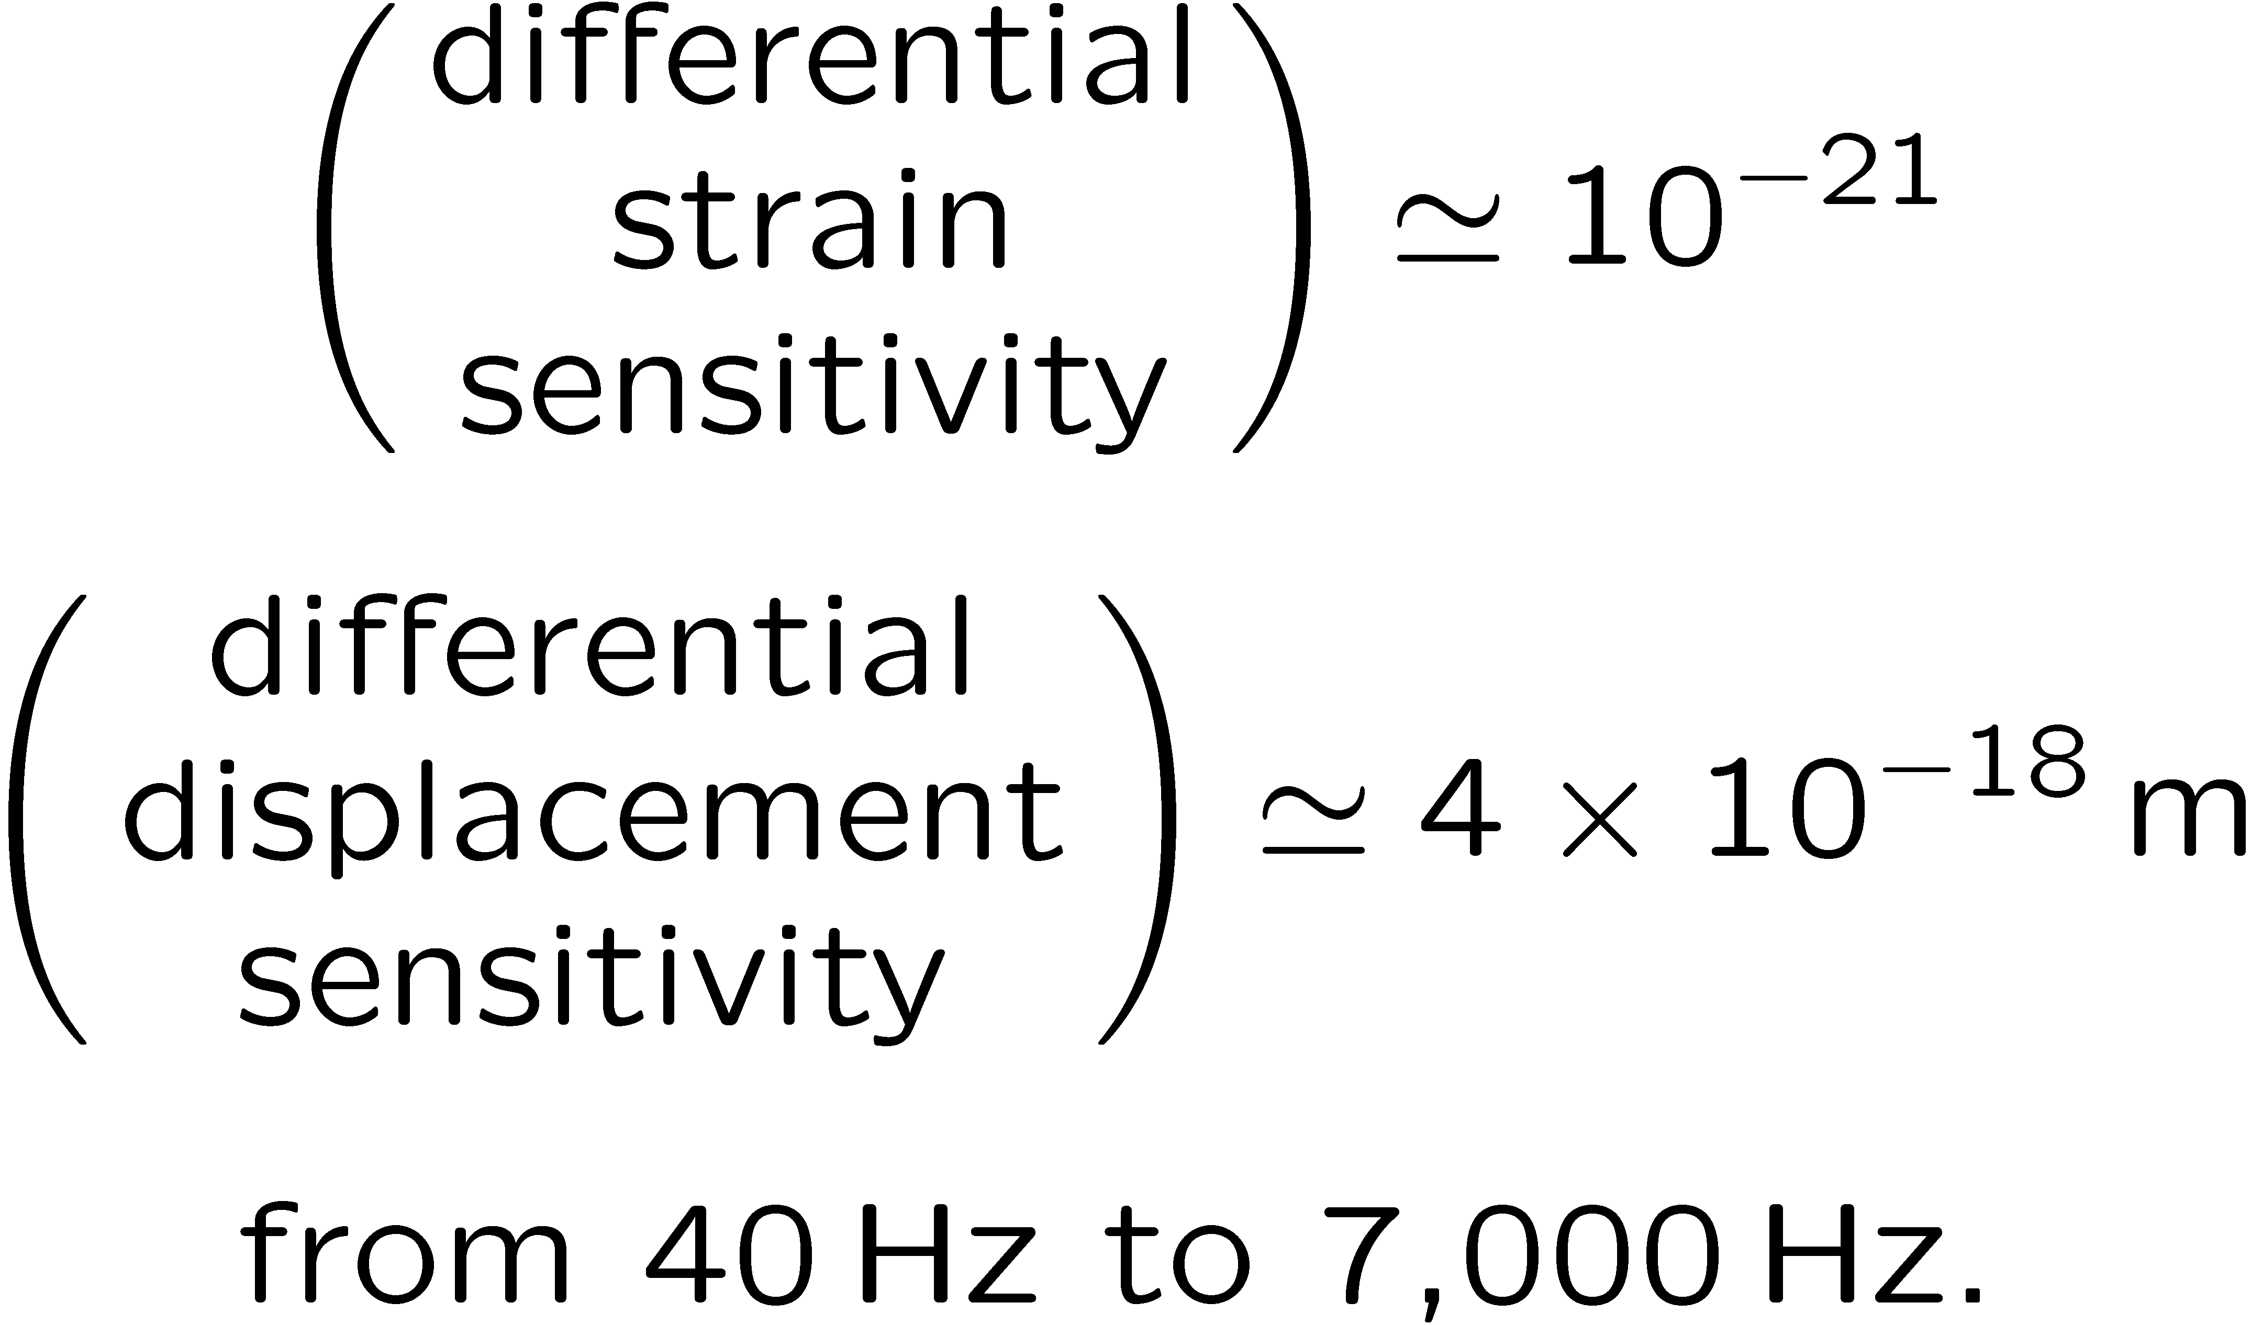
(Absurdly) high-precision interferometry for force sensing
Initial LIGO
Hanford, Washington
Laser Interferometer Gravitational Observatory (LIGO)
High-power, Fabry-Perot-cavity (multipass), power-recycled interferometers
4 km
Livingston, Louisiana

Slide 6
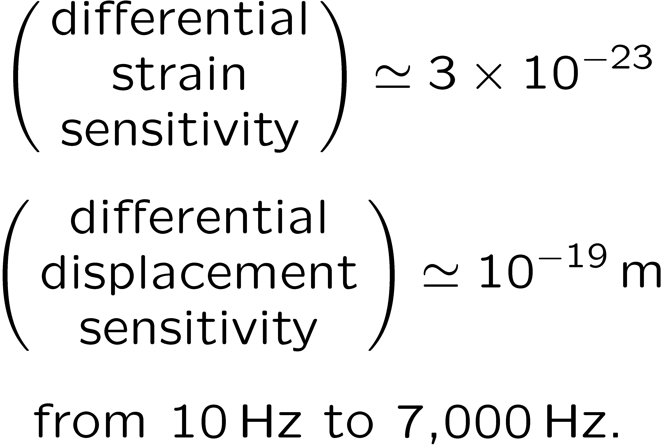
(Absurdly) high-precision interferometry for force sensing
Advanced LIGO
Hanford, Washington
Laser Interferometer Gravitational Observatory (LIGO)
High-power, Fabry-Perot-cavity (multipass), power-and signal-recycled, squeezed-light interferometers
4 km
Livingston, Louisiana

Slide 7
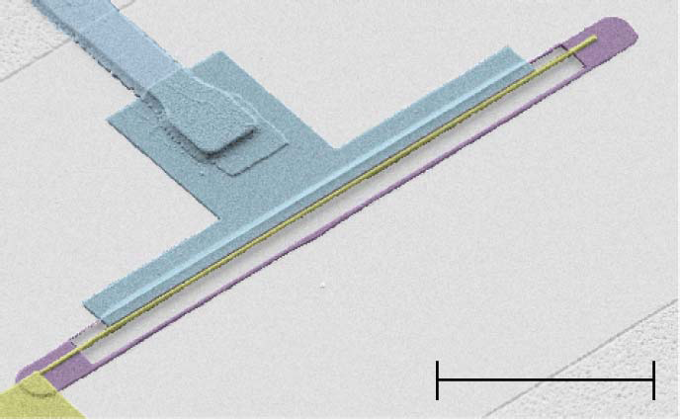
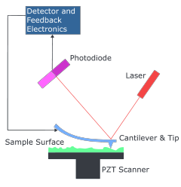
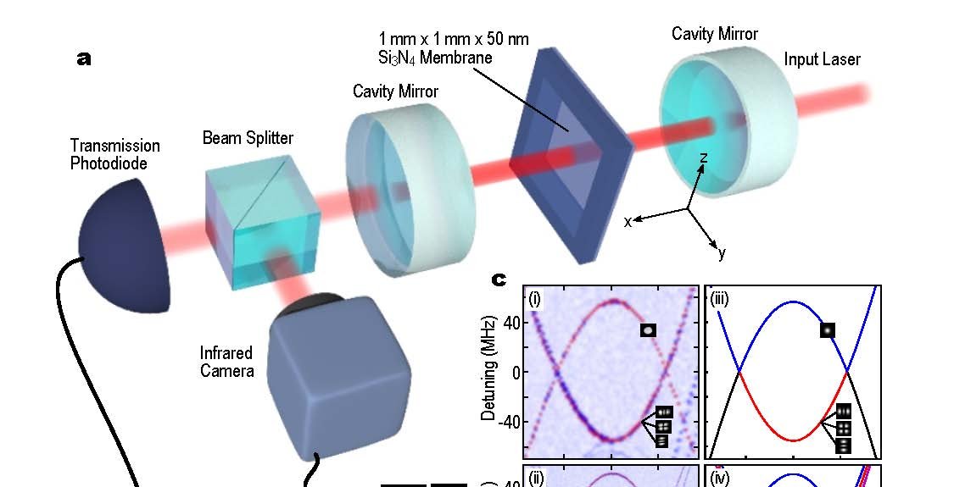
Opto,atomic,electro micromechanics
30 μm long
170 nm wide
140 nm thick
Beam microresonator
10 μm
T. Rocheleau, T. Ndukum, C. Macklin , J. B. Hertzberg, A. A. Clerk, and K. C. Schwab, Nature 463, 72 (2010).
Atomic force microscope
Dielectric micromembrane
J. C. Sankey, C. Yang, B. M. Zwickl, A. M. Jayich, and J. G. E. Harris, Nature Physics 6, 707 (2010).
Notes:
Need to call this opto-atomic-electronic-mechanics: show pictures of nanoresonator, toroidal optical, SiNx membranes, carbon nanotubes, Cleland nanoresonators.

Slide 8
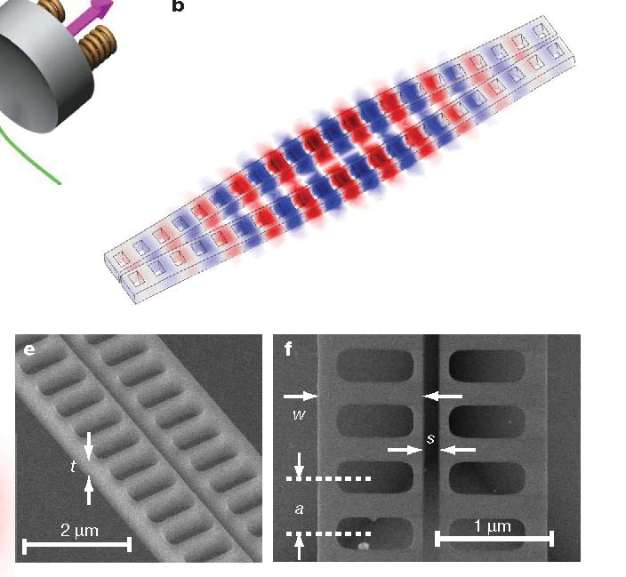
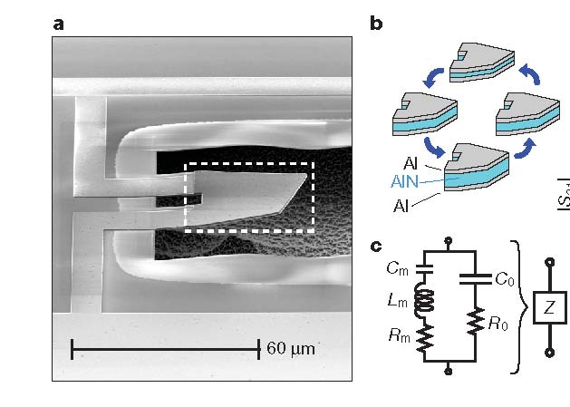
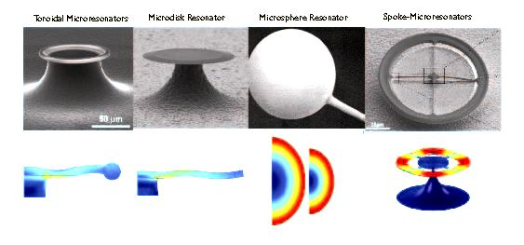
Opto,atomic, electro micromechanics
Zipper-cavity microresonator
Drum microresonator
A. D. O’Connell et al., Nature 464, 697 (2010).
M. Eichenfield, R. Camacho, J. Chan, K. J. Vahala, and O. Painter, Nature 459, 550 (2009).
A. Schliesser and T. J. Kippenberg, Advances in Atomic, Molecular, and Optical Physics, Vol. 58, (Academic Press, San Diego, 2010), p. 207.
Toroidal microresonator
Notes:
Need to call this opto-atomic-electronic-mechanics: show pictures of nanoresonator, toroidal optical, SiNx membranes, carbon nanotubes, Cleland nanoresonators.

Slide 9
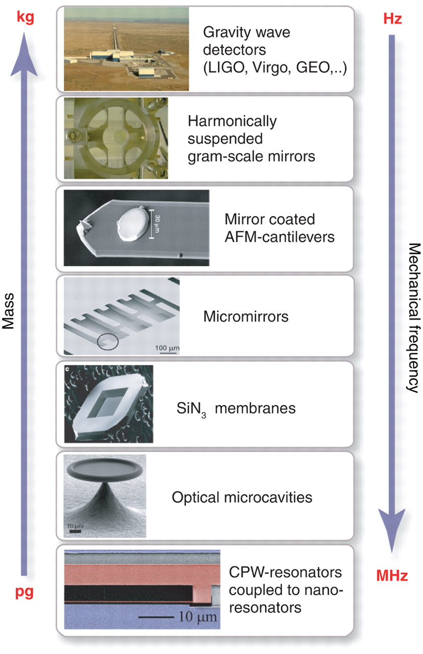

Mechanics for force sensing
T. J. Kippenberg and K. J. Vahala, Science 321, 172 (2008).
Notes:
Experimental cavity optomechanical systems. (Top to Bottom) Gravitational wave detectors [photo credit LIGO Laboratory], harmonically suspended gram-scale mirrors (28), coated atomic force microscopy cantilevers (29), coated micromirrors (14, 15), SiN3 membranes dispersively coupled to an optical cavity (31), optical microcavities (13, 16), and superconducting microwave resonators coupled to a nanomechanical beam (33). The masses range from kilograms to picograms, whereas frequencies range from tens of megahertz down to the hertz level. CPW, coplanar waveguide.

Slide 10
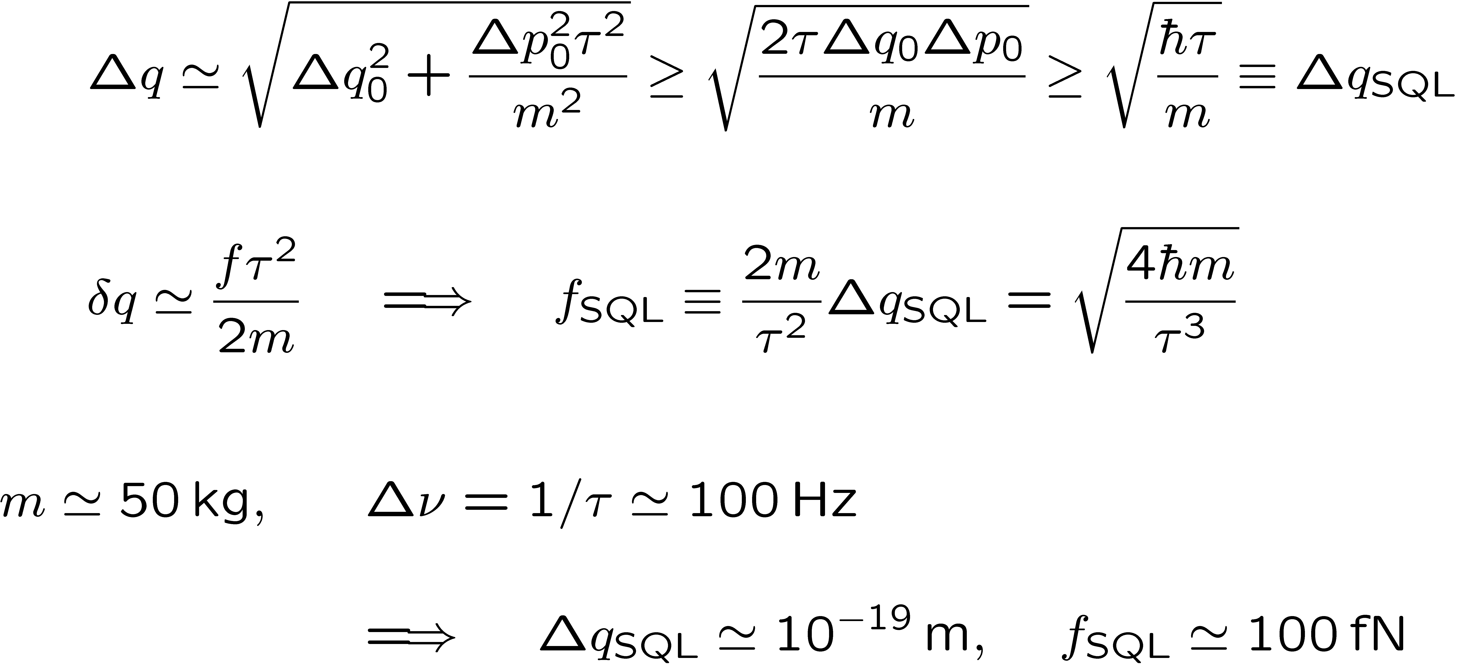
Standard quantum limit (SQL)
Wideband detection of force f on free mass m
LIGO interferometer
Back action

Slide 11
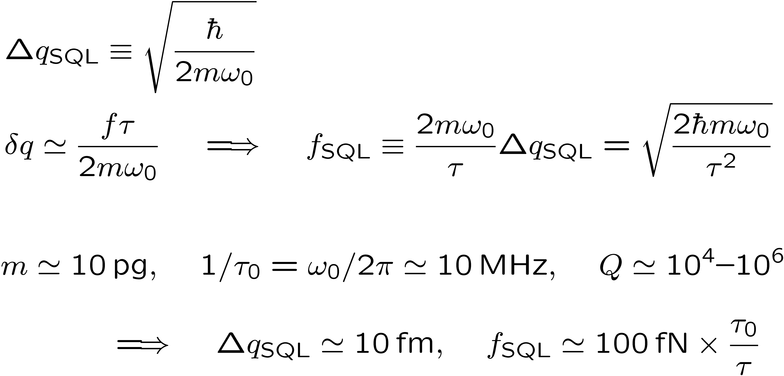
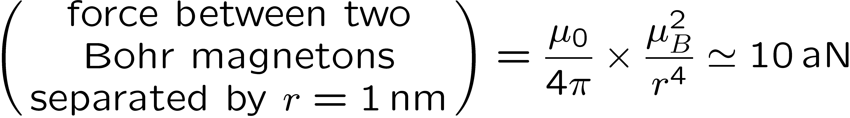
Standard quantum limit (SQL)
Narrowband, on-resonance detection of force f on
oscillator of mass m and resonant frequency ω₀
Nanoresonator
Back action?

Slide 12
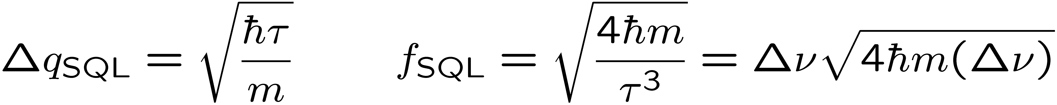
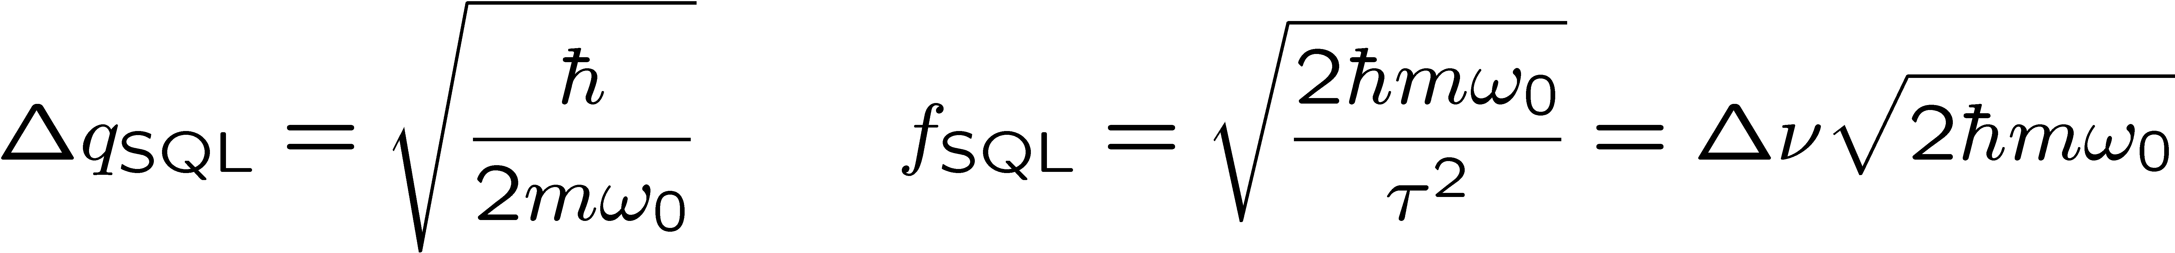
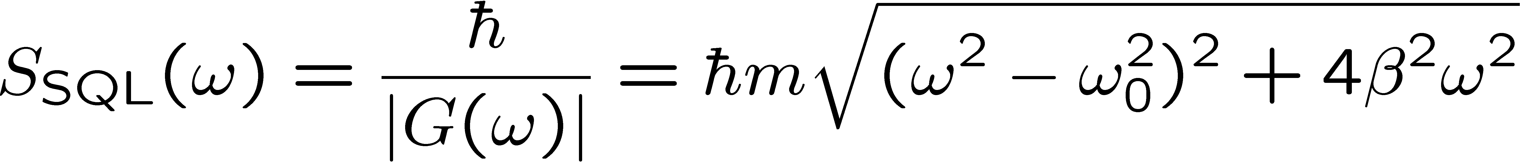
SQL
Wideband force f on free mass m
On-resonance force f on oscillator of
mass m and resonant frequency ω₀
It’s wrong.
It’s not even the right wrong story.
The right wrong story. Waveform estimation.

Slide 13
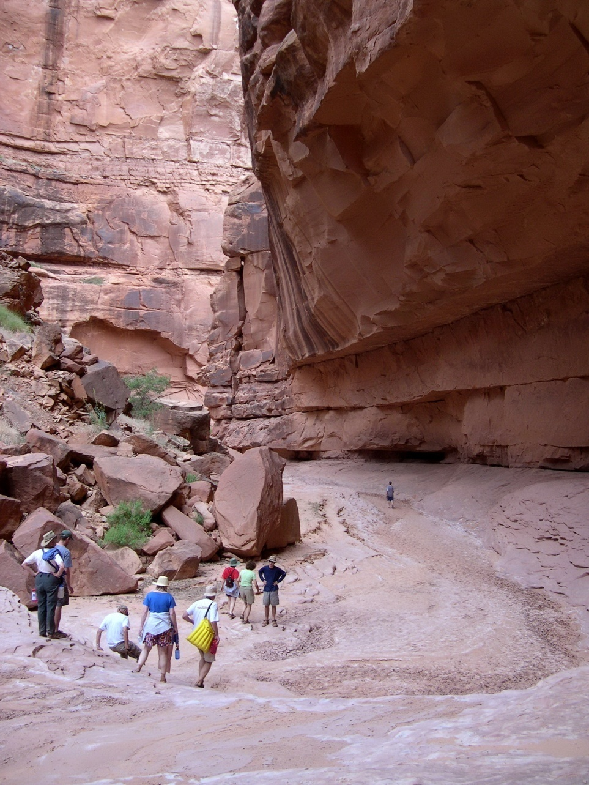
II. Standard quantum limit (SQL) for force detection. The right wrong story
Oljeto Wash
Southern Utah

Slide 14
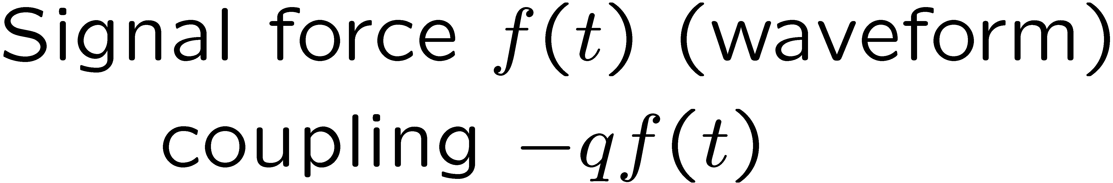
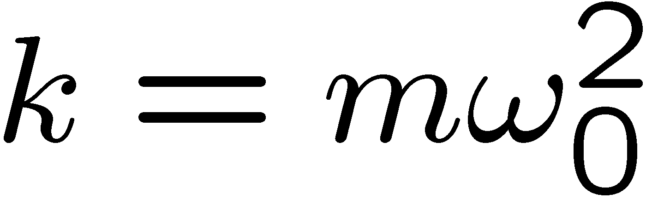
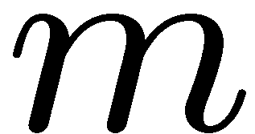
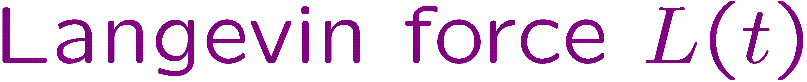
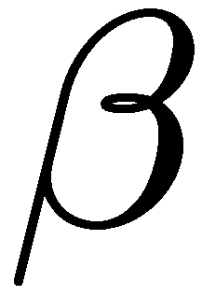
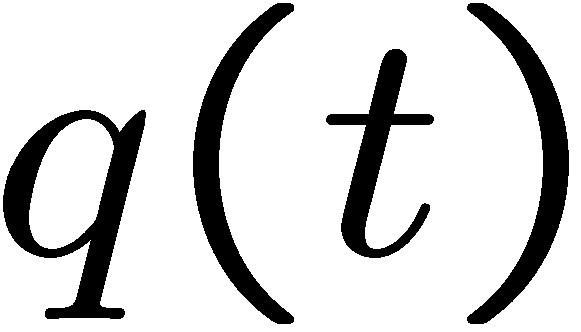
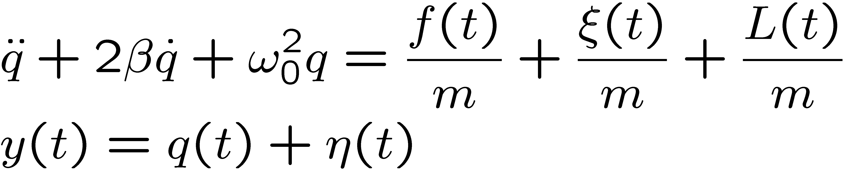
SQL for force detection
Monitor position
Back-action force
Langevin force
measurement (shot) noise
Notes:
Need a graph of the SQL. Explain that this is not a graph one ever sees, because to achieve it requires xi and eta to have nonflat spectra, and typically they don’t. So what one sees is graphs with shot noise dominating on one side, back action on the other, and one point where you achieve the SQL.

Slide 15
Interferometric readout
—
Laser
Notes:
Need a graph of the SQL. Explain that this is not a graph one ever sees, because to achieve it requires xi and eta to have nonflat spectra, and typically they don’t. So what one sees is graphs with shot noise dominating on one side, back action on the other, and one point where you achieve the SQL.

Slide 16
Interferometric readout
—
Laser
Notes:
Need a graph of the SQL. Explain that this is not a graph one ever sees, because to achieve it requires xi and eta to have nonflat spectra, and typically they don’t. So what one sees is graphs with shot noise dominating on one side, back action on the other, and one point where you achieve the SQL.

Slide 17
Interferometric readout
—
Vacuum input port
measurement
(shot) noise
Laser
Back-action noise
If shot noise dominates, squeeze the phase quadrature.
Notes:
Need a graph of the SQL. Explain that this is not a graph one ever sees, because to achieve it requires xi and eta to have nonflat spectra, and typically they don’t. So what one sees is graphs with shot noise dominating on one side, back action on the other, and one point where you achieve the SQL.

Slide 18
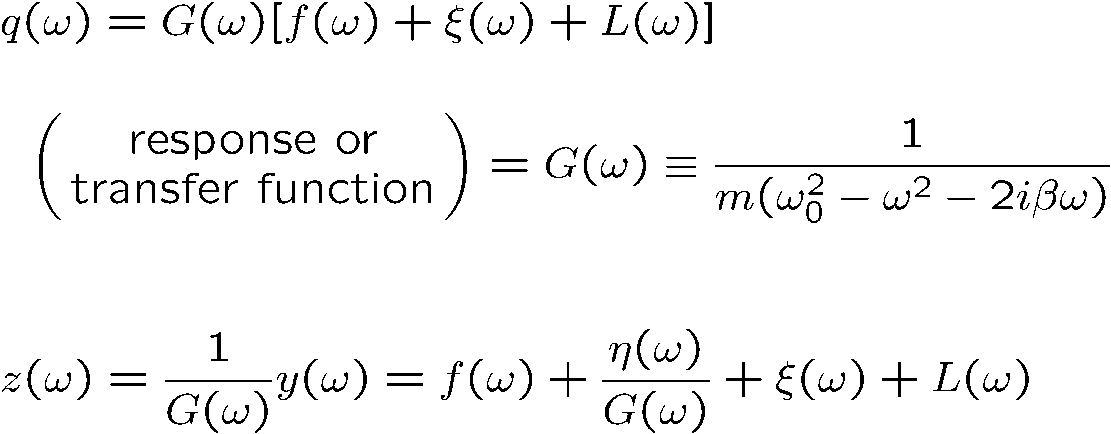
SQL for force detection
Back-action force
Time domain
Langevin force
measurement noise
Frequency domain
Back-action force
Langevin force
measurement noise

Slide 19
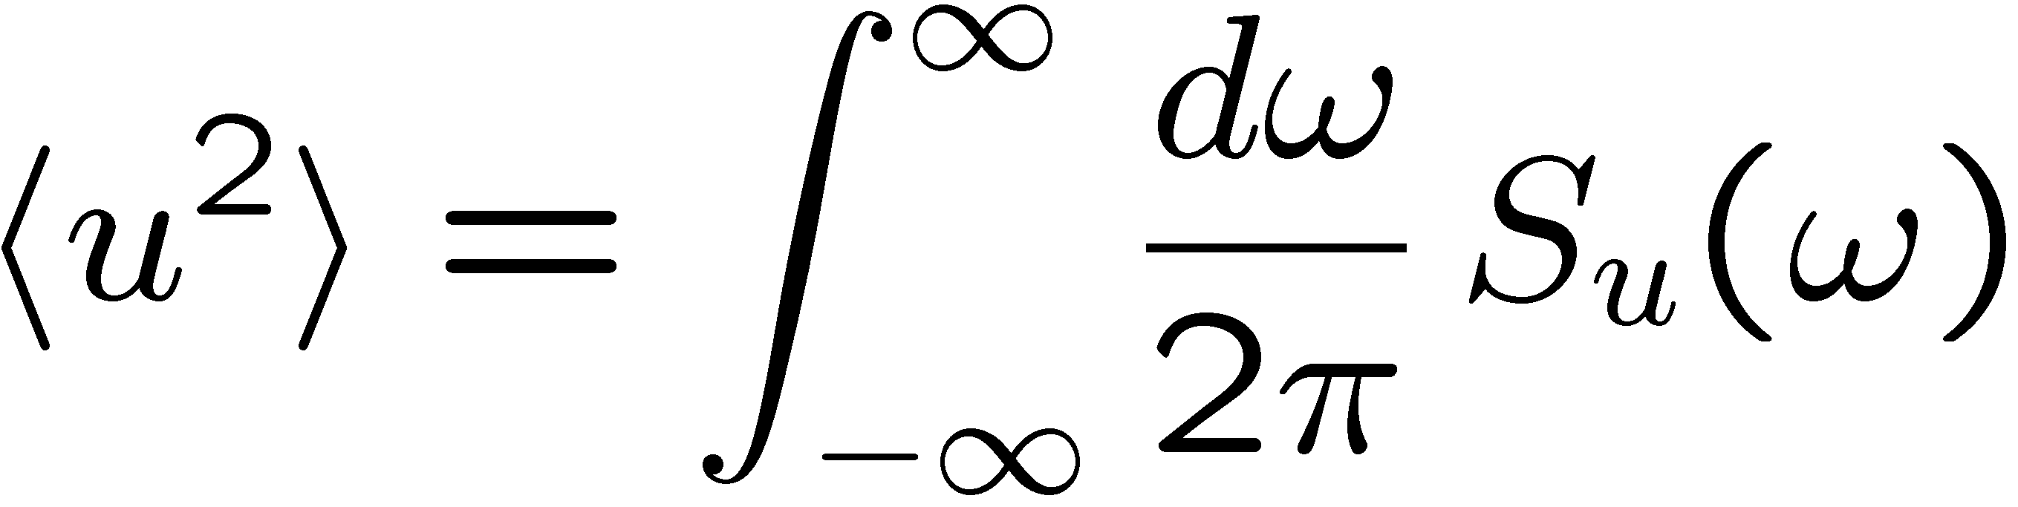
Noise-power spectral densities
Zero-mean, time-stationary random process u(t)
Noise-power spectral density of u
Notes:
Need a graph of the SQL. Explain that this is not a graph one ever sees, because to achieve it requires xi and eta to have nonflat spectra, and typically they don’t. So what one sees is graphs with shot noise dominating on one side, back action on the other, and one point where you achieve the SQL.

Slide 20
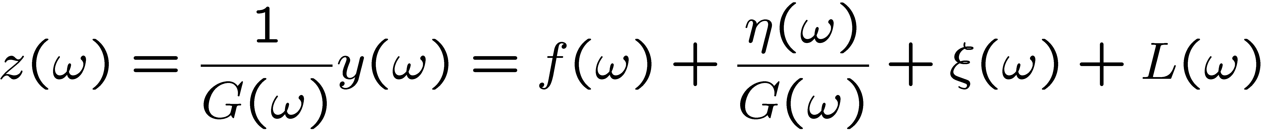
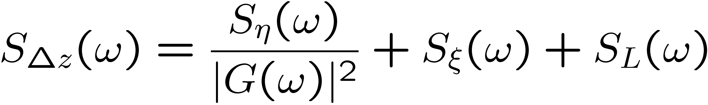
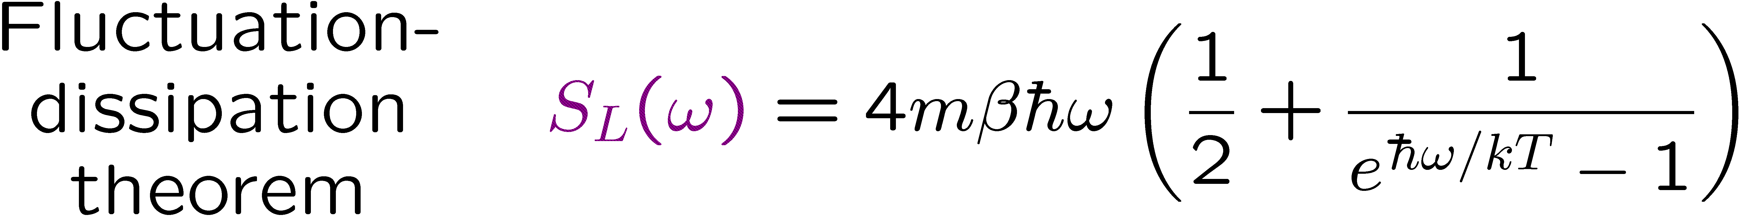
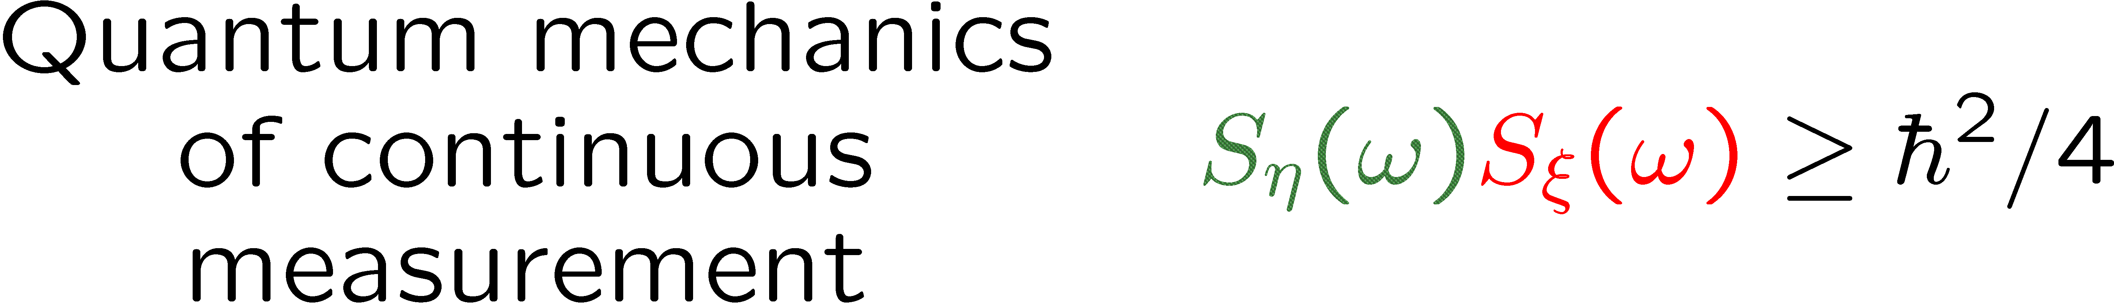
SQL for force detection
Back-action force
Langevin force
measurement noise

Slide 21
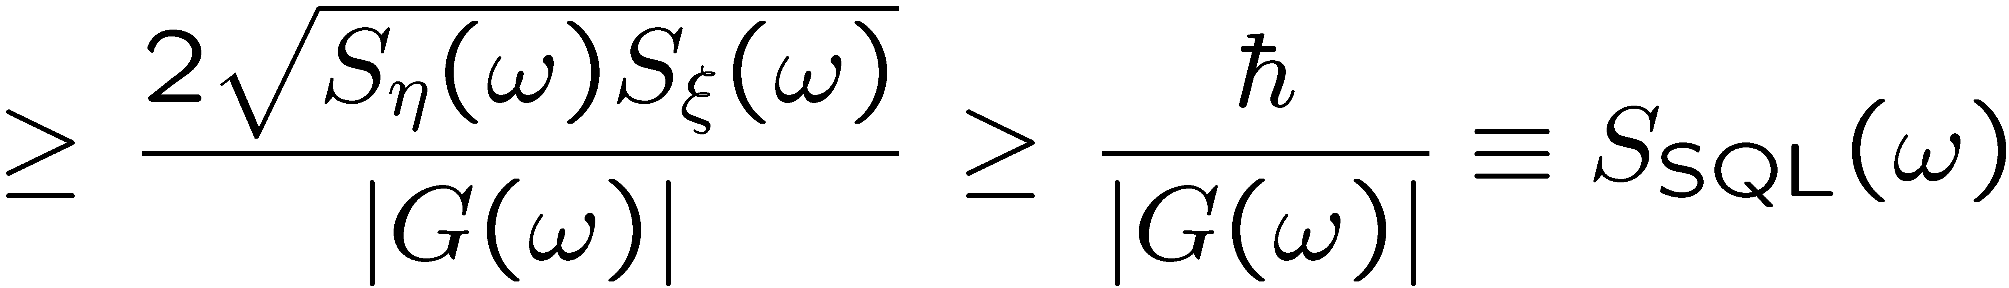
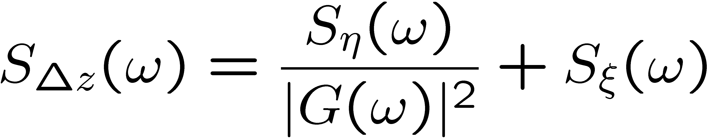
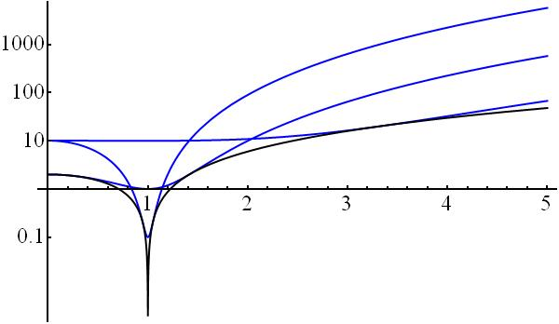
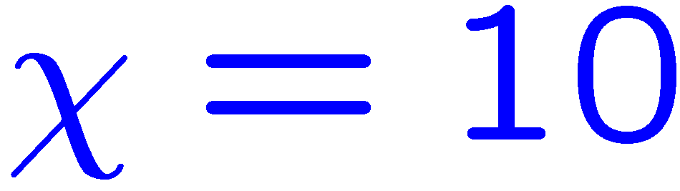
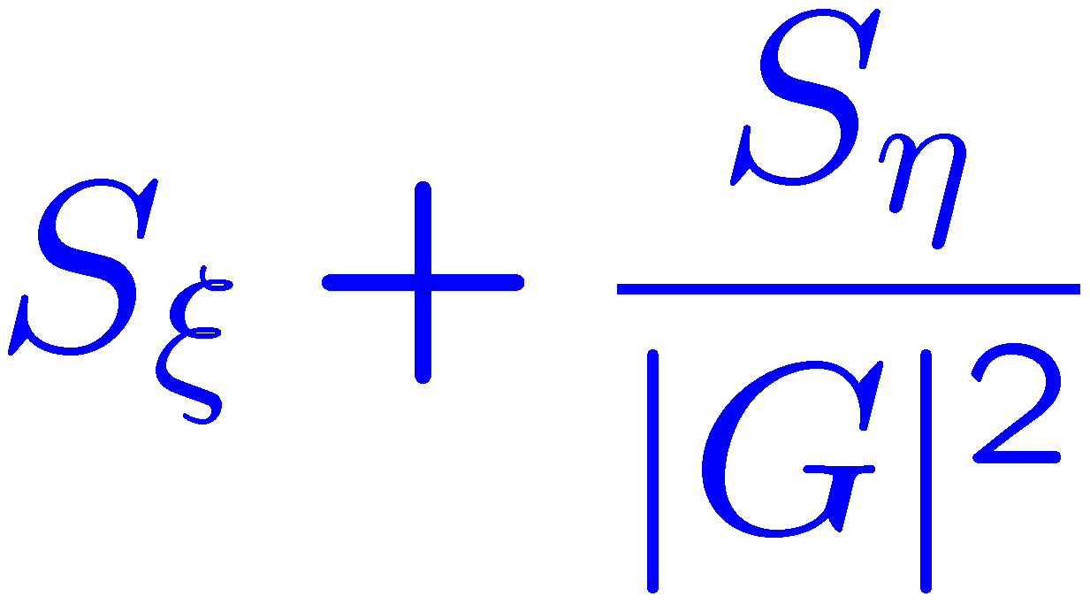
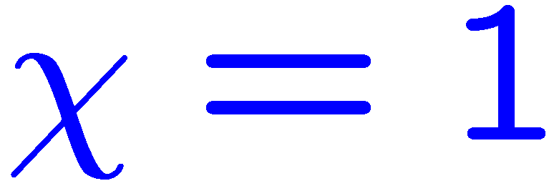
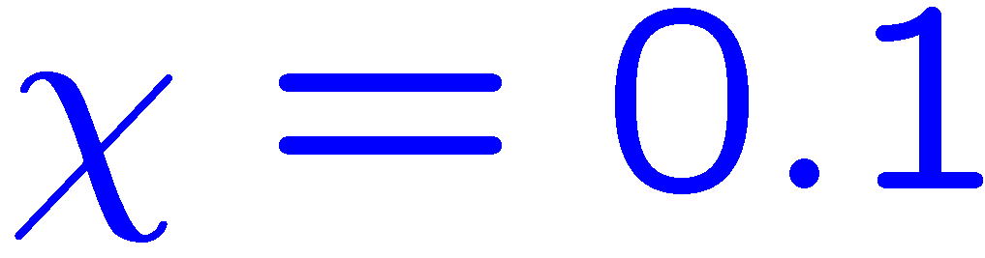
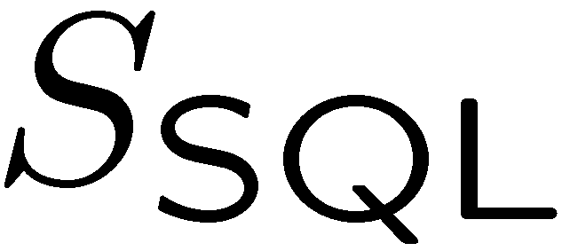
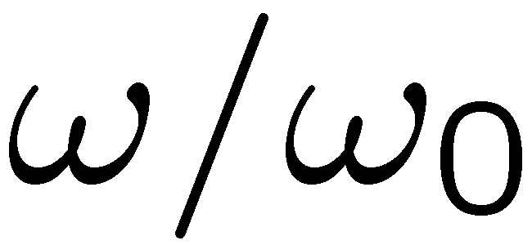
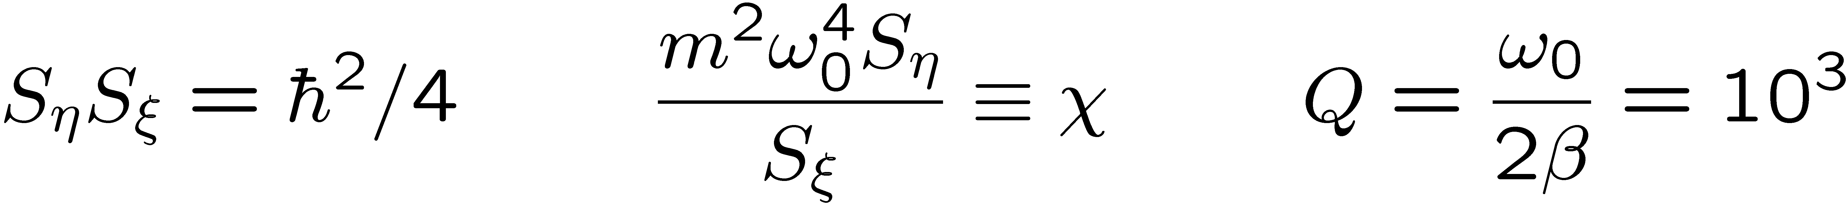
SQL for force detection

Slide 22
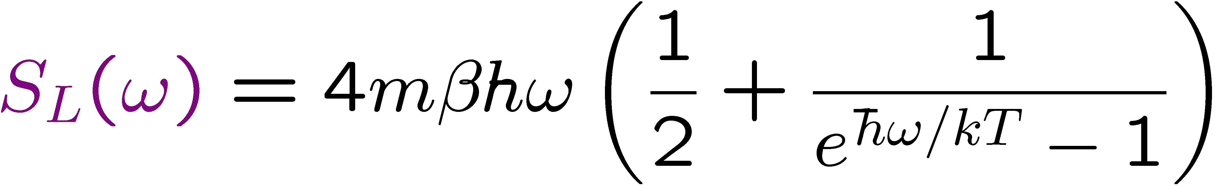
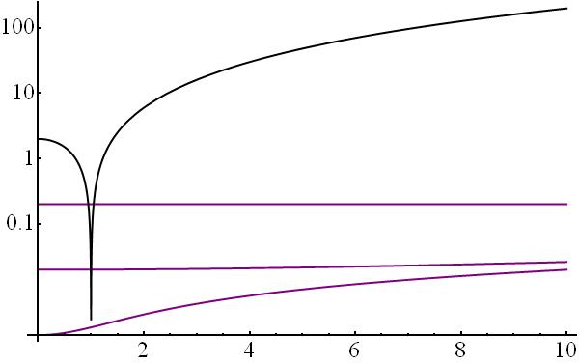
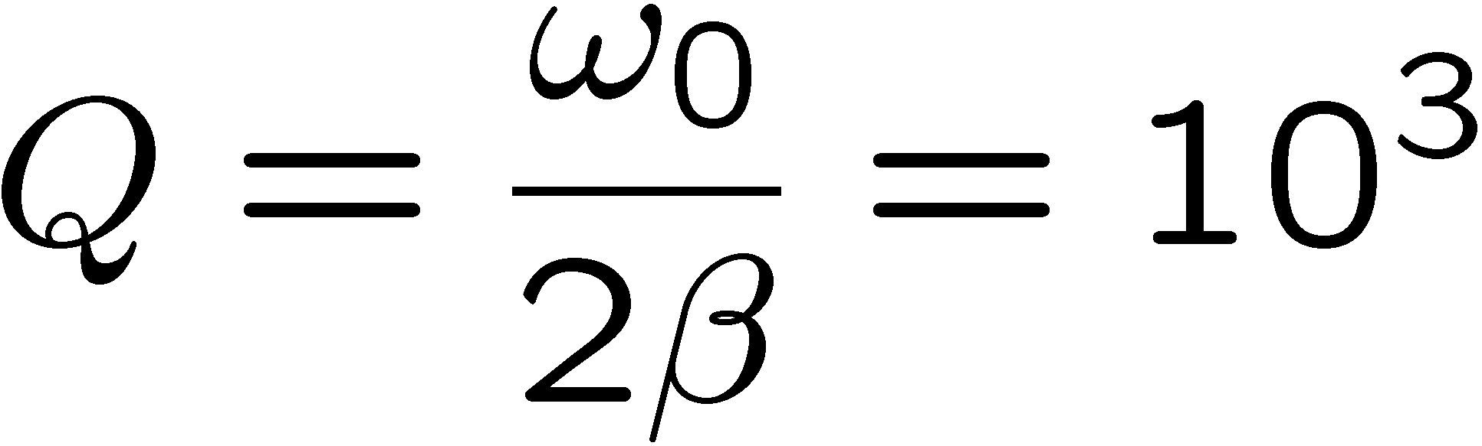
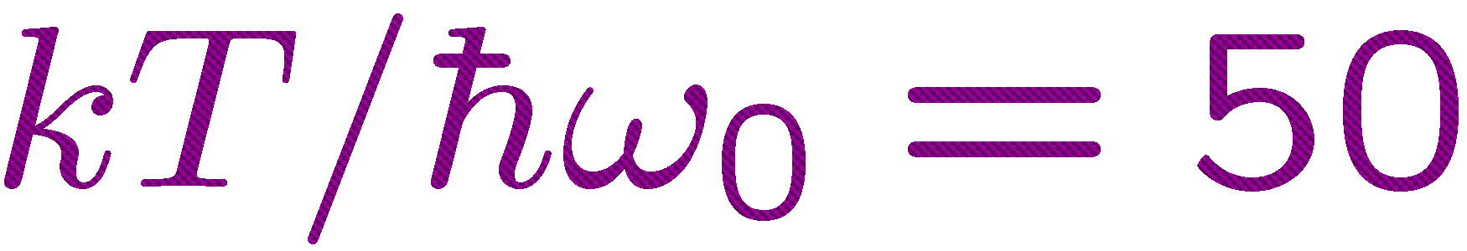



Langevin force

Slide 23


SQL for force detection
The right wrong story.
In an opto-mechanical setting, achieving the SQL at a particular frequency requires squeezing at that frequency, and achieving the SQL over a wide bandwidth requires frequency-dependent squeezing.
Notes:
Need a graph of the SQL. Explain that this is not a graph one ever sees, because to achieve it requires xi and eta to have nonflat spectra, and typically they don’t. So what one sees is graphs with shot noise dominating on one side, back action on the other, and one point where you achieve the SQL.

Slide 24

III. Beating the SQL. Three strategies
Truchas from East Pecos Baldy
Sangre de Cristo Range
Northern New Mexico

Slide 25
Beating the SQL. Strategy 1
Couple parameter to observable h, and monitor observable o conjugate to h.
Arrange that h and o are conserved in the absence of the parameter interaction; o is the simplest sort of quantum nondemolition (QND) or back-action-evading (BAE) observable.
Give o as small an uncertainty as possible, thereby giving h as big an uncertainty as possible (back action).
Strategy 1. Monitor a quadrature component.
Downsides
Detect only one quadrature of the force.
Mainly narrowband (no convenient free-mass version).
Need new kind of coupling to monitor oscillator.

Slide 26
Strategy 2. Interferometric readout
—
Vacuum input port
Output noise
Laser
All the output noise comes from the (frequency-dependent) purple quadrature. Squeeze it.
W. G. Unruh, in Quantum Optics, Experimental Gravitation, and Measurement Theory, edited by P. Meystre and M. O. Scully (Plenum, 1983), p. 647; F. Ya. Khalili, PRD 81, 122002 (2010).
Notes:
Need a graph of the SQL. Explain that this is not a graph one ever sees, because to achieve it requires xi and eta to have nonflat spectra, and typically they don’t. So what one sees is graphs with shot noise dominating on one side, back action on the other, and one point where you achieve the SQL.

Slide 27


Beating the SQL. Strategy 2
Strategy 2. Squeeze the entire output noise by correlating the measurement and back-action noise.

Slide 28
Quantum Cramér-Rao Bound (QCRB)
Single-parameter estimation: Bound on the error in estimating a classical parameter that is coupled to a quantum system in terms of the inverse of the quantum Fisher information.
Multi-parameter estimation: Bound on the covariance matrix in estimating a set of classical parameters that are coupled to a quantum system in terms of the inverse of a quantum Fisher-information matrix.
Waveform estimation: Bound on the continuous covariance matrix for estimating a continuous waveform that is coupled to a quantum system in terms of the inverse of a continuous, two-time quantum Fisher-information matrix.

Slide 29



Waveform QCRB.
Spectral uncertainty principle
M. Tsang, H. M. Wiseman, and C. M. Caves, PRL 106, 090401 (2011).
Prior-information term
At frequencies where there is little prior information,
Minimum-uncertainty noise
No hint of SQL—no back-action noise, only measurement noise—but can the bound be achieved?

Slide 30








Beating the SQL. Strategy 3
Strategy 3. Quantum noise cancellation (QNC) using oscillator and negative-mass oscillator.
Primary oscillator
Negative-mass oscillator
Monitor collective position Q
Conjugate pairs
QCRB
Oscillator pairs

Slide 31

Quantum noise cancellation
M. Tsang and C. M. Caves, PRL 105,123601 (2010).
Conjugate pairs
Oscillator pairs
Paired sidebands about a carrier frequency
Paired collective spins, polarized along opposite directions
W. Wasilewski , K. Jensen, H. Krauter, J. J. Renema, M. V. Balbas, and E. S. Polzik, PRL 104, 133601 (2010).

Slide 32

That’s it, folks! Thanks for your attention.
Echidna Gorge
Bungle Bungle Range
Western Australia

