Slide 1
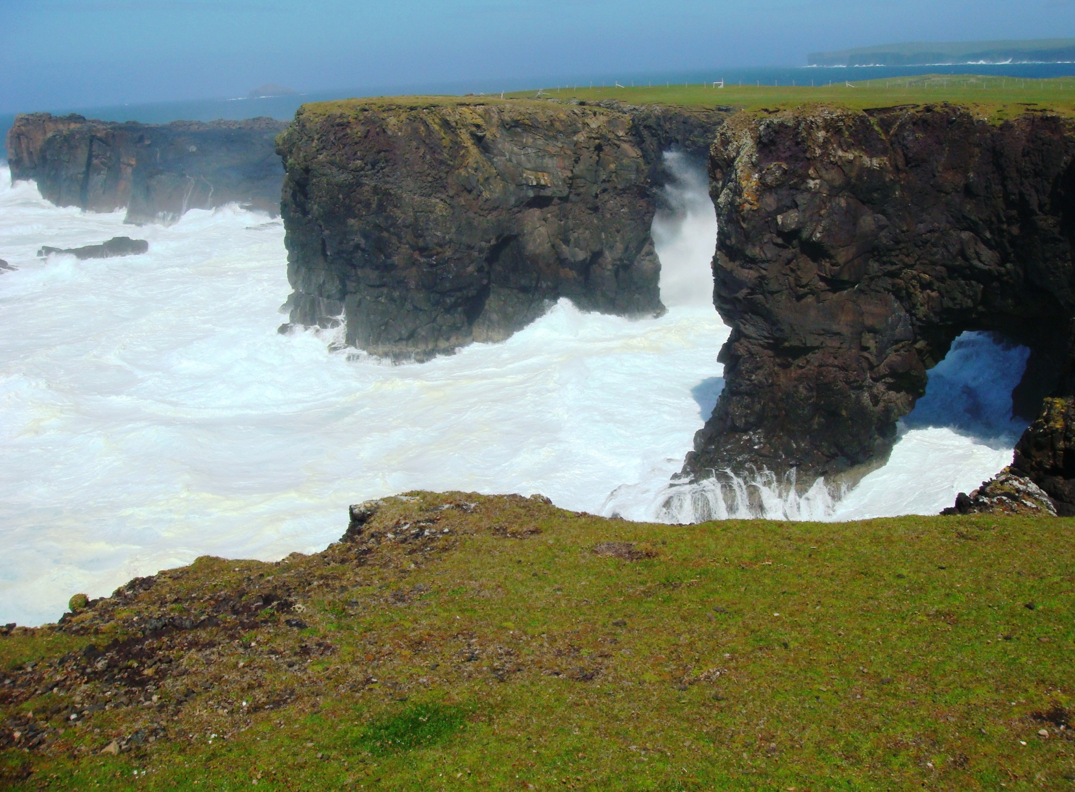
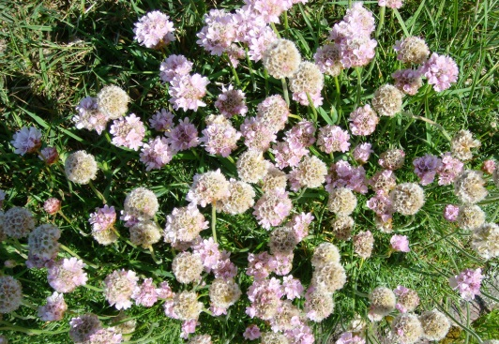
How I became a quantum optician
And the lessons for you
Carlton M. Caves
IYL Celebration, UNM, September 25, 2015
Moo Stack and the Villians of Ure
Eshaness, Shetland

Slide 2
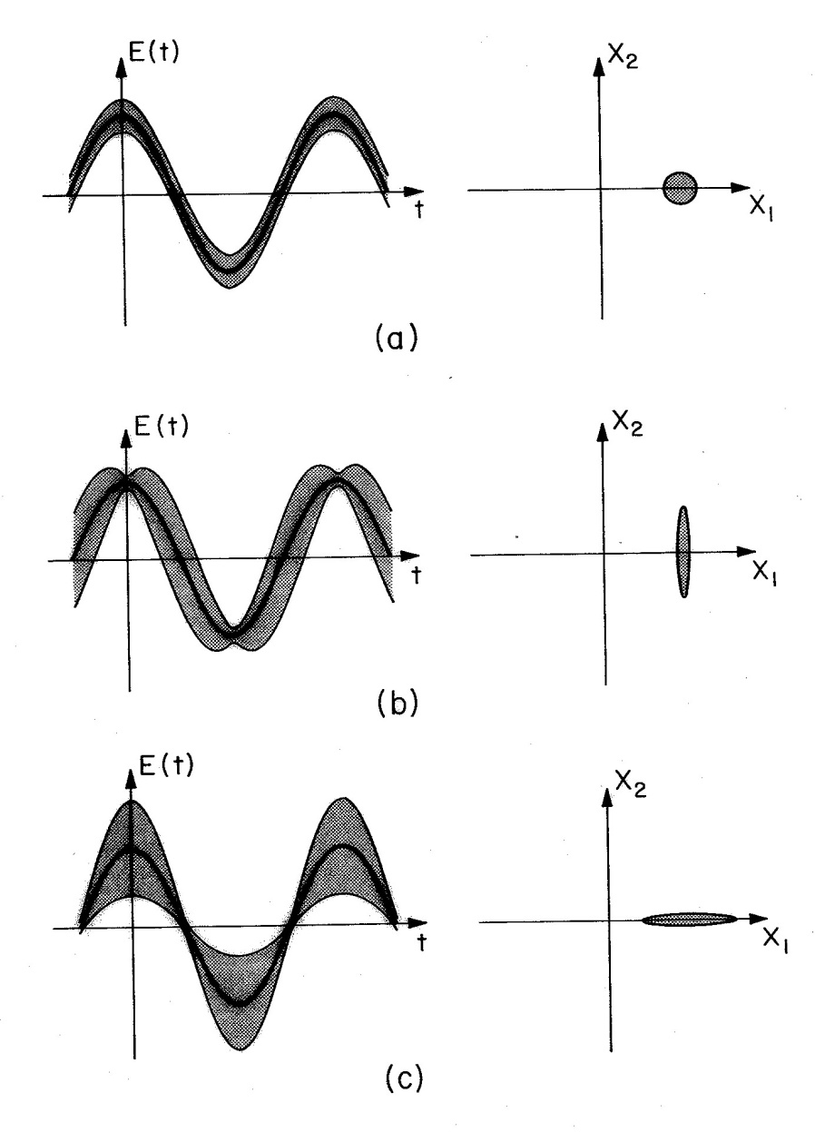
How I became a quantum optician
All quantum opticians are now quantum information scientists.

Slide 3
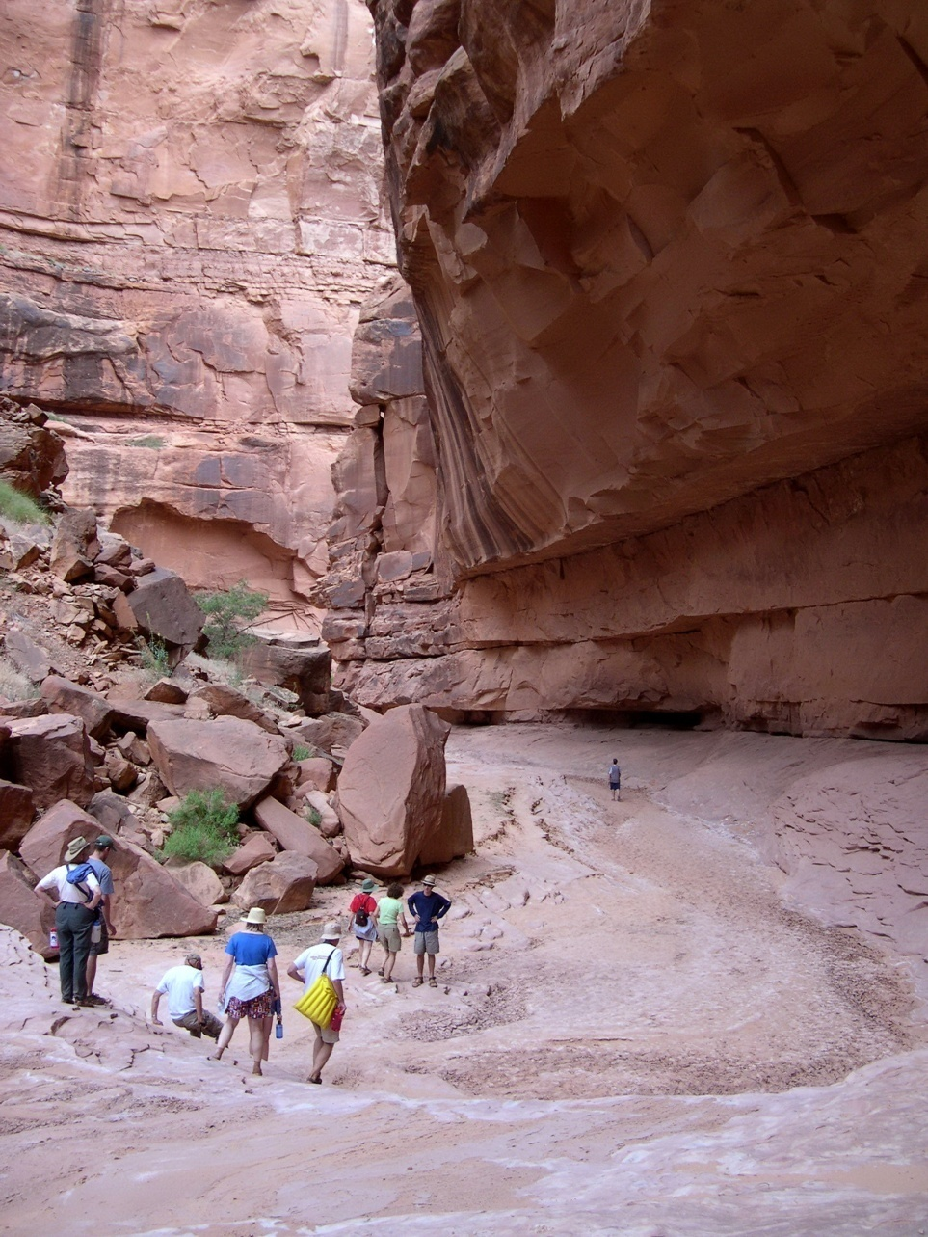
Lessons for you?
When an old fart starts handing out advice, take cover.
Those who fail to learn from the past are condemned to repeat it.
Those who learn from the mistakes of the past are condemned to make different mistakes.
Oljeto Wash
Southern Utah

Slide 4
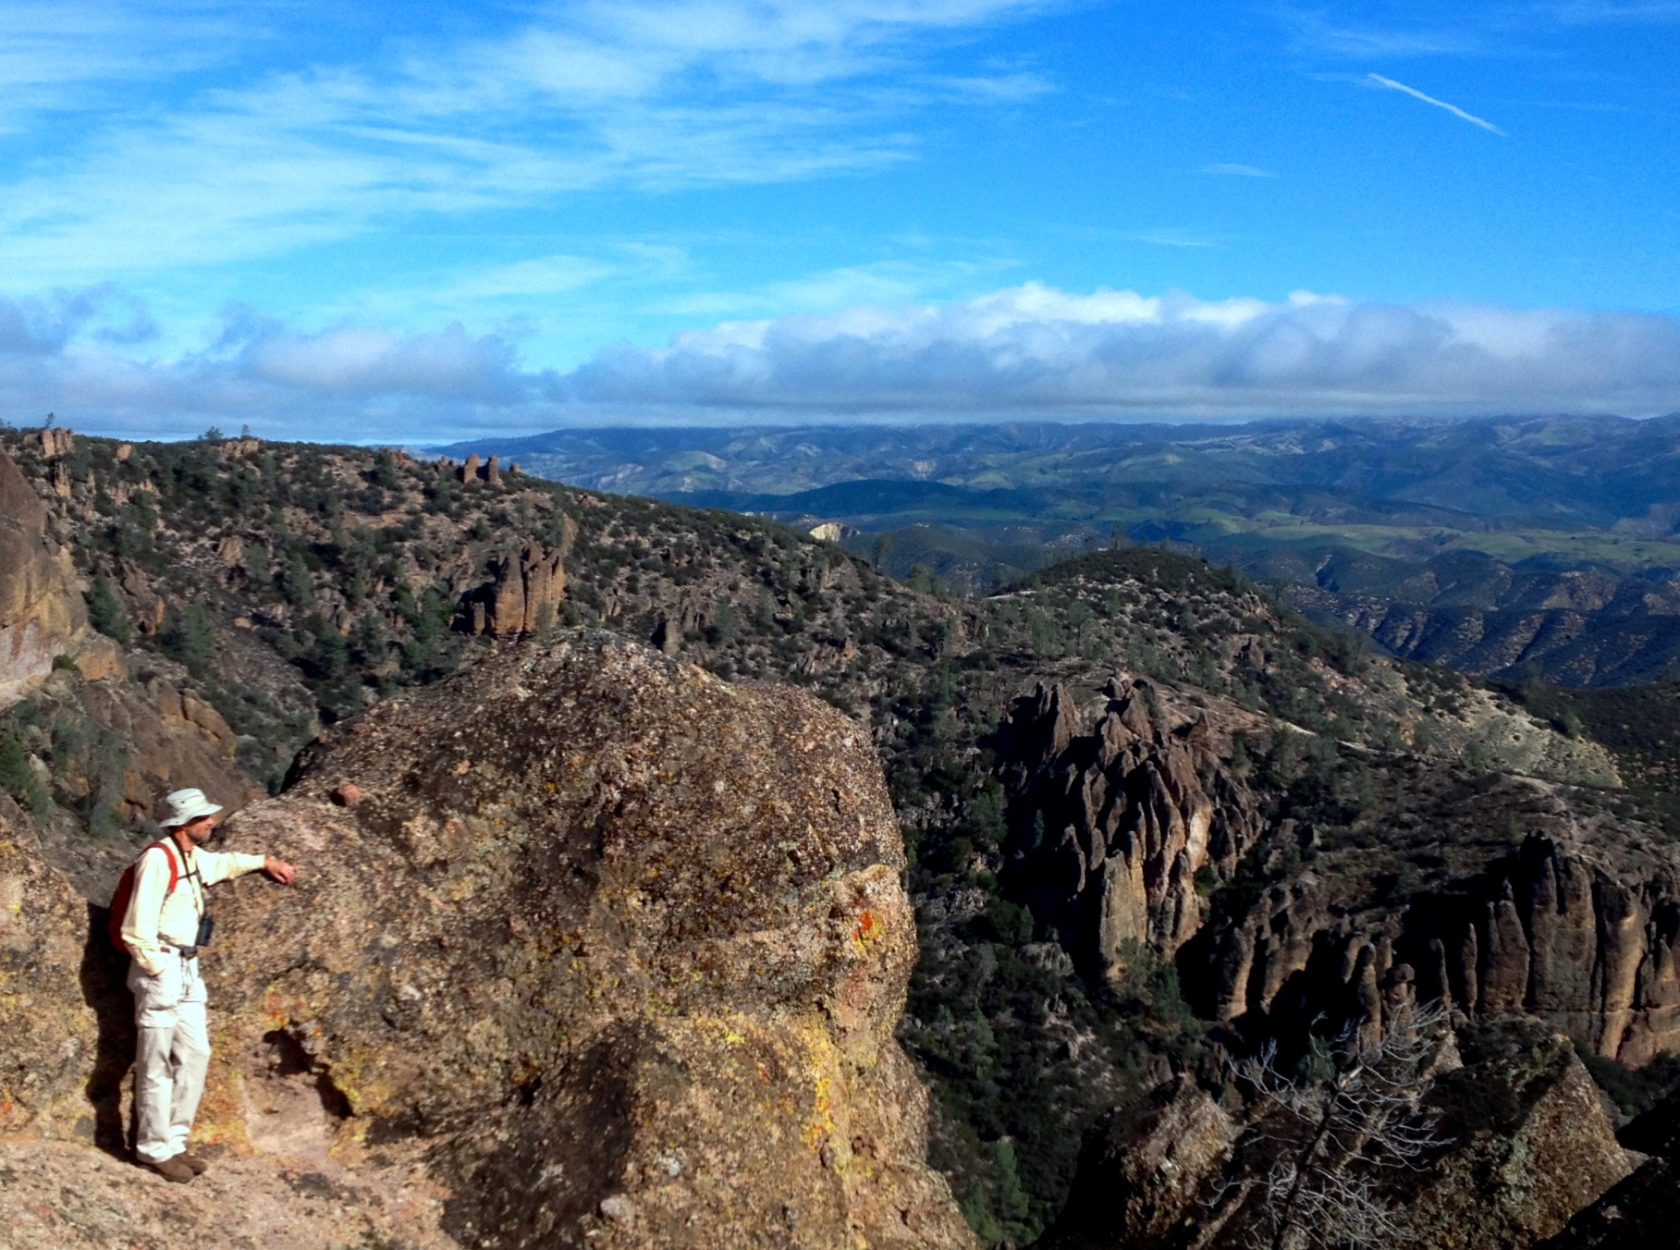
Join the international scientific community.
Let science and its quest for truth provide your identity and sense of purpose. Sublimate your national, religious, racial, ethnic, and gender identities within the universal scientific enterprise.
BE A SCIENTIST.
The truth shall make you free.
Pinnacles National Park
Central California

Slide 5
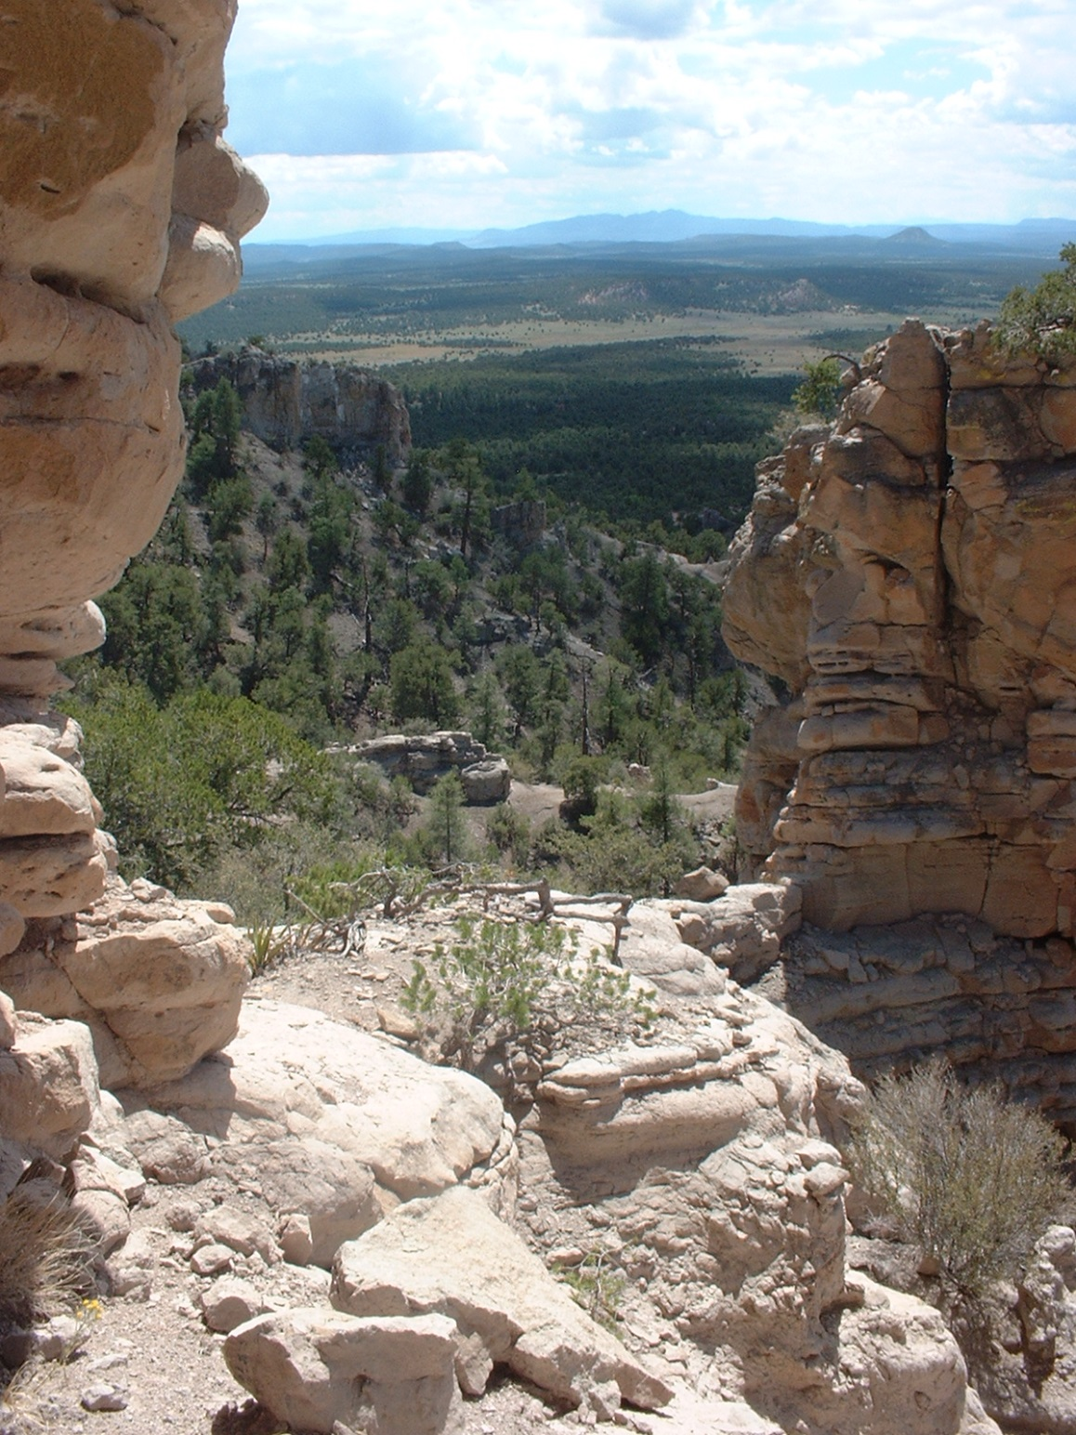
Have a passion, and work on it.
If I am not for myself, who is for me? But if I am only for myself, what am I? And if not now, when?
Hillel
In the Sawtooth range
Central New Mexico

Slide 6
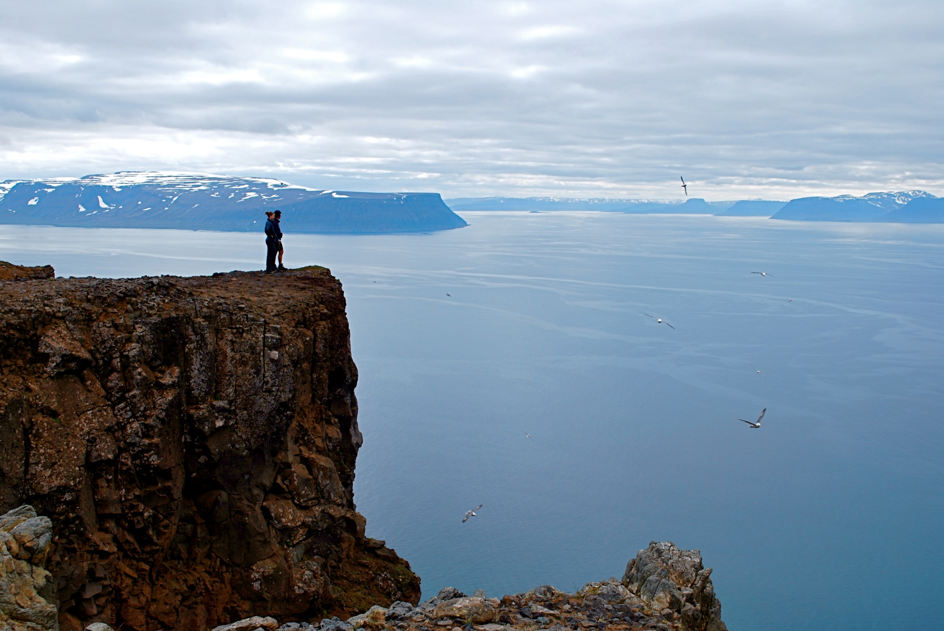
Have some heroes, and emulate them.
Kip S. Thorne, Roy J. Glauber, and E. T. Jaynes are mine.
Holstrandir Peninsula overlooking Ísafjarðardjúp
Westfjords, Iceland

Slide 7
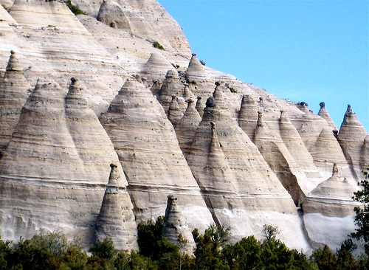
Change your name to something that is close to unique in a Web of Science search.
Tent Rocks
Kasha-Katuwe National Monument
Northern New Mexico

Slide 8
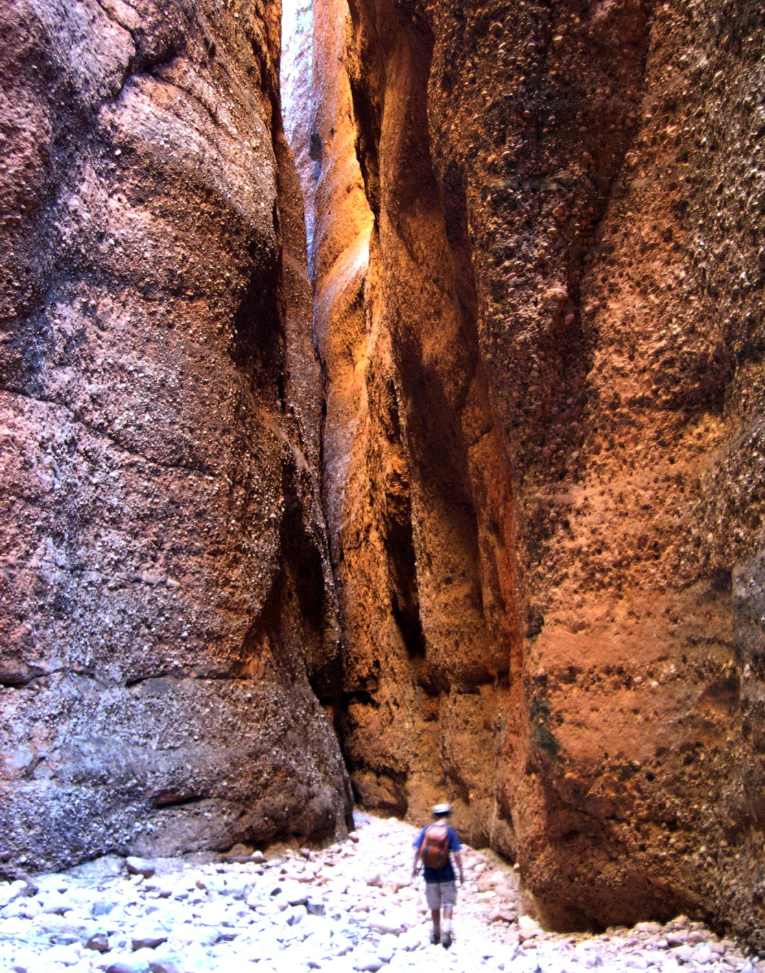
Famous?
Be at the right place at the right time to work on a problem that is just about to become important.
Know enough, but not too much.
Talent? Luck? There is always some of both.
There are no guarantees. So keep at it.
Echidna Gorge
Bungle Bungle Range
Western Australia

Slide 9
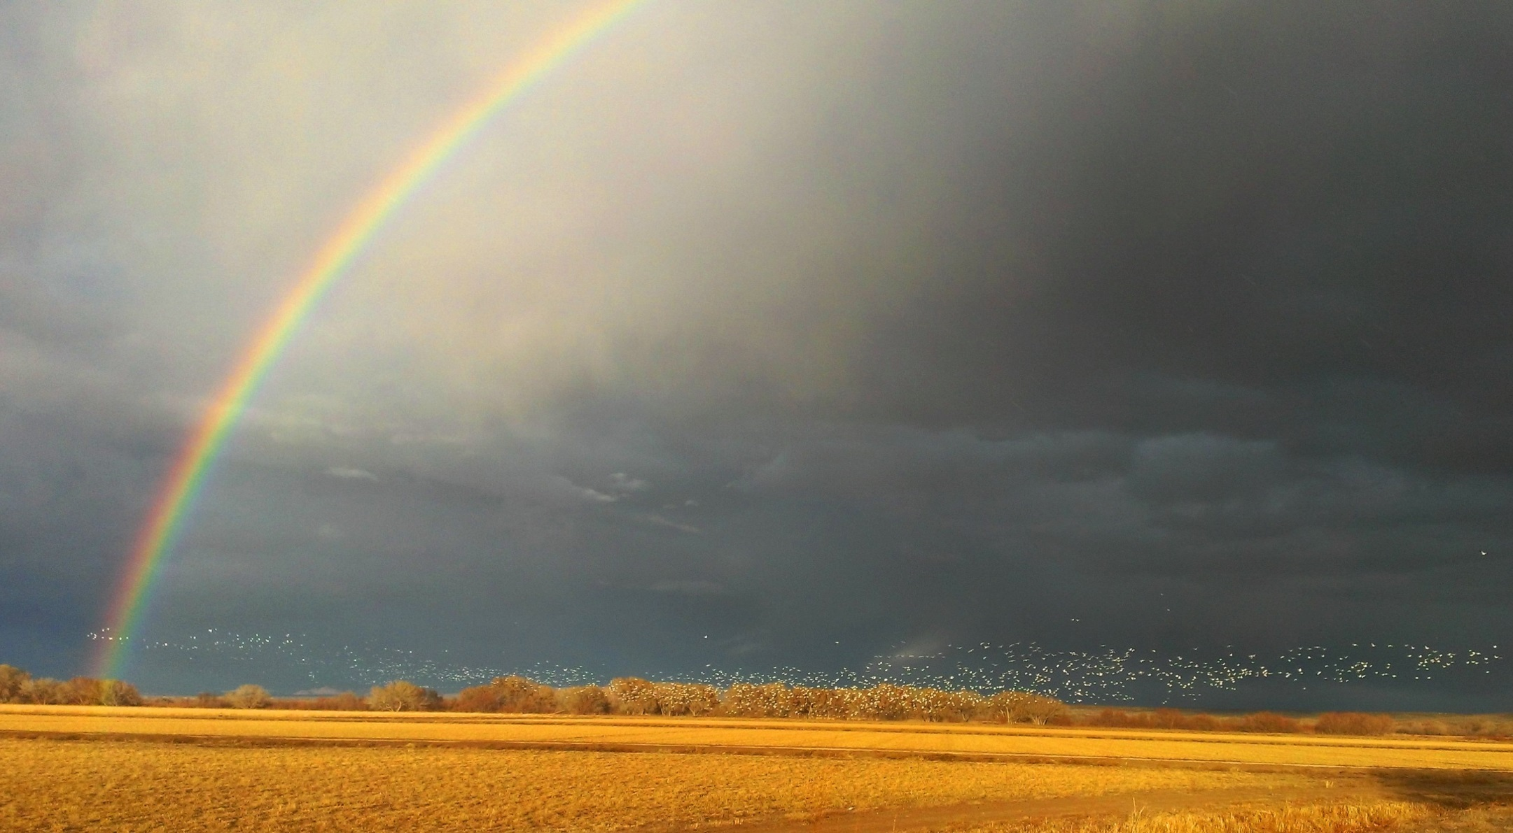
See the beauty.
The beauty and complexity of the world around us is all part of the greatest story ever told, the scientific story. Sign up to write your part.
Snow geese in a storm
Bosque del Apache, Central New Mexico

