Slide 1
The right kind of uncertainty principle. Fisher information
and
Quantum Cramér-Rao bounds
Carlton M. Caves
Center for Quantum Information and Control, University of New Mexico
http://info.phys.unm.edu/~caves

Slide 2
Quantum Cramér-Rao Bound (QCRB)
Single-parameter estimation: Bound on the mean-square error in estimating a classical parameter that is coupled to a quantum system in terms of the inverse of the quantum Fisher information.
Multi-parameter estimation: Bound on the covariance matrix in estimating a set of classical parameters that are coupled to a quantum system in terms of the inverse of a quantum Fisher-information matrix.
We are only going to consider the single-parameter case. An important distinction is that the single-parameter QCRB is saturable—there is a measurement that achieves the bound—whereas the multi-parameter QCRB is generally not.

Slide 3
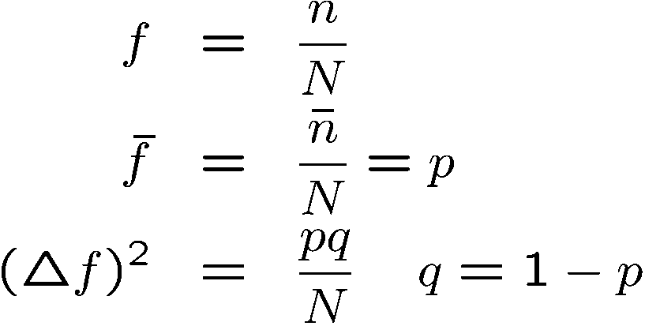
Fisher information
Estimating a probability p from N trials (random walk, polling)
Measuring the “distance” between neighboring probability distributions in units of their distinguishability
Fisher information

Slide 4
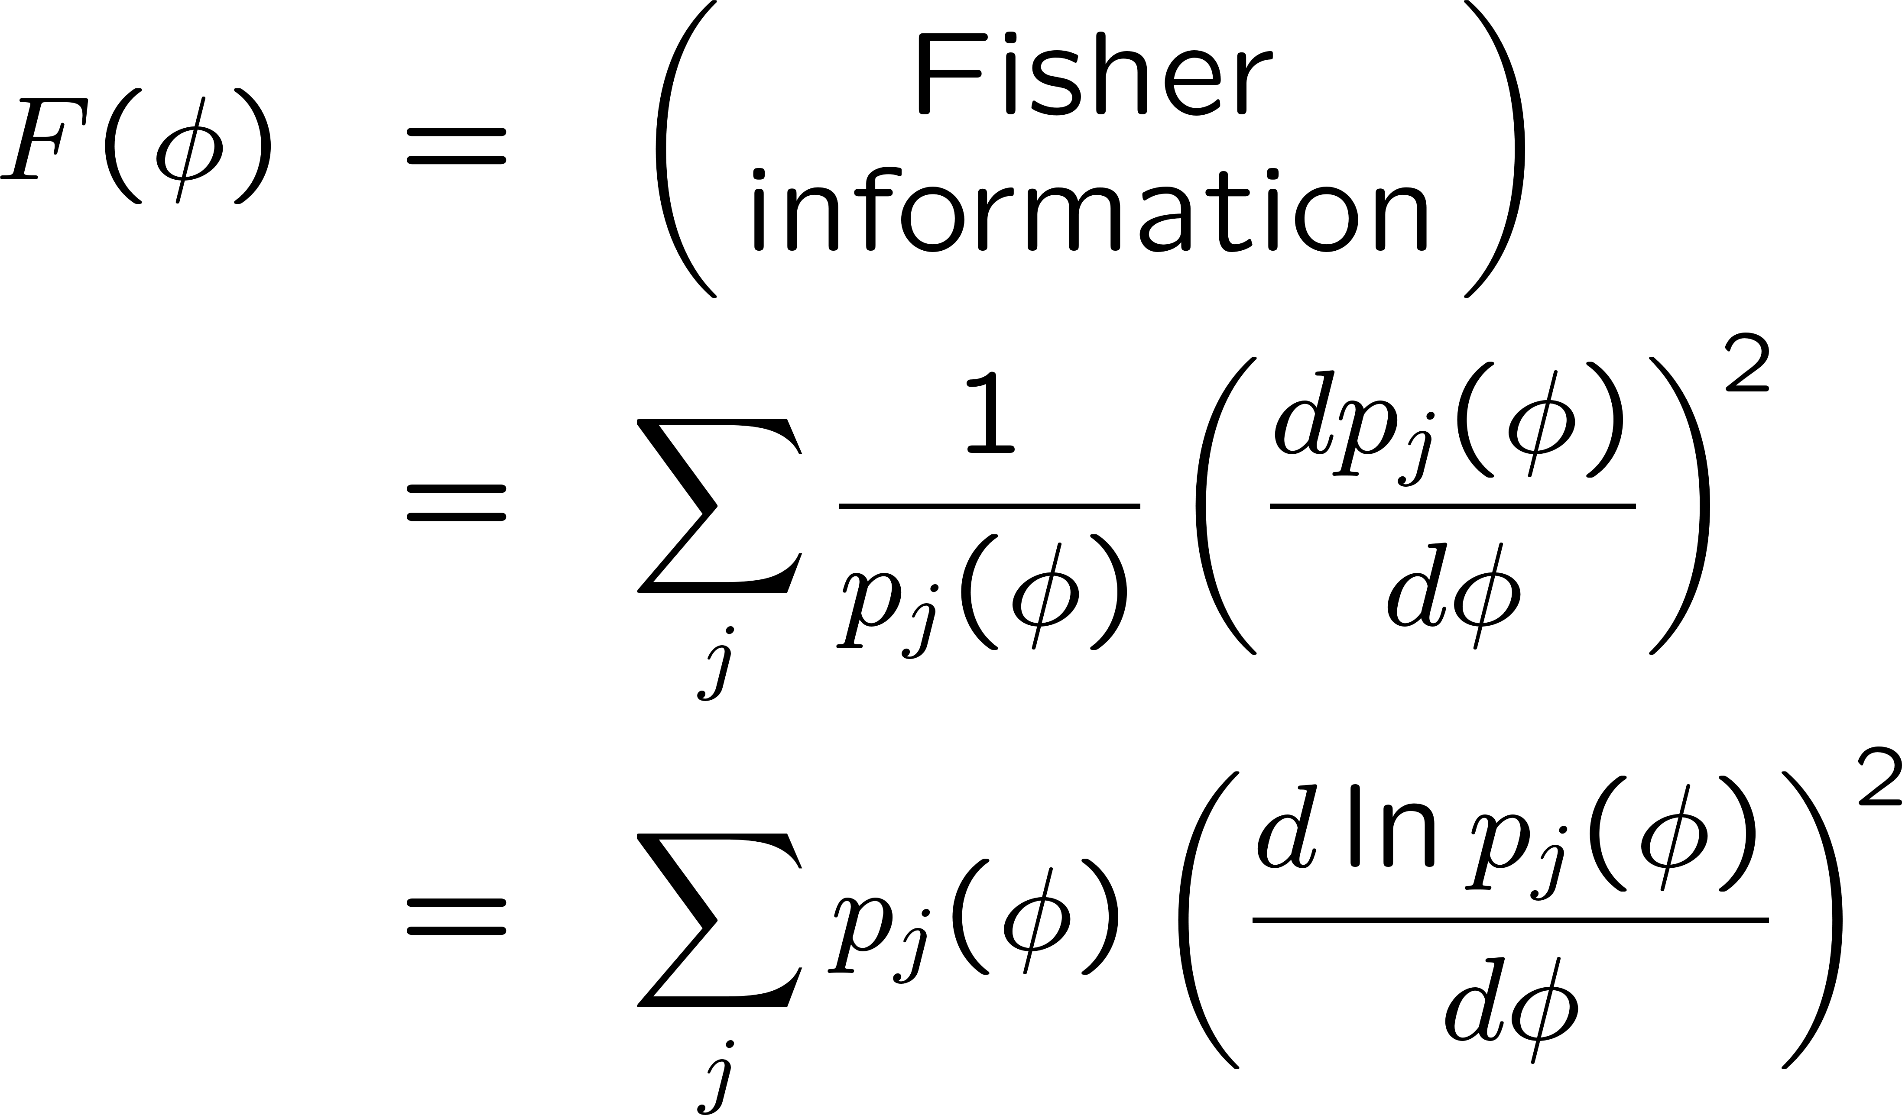
(Classical) Cramér-Rao bound

Slide 5
Proof of QCRB. Setting
For a more traditional proof of the QCRB, including nonunitary parameter displacements, see S. L. Braunstein and C. M. Caves, PRL 72, 3439 (1994).

Slide 6
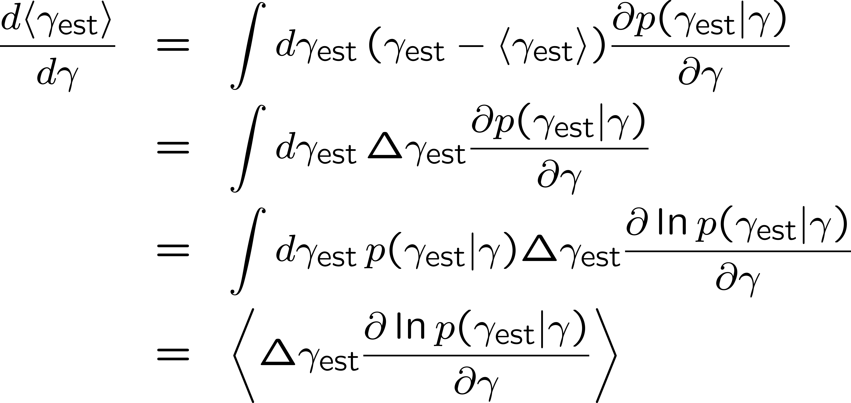
Proof of QCRB. Classical CRB

Slide 7
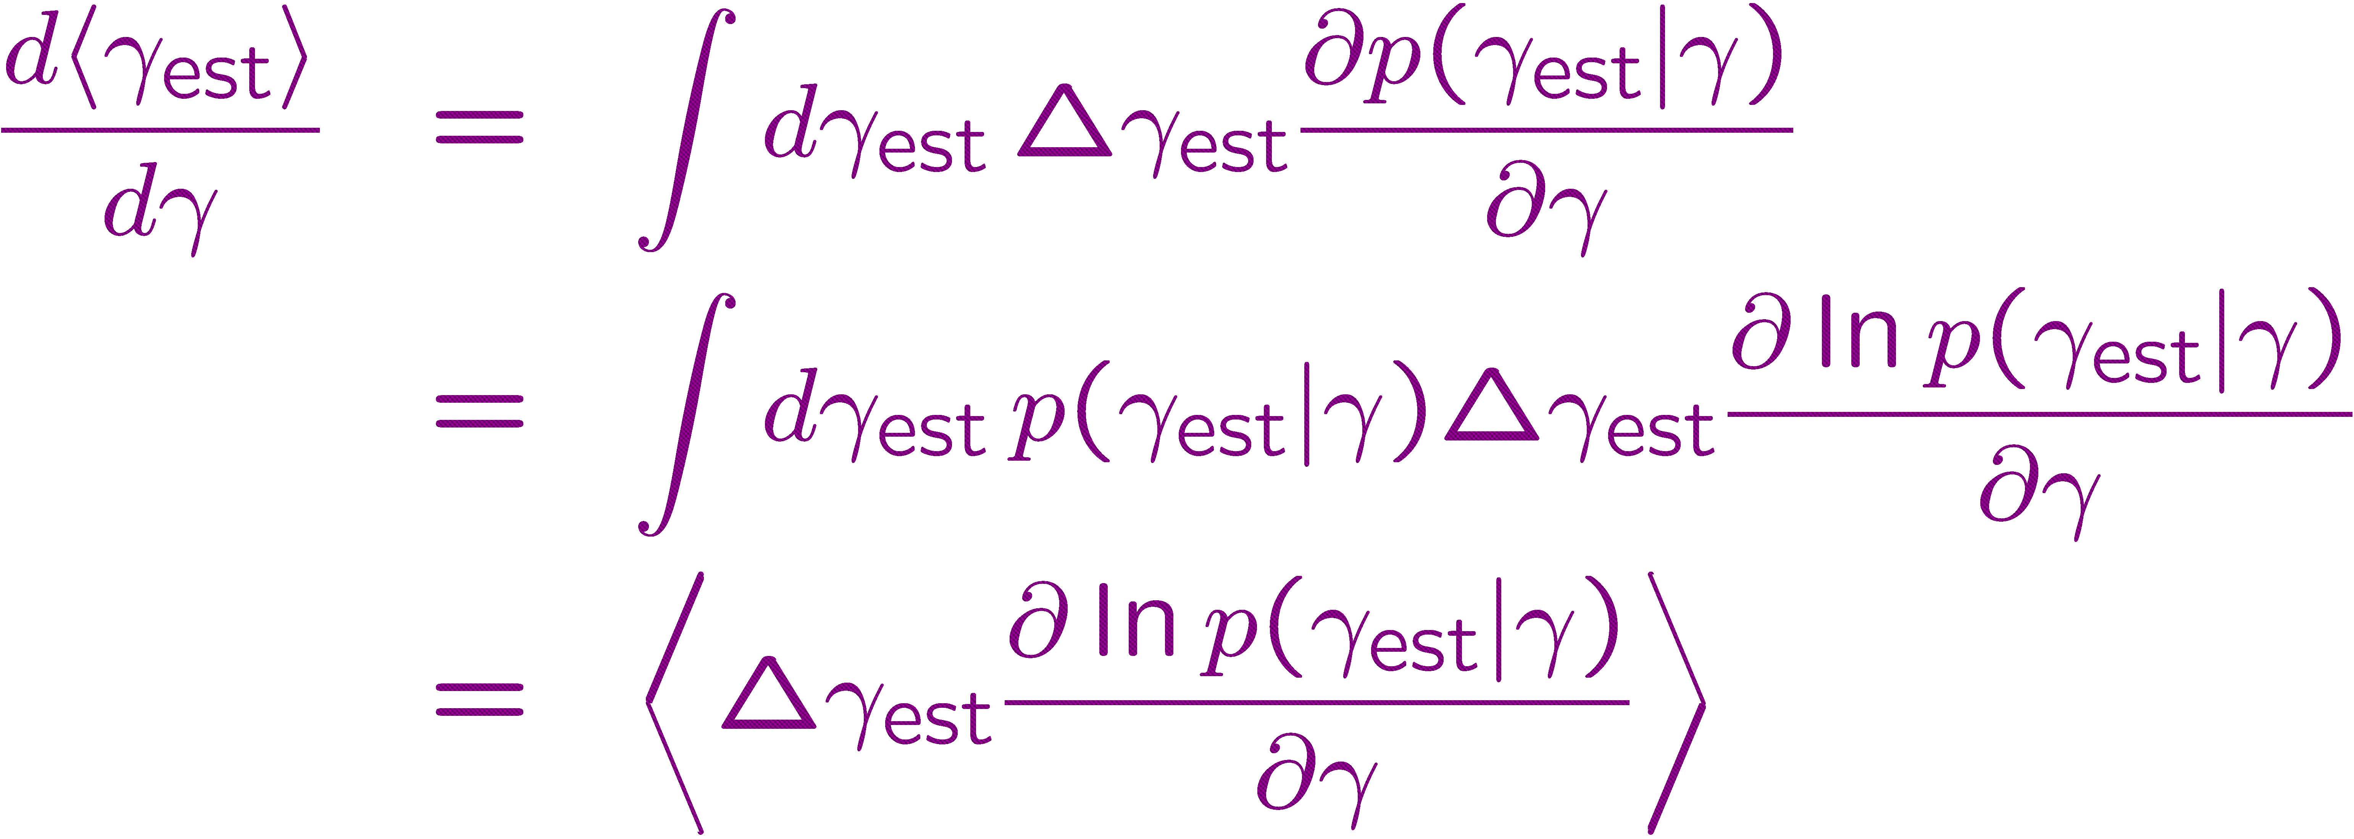
Proof of QCRB. Classical CRB

Slide 8
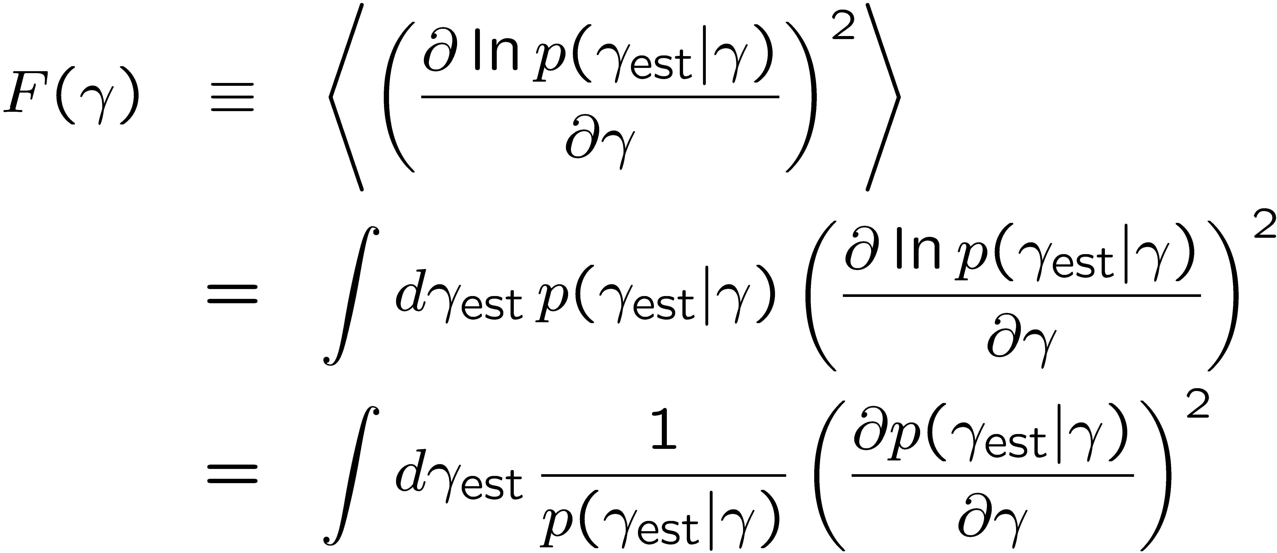
Proof of QCRB.
Classical Fisher information

Slide 9
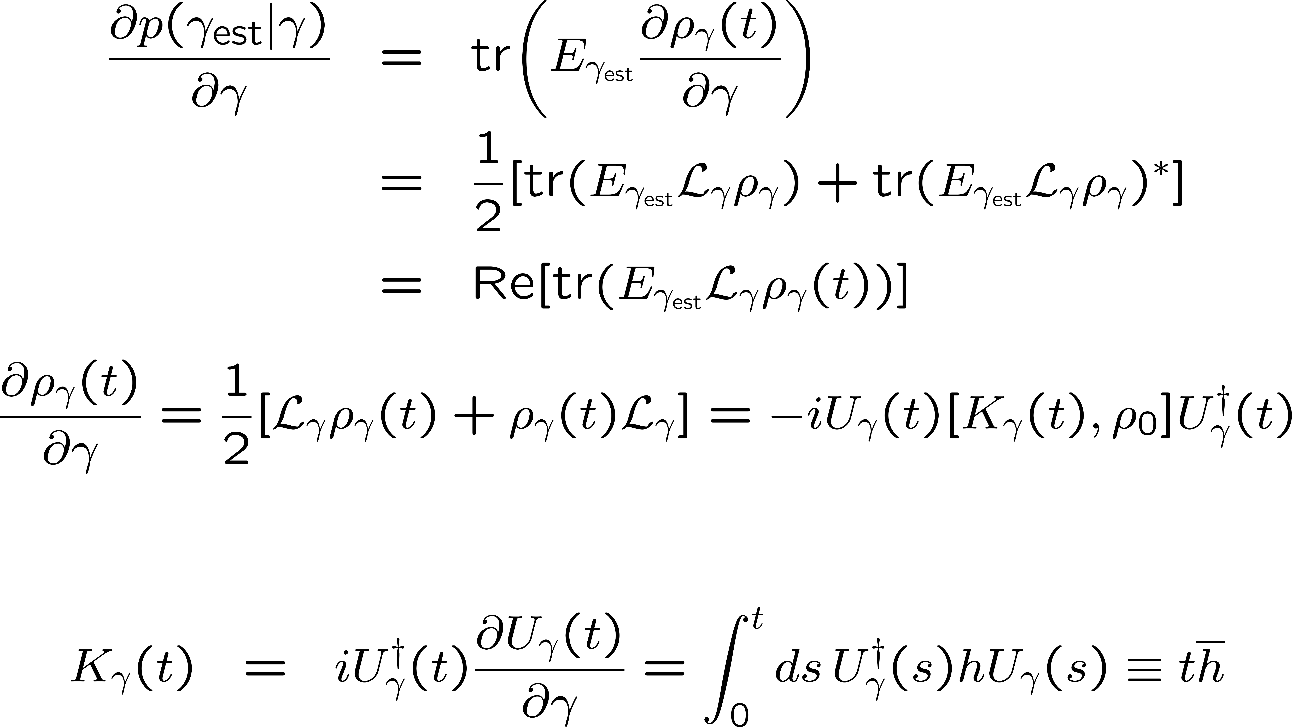
Proof of QCRB. Quantum mechanics

Slide 10
Proof of QCRB. Quantum mechanics

Slide 11
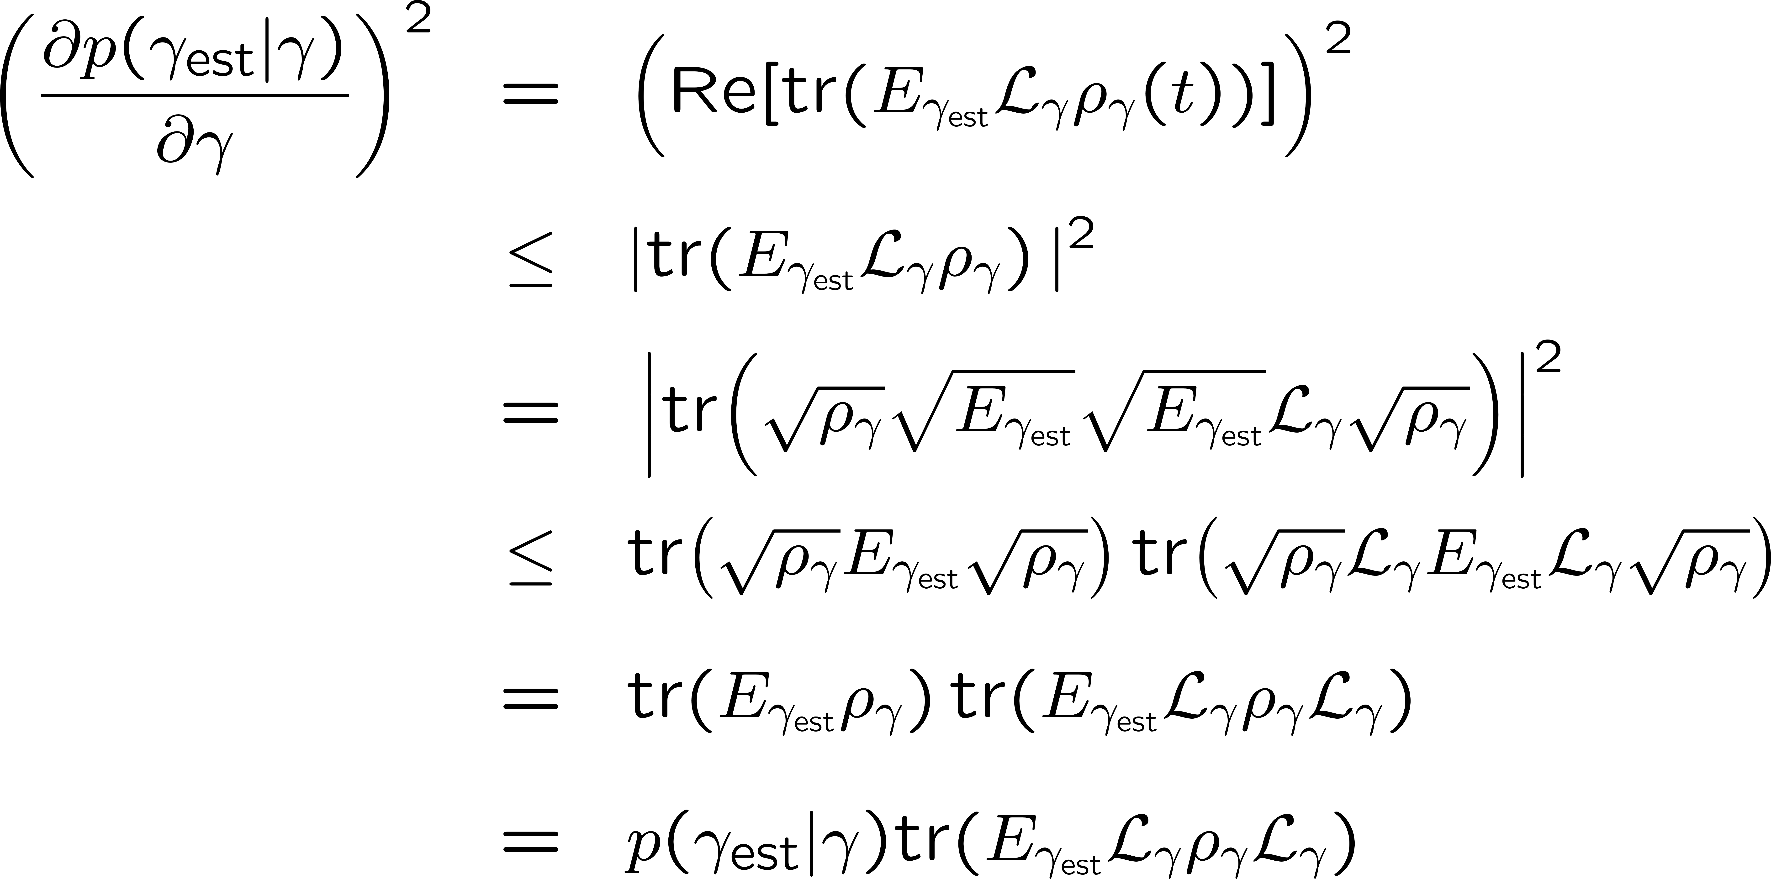
Proof of QCRB. Quantum mechanics
QCRB

Slide 12
Proof of QCRB. Summary
before optimization

Slide 13
Proof of QCRB. Optimizing the measurement
QCRB

Slide 14
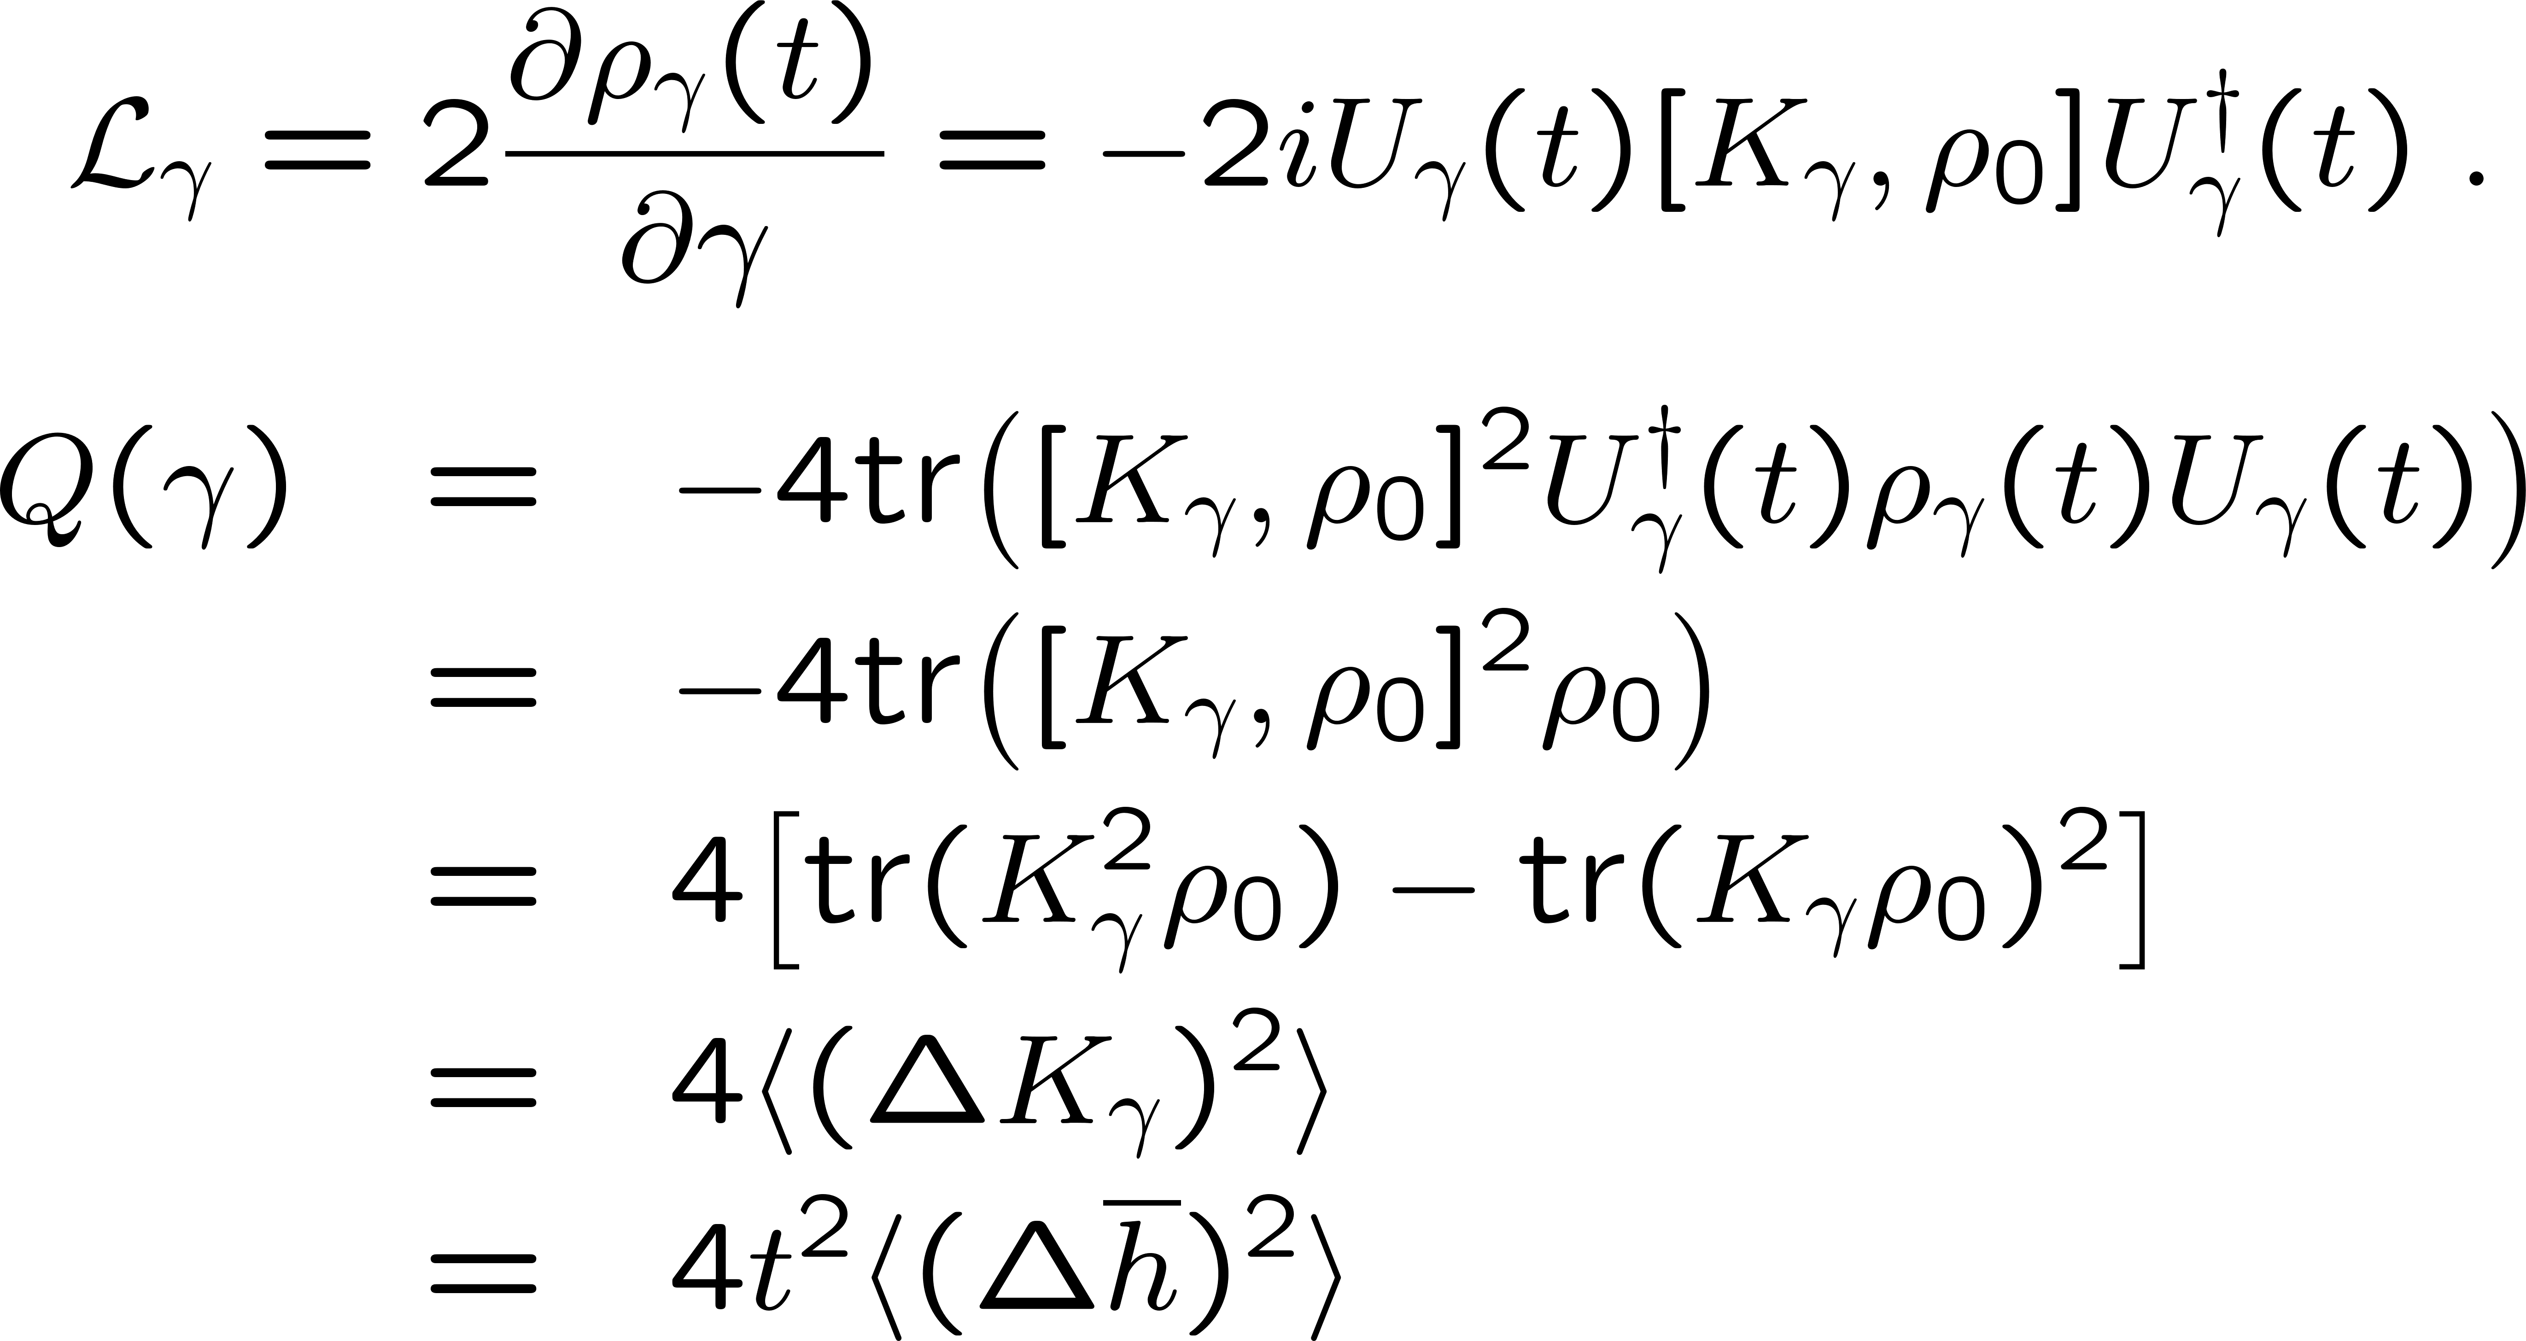
Proof of QCRB. Optimizing the state

Slide 15
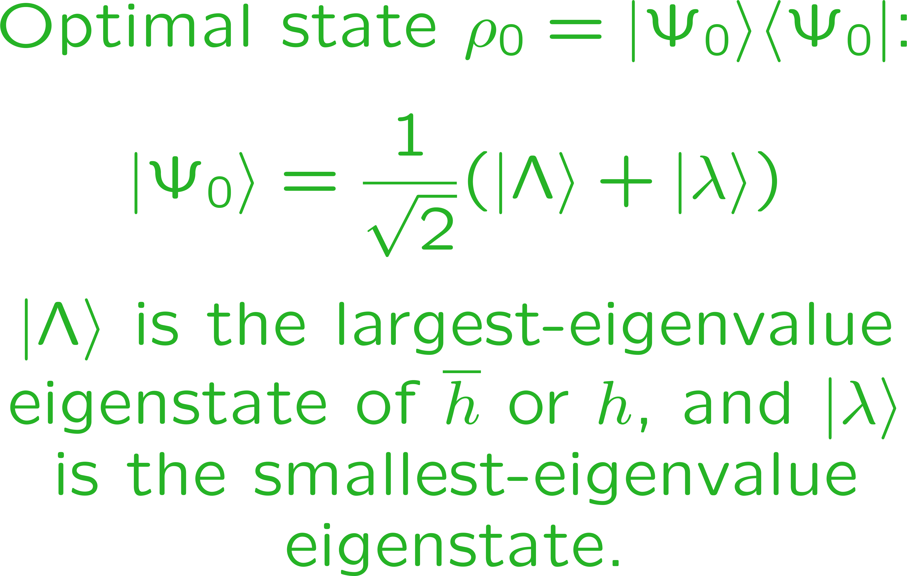
Proof of QCRB. Optimizing the state

Slide 16
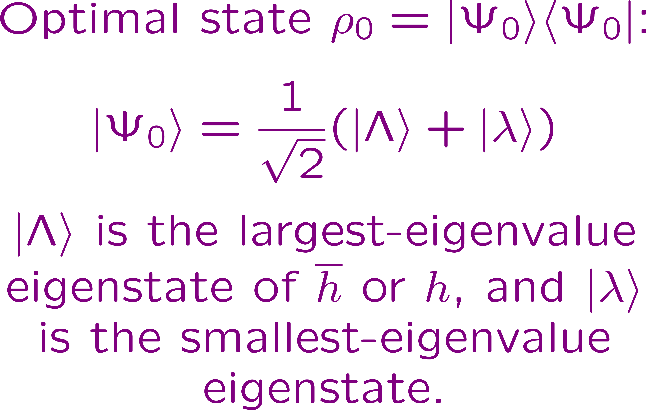
The bassackwardness of the QCRB. The final detail

Slide 17
The bassackwardness of the QCRB. The final detail
The End

