Slide 1



Quantum control and feedback:
A circuit-based perspective
Is there a problem?
Measurement-based and coherent control
True quantum Noncommutative control and feedback
Carlton M. Caves
Center for Quantum Information and Control, University of New Mexico
Centre for Engineered Quantum Systems, University of Queensland
http://info.phys.unm.edu/~caves
Co-workers: J. Combes, G. J. Milburn
Center for Quantum Information and Control
TexPoint fonts used in EMF.
Read the TexPoint manual before you delete this box.: AAAA

Slide 2

I. Is there a problem?
Cable Beach
Broome, Western Australia

Slide 3
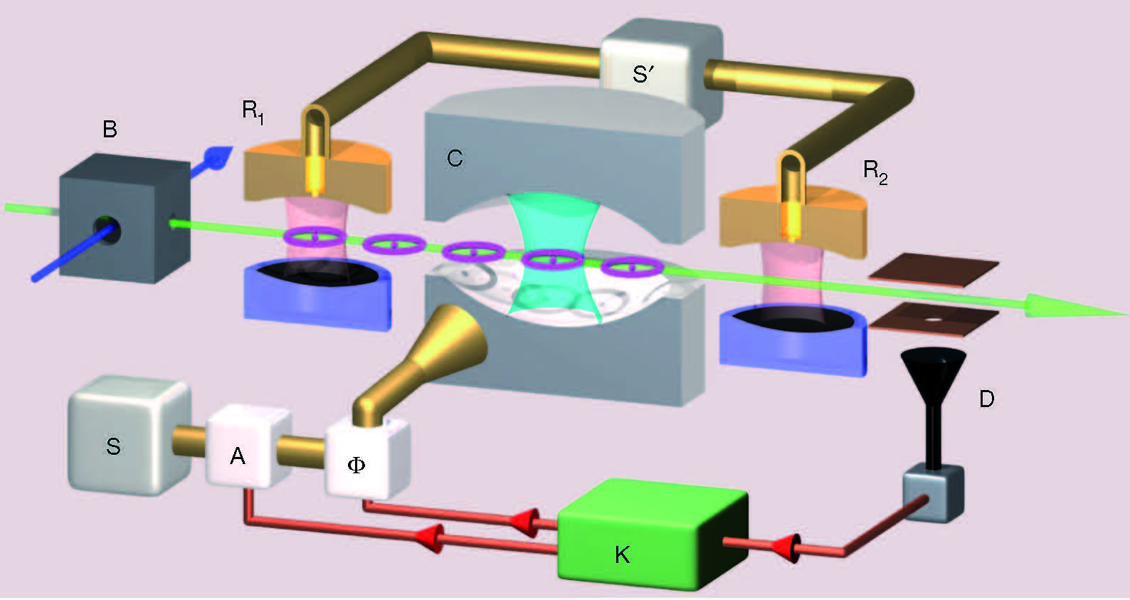
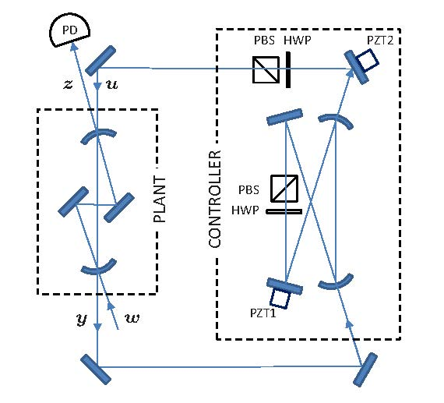
Examples and questions
M. R. James, H. I. Nurdin, and I. R.~Petersen, IEEE Trans. Auto. Control 53, 1787 (2008).
H. Mabuchi, Phys Rev A 78, 032323 (2008).
Haroche lab: C. Sayrin et al., Nature 477, 73 (2011).
Feedforward? Feedback? Measurement-based control? Coherent control?
Quantum control?
JNP-M

Slide 4
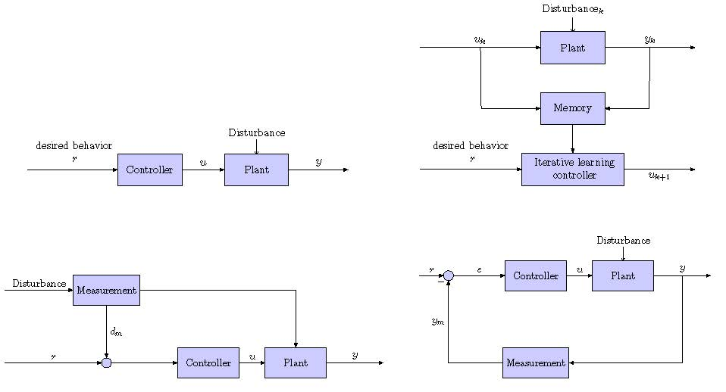
Classical control and feedback
Classical control diagrams do not (quantum circuit diagrams do)
Cleanly distinguish systems from their interactions.
Display both temporal (causal) and spatial (subsystem) relations.
A quantum circuit displays the interactions between the single degrees of freedom that process quantum information.
Iterative learning
Open-loop control
Michael Nielsen (c. 1998): Carl, you should learn how to use quantum circuits.
Feedforward
Feedback control

Slide 5
Messages
All measurement-based control and feedback can be converted to coherent quantum control.
Not all coherent quantum control can be converted to measurement-based control: control on noncommuting observables cannot be so converted and is something different.
Quantum feedback is distinguished from feedforward by the presence in a quantum circuit of interfering quantum paths that begin and end on the plant.

Slide 6

II. Measurement-based and
coherent control
Pinnacles National Park
Central California

Slide 7
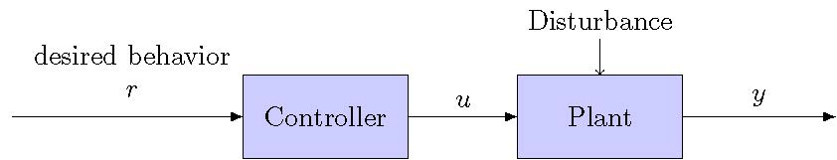
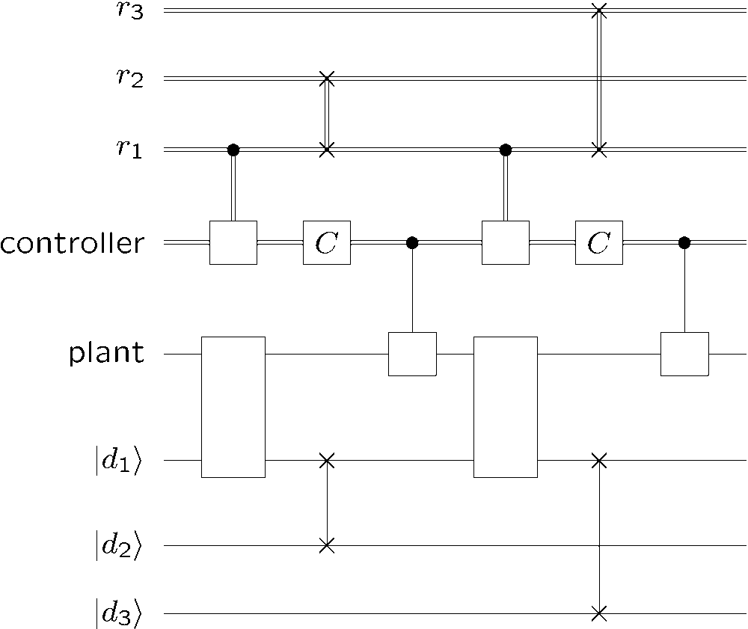
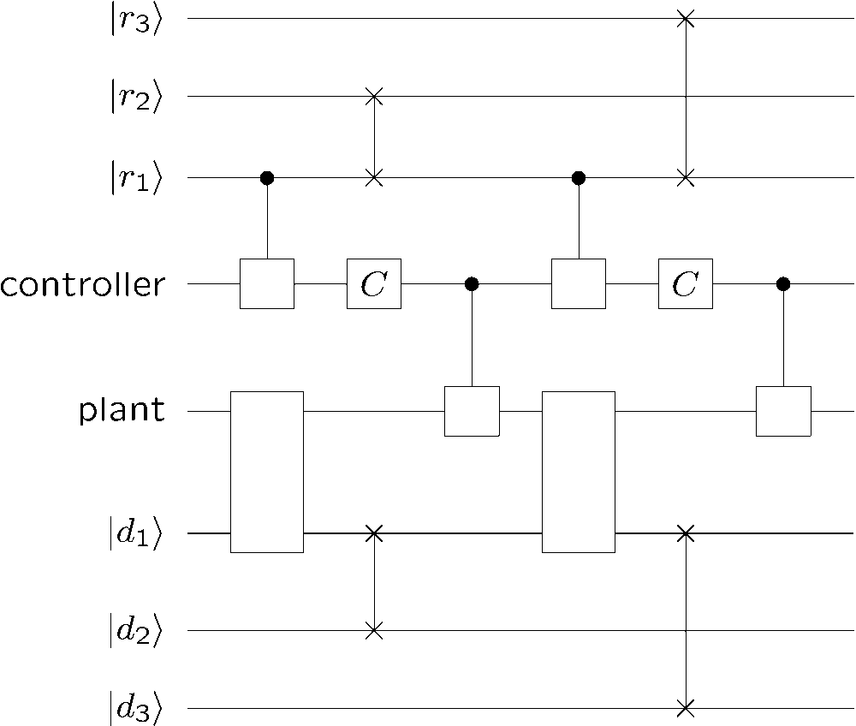
Open-loop
control
Classical diagram
Plant: persisting quantum system
Controller: classical information processor
Desired behavior: successive inputs
Disturbances: successive quantum systems
Quantum circuit
Coherent version
Repetitive elements

Slide 8
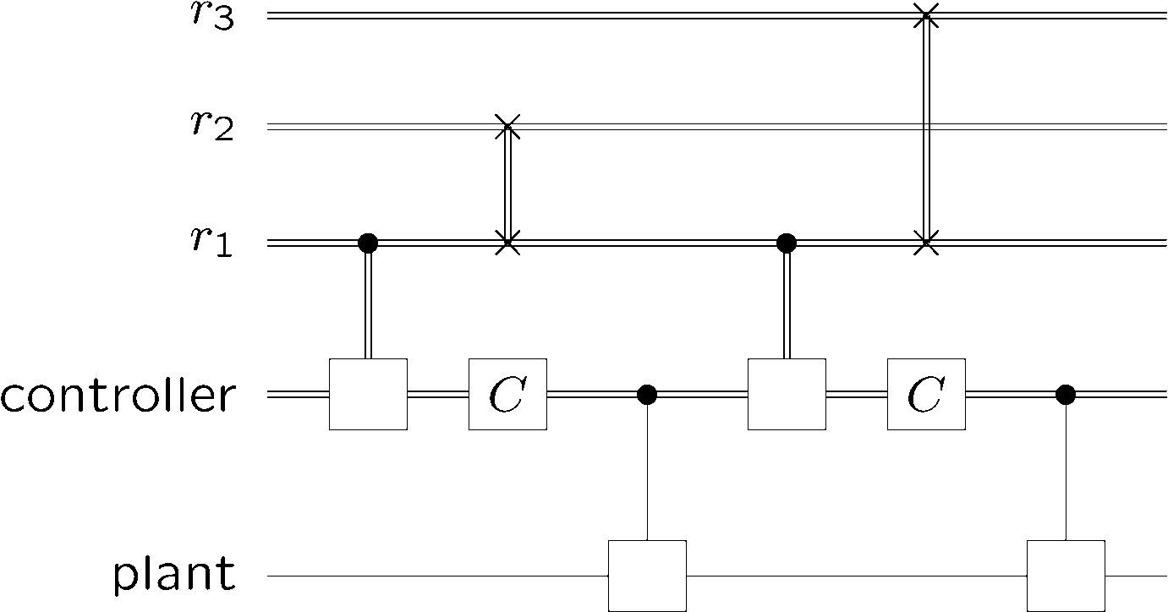

Open-loop
control
Classical diagram
Quantum circuit (disturbances omitted)
Quantum circuits generally omit classical open-loop controls, so this circuit reduces to
Objective: synthesize plant state or unitary or quantum operation
Measures of efficacy: efficiency, robustness
Notes:
The lines show Markovian interactions. The controller can be made coherent; generally leave it out in subsequent diagrams.

Slide 9
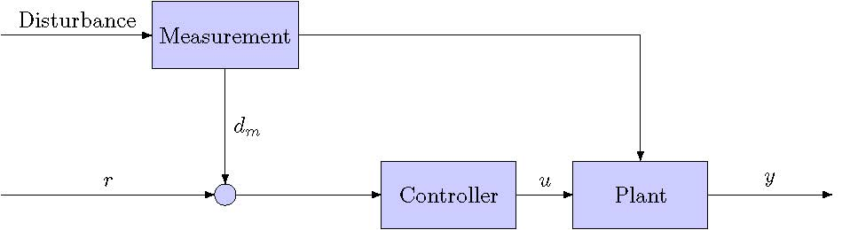
Feedforward
Classical diagram
Plant: atoms, optical or microwave cavity, mechanical oscillator
Probes and disturbances: successive quantum systems that interact with one another and with the plant, e.g., field modes, atoms, qubits, qudits (Markovicity?)
Controller: omitted
Measurement-based
quantum circuit

Slide 10
Feedforward
Use the Principle of Deferred Measurement to push the measurements through the associated controls to the end of the circuit, where they can be omitted.
R. B. Griffiths and C.-S. Niu, PRL 76, 3228 (1996).
Coherent version
Measurement-based
quantum circuit
No feedback onto plant:
no multiple (interfering quantum) paths that begin and end on the plant.

Slide 11
Feedforward onto probes
Measurement-based
quantum circuit
Coherent version

Slide 12
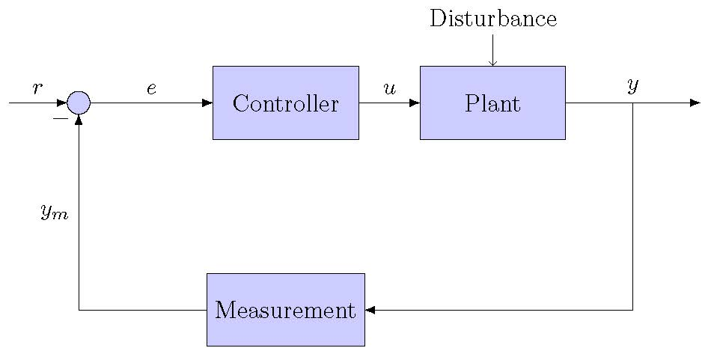
Direct feedback
Plant: atoms, optical or microwave cavity, mechanical oscillator
Probes: successive quantum systems that interact with one another and the plant, e.g., field modes, atoms, qubits, qudits
Disturbances and controller: omitted
Classical diagram
Measurement-based
quantum circuit

Slide 13
Direct
feedback
Use the Principle of Deferred Measurement to push the measurements through the associated controls to the end of the circuit, where they can be omitted.
Measurement-based
quantum circuit
Coherent version
Feedback loop
Feedback: multiple (interfering quantum) paths that begin and end on the plant.

Slide 14
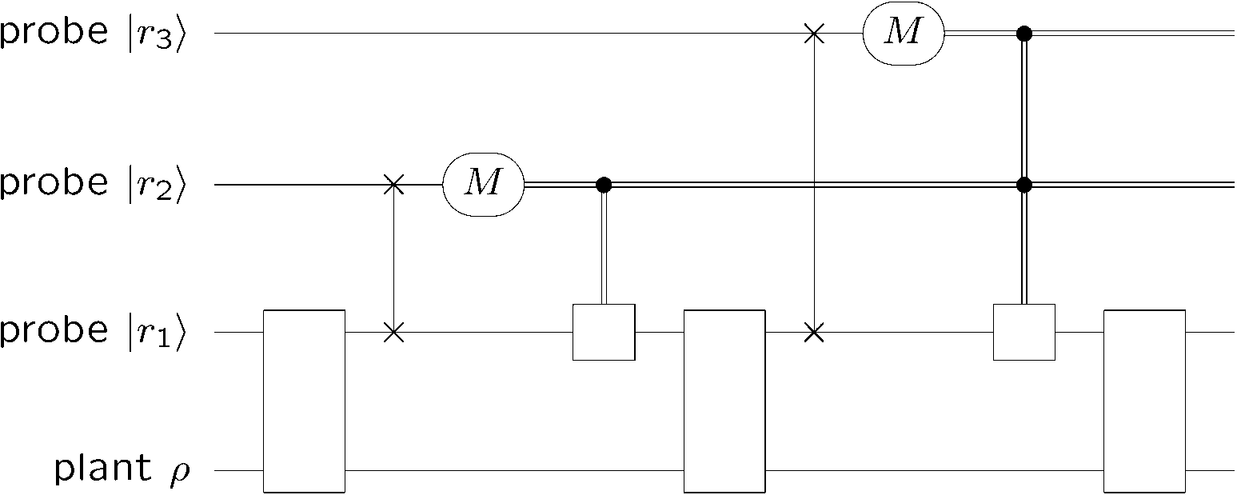
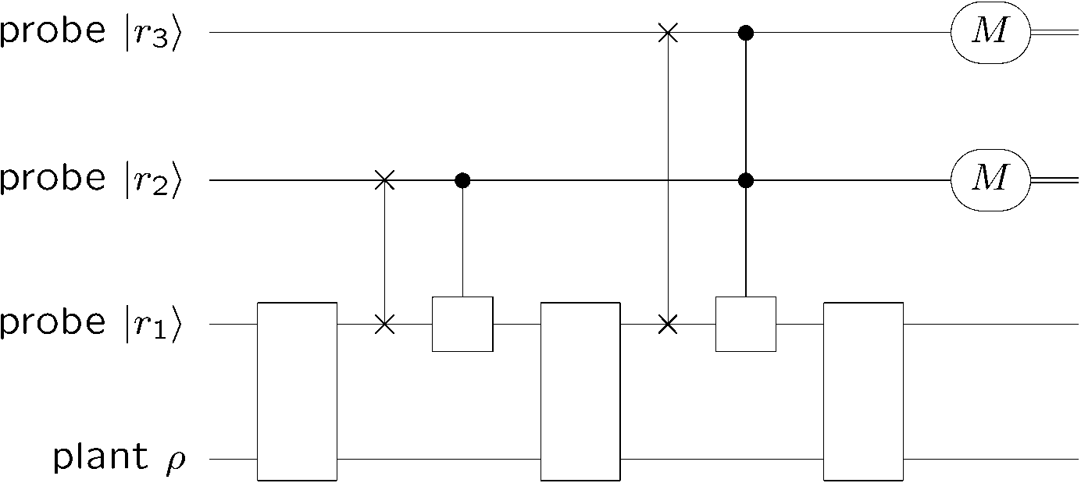
Indirect feedback
Measurement-based
quantum circuit
Coherent version
Feedback: multiple (interfering quantum) paths that begin and end on the plant.

Slide 15


True quantum Noncommutative
control and feedback
Moo Stack and the Villians of Ure
Eshaness, Shetland

Slide 16
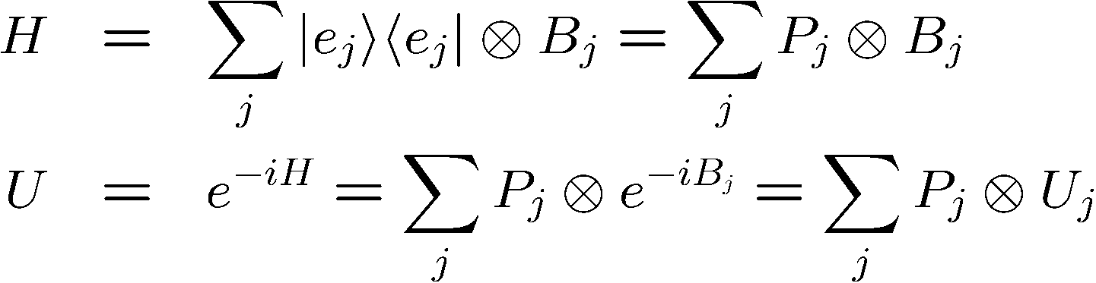
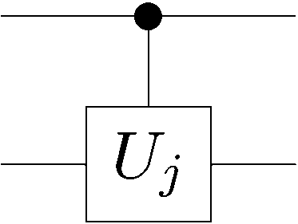
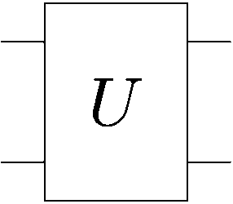
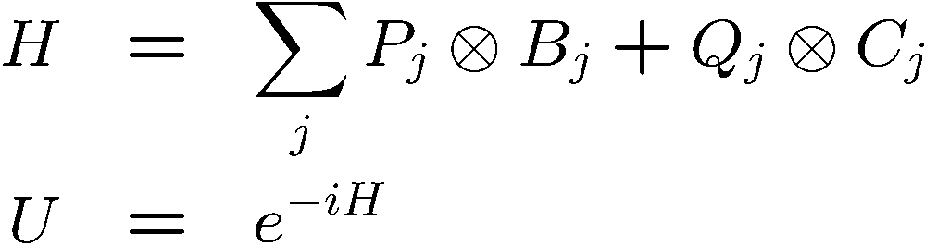
Controlled unitaries
But what about
Noncommuting (say, mutually unbiased, or conjugate) bases
H. M. Wiseman and G. J. Milburn, PRA 49, 4110 (1994).

Slide 17
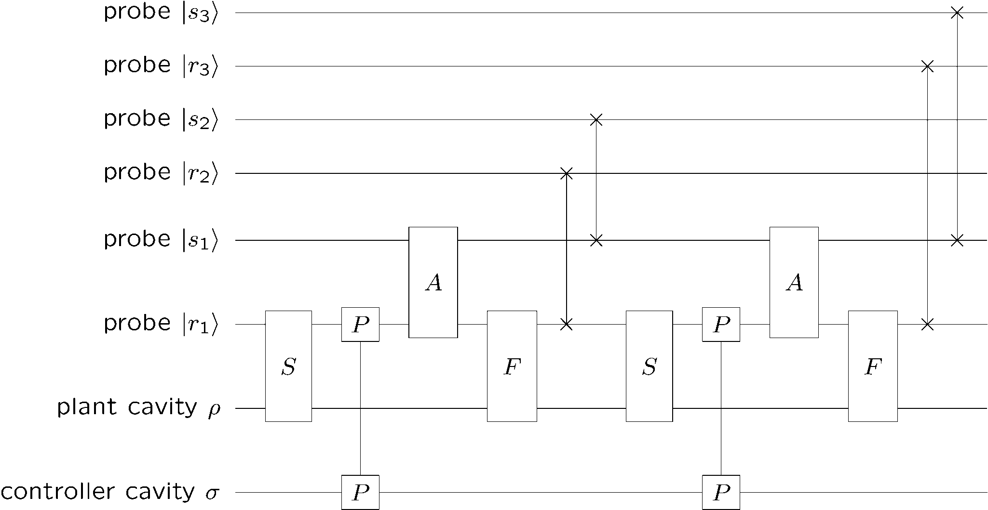
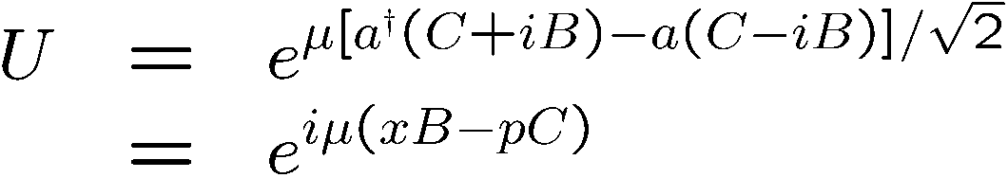

Noncommutative control
JNP-M
Plant cavity mirrors
Mirror
interaction

Slide 18
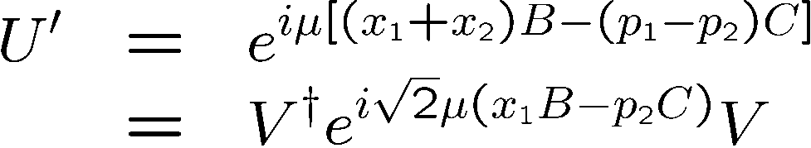

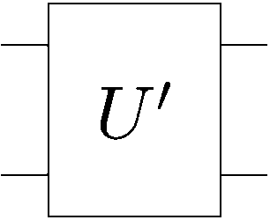

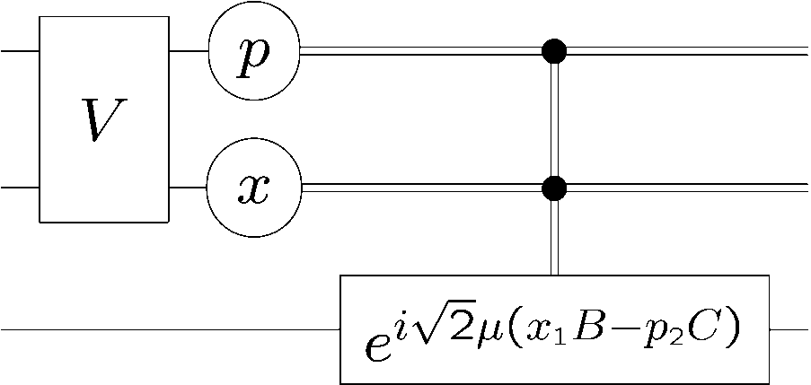
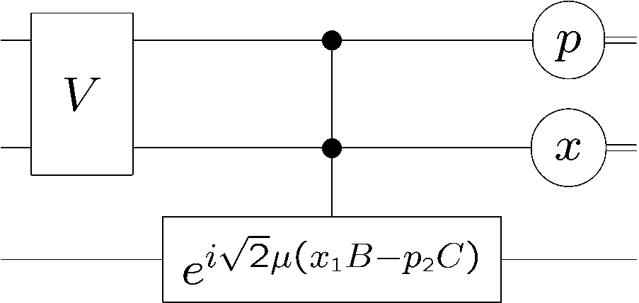


Noncommutative control
Mirror
interaction
Inequivalent
commuting
control

Slide 19
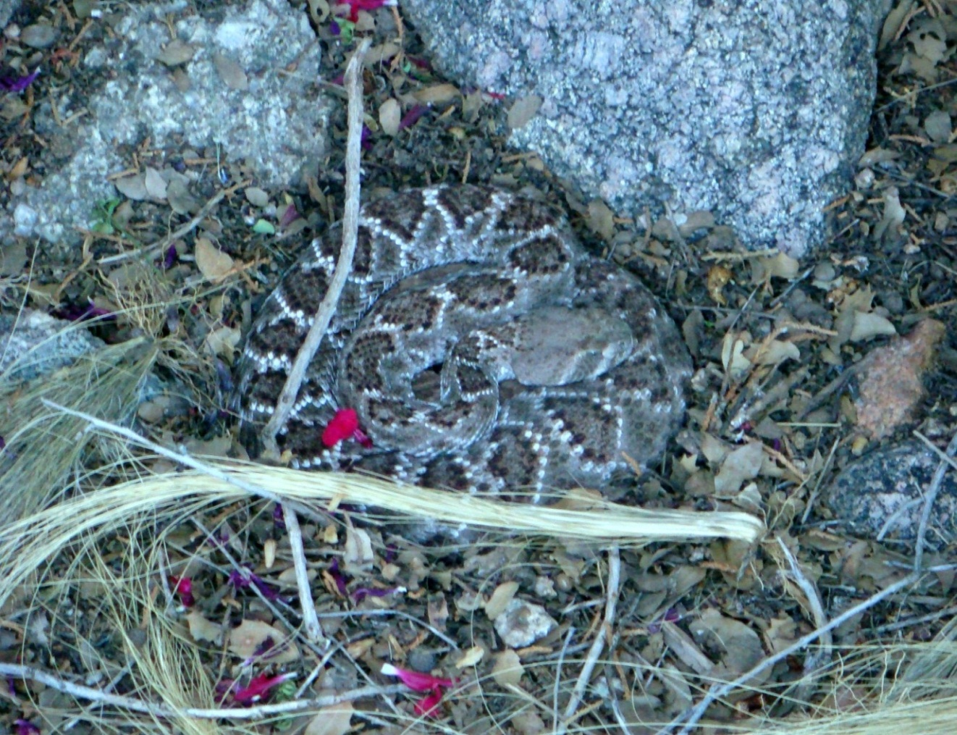
That’s all, folks!
Thanks for your attention.
Western diamondback rattlesnake
Sandia Heights, New Mexico
All measurement-based control and feedback can be converted to coherent quantum control.
Not all coherent quantum control can be converted to measurement-based control: control on noncommuting observables cannot be so converted and is something different.
Quantum feedback is distinguished from feedforward by the presence in a quantum circuit of interfering quantum paths that begin and end on the plant.

